Slide 1
2-3 and 2-3-4 Trees
COL 106
Shweta Agrawal, Amit Kumar

Slide 2
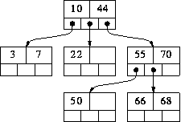
Multi-Way Trees
A binary search tree:
One value in each node
At most 2 children
An M-way search tree:
Between 1 to (M-1) values in each node
At most M children per node

Slide 3
M-way Search Tree Details
Each internal node of an M-way search has:
Between 1 and M children
Up to M-1 keys k₁ , k₂ , ... , k_{M-1}
k₁
. . .
k_{i-1}
k_{i}
. . .
k_{M-1}
Keys are ordered such that:
k₁ < k₂ < ... < k_{M-1}

Slide 4
Properties of M-way Search Tree
k
k
k
. . .
k
k
k
1
. . .
i-1
k
i
M-1
i
T
. . .
. . .
T
T
T
T
1
T
1
i
i
M
For a subtree T_{i} that is the i-th child of a node:
all keys in T_{i} must be between keys k_{i-1} and k_{i}
i.e. k_{i-1} < keys(T_{i} )< k_{i}
All keys in first subtree T_{1,} keys(T₁ )< k₁
All keys in last subtree T_{M}, keys(T_{M} ) > k_{M-1}

Slide 5
Example: 3-way search tree
68
Try: search 68

Slide 6
Search for X
At a node consisting of values V₁...V_{k}, there are four possible cases:
If X < V₁, recursively search for X in the subtree that is left of V1
If X > V_{k}, recursively search for X in the subtree that is right of V_{k}
If X=V_{i,} for some i, then we are done
(X has been found)
Else, for some i, V_{i} < X < V_{i+1}. In this case recursively search for X in the subtree that is between V_{i} and V_{i+1}
Time Complexity: O((M-1)*h)=O(h) [M is a constant]

Slide 7
Insert X
The algorithm for binary search tree can be generalized
Follow the search path
Add new key into the last leaf, or
add a new leaf if the last leaf is fully occupied
Example: Add 52,69
52
69

Slide 8
Delete X
The algorithm for binary search tree can be generalized:
A leaf node can be easily deleted
An internal node is replaced
by its successor and the
successor is deleted
Example:
Delete 10, Delete 44,
Time complexity: O(Mh)=O(h), but h can be O(n)

Slide 9
M-way Search Tree
What we know so far:
What is an M-way search tree
How to implement Search, Insert, and Delete
The time complexity of each of these operations is: O(Mh)=O(h)
The problem (as usual): h can be O(n).
B-tree: balanced M-way Search Tree

Slide 10
2-3 Tree

Slide 11
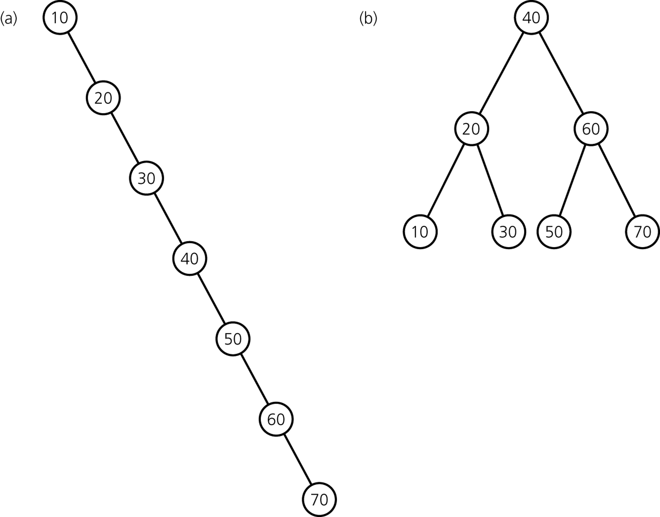
Why care about advanced implementations?
Same entries, different insertion sequence:
→ Not good! Would like to keep tree balanced.

Slide 12
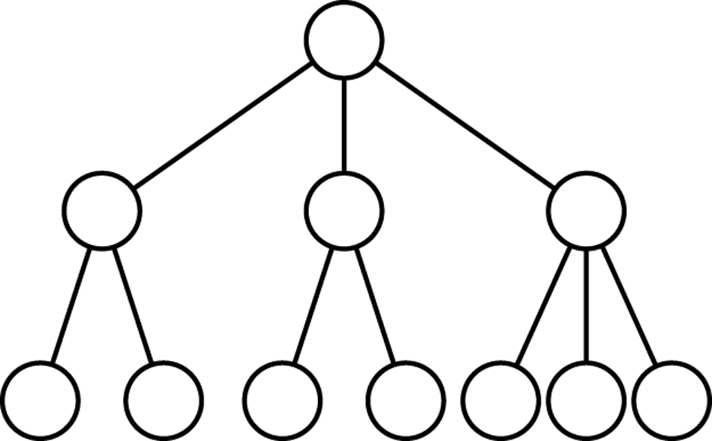
2-3 Trees
Features
each internal node has either 2 or 3 children
all leaves are at the same level

Slide 13
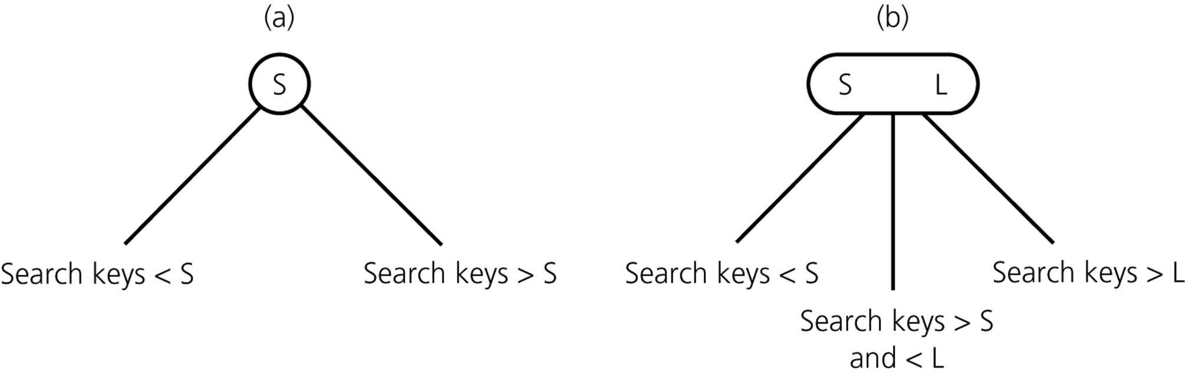
2-3 Trees with Ordered Nodes
2-node
3-node
leaf node can be either a 2-node or a 3-node

Slide 14
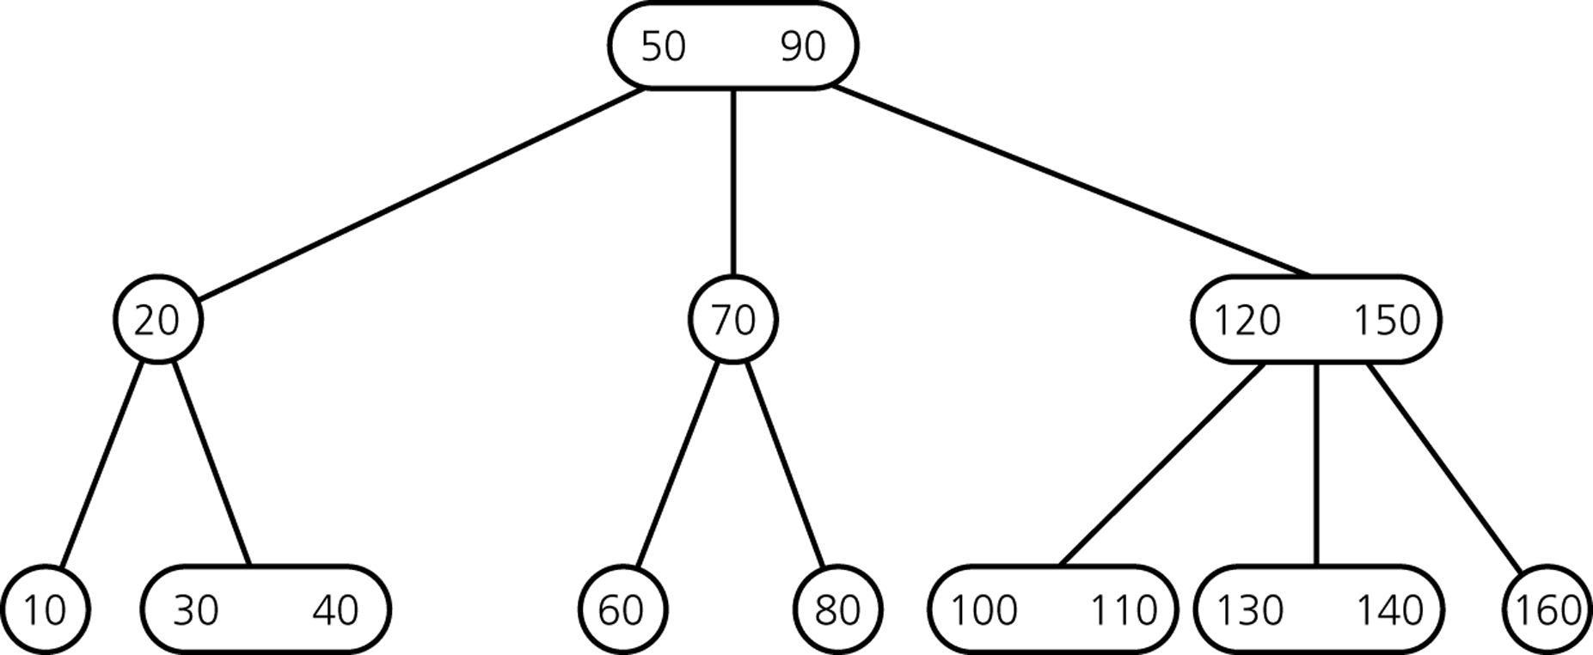
Example of 2-3 Tree

Slide 15
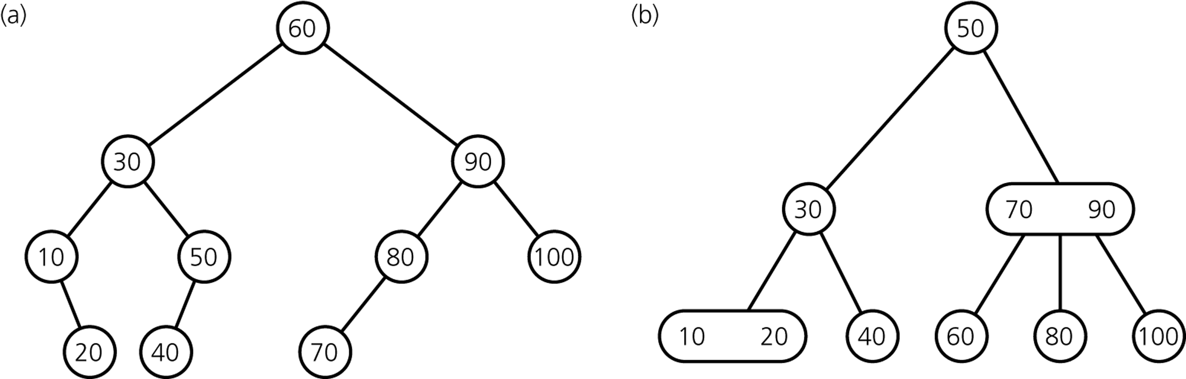
What did we gain?
What is the time efficiency of searching for an item?

Slide 16
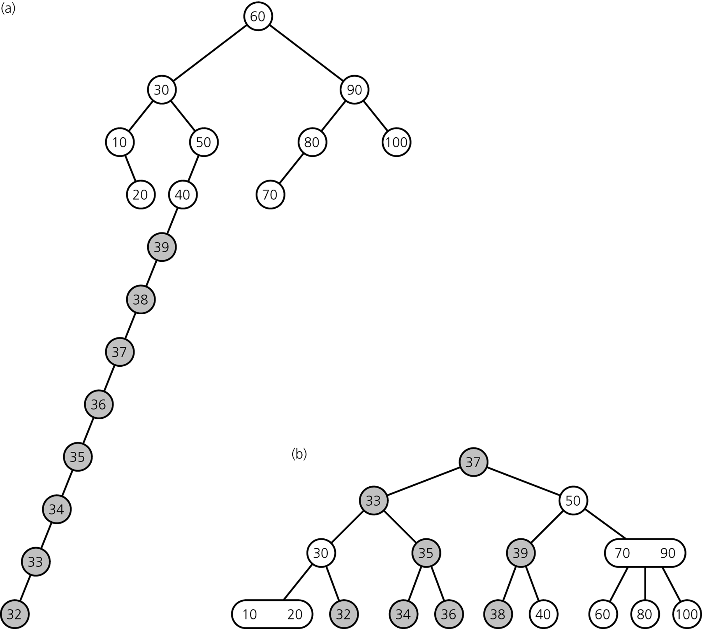
Gain: Ease of Keeping the Tree Balanced
Binary Search
Tree
both trees after
inserting items
39, 38, ... 32
2-3 Tree

Slide 17
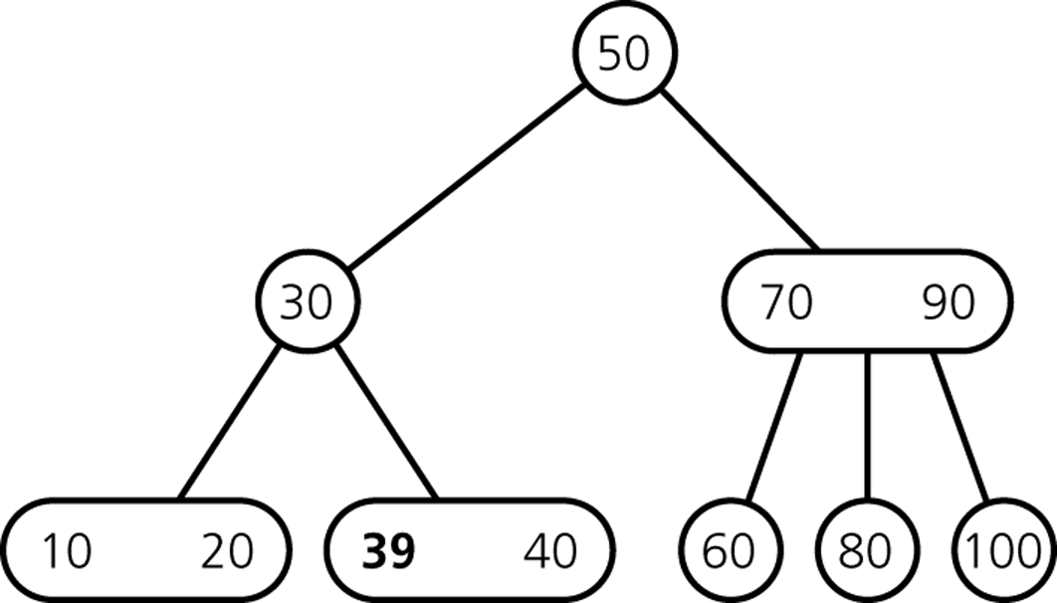
Inserting Items
Insert 39

Slide 18
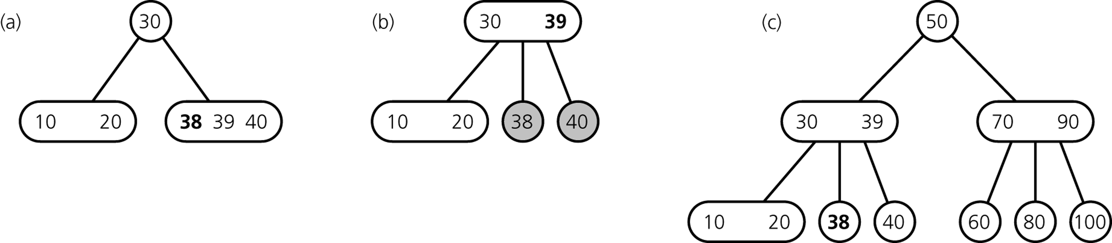
Inserting Items
Insert 38
divide leaf
and move middle
value up to parent
insert in leaf
result

Slide 19
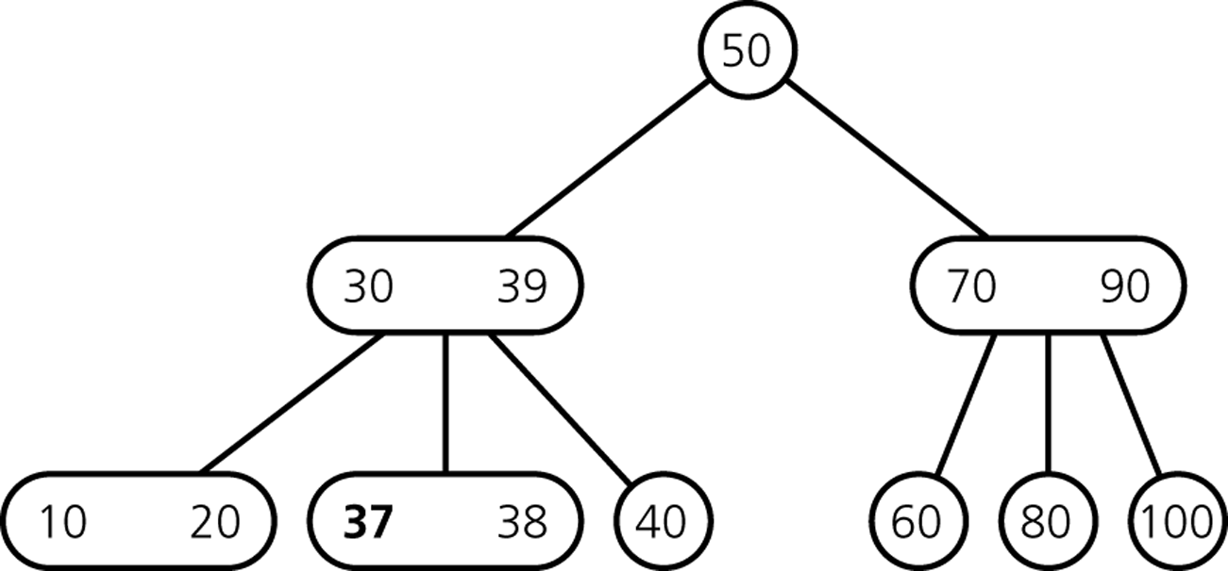
Inserting Items
Insert 37

Slide 20
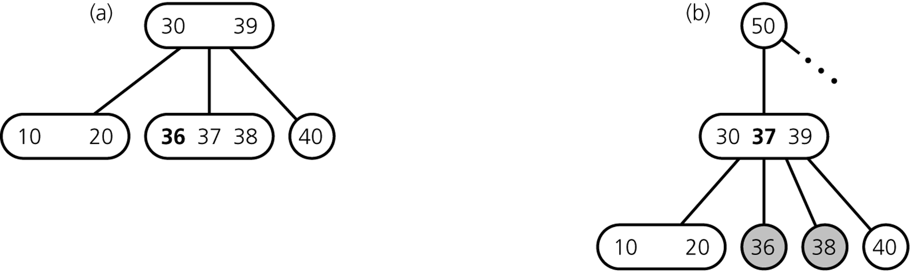
Inserting Items
Insert 36
divide leaf
and move middle
value up to parent
insert in leaf
overcrowded
node

Slide 21
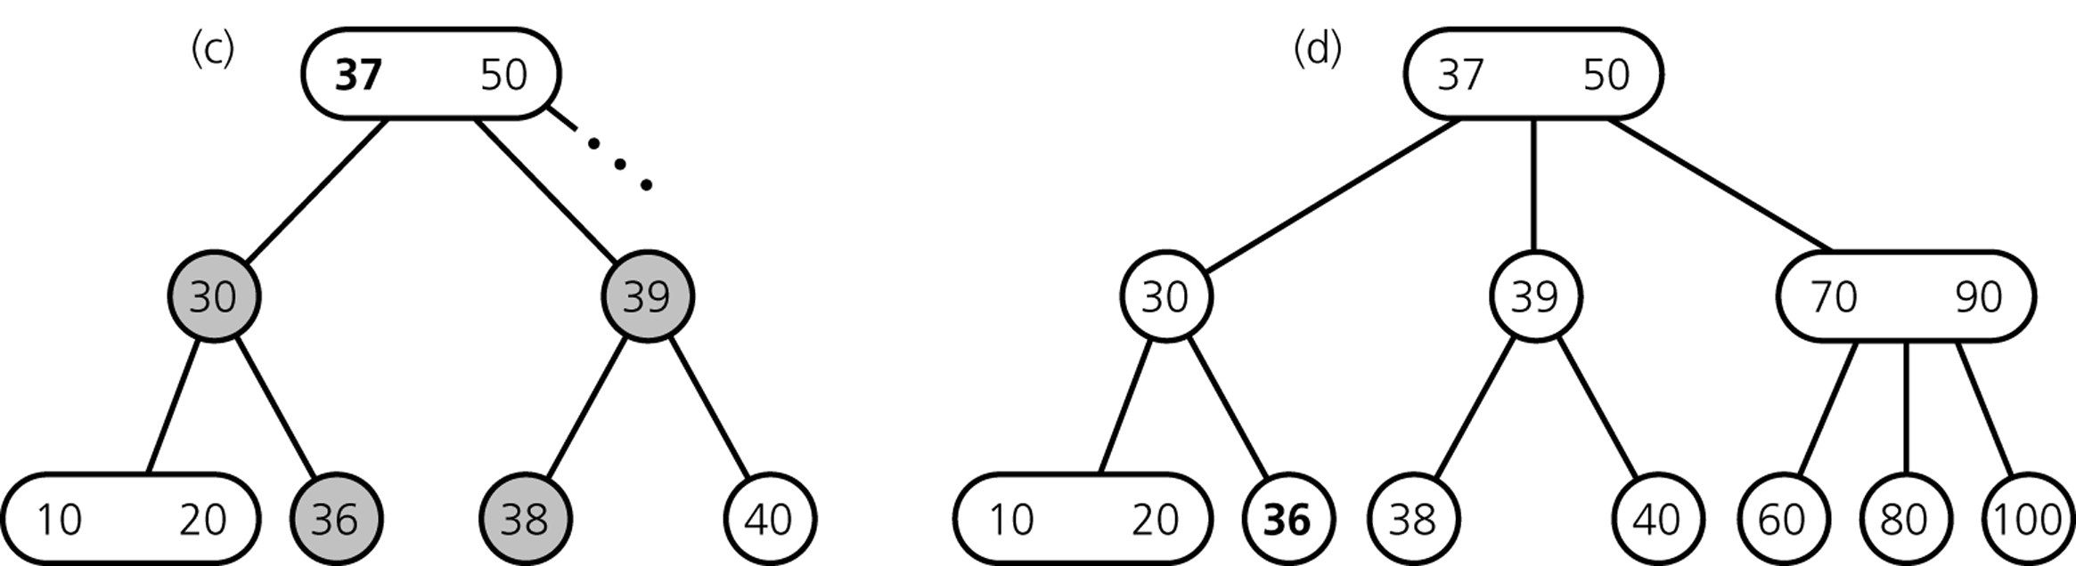
Inserting Items
... still inserting 36
divide overcrowded node,
move middle value up to parent,
attach children to smallest and largest
result

Slide 22
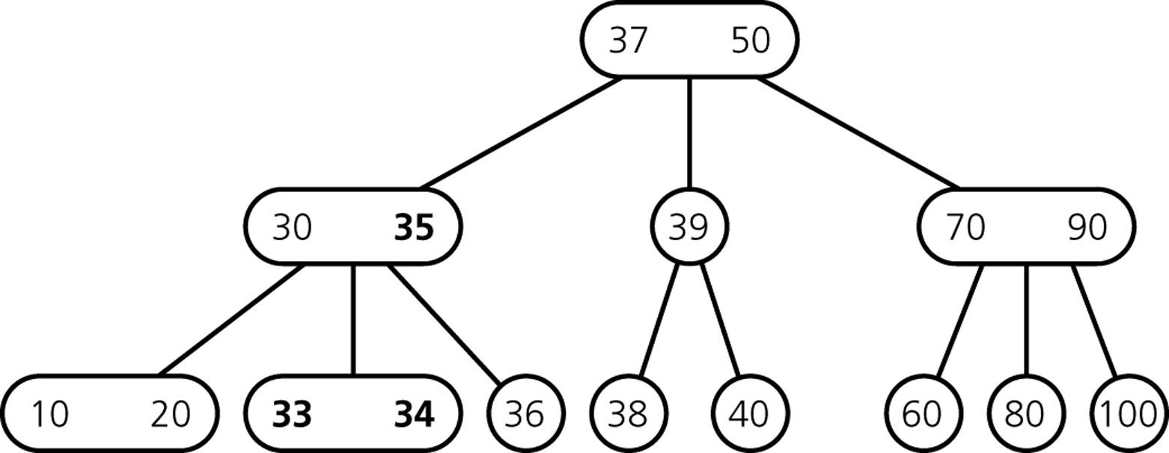
Inserting Items
After Insertion of 35, 34, 33

Slide 23
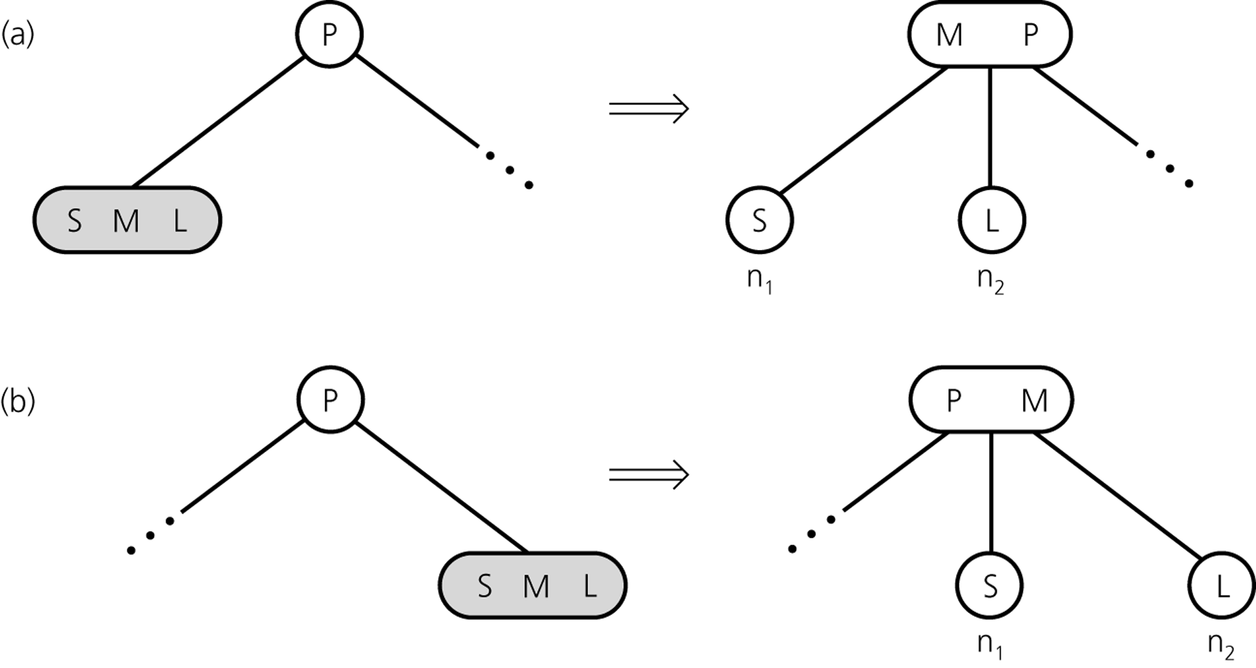
Inserting so far

Slide 24
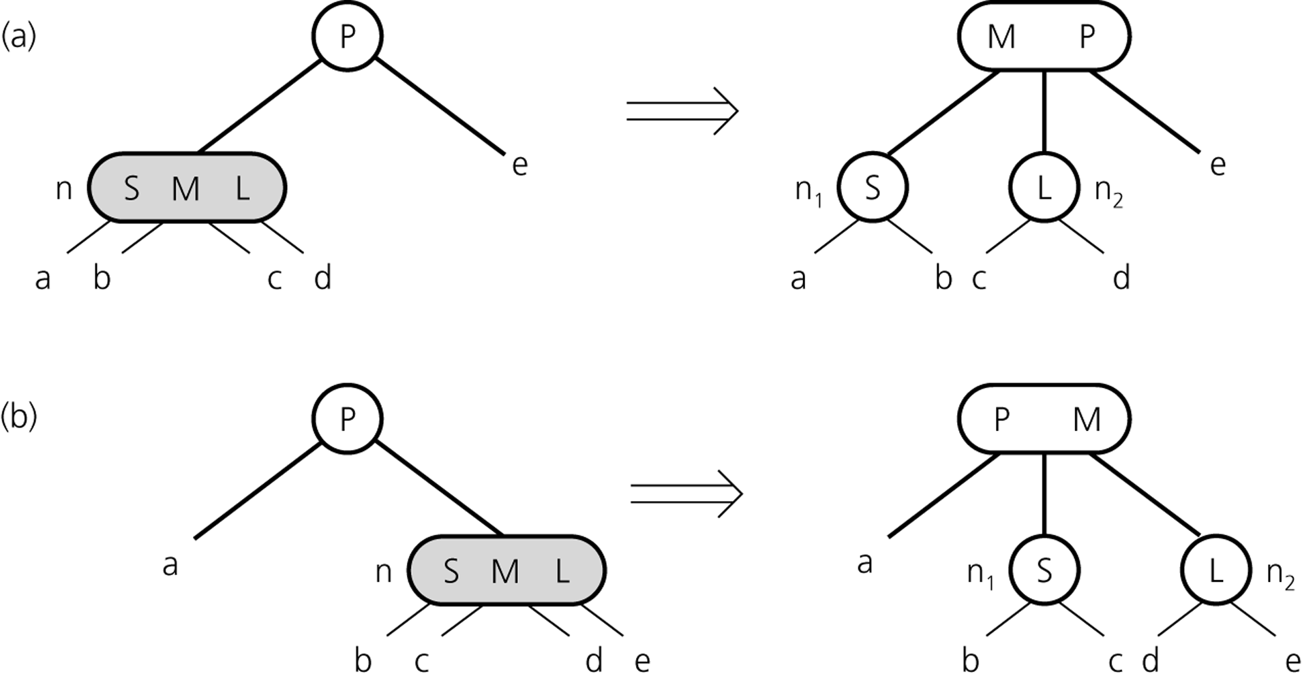
Inserting so far

Slide 25
Inserting Items
How do we insert 32?

Slide 26
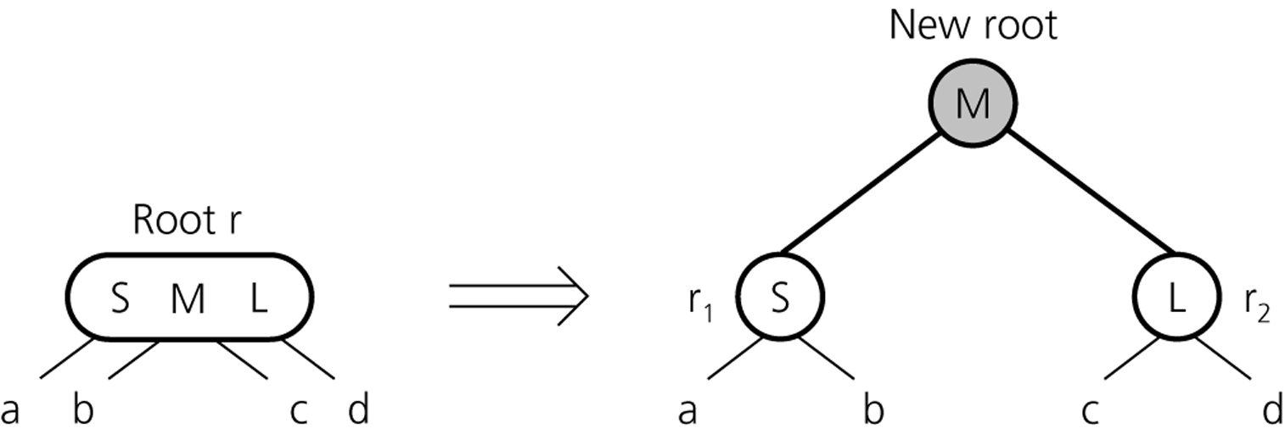
Inserting Items
creating a new root if necessary
tree grows at the root

Slide 27
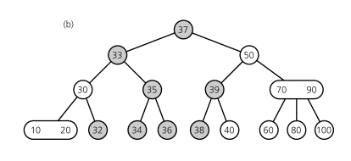
Inserting Items
Final Result

Slide 28
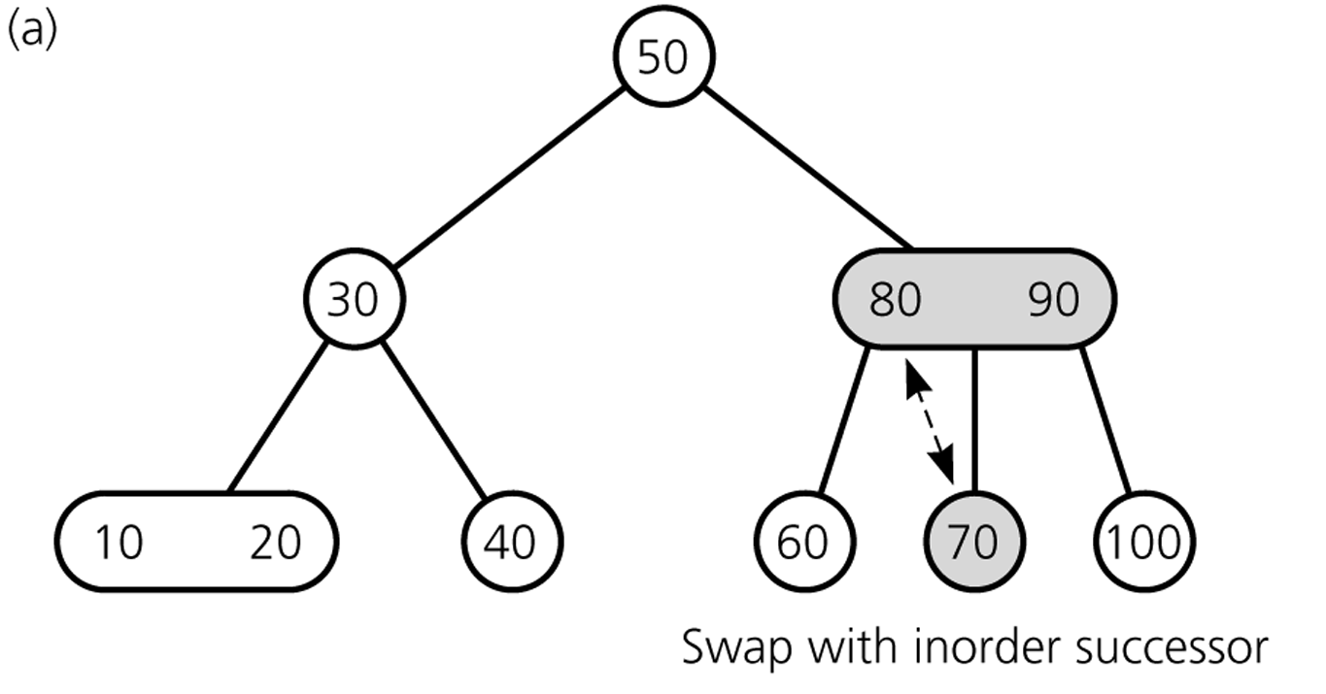
Deleting Items
Delete 70
70
80

Slide 29
Deleting Items
Deleting 70: swap 70 with inorder successor (80)

Slide 30
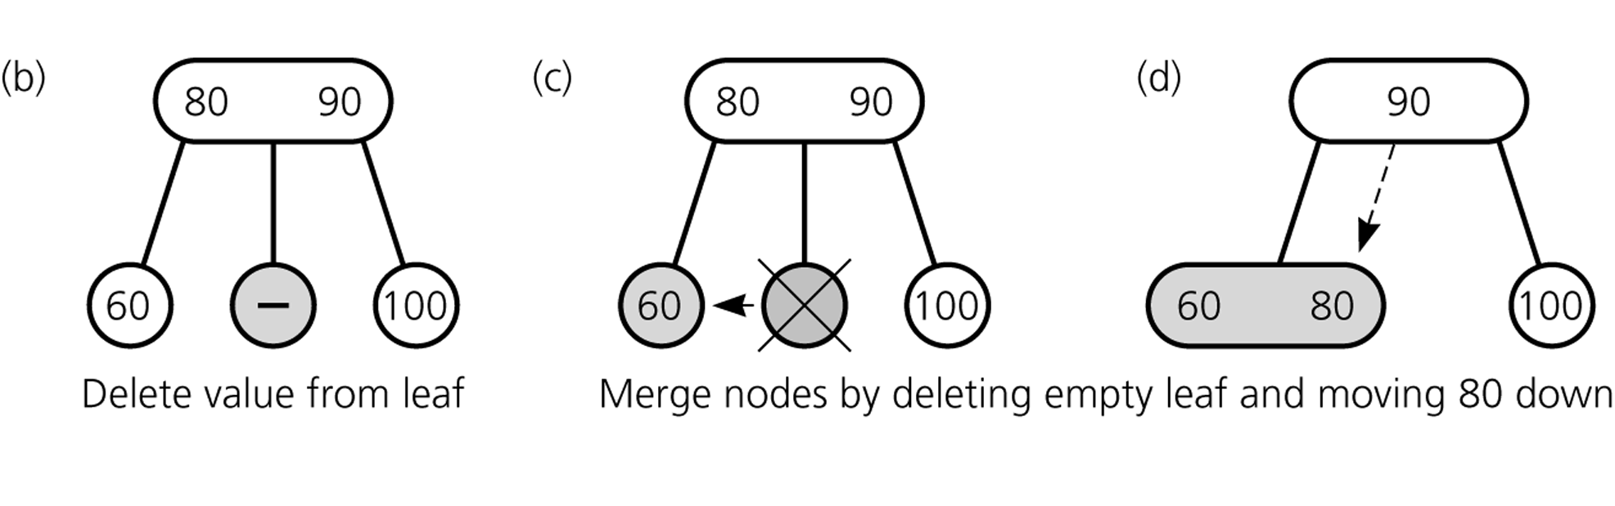
Deleting Items
Deleting 70: ... get rid of 70

Slide 31
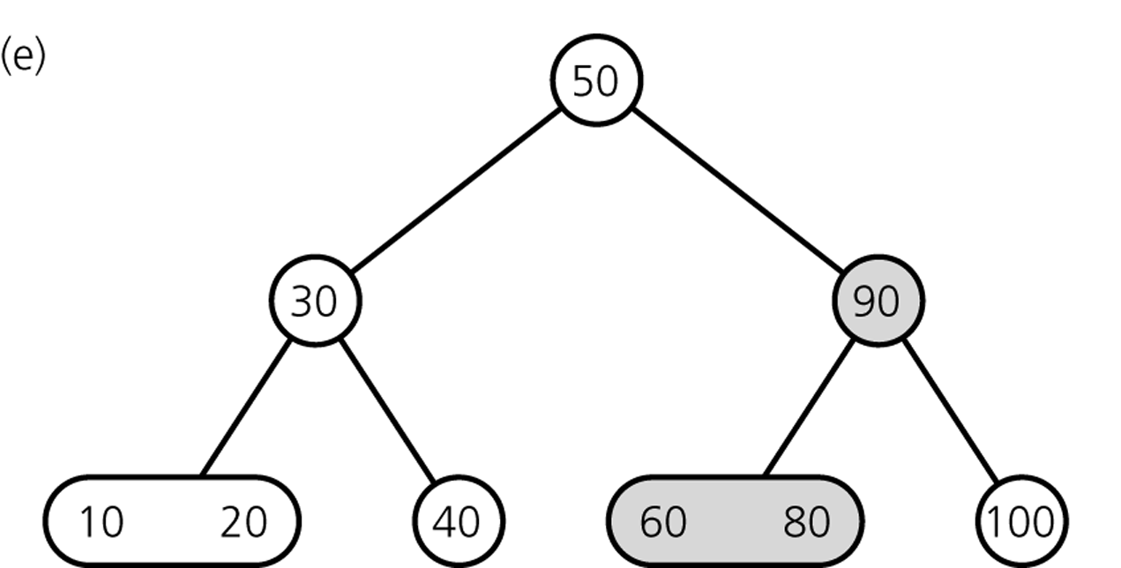
Deleting Items
Result

Slide 32
Deleting Items
Delete 100

Slide 33
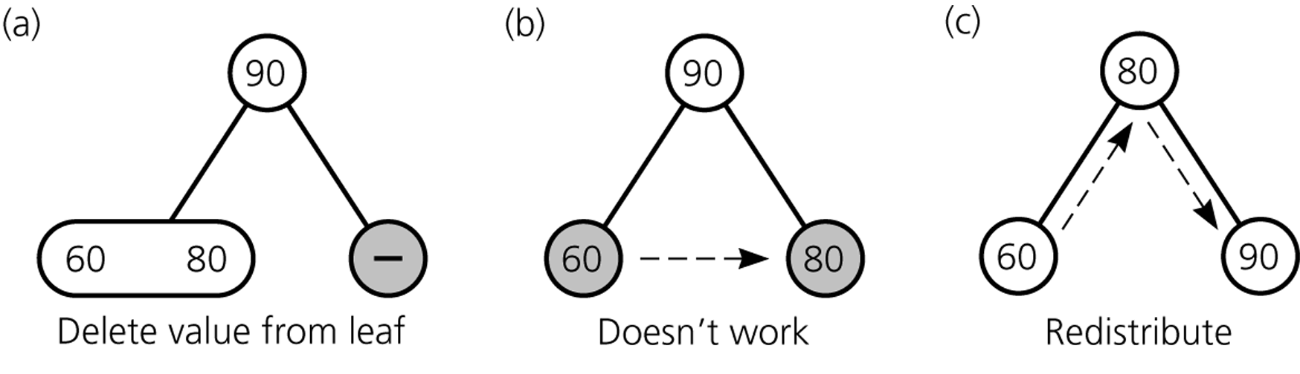
Deleting Items
Deleting 100

Slide 34
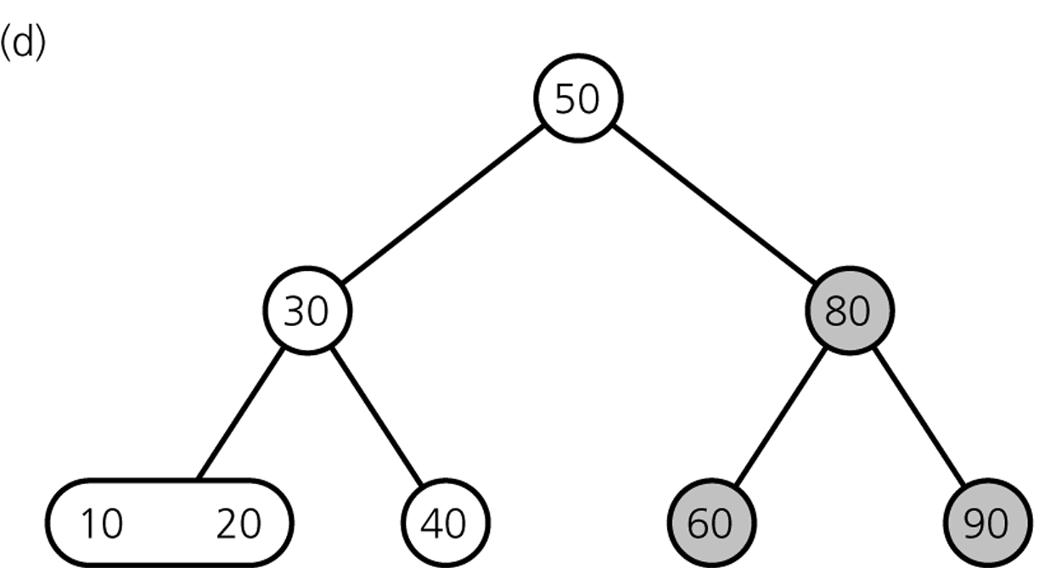
Deleting Items
Result

Slide 35
Deleting Items
Delete 80

Slide 36
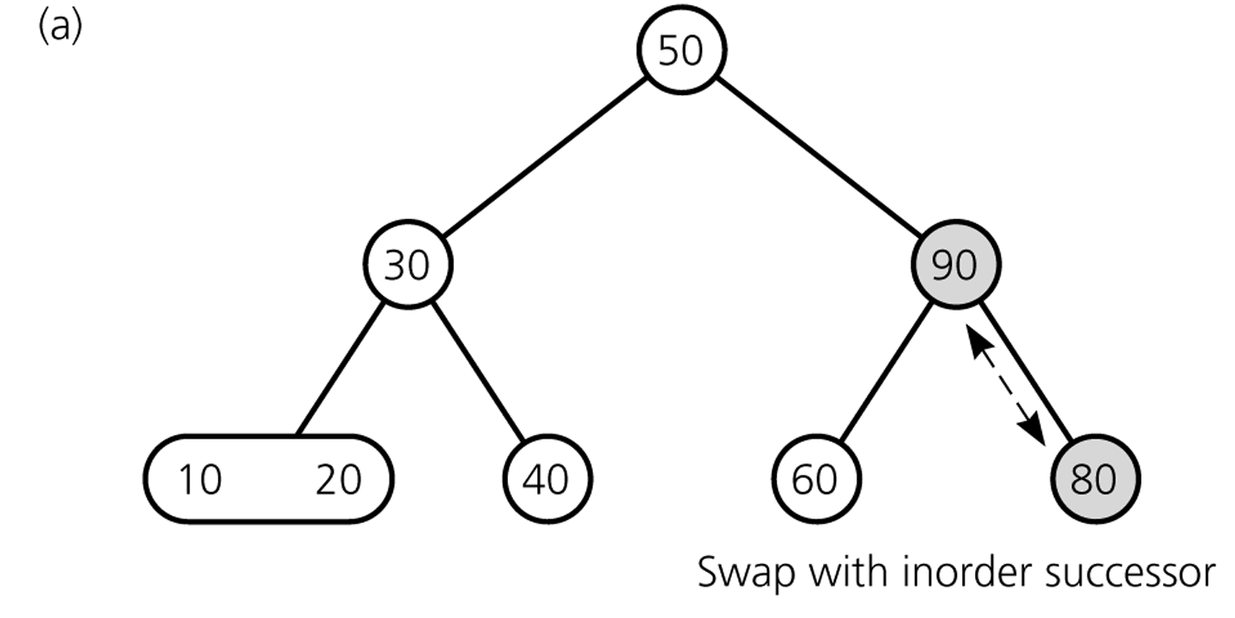
Deleting Items
Deleting 80 ...

Slide 37
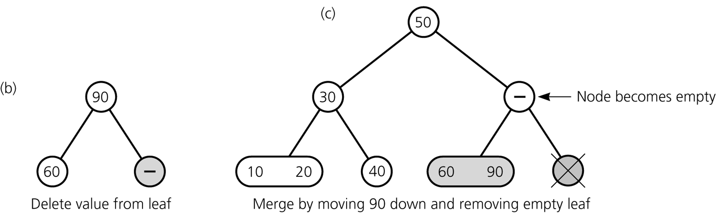
Deleting Items
Deleting 80 ...

Slide 38
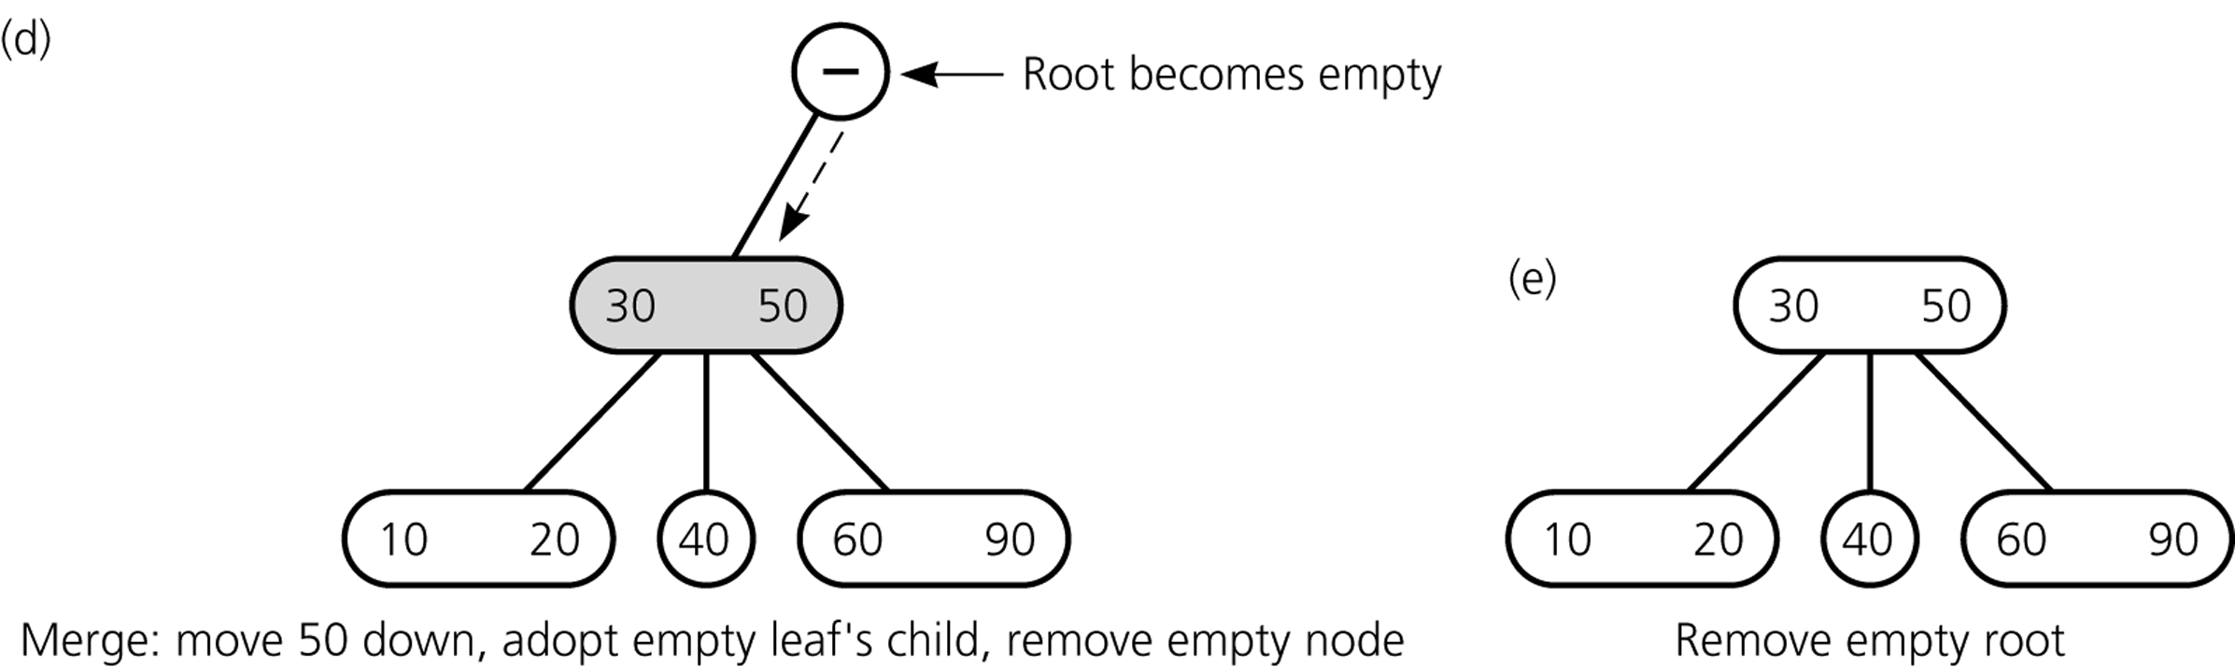
Deleting Items
Deleting 80 ...

Slide 39
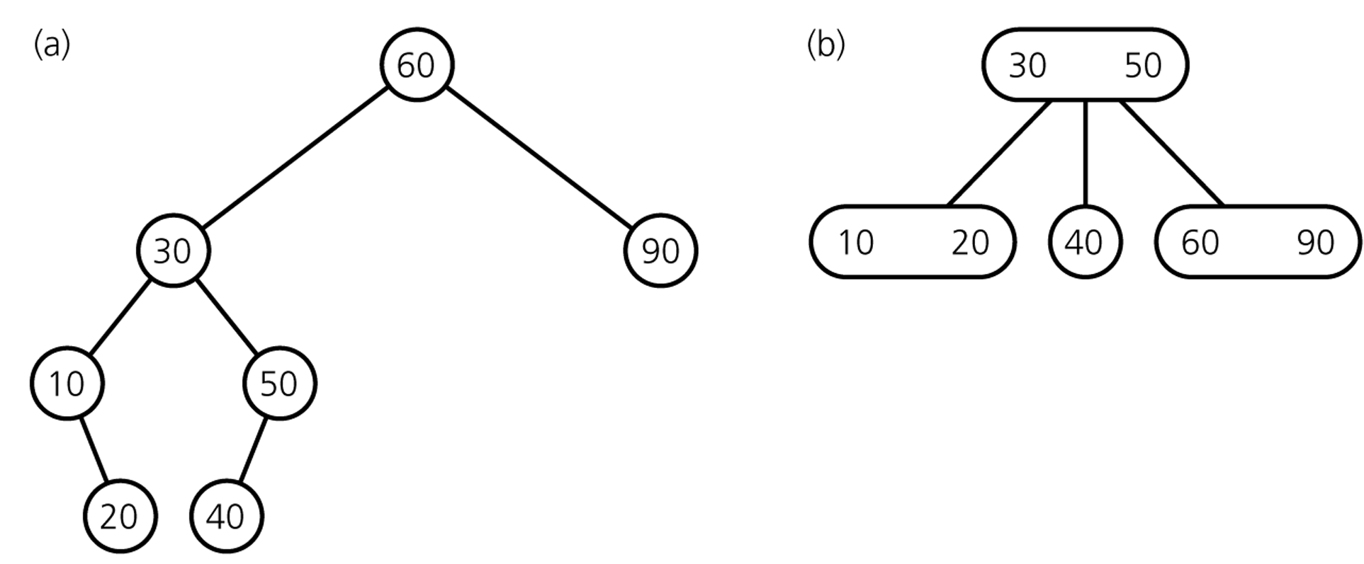
Deleting Items
Final Result
comparison with
binary search tree

Slide 40
Deletion Algorithm I
Deleting item I:
Locate node n, which contains item I
If node n is not a leaf → swap I with inorder successor
deletion always begins at a leaf
If leaf node n contains another item, just delete item I else try to redistribute nodes from siblings (see next slide) if not possible, merge node (see next slide)

Slide 41
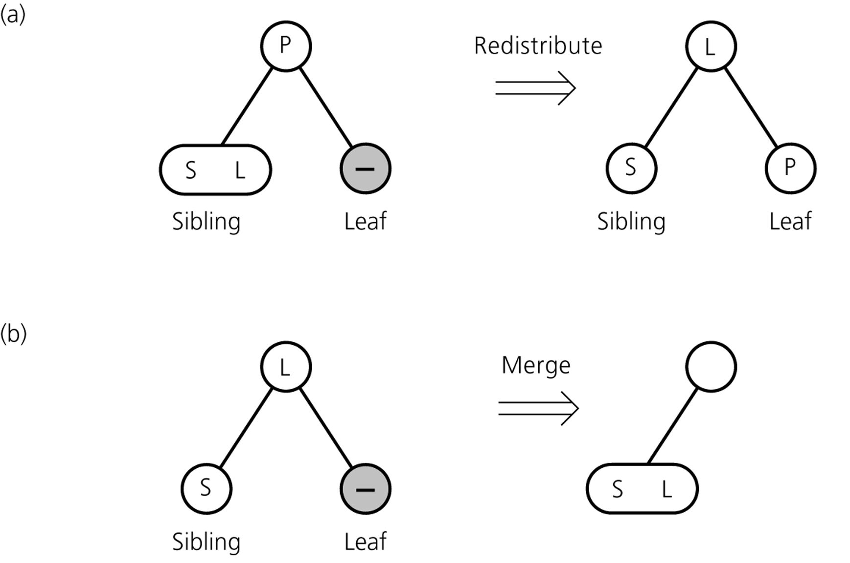
Deletion Algorithm II
Redistribution
A sibling has 2 items:
redistribute item between siblings and parent
Merging
No sibling has 2 items:
merge node
move item from parent to sibling

Slide 42
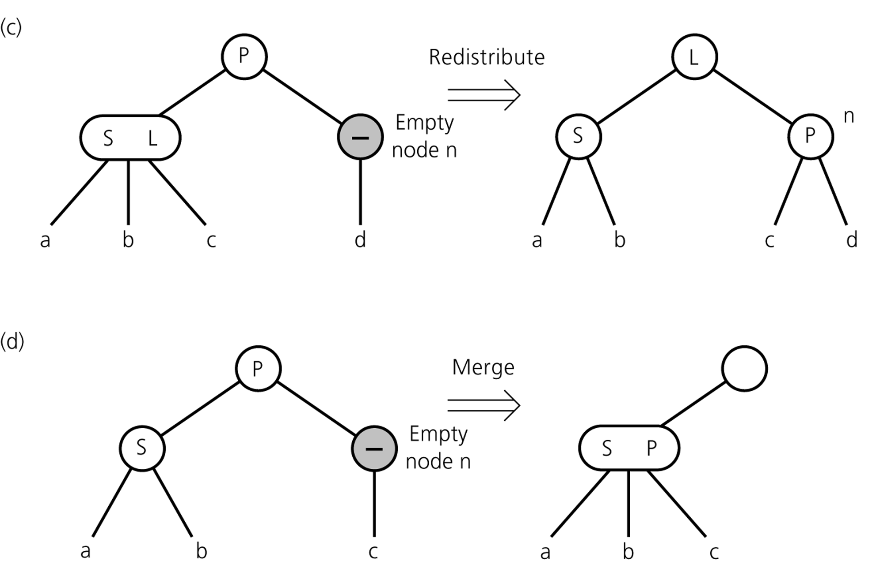
Deletion Algorithm III
Redistribution
Internal node n has no item left
redistribute
Merging
Redistribution not possible:
merge node
move item from parent to sibling
adopt child of n
If n's parent ends up without item, apply process recursively

Slide 43
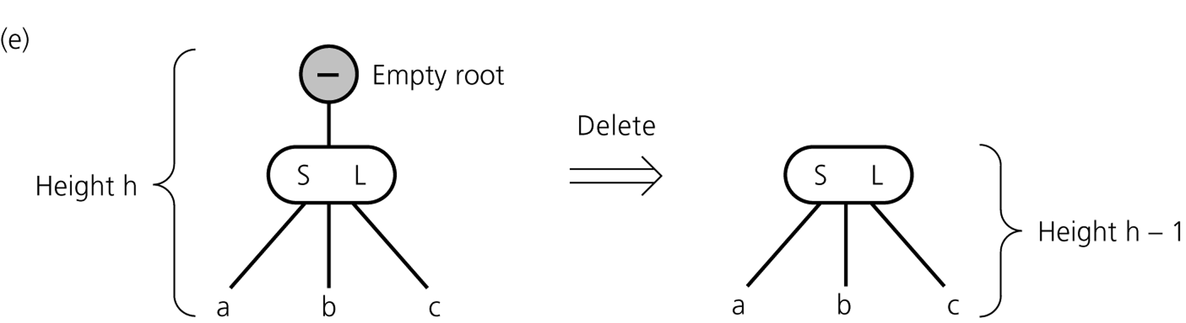
Deletion Algorithm IV
If merging process reaches the root and root is without item
→ delete root

Slide 44
Operations of 2-3 Trees
all operations have time complexity of log n

Slide 45
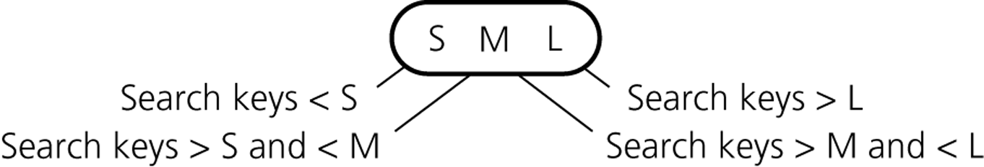
2-3-4 Trees
similar to 2-3 trees
4-nodes can have 3 items and 4 children
4-node

Slide 46
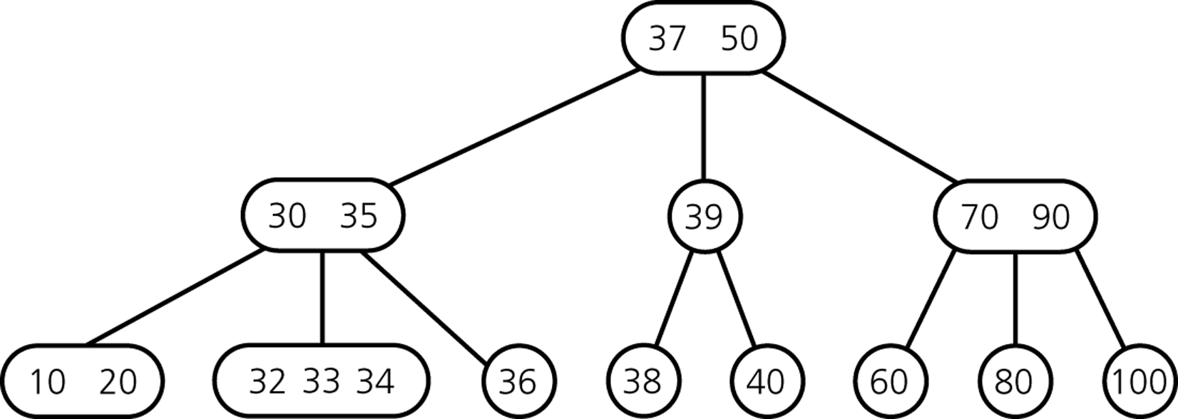
2-3-4 Tree Example

Slide 47
2-3-4 Tree: Insertion
Insertion procedure:
similar to insertion in 2-3 trees
items are inserted at the leafs
since a 4-node cannot take another item, 4-nodes are split up during insertion process
Strategy
on the way from the root down to the leaf: split up all 4-nodes "on the way"
→ insertion can be done in one pass (remember: in 2-3 trees, a reverse pass might be necessary)

Slide 48
2-3-4 Tree: Insertion
Inserting 60, 30, 10, 20, 50, 40, 70, 80, 15, 90, 100

Slide 49
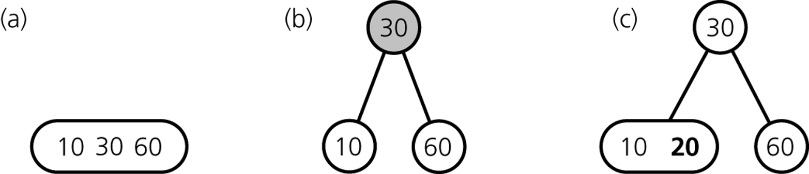
2-3-4 Tree: Insertion
Inserting 60, 30, 10, 20 ...
... 50, 40 ...

Slide 50
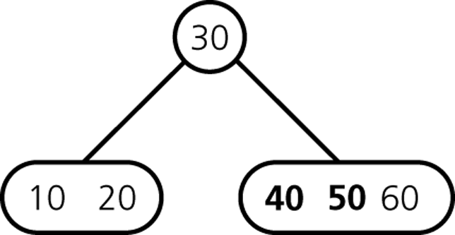
2-3-4 Tree: Insertion
Inserting 50, 40 ...
... 70, ...

Slide 51
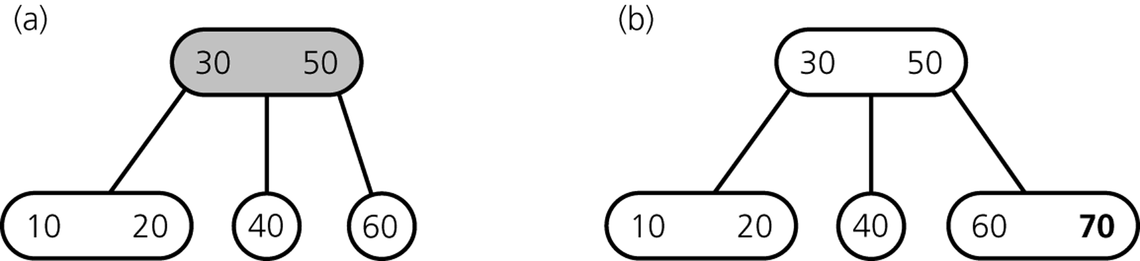
2-3-4 Tree: Insertion
Inserting 70 ...
... 80, 15 ...

Slide 52
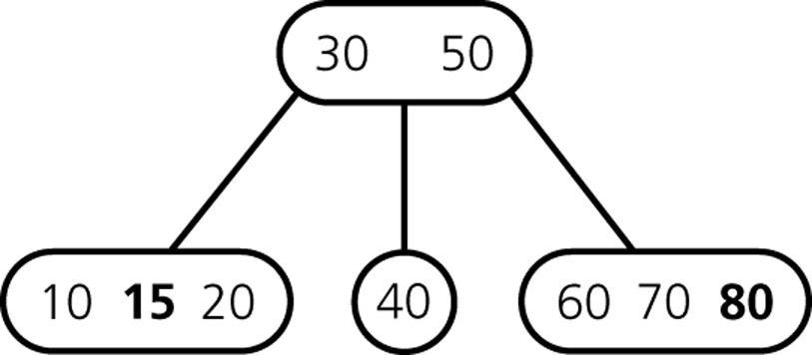
2-3-4 Tree: Insertion
Inserting 80, 15 ...
... 90 ...

Slide 53
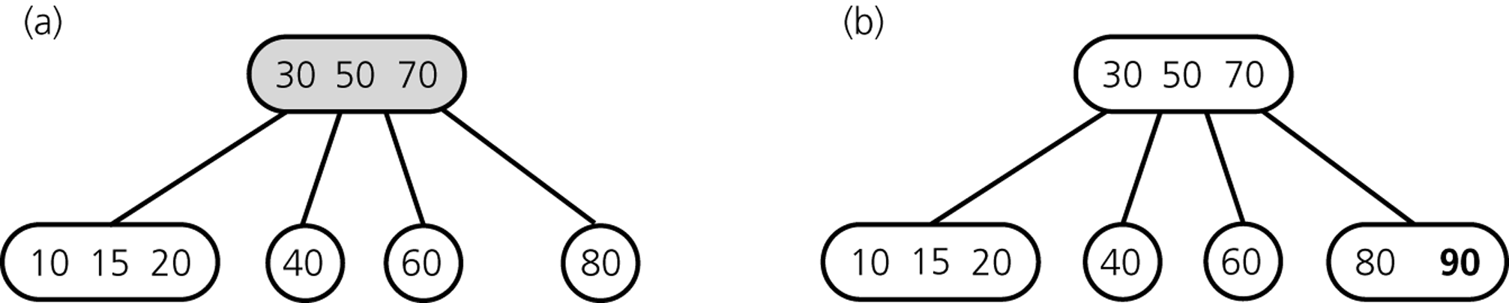
2-3-4 Tree: Insertion
Inserting 90 ...
... 100 ...

Slide 54
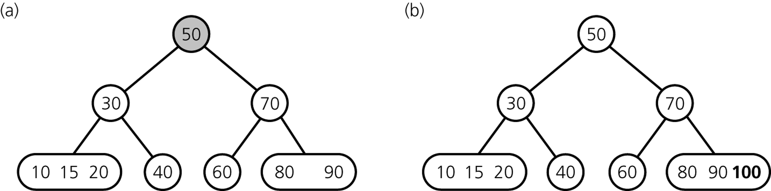
2-3-4 Tree: Insertion
Inserting 100 ...

Slide 55
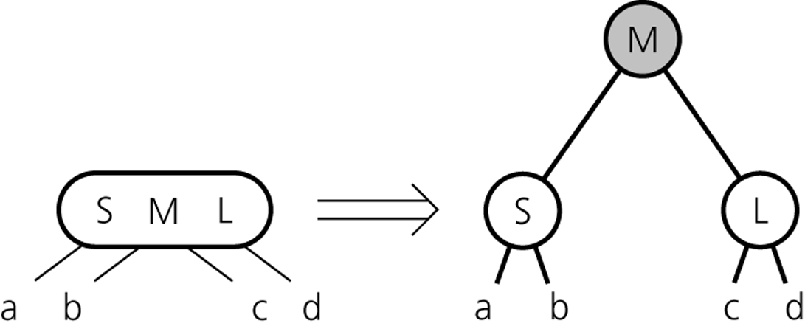
2-3-4 Tree: Insertion Procedure
Splitting 4-nodes during Insertion

Slide 56
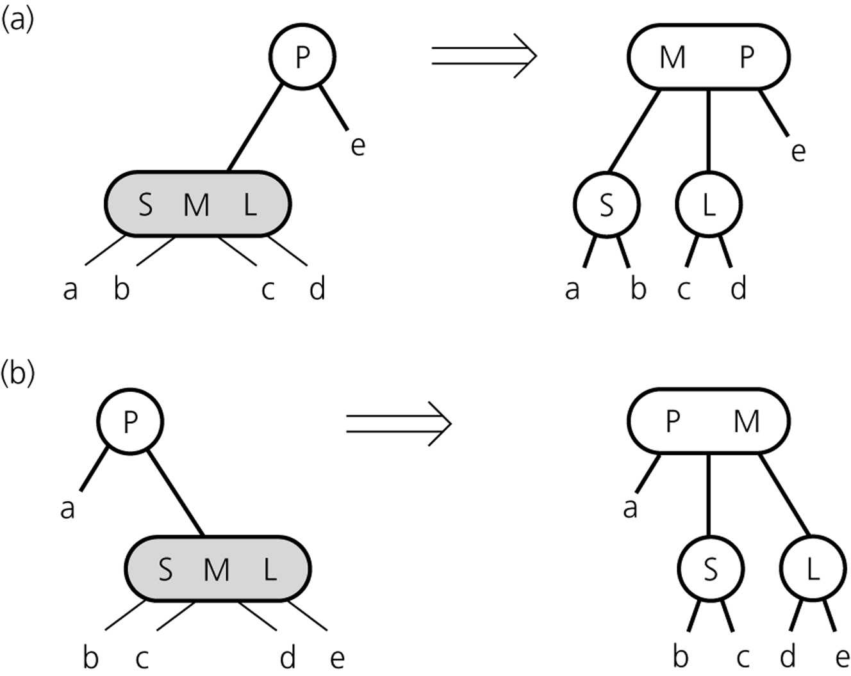
2-3-4 Tree: Insertion Procedure
Splitting a 4-node whose parent is a 2-node during insertion

Slide 57
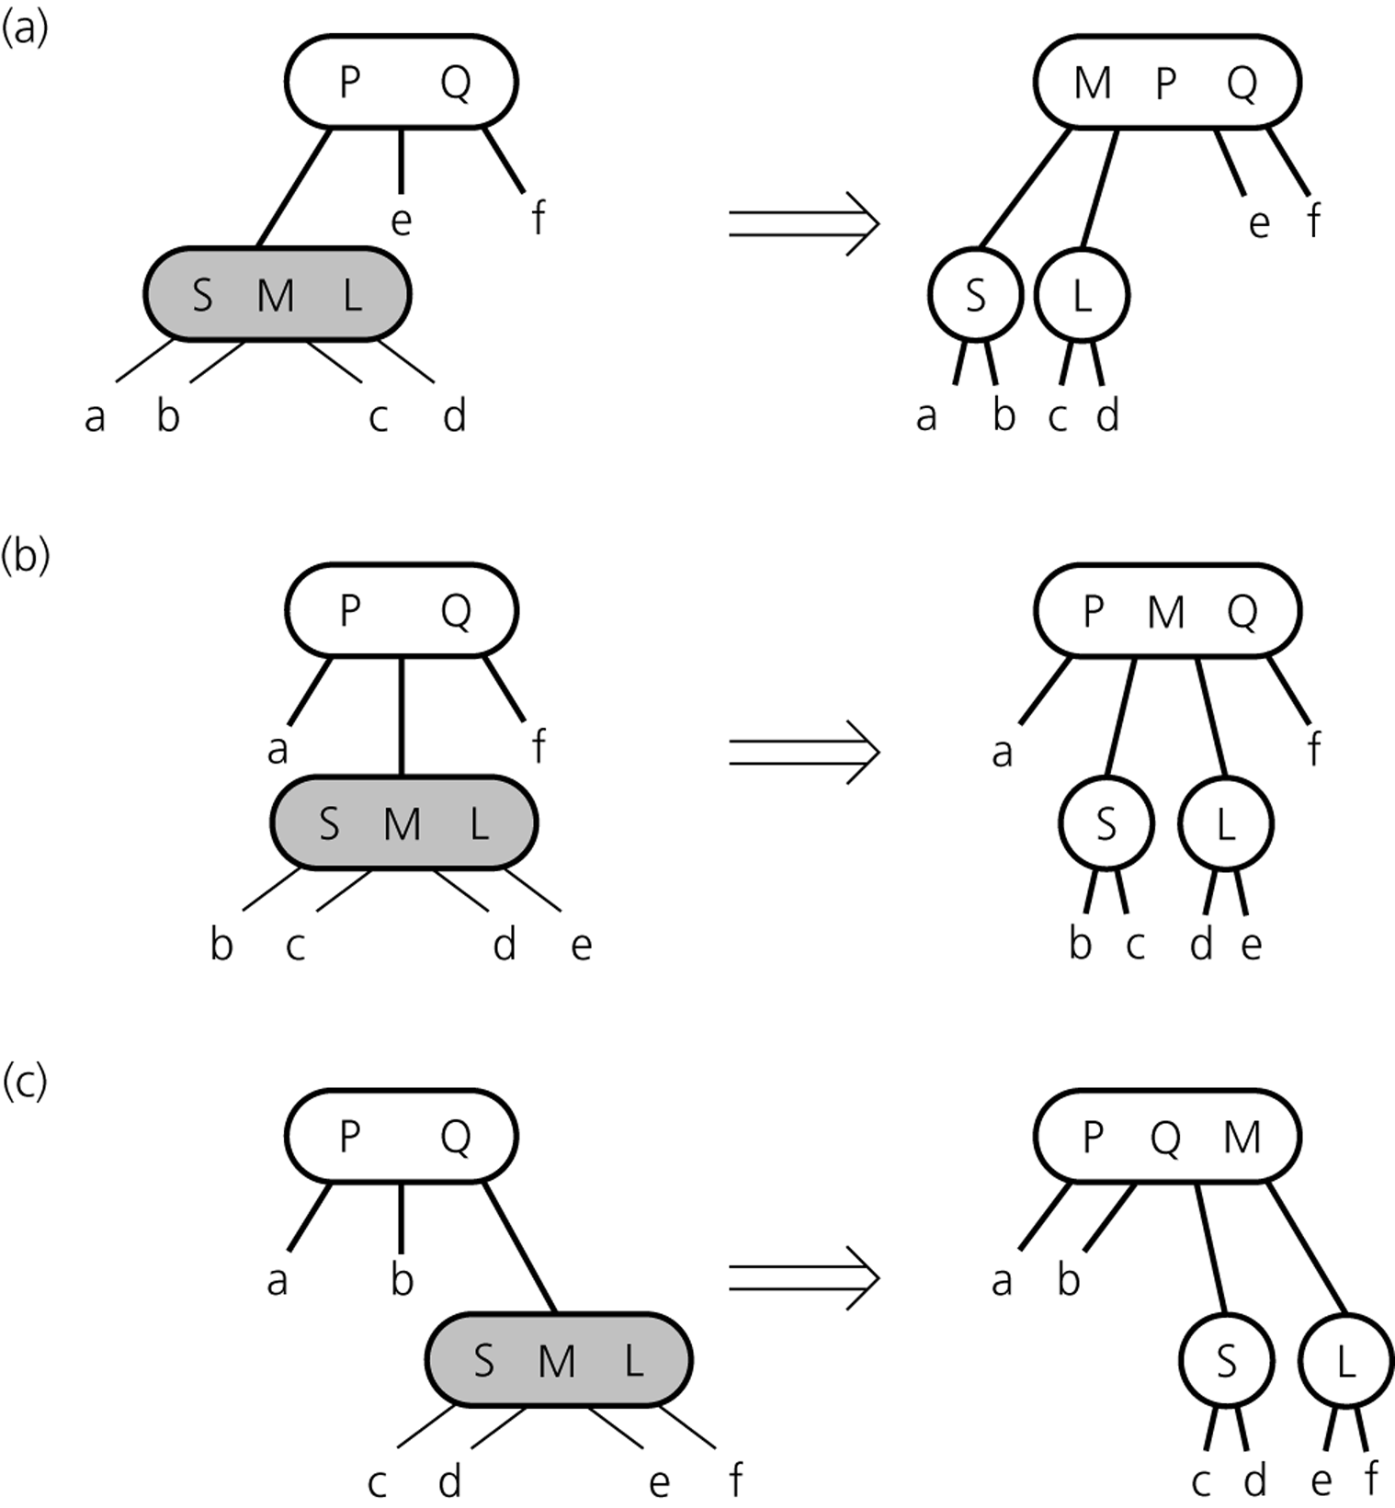
2-3-4 Tree: Insertion Procedure
Splitting a 4-node whose parent is a 3-node during insertion

Slide 58
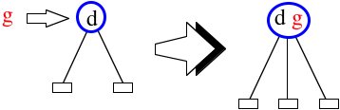
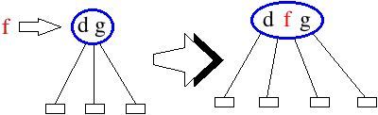
Insertion Algorithm
Insert the new key at the lowest node reached in the search
2-node becomes 3-node
3-node becomes 4-node
What about a 4-node?
We can’t insert another key!

Slide 59
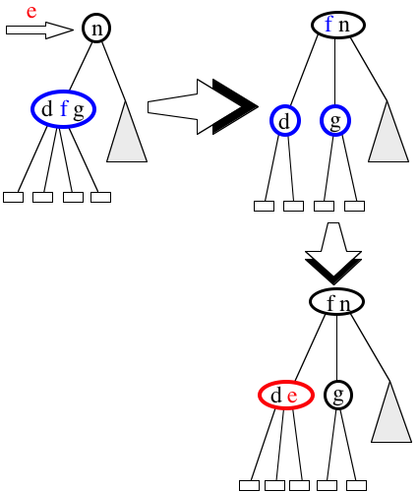

Top Down Insertion
In our way down the tree, whenever we reach a 4-node, we break it up into two 2-nodes, and move the middle element up into the parent node
Now we can perform the insertion using one of the previous two cases
Since we follow this method from the root down to the leaf, it is called top down insertion

Slide 60
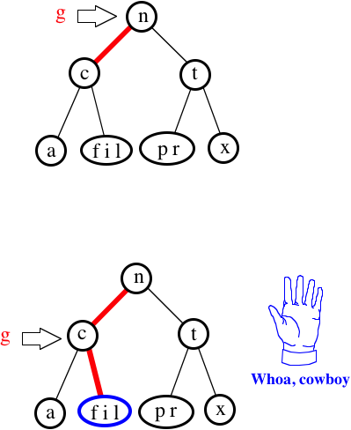
An Example

Slide 61
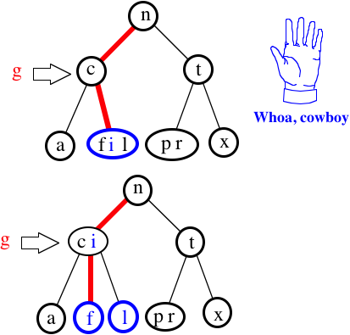
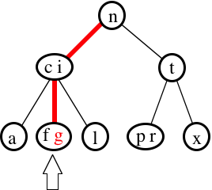

Slide 62
Algorithm: Top Down Insertion
If the current node is a 4-node:
Remove and save the middle value to get a 3-node.
Split the remaining 3-node up into a pair of 2-nodes (the now missing middle value is handled in the next step).

Slide 63
Algorithm: Top Down Insertion
If the current node is a 4-node:
Remove and save the middle value to get a 3-node.
Split the remaining 3-node up into a pair of 2-nodes (the now missing middle value is handled in the next step).
If current node is root node (which thus has no parent):
the middle value becomes the new root 2-node and the tree height increases by 1. Ascend into the root.
Otherwise, push the middle value up into the parent node. Ascend into the parent node.

Slide 64
Algorithm: Top Down Insertion
If the current node is a 4-node:
Remove and save the middle value to get a 3-node.
Split the remaining 3-node up into a pair of 2-nodes (the now missing middle value is handled in the next step).
If current node is root node (which thus has no parent):
the middle value becomes the new root 2-node and the tree height increases by 1. Ascend into the root.
Otherwise, push the middle value up into the parent node. Ascend into the parent node.
Find the child whose interval contains the value to be inserted.
If that child is a leaf, insert the value into the child node and finish.
Otherwise, descend into the child and repeat from step 1

Slide 65
Time Complexity of Insertion
Time complexity:
A search visits O(log N) nodes
An insertion requires O(log N) node splits
Each node split takes constant time
Hence, operations Search and Insert each take time O(log N)
Notes:
Instead of doing splits top-down, we can perform them bottom-up starting at the insertion node, and only when needed. This is called bottom-up insertion.
A deletion can be performed by fusing nodes (inverse of splitting)

Slide 66
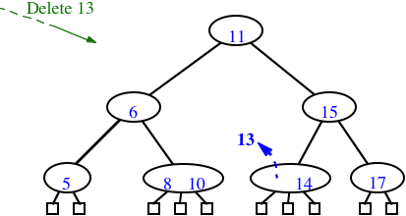
2-3-4 Tree: Deletion
A little trickier
First of all, find the key with a simple multi-way search
If the item to delete has children, swap with inorder successor
Remove the item
...but what about removing from 2-nodes?

Slide 67
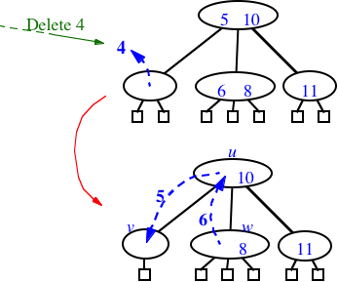
2-3-4 Tree: Deletion
Not enough items in the node
- underflow
Pull an item from the parent, replace it with an item from a sibling
- called transfer
Still not good enough! What happens if siblings are 2-nodes?
Could we just pull one item from the parent?
No. Too many children
But maybe...

Slide 68
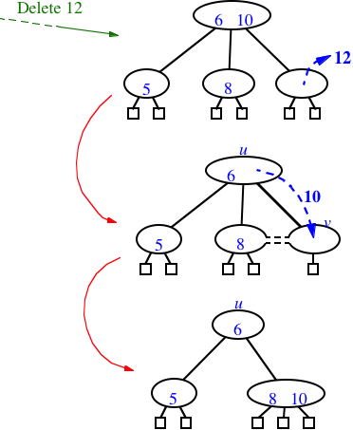
2-3-4 Tree: Deletion
We know that the node’s sibling is just a 2-node
So we fuse them into one (after stealing an item from the parent, of course)
Last special case: what if the parent was a 2-node?

Slide 69
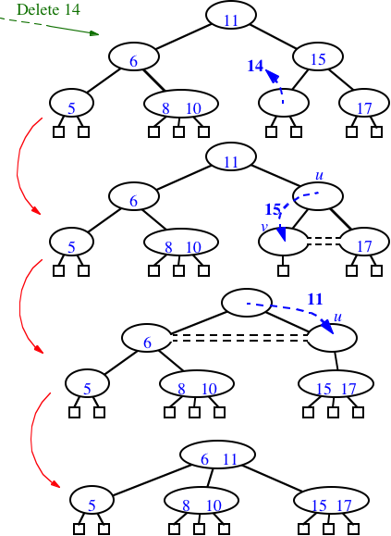
2-3-4 Tree: Deletion
Underflow can cascade up the tree, too.

Slide 70
2-3-4 Tree: Deletion
Deletion procedure:
similar to deletion in 2-3 trees
items are deleted at the leafs → swap item of internal node with inorder successor
note: a 2-node leaf creates a problem
Strategy (different strategies possible)
on the way from the root down to the leaf: turn 2-nodes (except root) into 3-nodes
→ deletion can be done in one pass

