Slide 1
Strongly Connected Components
Every pair of vertices are reachable from each other
Graph G is strongly connected if, for every u and v in V, there is some path from u to v and some path from v to u.
Strongly Connected
Not Strongly Connected
Data Structure and Algorithm

Slide 2
Example
a
{ a , c , g }
g
c
d
{ f , d , e , b }
e
f
b
Data Structure and Algorithm

Slide 3
Finding Strongly Connected Components
Input: A directed graph G = (V,E)
Output: a partition of V into disjoint sets so that each set defines a strongly connected component of G
Data Structure and Algorithm

Slide 4
Algorithm
Strongly-Connected-Components(G)
call DFS(G) to compute finishing times f[u] for each vertex u. Cost: O(E+V)
compute G^{T} Cost: O(E+V)
call DFS(G^{T}), but in the main loop of DFS, consider the vertices in order of decreasing f[u] Cost: O(E+V)
output the vertices of each tree in the depth-first forest of step 3 as a separate strongly connected component.
The graph G^{T} is the transpose of G, which is visualized by
reversing the arrows on the digraph.
Cost: O(E+V)
Data Structure and Algorithm

Slide 5
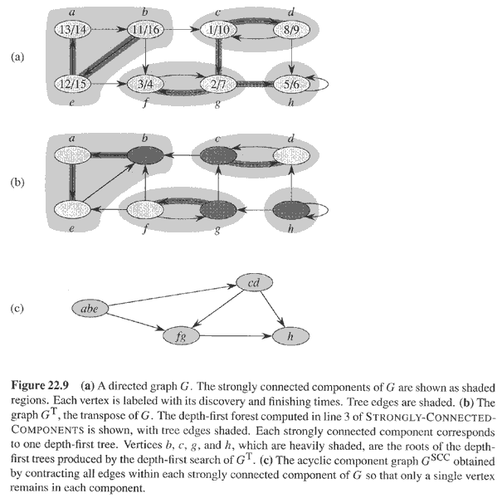
Example
Data Structure and Algorithm

Slide 6
Questions
Let C={C₁,C₂....,C_{n} } be the set of strongly connected components of G=(V,E).
Let,
G^{SCC} =(V^{SCC}, E^{SCC}) where V^{SCC}={v₁,v₂,....v_{n}} where each vertex v_{i} in V^{SCC} represents the strongly connected component C_{i} in C. There is a directed edge (v_{i}, v_{k}) in E^{SCC} if there is a directed edge (x,y) ∈ E such that x ∈ C_{i} and y ∈ C_{k}.
Then, ((G^{T})^{SCC})^{T} = G^{SCC} where G^{T} denotes the transpose graph of G.
True/False ?
Data Structure and Algorithm

Slide 7
Consider a directed graph G=(V,E) where each node is initially colored white. What should be the minimum number of nodes that we should change to red such that for each white node v in G, there exists at least one red node r such that there is a directed path from r to v and v to r. Assume that for every node there is at least one other node it is reachable from and can reach to.
Data Structure and Algorithm

