Slide 2
In an experiment that sounds more like science fiction than reality, two humans were able to send greetings to each other using only a digital connection linking their brains.
"Could we develop an experiment that would bypass the talking or typing part of Internet and establish direct brain-to-brain communication between subjects located far away from each other, in India and France?" co-author Dr. Alvaro Pascual-Leone from Harvard said in a statement.

Slide 3
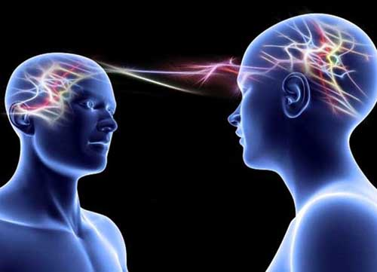
In the experiment, the message sender, in India, transmitted the words "hola" (Spanish for "hello") and "Ciao" (Italian for "hello"/"goodbye") to the message recipients in France, located 5,000 miles (8,000 kilometers) away. All three recipients correctly translated the message!

Slide 4
How it works:
First, the team had to establish binary-code equivalents of letters; for example “h” is “0-0-1-1-1.” Then, with EEG (electroencephalography) sensors attached to the scalp, the sender moved either his hands or feet to indicate a 1 or a 0. The code then passed to the recipient over email. On the other end, the receiver was blindfolded with a transcranial magnetic stimulation (TMS) system on his head.
The TMS headset stimulated the recipient’s brain, causing him to see quick flashes of light. A flash was equivalent to a “1” and a blank was a “0.” From there, the code was translated back into text. It took about 70 minutes to relay the message.

Slide 5
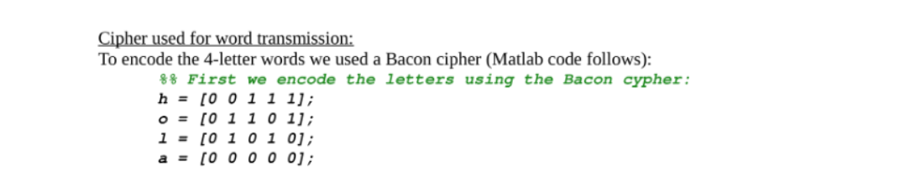
The Bacon cipher:

Slide 6
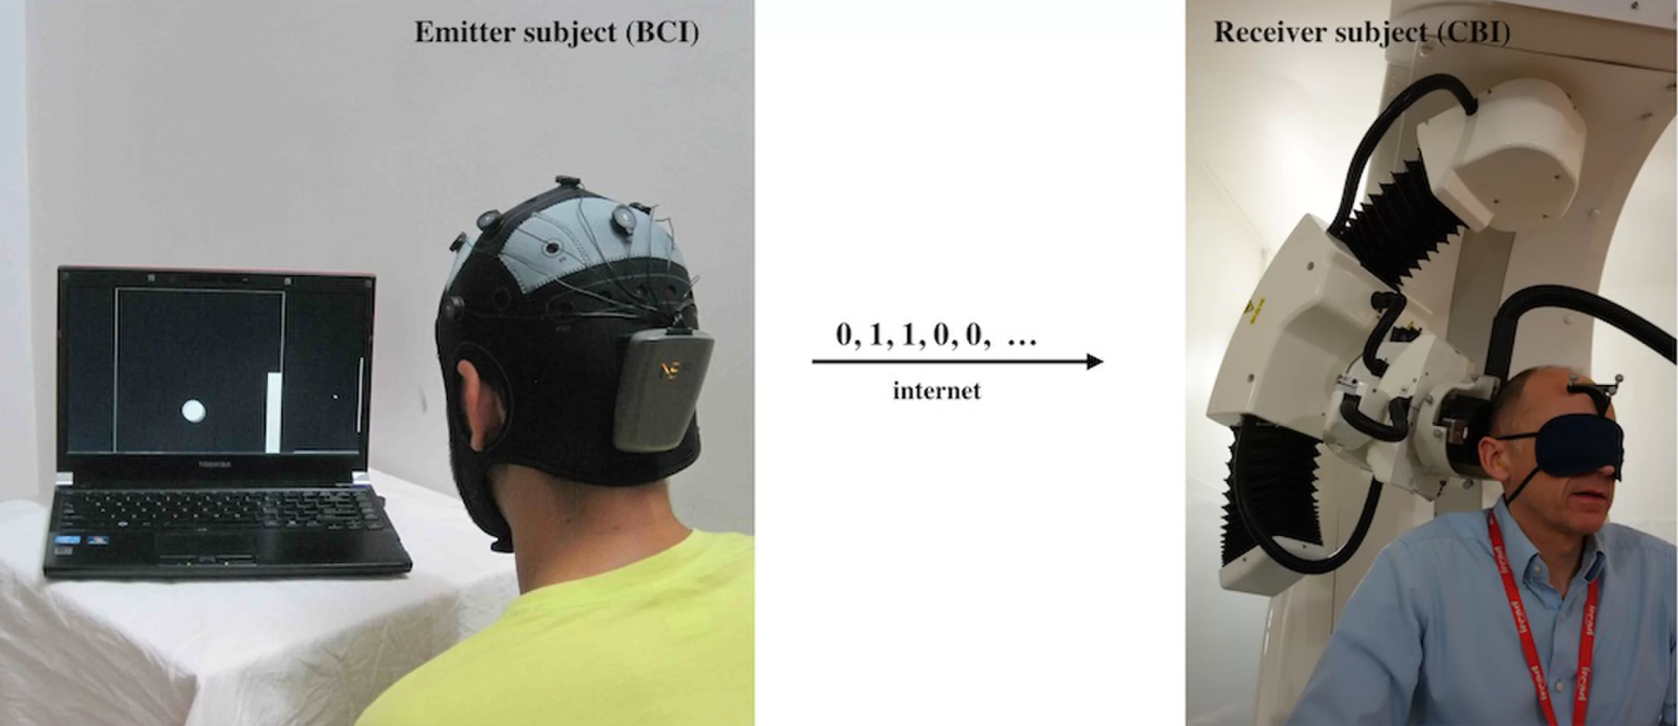

Slide 7
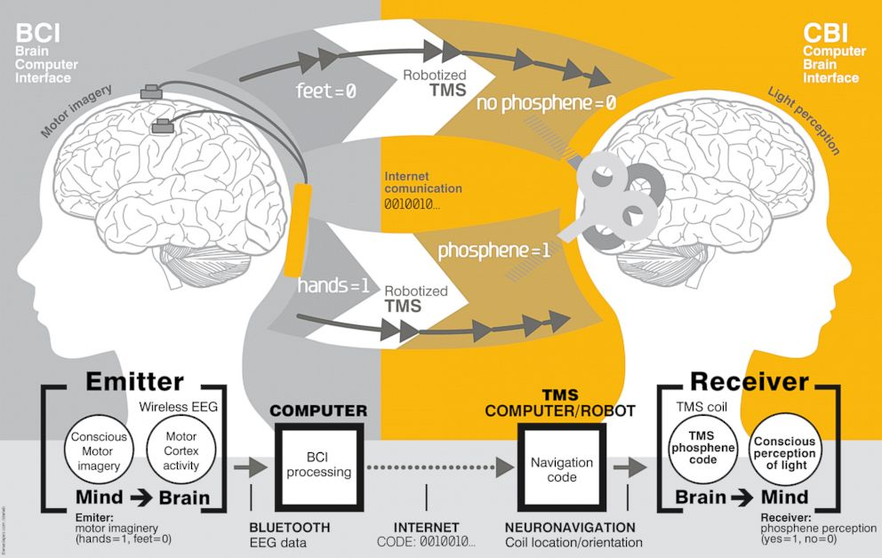

Slide 8
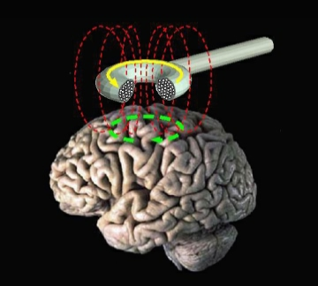
What is TMS?
Transcranial magnetic stimulation (TMS) is a noninvasive form of brain stimulation in which a changing magnetic field is used to cause electric current at a specific area of the brain through electromagnetic induction. An electric pulse generator, or stimulator, is connected to a magnetic coil, which in turn is connected to the scalp. The stimulator generates a changing electric current within the coil which induces a magnetic field; this field then causes a second inductance of inverted electric charge within the brain itself.[

Slide 9
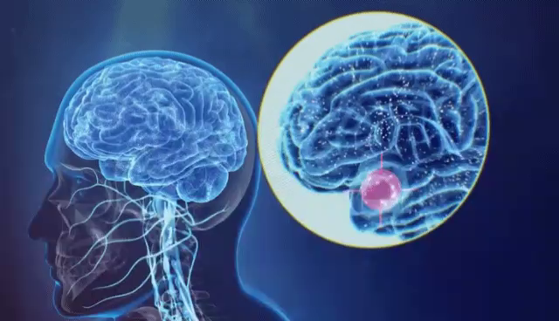

Slide 10
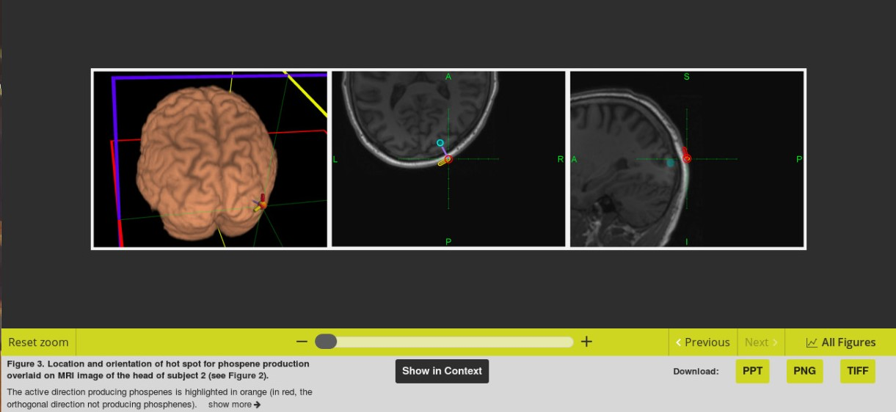

Slide 11
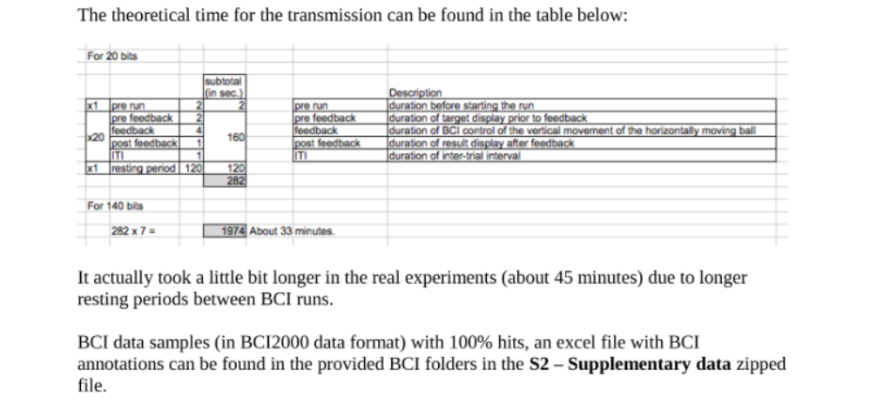

Slide 12
140 bits were encoded by the BCI emitter in Thiruvananthapuram and automatically sent via email to Strasbourg, where the CBI receiver was located. There, a program parsed incoming emails to navigate the robot and deliver TMS pulses precisely over the selected site and with the appropriate coil orientation.
BCI and CBI transmission rates were of 3 and 2 bits per minute respectively. The overall B2B transmission speed was of 2 bits per minute (limited by the CBI branch).

Slide 13
The probability of guessing correctly 140 random, balanced bits with an error rate of 20% (28 errors out of 140) or less is extremely low.

