Slide 1

Who-To-Follow
Discover High Quality Content on Twitter
Susie X. Sun | linkedin: susiexsun
Notes:
Feedback:
State motivation more clearly. Twitter is not serious – make your example serious
Speak a little less on each slide

Slide 2

Motivation
Surface the Quality Content on Twitter

Slide 3
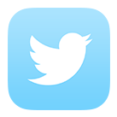

Obstacles: Noise and Subjectivity
99
Non-content e.g. conversations and self-promotion
Amount of tweets: 500 million / day
Quality means different things to different people

Slide 4
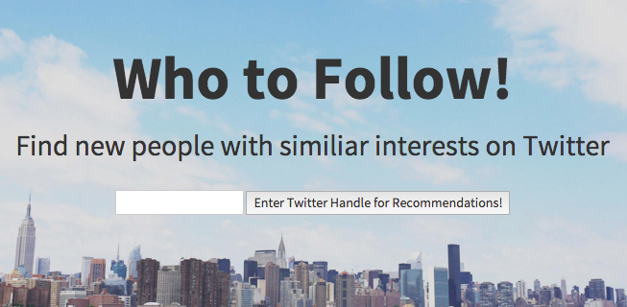
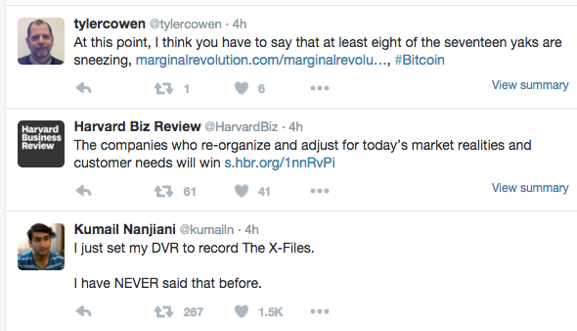
Recommender based on Graph & NLP
Recommends People

Slide 5
Model Step 1: The Graph
Retweet is signal for quality
User 0
User 1A
User 2A
Who did User 1A retweet the most?
Who did User 0 retweet most?
User 2B
User 2C
User 1B
User 1C
Intermediate result: People with a high probability of quality
Notes:
----- Meeting Notes (1/15/16 16:34) -----
Too long for this slide

Slide 6
Model Step 2: The Content
Extract each tweet and turn into a document
TF-IDF
Cosine Similarity with User 0’s tweets
Find top 20% of tweets for each User 0 tweet
Return 5 people with most # of tweets in top 20%

Slide 7


Data Pipeline
IMPROVEMENTS NEEDED HERE
User 0
Corpus
Model
Twitter REST API
User Timeline
Friends / IDs
Data Storage

Slide 8
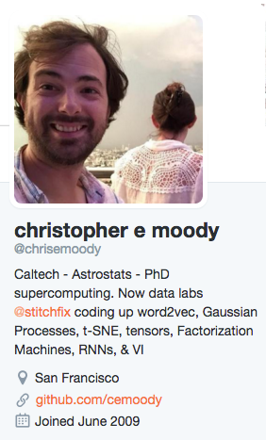

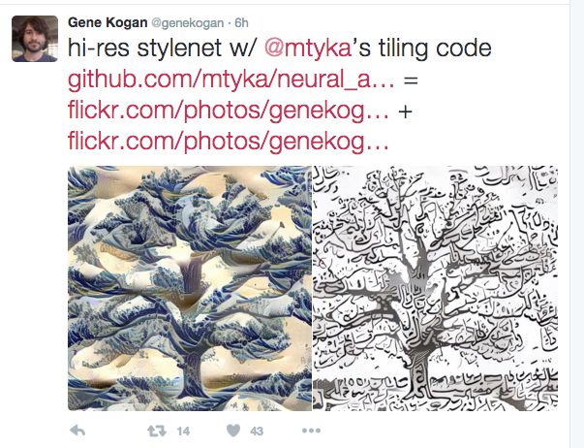
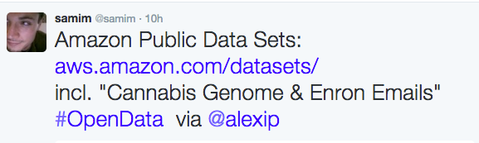
Validating Results

Slide 9




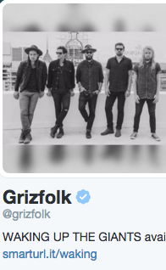
Validating Results

Slide 10
Further Work
User Testing
Feedback and A/B Testing
Refining the Model
“PageRank” for Retweets
Broader Applications
News Music TV Shows

Slide 11
Thank you!
Any questions?
Susie X Sun
linkedin: susiexsun
github: susiexsun

