Slide 1

Who To Follow!
Discover High Quality Content on Twitter
Susie X. Sun | linkedin/in/susiexsun

Slide 2
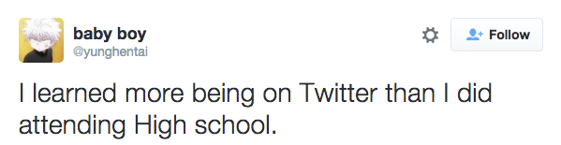
Goal: Quality Content Discovery
Find people who tweet high quality content on your interested topics

Slide 3
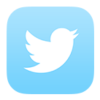

Obstacles: Noise and Subjectivity
99
NOISE: Non-content such as conversations occur Twitter.
SUBJECTIVITY: quality means different things to different people

Slide 4
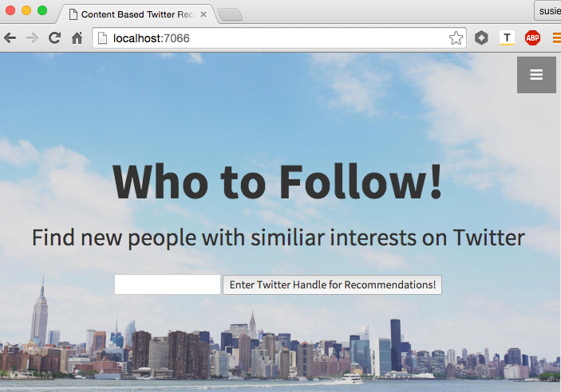
Result: Content & Graph Based Recommender
PICTURE OF RESULT PAGE HERE

Slide 5
Model: Step 1 – The Graph
A Retweet is signal for quality.
User 0
User 1A
User 2A
Who did User 1A retweet the most?
Who did User 0 retweet most?
User 2B
User 2C
User 1B
User 1C
Intermediate result: People with a high probability of quality

Slide 6
Model: Step 2 – The Content
Extract each tweet and turn into a document
TF-IDF
Cosine Similarity with User 0’s tweets
Take top 20% of tweets for user similarity
Return 5 people with most # of tweets in top 20%

Slide 7



Data Source / Data Pipeline
IMPROVEMENTS NEEDED HERE
Twitter REST API
User Timeline
Friends / IDs

Slide 8
Validating Results
Example 1
Example 2

Slide 9
Further Work
User Testing
Feedback and A/B Testing
Refining the Model
PageRank Word2vec
Broader Applications
News Movies Books

