Slide 1
Fraud Detection Case
Kevin & Susie

Slide 2
Feature Engineering
Feature | What We Did
Suspicious Domains | 1 or 0 value for commonly fraudulent domains. ex: ymail.com = 1, galvanize.com = 0
Length of text Previous Payouts , Description, Ticket Types, Org Description | Noticed fraudulent accounts may have shorter values / dictionaries in these fields
Payee Name vs Org Name | Payee Name should be similar to Org Name. We did a Fuzzy String similarity between these two fields. ex. Not Fraud = Galvanize Inc & Galvanize Immersive Fraud = National Guard & Robert Smith
Dummies for categorical values

Slide 3
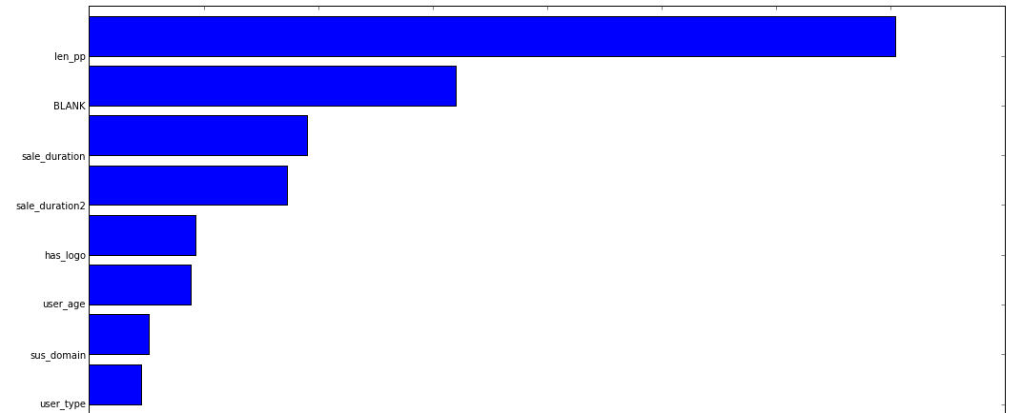
Feature Importance

Slide 4
Models & Results
Smote it!
Top 20 Features
Feature | Accuracy Score | Recall
Random Forest Classifier | 0.986 | 0.906
Logistic Regression | 0.956 | --
SVM Gaussian Kernel | 0.912 | 0.01
GBR | 0.988 | 0.913
Winner!
Winner!

Slide 5
Confusion Matrix
Prediction Outcome
 | True | False
True | 230 | 24
False | 14 | 2600
Actual Outcome

Slide 6
Web App
http://0.0.0.0:7777/

