Slide 1

**** x86 ASSEMBLY BASICS ****
0 ”TOPICS OF DISCUSSION”
1 “WHAT IS ASSEMBLY”
2 “REGISTERS”
3 “INSTRUCTIONS”
4 “MAKING A+B PROGRAM”
5 “PASSING IT ARGUMENTS”
6 “SYSTEM CALLS”
7 “MAKING PUT-STRING”
8 “THE STACK”
9 “DISASSEMBLING C”
10“HARDWARE INTERACTION”

Slide 2

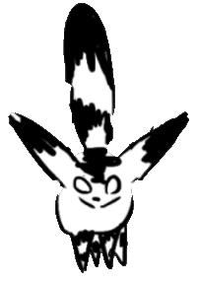
The slides & practice programs can be found on github github.com/susikohmelo/assembly_basics_presentation

Slide 3
What *actually* is Assembly?
Generic term
Languages which communicate directly with hardware.
Hardware specific.
Many different syntax can exist for the same language
**** EXAMPLES ****
x86 : intel & AMD
ARM : mobile
RISCV: open-source
alternative

Slide 4
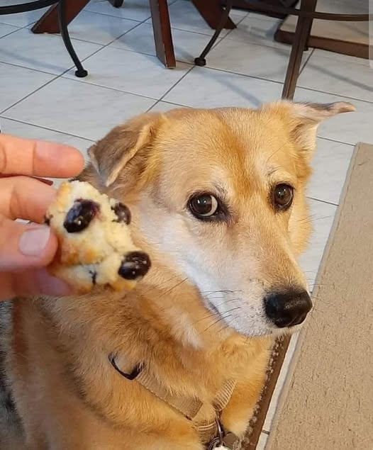

(Almost) everything is just memory
Operations, variables...
It’s all just data in memory.
Fundamentally there is no difference between data and code.
Everything in your program is just a value stored in some address of RAM which you can freely access and edit.
( Assuming the OS lets you )
You can even make self modifying code

Slide 5
Registers
Super fast, temporary memory inside the CPU
Registers can be used to:
- Store/assign values from/to other registers & RAM
- Do operations on the value they hold (add, multiply etc.)

Slide 6
(Some) commonly used registers
**** GENERAL ****
ANYTHING GOES HERE
-------------------
ax, bx, cx, dx
SRC/DEST POINTERS
-------------------
si : source index
di : destination
**** SPECIAL ****
STACK POINTERS
-------------------
sp : Top pointer
bp : Bottom pointer
FLAG REGISTERS
-------------------bazillion of them

Slide 7

Register inception
Registers can be divided into multiple smaller registers
64-bits
32-bits
16-bits
8-bits
RAX
EAX
AX
AL

Slide 8
Instructions
Instructions are the
actual commands we can
give the CPU to execute
- Operations on registers
(assign, add, multiply etc.)
- Move values in RAM & registers
- Jump to locations
**** EXAMPLES ****
MOV ax, 42
------------------
Move the value 42 into register ax
ADD ax, bx
------------------
Add value in bx to the value in ax.

Slide 9
Simple program example
**** PROGRAM ****
_start: ←
MOV ax, 42
MOV bx, ax
ADD ax, bx
MOV bx, 0x42
MOV [bx], ax
**** REGISTERS ****
ax : 0
bx : 0
**** RAM ****
0x42 = 0

Slide 10
Simple program example
**** PROGRAM ****
_start:
MOV ax, 42 ←
MOV bx, ax
ADD ax, bx
MOV bx, 0x42
MOV [bx], ax
**** REGISTERS ****
ax : 42
bx : 0
**** RAM ****
0x42 = 0

Slide 11
Simple program example
**** PROGRAM ****
_start:
MOV ax, 42
MOV bx, ax ←
ADD ax, bx
MOV bx, 0x42
MOV [bx], ax
**** REGISTERS ****
ax : 42
bx : 42
**** RAM ****
0x42 = 0

Slide 12
Simple program example
**** PROGRAM ****
_start:
MOV ax, 42
MOV bx, ax
ADD ax, bx ←
MOV bx, 0x42
MOV [bx], ax
**** REGISTERS ****
ax : 84
bx : 42
**** RAM ****
0x42 = 0

Slide 13
Simple program example
**** PROGRAM ****
_start:
MOV ax, 42
MOV bx, ax
ADD ax, bx
MOV bx, 0x42 ←
MOV [bx], ax
**** REGISTERS ****
ax : 84
bx : 0x42
**** RAM ****
0x42 = 0

Slide 14
Simple program example
**** PROGRAM ****
_start:
MOV ax, 42
MOV bx, ax
ADD ax, bx
MOV bx, 0x42
MOV [bx], ax ←
**** REGISTERS ****
ax : 84
bx : 42
**** RAM ****
0x42 = 84

Slide 15
Let’s make a simple A+B function that can be called from a C program

Slide 16
How can we pass parameters/args?
Many ways!
1. Arbitrary RAM location (bad)
2. Registers
3. Stack
In 32-bit C programs, all parameters are pushed onto stack.
[ We’ll look at this later ]
In 64-bit C programs, parameters are put into specific registers, arguments > 6 get put onto stack.
** 64-BIT LINUX **
CALLING CONVENTION
rdi : param. 1
rsi : param. 2
rdx : param. 3
rcx : param. 4
r8 : param. 5
r9 : param. 6
stack: param. 7..

Slide 17
Let’s add that

Slide 18
System calls (syscall)
System calls ask the OS to do something for us
Usually done by sending a software interrupt signal.
Registers are used as parameters for the syscall.
‘syscall’ sends the interrupt
**** EXAMPLE ****
/* syscall #60 */
MOV rax, 60
/* exit code */
MOV rdi, 42
syscall

Slide 19
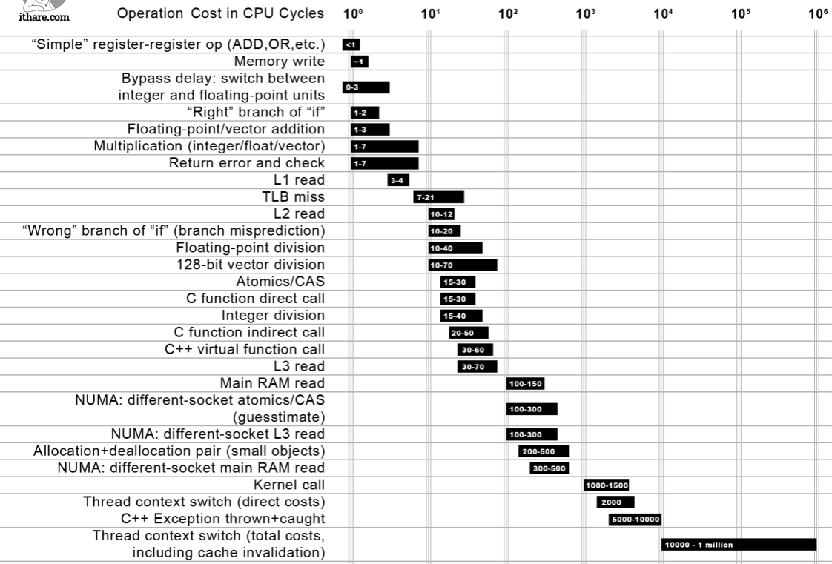
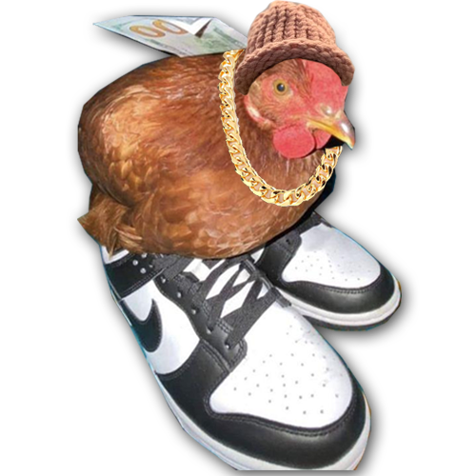
System calls are expensive

Slide 20
Let’s print something onto the screen with a system call

Slide 21
The stack redpill
sp/bp point to the top and bottom of the stack
You can access anything in the stack, not just the top!
When you push a value, it gets put in to the address that the stack top is pointing to & the pointer is incremented.
The stack grows downwards. So as you add more things,
the top of the stack becomes a smaller address.
You can PUSH and POP registers and values onto the stack. But you can also just use the stack like a normal pointer!

Slide 22
NOTE
In the examples the push/pop operations add/remove 1 byte.
Unless you’re on 8/16-bit hardware, the stack typically operates on 4+ bytes.
The return address is also not being shown
[ That is coming later ]

Slide 23
Simple program example
**** PROGRAM ****
_start: ←
PUSH 42
PUSH 3
MOV al, [sp+1]
POP bl
ADD sp, 1
**** STACK ****
RAM
------------------
0x00 : 0
0x01 : 0
0x02 : 0
0x03 : 0 ← sp/bp
REGISTERS
------------------
sp : 0x03
bp : 0x03
al : 0
bl : 0

Slide 24
Simple program example
**** PROGRAM ****
_start:
PUSH 42 ←
PUSH 3
MOV al, [sp+1]
POP bl
ADD sp, 1
**** STACK ****
RAM
------------------
0x00 : 0
0x01 : 0
0x02 : 42 ← sp
0x03 : 0 ← bp
REGISTERS
------------------
sp : 0x02
bp : 0x03
al : 0
bl : 0

Slide 25
Simple program example
**** PROGRAM ****
_start:
PUSH 42
PUSH 3 ←
MOV al, [sp+1]
POP bl
ADD sp, 1
**** STACK ****
RAM
------------------
0x00 : 0
0x01 : 3 ← sp
0x02 : 42
0x03 : 0 ← bp
REGISTERS
------------------
sp : 0x01
bp : 0x03
al : 0
bl : 0

Slide 26
Simple program example
**** PROGRAM ****
_start:
PUSH 42
PUSH 3
MOV al, [sp+1]←
POP bl
ADD sp, 1
**** STACK ****
RAM
------------------
0x00 : 0
0x01 : 3 ← sp
0x02 : 42
0x03 : 0 ← bp
REGISTERS
------------------
sp : 0x01
bp : 0x03
al : 42
bl : 0

Slide 27
Simple program example
**** PROGRAM ****
_start:
PUSH 42
PUSH 3
MOV al, [sp+1]
POP bl ←
ADD sp, 1
**** STACK ****
RAM
------------------
0x00 : 0
0x01 : 3
0x02 : 42 ← sp
0x03 : 0 ← bp
REGISTERS
------------------
sp : 0x02
bp : 0x03
al : 42
bl : 3

Slide 28
Simple program example
**** PROGRAM ****
_start:
PUSH 42
PUSH 3
MOV al, [sp+1]
POP bl
ADD sp, 1 ←
**** STACK ****
RAM
------------------
0x00 : 0
0x01 : 3
0x02 : 42
0x03 : 0 ← sp/bp
REGISTERS
------------------
sp : 0x03
bp : 0x03
al : 42
bl : 3

Slide 29
‘Stack frames’
Refers to a region of the stack “belonging” to a function
On function calls, the bottom ptr is saved to the stack.
The bottom ptr is then set to point to top of the stack.
This effectively makes a new stack on top of the old one.
When the function returns, we pop the old bottom pointers location and now we are back in the original stack frame.

Slide 30
Simple program example
**** PROGRAM ****
my_funct:
PUSH bp
MOV bp, sp
...
POP bp
RET
_start: ←
PUSH 42
CALL my_funct()
...
**** STACK ****
RAM
------------------
0x00 : 0
0x01 : 0
0x02 : 0
0x03 : 0
0x04 : 0
0x05 : 0 ← sp/bp
REGISTERS
------------------
sp : 0x05
bp : 0x05

Slide 31
Simple program example
**** PROGRAM ****
my_funct:
PUSH bp
MOV bp, sp
...
POP bp
RET
_start:
PUSH 42 ←
CALL my_funct()
...
**** STACK ****
RAM
------------------
0x00 : 0
0x01 : 0
0x02 : 0
0x03 : 0
0x04 : 42 ← sp
0x05 : 0 ← bp
REGISTERS
------------------
sp : 0x04
bp : 0x05

Slide 32
Simple program example
**** PROGRAM ****
my_funct:
PUSH bp
MOV bp, sp
...
POP bp
RET
_start:
PUSH 42
CALL my_funct()←
...
**** STACK ****
RAM
------------------
0x00 : 0
0x01 : 0
0x02 : 0
0x03 : 0
0x04 : 42 ← sp
0x05 : 0 ← bp
REGISTERS
------------------
sp : 0x04
bp : 0x05

Slide 33
Simple program example
**** PROGRAM ****
my_funct: ←
PUSH bp
MOV bp, sp
...
POP bp
RET
_start:
PUSH 42
CALL my_funct()
...
**** STACK ****
RAM
------------------
0x00 : 0
0x01 : 0
0x02 : 0
0x03 : 0
0x04 : 42 ← sp
0x05 : 0 ← bp
REGISTERS
------------------
sp : 0x04
bp : 0x05

Slide 34
Simple program example
**** PROGRAM ****
my_funct:
PUSH bp ←
MOV bp, sp
...
POP bp
RET
_start:
PUSH 42
CALL my_funct()
...
**** STACK ****
RAM
------------------
0x00 : 0
0x01 : 0
0x02 : 0
0x03 : 0x05← sp
0x04 : 42
0x05 : 0 ← bp
REGISTERS
------------------
sp : 0x03
bp : 0x05

Slide 35
Simple program example
**** PROGRAM ****
my_funct:
PUSH bp
MOV bp, sp ←
...
POP bp
RET
_start:
PUSH 42
CALL my_funct()
...
**** STACK ****
RAM
------------------
0x00 : 0
0x01 : 0
0x02 : 0
0x03 : 0x05← sp/bp
0x04 : 42
0x05 : 0
REGISTERS
------------------
sp : 0x03
bp : 0x03

Slide 36
Simple program example
**** PROGRAM ****
my_funct:
PUSH bp
MOV bp, sp
... ←
POP bp
RET
_start:
PUSH 42
CALL my_funct()
...
**** STACK ****
RAM
------------------
0x00 : 0
0x01 : 0
0x02 : 0
0x03 : 0x05← sp/bp
0x04 : 42
0x05 : 0
REGISTERS
------------------
sp : 0x03
bp : 0x03

Slide 37
Simple program example
**** PROGRAM ****
my_funct:
PUSH bp
MOV bp, sp
... ←
POP bp
RET
_start:
PUSH 42
CALL my_funct()
...
**** STACK ****
RAM
------------------
0x00 : 0
0x01 : 0
0x02 : 99 ← sp
0x03 : 0x05← bp
0x04 : 42
0x05 : 0
REGISTERS
------------------
sp : 0x02
bp : 0x03

Slide 38
Simple program example
**** PROGRAM ****
my_funct:
PUSH bp
MOV bp, sp
... ←
POP bp
RET
_start:
PUSH 42
CALL my_funct()
...
**** STACK ****
RAM
------------------
0x00 : 0
0x01 : 22 ← sp
0x02 : 99
0x03 : 0x05← bp
0x04 : 42
0x05 : 0
REGISTERS
------------------
sp : 0x01
bp : 0x03

Slide 39
Simple program example
**** PROGRAM ****
my_funct:
PUSH bp
MOV bp, sp
... ←
POP bp
RET
_start:
PUSH 42
CALL my_funct()
...
**** STACK ****
RAM
------------------
0x00 : 0
0x01 : 22
0x02 : 99 ← sp
0x03 : 0x05← bp
0x04 : 42
0x05 : 0
REGISTERS
------------------
sp : 0x02
bp : 0x03

Slide 40
Simple program example
**** PROGRAM ****
my_funct:
PUSH bp
MOV bp, sp
... ←
POP bp
RET
_start:
PUSH 42
CALL my_funct()
...
**** STACK ****
RAM
------------------
0x00 : 0
0x01 : 22
0x02 : 99
0x03 : 0x05← sp/bp
0x04 : 42
0x05 : 0
REGISTERS
------------------
sp : 0x03
bp : 0x03

Slide 41
Simple program example
**** PROGRAM ****
my_funct:
PUSH bp
MOV bp, sp
...
POP bp ←
RET
_start:
PUSH 42
CALL my_funct()
...
**** STACK ****
RAM
------------------
0x00 : 0
0x01 : 22
0x02 : 99
0x03 : 0x05
0x04 : 42 ← sp
0x05 : 0 ← bp
REGISTERS
------------------
sp : 0x04
bp : 0x05

Slide 42
Simple program example
**** PROGRAM ****
my_funct:
PUSH bp
MOV bp, sp
...
POP bp
RET ←
_start:
PUSH 42
CALL my_funct()
...
**** STACK ****
RAM
------------------
0x00 : 0
0x01 : 22
0x02 : 99
0x03 : 0x05
0x04 : 42 ← sp
0x05 : 0 ← bp
REGISTERS
------------------
sp : 0x04
bp : 0x05

Slide 43
Simple program example
**** PROGRAM ****
my_funct:
PUSH bp
MOV bp, sp
...
POP bp
RET
_start:
PUSH 42
CALL my_funct()
... ←
**** STACK ****
RAM
------------------
0x00 : 0
0x01 : 22
0x02 : 99
0x03 : 0x05
0x04 : 42 ← sp
0x05 : 0 ← bp
REGISTERS
------------------
sp : 0x04
bp : 0x05

Slide 44
Let’s look at some disassembled C code
We should now be able to understand quite a lot of what’s going on.

Slide 45

How does the CPU know where to go
Push, then pop a return address
A pointer to the current line of code being executed by the CPU is kept in
the instruction pointer register (IP)
When you call a function:
1. Pushes next line of code to the stack
2. Sets IP as the newly called address
Returning from a function
1. Pops the address back into IP

Slide 46
Interacting with hardware
The majority of devices are mapped somewhere in memory
You can communicate with devices by reading/writing some specific area of memory, usually in RAM.
In addition to RAM, there is I/O memory.
You can think of it like a completely separate mini-RAM.
The way you use it is the same as RAM. But instead of the
‘mov’ instruction, you use ‘in’ and ‘out’ to read/write.
I/O memory is often used to configure the hardware. Like telling the device which RAM address it should map to.

Slide 47
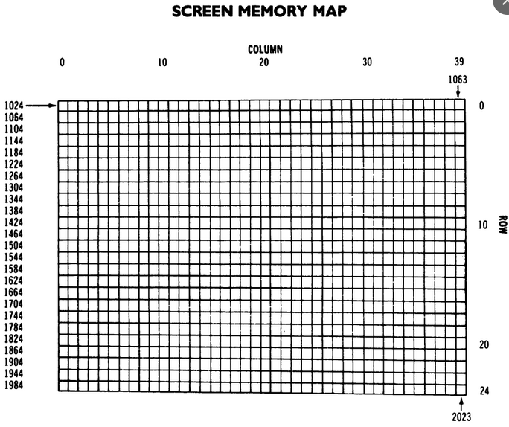
Map of the screen from C64
To put a char on screen, move the value to the corresponding location in RAM.
Example:
MOV edi, 1024
MOV [edi], 13
Would display the character corresponding to the value 13 at the top left of the screen
**Though if you were actually using a C64, you would use BASIC command ‘POKE’.

Slide 48
The slides & practice programs can be found on github github.com/susikohmelo/assembly_basics_presentation

