Slide 1
Agentic AI Autonomous Automation Systems

Slide 2
Paradigm Shift in Artificial Intelligence Architecture
Theoretical Framework and Evolution
Generative AI has really changed the way the architects build AI systems. Instead of sticking with one huge model that tries to do everything, automation architects now use teams of specialized agents that work together to solve tough problems.
Key Contributions:
Large Language Models (LLMs): Think of LLMs as the brains behind the system. They handle language, generate code, and summarize information.
Agentic Augmentation: AI agents push LLMs even further. By connecting with tools and outside systems, agents break out of simple chat-style interactions and get more things done.
Real-World Task Execution: These agents make automation real. They report bugs, create test cases on their own, and convert scripts without human intervention.
Collaborative Intelligence Framework: With this multi-agent setup, automation is not just talk. Intelligent agents share work, coordinate, and make entire workflows more efficient.

Slide 3
Agentic AI Automation Layered Architecture
LLM
MCP
MCP Config
LLM
External
AI Agent = LLM + MCP
MCP Configuration
(JSON file)
MCP Client
Playwright MCP
MySQL MCP
Rest API MCP
File System MCP
Excel MCP
MCP Server
Web Browser
Database
External APIs
File System
Excel Files

Slide 4
Model Context Protocol (MCP) – Architectural Innovation
Theoretical Contribution and Technical Foundation
The Model Context Protocol (MCP) changes how AI talks to other systems, a bit like plugging everything in with an universal USB-C connector. It is a standardized bridge that lets AI models plug into all sorts of platforms without a headache.
Here is how MCP works in practice:
First, you have got the MCP Client. This is what people actually use to give commands in plain English (Prompt Engineering). Think Claude Desktop, smart IDEs like Cursor or VS Code, or specialized AI apps—these all act as MCP Clients.
Then, there is the MCP Server. It sits in the middle, keeping the conversation flowing between the AI Agent and whatever system it needs to work with. The server hands out tools tailored for each domain: if you are automating a browser, you get options like navigate_browser and click_element; if you are talking to a database, you have got execute_sql and fetch_records.
Of course, it needs to hook into real-world systems, too. MCP connects to external tools like MySQL and PostgreSQL databases, browser automation frameworks (Playwright, Selenium), REST APIs, your local files, and spreadsheet apps.
How does it all play out?
It is a step-by-step process. The AI agent starts by breaking down your request, figuring out what you want. Next, it scouts for MCP servers and checks which tools they offer. Finally, it picks the best tools for the job and gets to work. That is basically how MCP keeps everything running smoothly between AI agent and external systems.

Slide 5
AutoGen Framework – Multi-Agent Orchestration
Building Out Collaborative Intelligence with Microsoft AutoGen
The Microsoft’s AutoGen framework lays the groundwork for teams of intelligent agents to actually work together, not just in theory, but in practice. Each agent is not just a generic bot; it can have its own set of skills and a well-defined role.
Let’s break down the key pieces:
AssistantAgent Architecture: This is the basic building block. It is an agent powered by a large language model, set up with API credentials so it can “think” and act within its scope.
How work gets done:
You can run the show with a single agent for simple question-and-answer stuff.
When things get tricky or layered, you split up the project and pass each slice to an agent with the right expertise.
And if there is a call for human judgment, maybe a spot where common sense has to kick in you keep a person in the loop right where it matters.
How the agents work together: They do not just shout over each other. Instead, they take turns, think of it as a group chat, each agent stepping in when it is their turn, following prompts set up for their role. There are clear stopping points too, so they are not just endlessly talking in circles.
Remembering Context: The system tracks what is happened in the conversation, so when work stretches over time, the agents are not just starting from scratch each time.
Defining Roles: Every agent knows what it is responsible for and what not to mess with. They are given exact instructions through system prompts, so each one sticks to their domain and collaborates smoothly.

Slide 6
Multi-Agent Automation Framework – Technical Implementation
Making Agent Teams Work in Practice
This framework brings together a group of specialized agents that work as one team. Together, they handle tough automation jobs, like testing user interfaces, checking databases, verifying APIs, and even generating reports.
Here is how it comes together:
1. Agent Factory: Starter Kit, The Agent Factory builds agents using ready-made templates, so you do not have to start from scratch every time.
AutomationAgent: Handles any sort of browser-based automation.
DatabaseAgent: Takes care of SQL tasks and grabs the data you need.
APIAgent: Checks APIs and runs integration tests.
ExcelAgent: Deals with spreadsheets and exporting data.
Every time you spin up a new agent, you set three things: its role, the decision-making model it will use, and a tailored toolkit that gives it the skills it needs for the job.

Slide 7
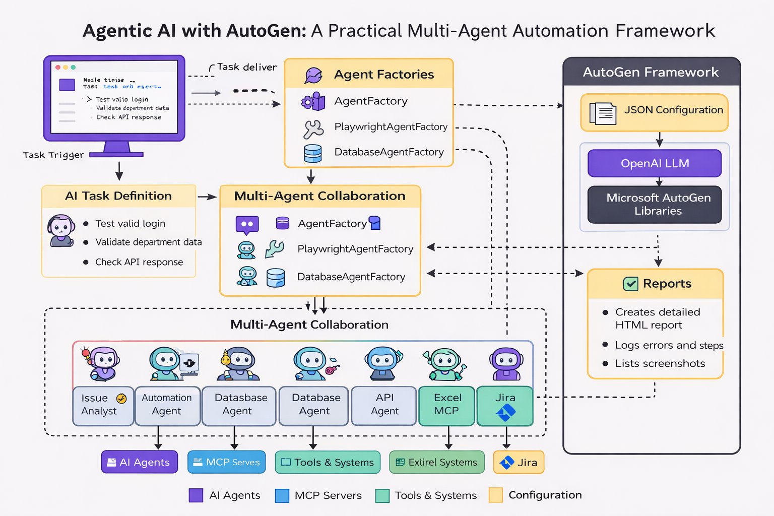

Slide 8
Multi-Agent Automation Framework – Technical Implementation
2. MCP Configuration: Orchestrating Tasks with External Tools.
McpConfig connects agents to the right external tool for the job:
Playwright MCP handles browser automation.
MySQL MCP runs database queries.
REST API MCP manages API calls.
Excel MCP deals with spreadsheets.
3. Scenario Definition: Defining the task, scenarios work like test cases, they lay out what the task involves and what results are expected.
Tech Stack:
Python 3.10+, Microsoft AutoGen, OpenAI API, Model Context Protocol (MCP), Playwright, mysql-connector-Python and mysql_mcp_server.

Slide 9
Advanced Concepts and Trajectory
Sophisticated Agent Coordination Mechanisms
Clear rules for when agents should stop ensure their conversations do not run forever. This keeps computing costs and API token use under control.
On top of that, complex systems use persistent memory to help agents remember what happened in earlier interactions.
With this kind of memory, agents can plan better and work together on tasks that take more than one exchange.
Sometimes, these systems invite humans into the loop at key moments. When people step in to make decisions or just check on things, they balance the agents’ autonomy with common sense and risk management.
Finally, SelectorGroupChat protocols use smart picking methods. They match agents to tasks based on what each agent’s good at and what the situation calls for, so you are always getting the right agent for the job.

Slide 10
KPI Agentic AI Automation Framework
KPI Name | Definition | Formula | Why It Matters | Target Benchmark
Automation Success Rate (%) | Percentage of scenarios that worked well without any issues | (Successful Scenarios / Total Scenarios) × 100 | Measures how well the multi-agent system works overall. | 90%+
Execution Time Reduction (%) | How faster it got done compared to old automation ways | ((Manual Time − Agent Time) / Manual Time) × 100 | It helps tasks and makes sure everything runs smoothly. | 30–40% faster
Task Completion Accuracy (%) | Percentage of tasks done right with results as expected | (Correct Task Outcomes / Total Tasks) × 100 | Ensures the outputs are correct This includes things like: UI actions, DB validation, API responses, reporting are all accurate. | 95%+

Slide 11
Drawbacks of Agentic Automation
The framework heavily depends on LLM accuracy, making behavior non-deterministic and sometimes unreliable.
Multi-agent workflows increase API usage and token consumption, leading to higher operational costs.
Execution can be slower due to multiple steps like reasoning, tool selection, and MCP interactions.
Debugging is complex because decisions are AI-driven and failures can occur across multiple agents.
There are security risks when agents interact with real systems like databases, APIs, and file systems without strict controls.

Slide 12
MNPAgenticAIAutomation/ Framework Tool Core Files & Folders (To be Developed)
├ config/
└── config.properties # Central key-value file for credentials, URLs, and browser settings.
├ Data/
└── files/ # If required, Repository for input test data like Excel sheets, CSVs, or text files.
├ framework/
├ agentfactory/
│ └── agentFactory.py # Factory that instantiates specialized agents (UI, DB, API etc.) with pre-configured tools.
└── mcp_config/
└── mcp_config.py # Manages the connection and lifecycle of MCP workbenches (Playwright, postgres, api etc.).
├ libs/
├ config_reader.py # Logic for parsing property files and mapping them to environment variables.
├ report_manager.py # High-level wrapper that automates scenario execution, error handling, and reporting.
├ reporter.py # Engine responsible for generating HTML reports for both individual tests and the full suite.
└ screenshot_tool.py # Standardizes naming and path generation for browser screenshots.
├ reports/
├ result/ # Final destination for generated individual and suite-level HTML reports.
└- Screenshots/ # Storage for all image evidence captured during UI automation.
├ scenarios/
├ scenario_01_test.py # Contains the actual test scripts ("what" to automate) using the framework.
├ requirements.txt # List of all Python libraries needed to run the framework.
├ run_suite.py # The main execution engine that auto-discovers and runs all scenarios.

Slide 13
Tool Development Work Plan
S. No. | Phases | Work to be done | Start – End date (3-4hrs/day) | Status
1. | Architect the Multi-Agent Core | Define the project structure and select an agentic orchestration library (e.g., Microsoft AutoGen) to manage the lifecycle, message passing, and group chat dynamics between different AI personas. | 07 – 08 April 2026
2. | Implement the MCP Tool Workbench | Build a modular configuration layer to integrate Model Context Protocol (MCP) servers. This allows agents to interact with the real world through standardized tools for browser automation (Playwright), databases (SQL), and enterprise APIs (Jira/REST). | 13-15 April 2026
3. | Develop a Specialized Agent Factory | Create a Factory Pattern to instantiate agents with predefined roles. Each agent should be "born" with a specific system message and a subset of tools relevant to its task (e.g., a DatabaseAgent gets SQL tools, while an AutomationAgent gets browser tools). | 15 – 17 April 2026
4. | Build a Centralized Configuration & Data Layer | Engineer a robust Config Manager to handle environment-specific variables, credentials, and file paths. This ensures the framework can switch between environments (Dev, QA, Prod) by simply updating a .properties or .env file without changing code. | 19-20 April 2026
5. | Create an Automated Reporting & Screenshot Engine | Develop a custom Reporter Library that captures the raw LLM conversation, determines the PASS/FAIL status based on termination tokens, and generates visual HTML reports with embedded screenshots for auditability. | 20-21 April 2026
6. | Engineer a Scenario Discovery & Suite Runner | Build a central Execution Engine (like run_suite.py) that uses dynamic file discovery to find and run test scenarios. It should handle sequential execution, error isolation (one test failing doesn't stop the suite), and aggregate all results into a single dashboard. | 28-29 April 2026

