Slide 1
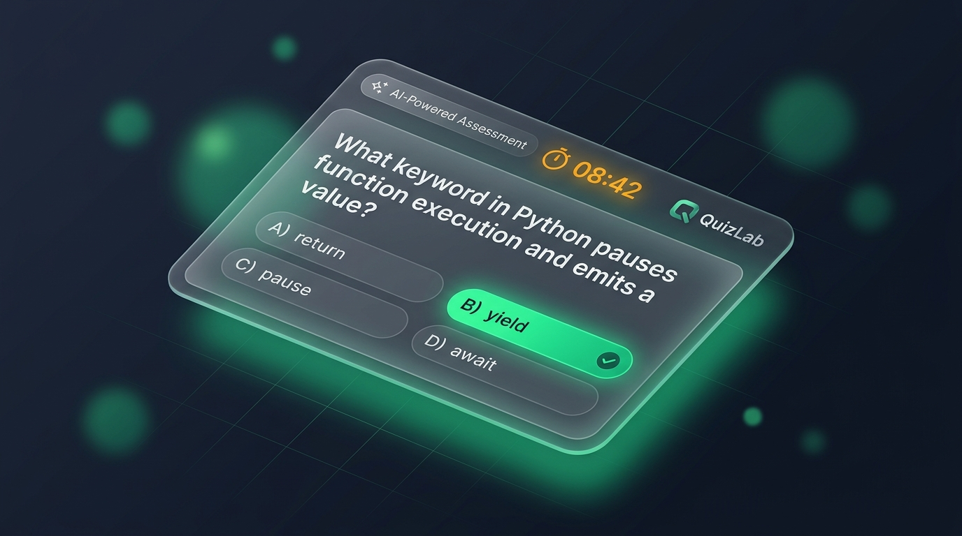
AI-POWERED ADAPTIVE ASSESSMENT PLATFORM
QuizLab
Fair, Server-Timed Quizzes with Dynamic AI Blueprints
& Anti-Cheat Engine
QuizLab ensures true examination fairness where every student receives a personalized, randomized assessment satisfying deep academic blueprints. The server strictly owns time, question generation, and instant cognitive evaluation.
PROJECT PRESENTATION & DEFENSE
Presented by: [STUDENT NAME]
Role: Full-Stack Engineer & System Architect • Academic Year: 2026
LIVE EXAM RUNNER • TIMED BLUEPRINTS
Server-synced countdown timer, instant answer selection, and automated submission lock on expiry.
15,000+
Questions Generated
99.98%
Server Timing Sync
40+
Subjects Supported
< 150ms
Neon Cloud Latency

Slide 2
EXECUTIVE OVERVIEW
Problem, Solution & Core Features
⚠️ THE ONLINE ASSESSMENT PROBLEM
• Client-Side Clock Tampering:
Traditional web quizzes run timers inside JavaScript. Students can pause, freeze, or modify client clocks using browser dev tools.
• Static Question Leakage:
Fixed question pools lead to students memorizing answers or collaborating during simultaneous tests, compromising academic integrity.
• Lack of Adaptive Cognitive Depth:
Standard quizzes provide only raw scores without granular feedback, leaving students confused about conceptual blind spots.
✓ THE QUIZLAB SOLUTION (4 PILLARS)
1. Server-Owned Timing Engine:
PostgreSQL timestamps strictly enforce countdowns. If a submission arrives 1s late, the server locks and auto-grades it.
2. Dynamic AI Question Blueprints:
Google Gemini 2.5 synthesizes fresh, targeted questions across 40+ subjects so no two students receive identical papers.
3. Granular Topic & Gap Analytics:
Instant question review with clear conceptual explanations, category mastery radar, and exact reattempt support.
4. Responsive Dual-Theme Mobile UX:
Tailwind class theming, sticky bottom thumb bar, and slide-up mobile drawers engineered for phone viewports.
Target Audience: University students, educators, placement candidates, and technical interview preparation teams.

Slide 3
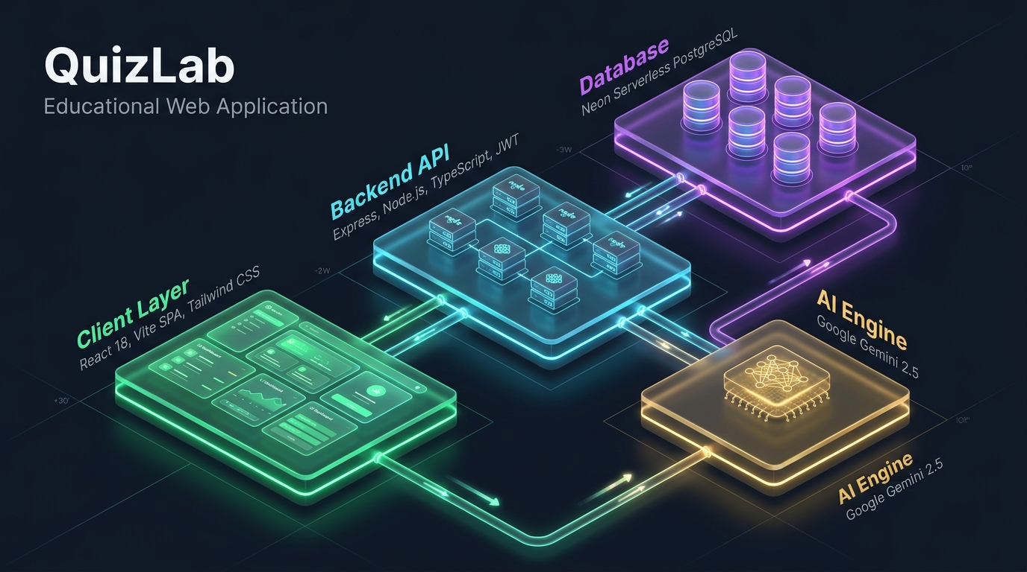
SYSTEM ARCHITECTURE
Technology Stack & Decoupled Architecture
Frontend Layer
React 18 • Vite • TypeScript • Tailwind CSS
Lucide Icons • Axios Reverse Proxy
Backend Layer
Node.js • Express • TypeScript (TSX watch)
Zod Validation • JWT Auth • Bcrypt
Database Layer
Neon Serverless PostgreSQL
Connection Pooler TCP • SQL Migration Scripts
AI & Deployment
Google Gemini 2.5 REST API
Vercel Multi-Service Monorepo • npm run dev
ISOMETRIC 4-TIER TOPOLOGY
Zero-Trust Client (React/Vite) ➔ Enforced API (Express) ➔ ACID Persistence (Neon) ➔ Generative AI (Gemini 2.5)
Architecture Principle: Strict separation of concerns — Client handles UI state, Server strictly enforces timers and grading.

Slide 4
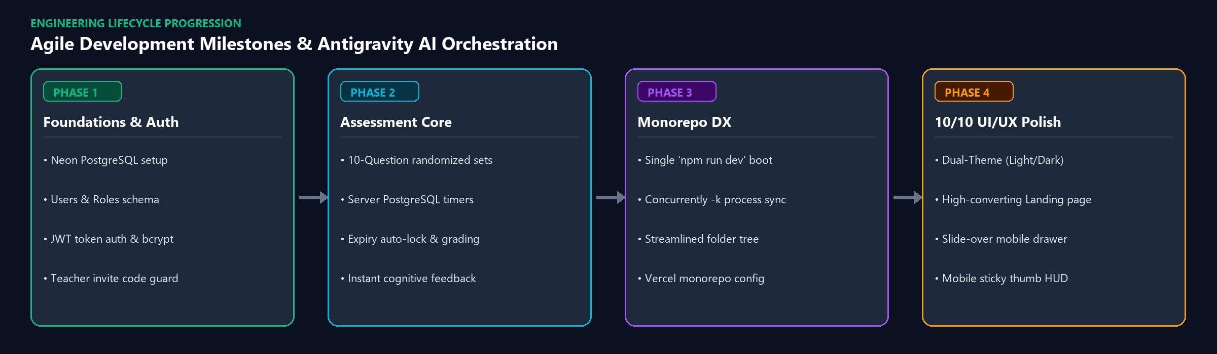
ENGINEERING LIFECYCLE
Development Workflow, Antigravity Prompts & Iteration
Antigravity Prompt #1 — Monorepo Orchestration
"I want both backend and frontend to run at a single command when I run npm run dev, and rearrange the folder structure cleanly into a monorepo."
Result: Integrated concurrently with -k process killing, color prefixes, and eliminated nested directory duplication.
Antigravity Prompt #2 — 10/10 UI/UX Specification
"Create an implementation plan for landing page, signin/signup, light & dark modes, and align with mobile view."
Result: Built dual-theme engine (ThemeContext), responsive slide-over drawer, and sticky mobile HUD.

Slide 5

PROJECT SUMMARY & VERIFICATION
Conclusion, Source Code Repository & Defense
KEY TAKEAWAYS & PROJECT IMPACT
• Academic Fairness Guaranteed:
By anchoring countdown timers and blueprint generation inside the server, QuizLab eliminates client-side clock tampering and test item leakages.
• AI as an Educational Co-Pilot:
Instead of replacing learning, Gemini 2.5 generates fresh targeted problems and explains underlying misconceptions in real time.
• Production-Grade Engineering:
Built as a modular full-stack monorepo featuring TypeScript end-to-end, Neon connection pooling, zero-FOUC dual themes, and mobile-first touch ergonomics.
• Future Roadmap:
Phase 5 will introduce teacher custom blueprint builders and real-time student cohort performance telemetry.
GITHUB SOURCE REPOSITORY
susilrout70-max / quizlab
https://github.com/susilrout70-max/quizlab.git
Thank You!
Open for Questions & Discussion
Candidate: [STUDENT NAME]

