Slide 1
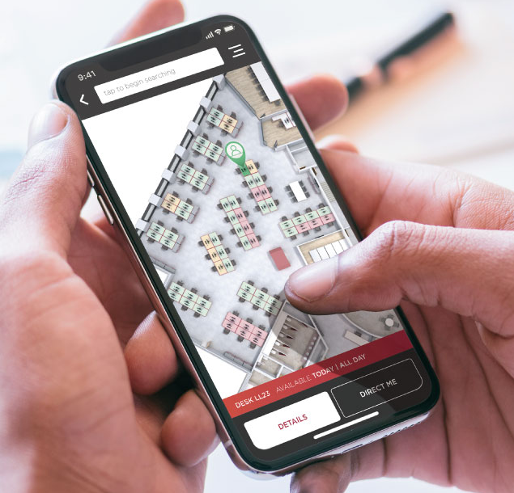

SMART DESK RESERVATION
Team SHESQUAD
Organization: Credit Suisse
Women In Technology Hackathon
June 2020

Slide 2
Team Members:
Apoorva Ambesange
Ananya Yashasvi
Bhamini Subhash
Megha M
Susithra Chandrabose

Slide 3
Problem Statement:
Create an application to assist employees to pre-book their desks and confirm their arrival to the office which will help in maintaining limited employee count at any given point of time and social distancing during this COVID situation.

Slide 4
Real Time Problem:
We are moving towards a new COVID world where we will have to start working from office, stepping outside of our home, but still maintaining all social distancing steps. One of the problems which we came across was “how are we going to limit the number of people coming to office in the most efficient way”.
Most of the companies have either fixed seating arrangements or smart working environment, in either of the case the problem we will face when we are trying to bring people to office on count/rotation basis will be how to restrict the number of people coming, how will these desks be assigned so that social distancing is maintained because every day different sets of people would be coming.
We have thus come up with the idea of a “SMART DESK Reservation”, a web based application, which will help the employees to pre-book their desks and confirm their arrival to the office, which will in return help the office administration in maintaining limited employee count at any given point of time and social distancing during this COVID situation.

Slide 5
Key Benefits:
With this, employees can get to know how many employees are going to office at the tip of their fingers. We can Pre-book our desks before reaching office We will be able to View entire floor plan and its desk occupancy/availability, on a click of a button.
People would be able to view individual’s reservation details that is who has booked which seat as of that moment
Features:
Allows booking of a single desk by an employee 1 day prior/before 8am for current day
Cancellation of the reservation latest by 8am of the day of booking
View entire floor plan and its desk occupancy/availability
View individual’s reservation details
Number of desks available for booking is controlled; Based on phases of the COVID plan, desk availability can be increased ex: 20% in phase 1, 40% in phase 2 etc.

Slide 6
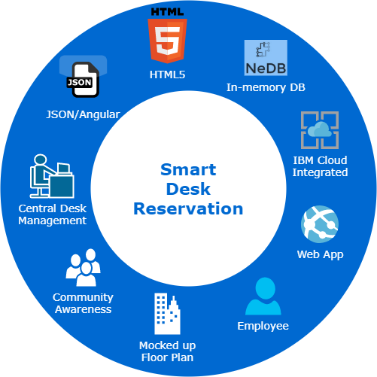
App at a quick glance:
HTML5 is used to design the UI
NeDB, a in-memory DB is used to store the data
App is written in Angular/JavaScript
App is hosted on IBM Cloud
Currently, Admin UI to manage Desks is not part of this submission (due to lack of time)
Desk availability will be controlled by Admins only
App is created as a web application
Every employee will be aware of how many people are working from office on a particular day (not just admin/leads)
Target audience is employees
Floor plan is mocked up

Slide 7
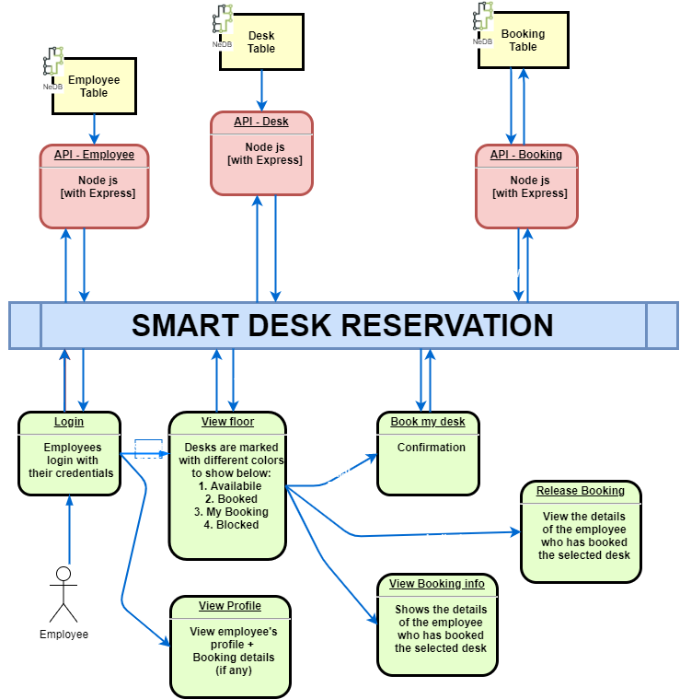
Detailed Design:
Currently, Admin UI to manage Desks is not part of this submission (due to lack of time)

Slide 8
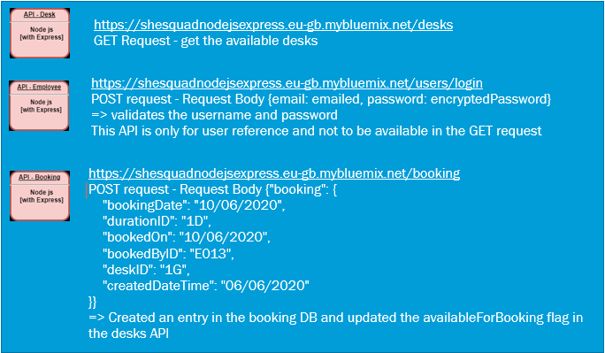
REST API Details:

Slide 9
App Demo
Link to Demo Video: https://photos.app.goo.gl/JPK1WmSpfFyUMrUz5
Use below user credentials for login to the app:
UserEmail | Password
anand.biradar@credit-suisse.com | Credit129
anil.gangele@credit-suisse.com | Credit134
susithra.chandrabose@credit-suisse.com | Credit131
apoorva.ambesange@credit-suisse.com | Credit125
aman.agarwal@credit-suisse.com | Credit123

Slide 10
Benefits:
“Lightweight JavaScript Database” (in memory), are currently used for storing desk reservation data and interactions to these DB are via API. Hence, this gives us the flexibility for migrating these DB files to bigger DB in the actual solution with minimal to no code changes in the app.
Employee profile & Desk information are accessed via Rest API, which gives the flexibility to re-route these to the actual data source when we need to integrate to the actual solution (with minimal impact to the app).

Slide 11
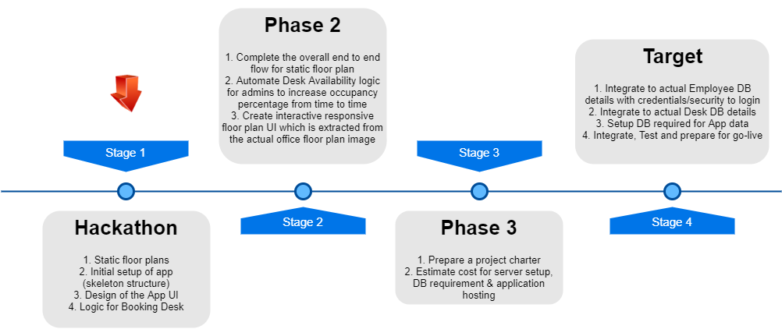
Product Roadmap:

Slide 12
Links to source code repository:
Git Repository of Node.js project: https://us-south.git.cloud.ibm.com/susithra.chandrabose/SheSquadNodejsExpress
Angular UI project: https://github.com/susithrac/shesquad
IBM Cloud Services or IBM Systems
https://cloud.ibm.com/cloudfoundry/overview IBM Cloud Foundry service was used to build, deploy and run our application with Continuous Integration.

Slide 13
!! Future Enhancements !!
Next Steps for Enhancements:
AUTOMATE DESK AVAILABILITY:
Controlling of Desk i.e., blocking or releasing a specific desk for booking by Admins is currently manual. Admins should be able to provide a percentage of desks which they would want to release for booking ex: 20%, 40%, etc. Based on this input, system should block or release specific desks.
IMPROVISE FLOOR PLAN DESIGN:
Floor plan is currently static. Hence, 2 approaches are to be explored as next step for enhancing the app which can then be directly rolled out for usage.

Slide 14
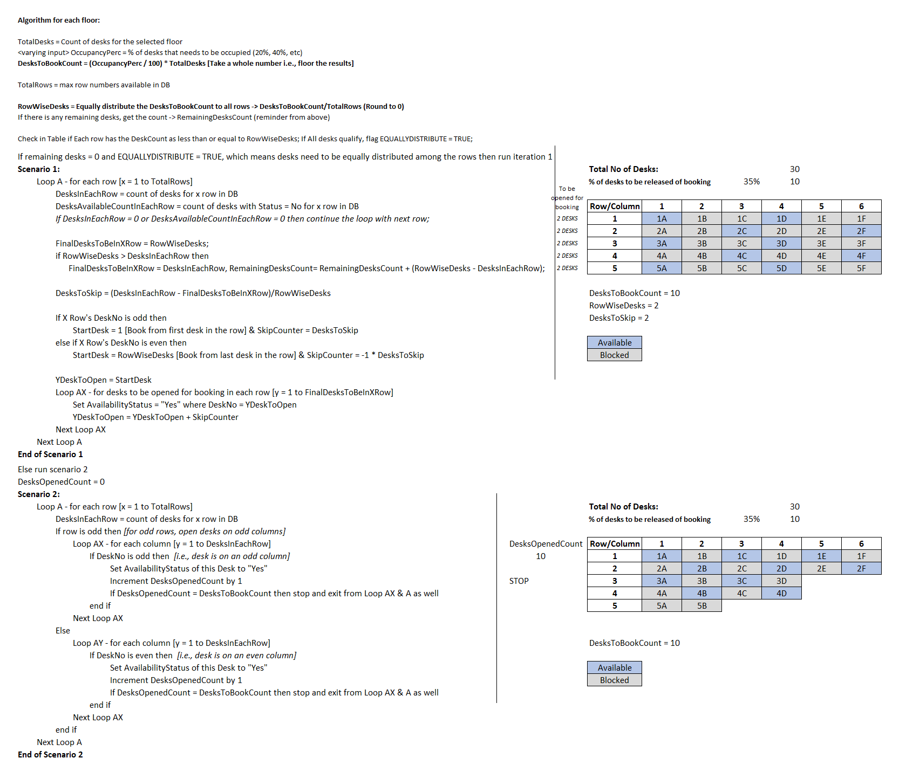
!! Future Enhancements !!
Automate Desk Availability :
Design a logic to identify desks which can be opened up for booking.

Slide 15
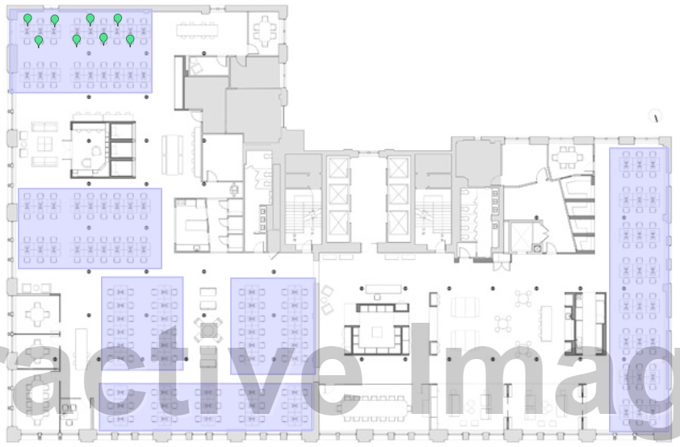
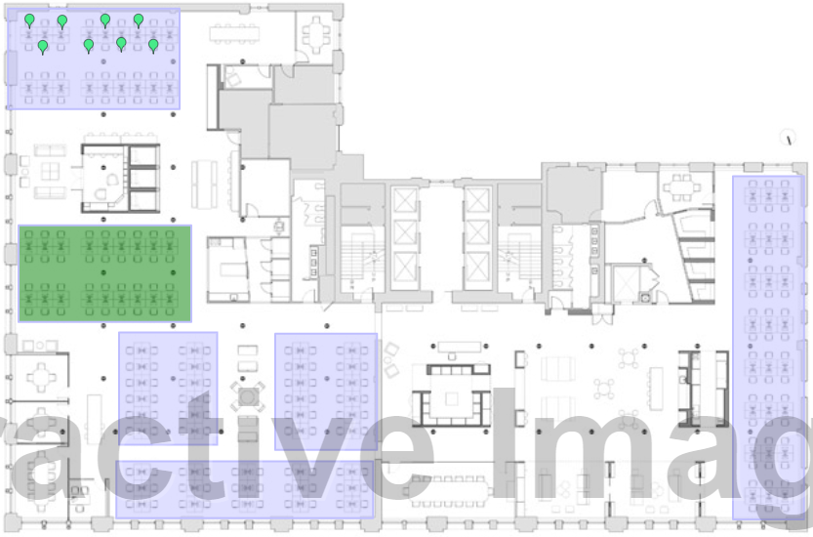
!! Future Enhancements !!
Improvising Floor Plan Design
Approach 1 :
Use the actual floor plan layout instead of mock up
Edit the image to convert it into an interactive responsive HTML page
Associate identifiers/markers for desks (as purpose of booking is desk) & add event handlers. Tag these markers to the actual desk IDs.
Zones to be created and highlighted upon selection. This is for ease of locating individual’s department.
Sample UI with this approach:

Slide 16
!! Future Enhancements !!
Improvising Floor Plan Design
Approach 2 :
Use the actual floor plan layout instead of mock up
Convert the floor plan to interactive UI by automatically scanning the image and identifying the objects (desks)
Google Drive’s OCR feature to be further explored in detail to achieve this; any other tools also to be explored
Objects are then to be tagged to the actual desk IDs

Slide 17
Thank You !!!

