Slide 1
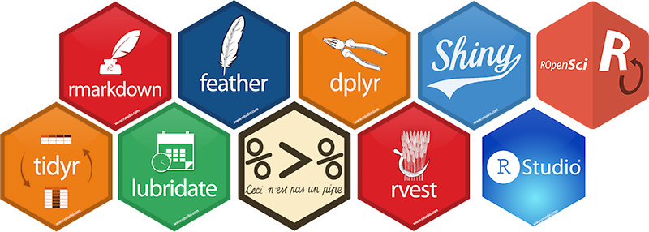
Using R as a Research Tool.
NERC E4 DTP Training – 27st February 2024
Dr Susan Johnston, Institute of Evolutionary Biology

Slide 2
Life of a research project.
Research Question
Create & Structure an R Project
Embed code, figures and results in R Markdown
Statistical tests on research data
Data
Visualisation
Analysis
Writing
Loading & managing data
with dplyr
Data visualisation with ggplot2
Let’s talk about the process (git & journals)
Publish

Slide 3


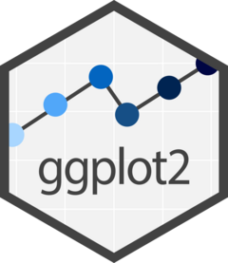

Today’s session:
Fast dynamic report generation.
Version control system.
Continue data processing and visualization.

Slide 4
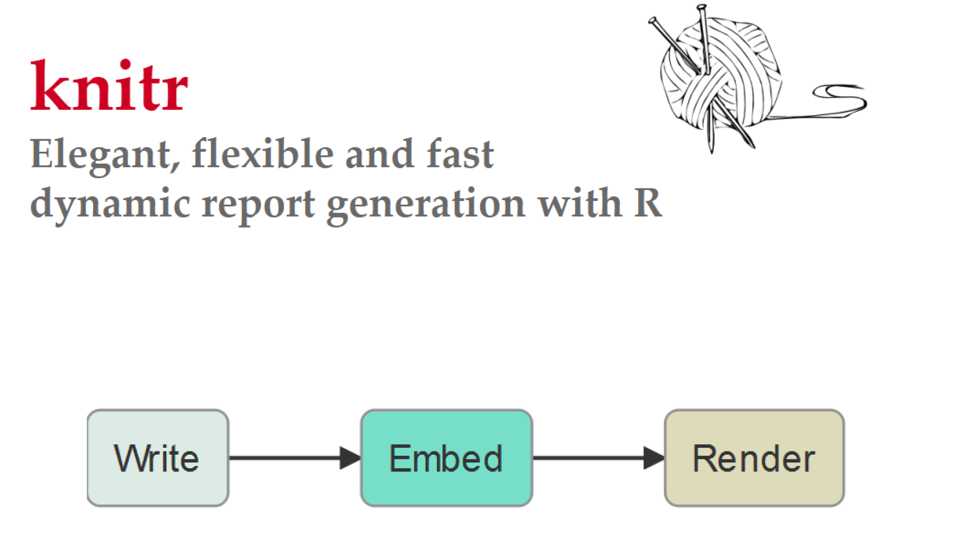
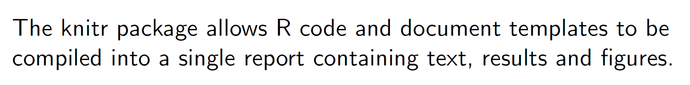

Slide 5
Markdown Language
Lightweight mark-up language
Basic text formatting, adding images, creating lists, etc.
Can embed code and results, making it useful for reproducible research.
Looks very much like regular text with a few extra characters (#, *, etc)
Notes:
formatting words as bold or italic, adding images, and creating lists are just a few of the things we can do with Markdown. Mostly, Markdown is just regular text with a few non-alphabetic characters thrown in, like # or *.

Slide 6
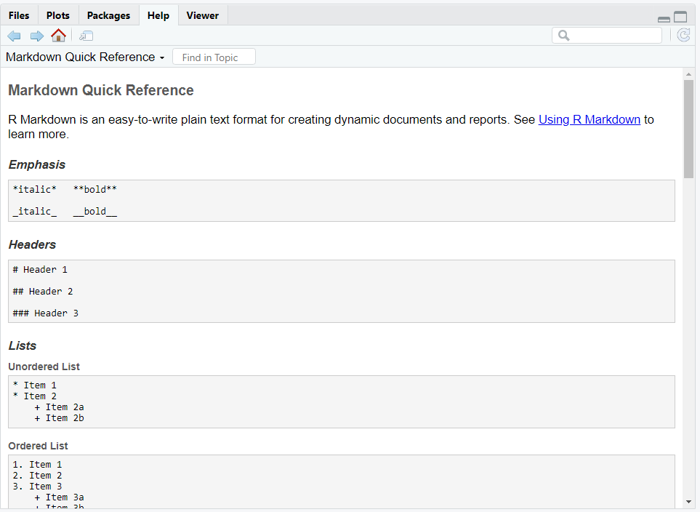

Slide 7
Worked example…

Slide 8
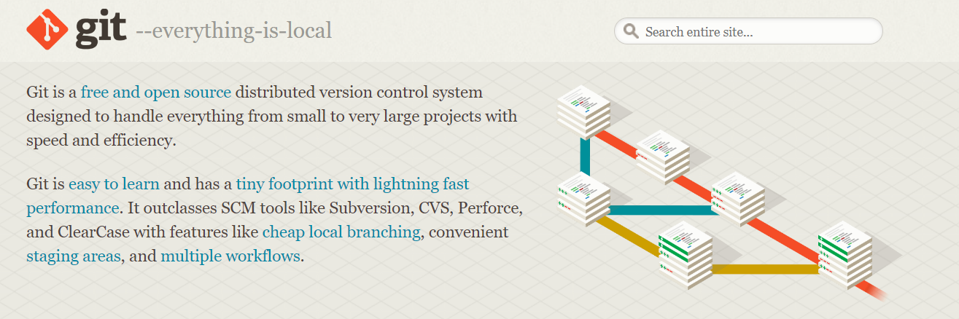
What is ?

Slide 9
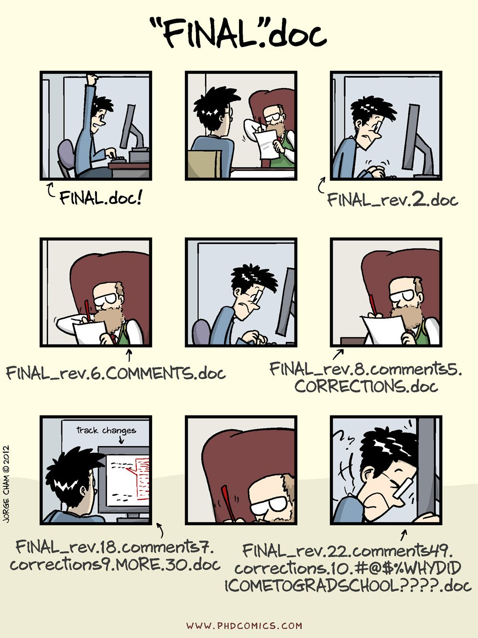
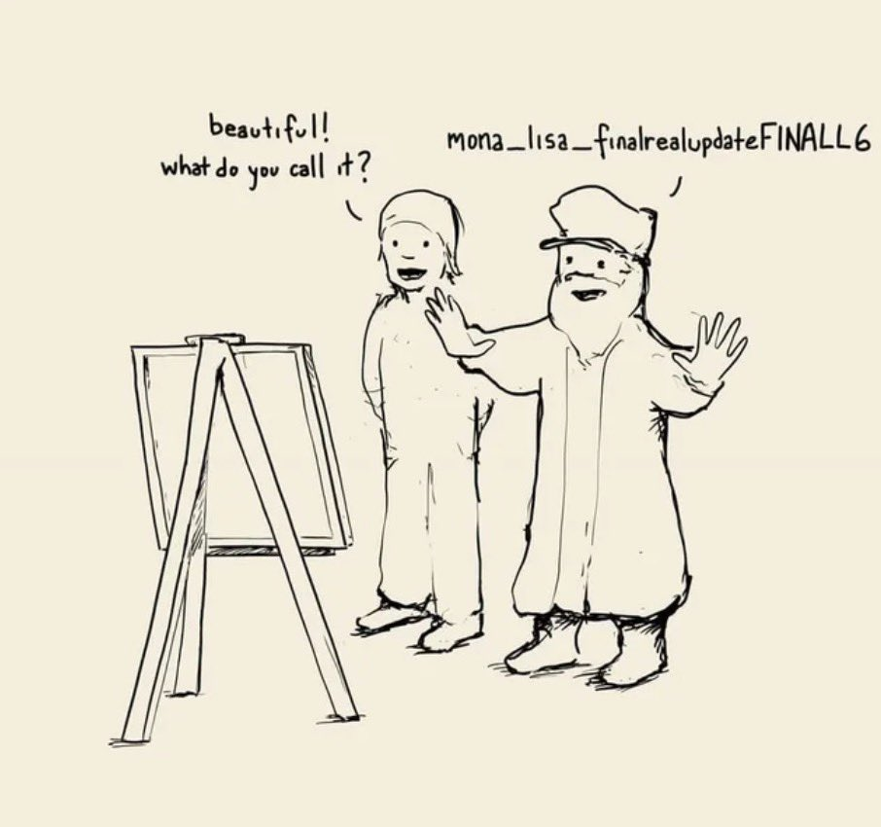
Version control: keep track of file updates (and revert if needed).

Slide 10
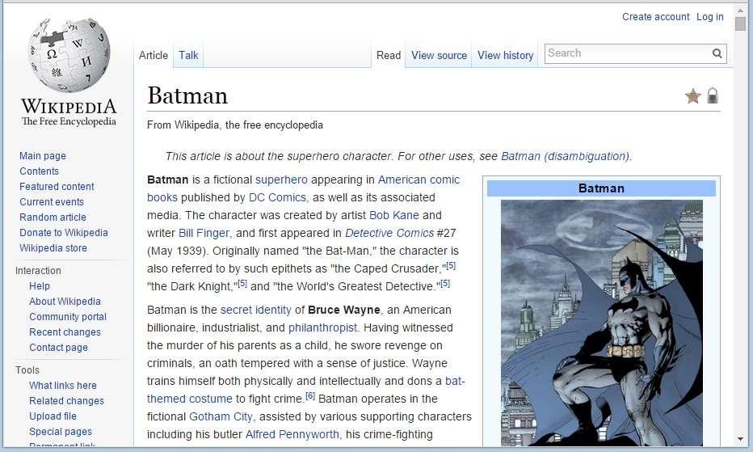
Version control: revert a file to a previous version.

Slide 11
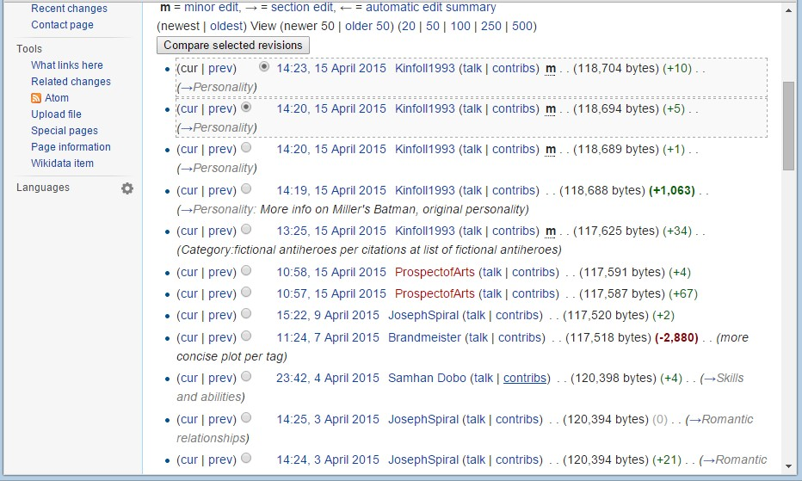
Version control: revert a file to a previous version.

Slide 12
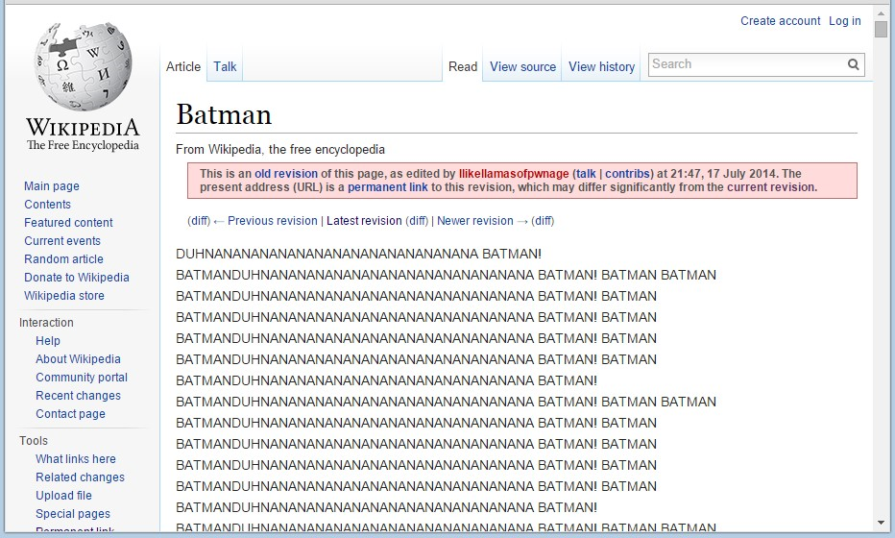
Version control: revert a file to a previous version.

Slide 13
Version control: revert a file to a previous version.

Slide 14
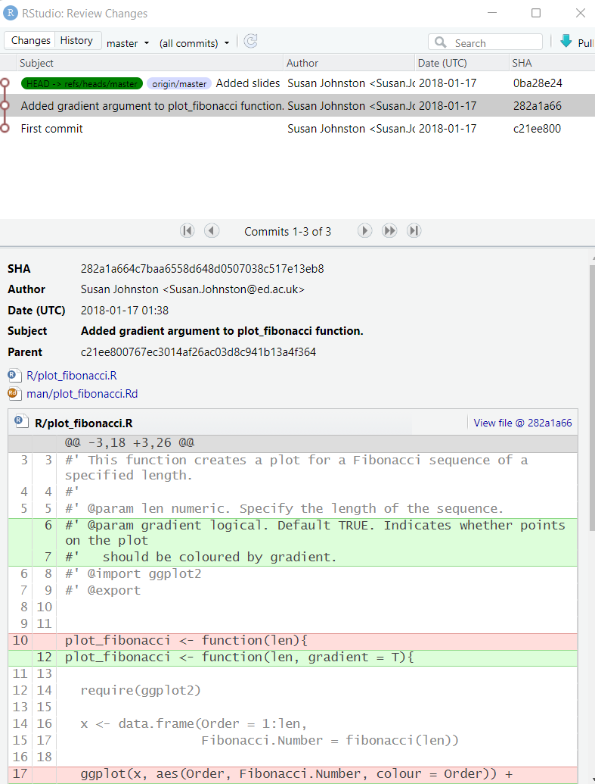
Version control: keep track of file updates (and revert if needed).

