Slide 1
Imputation info
SEJ, July 2022

Slide 2

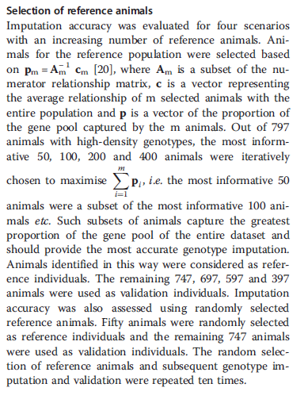
https://gsejournal.biomedcentral.com/articles/10.1186/1297-9686-45-3

Slide 3
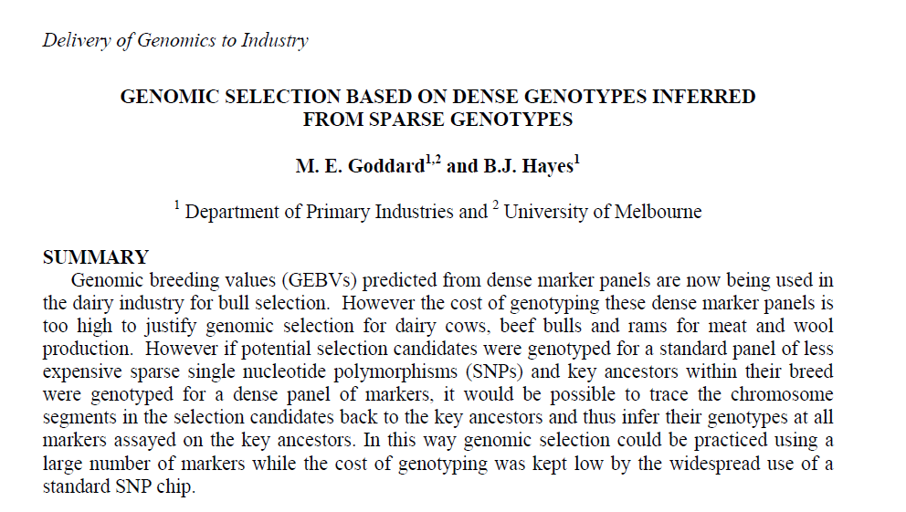
This is the paper [20] that they cite:
https://citeseerx.ist.psu.edu/viewdoc/download?doi=10.1.1.599.3858&rep=rep1&type=pdf

