Slide 1
IBM University Engagement Project Submission
“Exploring the Power of Machine Learning with IBM Cloud”

Slide 2

Project Title – [Smart Predictive System for Industrial Machinery Using Machine Learning
Domain of Project – [Industrial AI / Manufacturing]
Student Name | Recent Passport Photo | Email ID | Mobile number [WhatsApp]
Susmija Punnam |  | punnamsusmija@gmail.com | 7674905200

Slide 3
Problem Statement
Problem Statement:Smart Predictive System for Industrial Machinery Using Machine Learning
Industrial machinery plays a vital role in manufacturing and production, where unexpected equipment failures can result in costly downtime, production delays, increased maintenance expenses, and reduced operational efficiency. Traditional maintenance methods, such as reactive maintenance (repairing machines after failure) and preventive maintenance (servicing machines at fixed intervals), often fail to accurately predict when a machine is likely to break down. As industries become increasingly data-driven, there is a growing need for an intelligent system that can continuously analyze machine operating conditions and detect potential failures before they occur. This project aims to develop a Smart Predictive System for Industrial Machinery Using Machine Learning that analyzes sensor data, including air temperature, process temperature, rotational speed, torque, and tool wear, to predict machine failures.

Slide 4
Proposed Solution -
The proposed solution is a Smart Predictive System for Industrial Machinery developed using IBM watsonx.ai Studio, AutoAI, and IBM watsonx.ai Runtime. The system analyzes machine sensor data, including air temperature, process temperature, rotational speed, torque, and tool wear, to predict potential equipment failures. IBM AutoAI automates data preprocessing, feature engineering, algorithm selection, model training, and hyperparameter optimization to identify the most accurate machine learning model. The trained model is then deployed on IBM Cloud, enabling real-time predictions and supporting predictive maintenance. This solution helps industries detect failures in advance, reduce unexpected downtime, lower maintenance costs, improve equipment reliability, and enhance overall operational efficiency.
IBM AutoAI automates data preprocessing, feature engineering, algorithm selection, model training, and hyperparameter optimization to identify the best-performing machine learning model. The trained model is deployed on IBM Cloud to provide real-time predictions, enabling predictive maintenance, reducing downtime, lowering maintenance costs, and improving equipment reliability and operational efficiency.

Slide 5
Technology Used
IBM Cloud
IBM Cloud provides a secure and scalable platform to develop, train, deploy, and manage machine learning models. It enables seamless integration with IBM watsonx.ai Studio for building predictive maintenance solutions, deploying trained models, and real-time predictions for industrial machinery.
IBM watsonx.ai Studio
IBM watsonx.ai Studio is used to build the predictive maintenance model using AutoAI. It automates data preprocessing, feature engineering, algorithm selection, model training, and hyperparameter optimization to identify the best-performing machine learning pipeline.
ML Algorithm / Model Used
Batched Tree Ensemble Classifier (Snap Random Forest Classifier)
Accuracy Obtained
99.9% (0.999 Cross Validation Accuracy)
Enhancements and Hyperparameter Tuning
Automated Feature Engineering (FE)
Hyperparameter Optimization (HPO-1)
Hyperparameter Optimization (HPO-2)
Batch Optimization
Automatic Data Preprocessing
Model Selection using IBM AutoAI

Slide 6
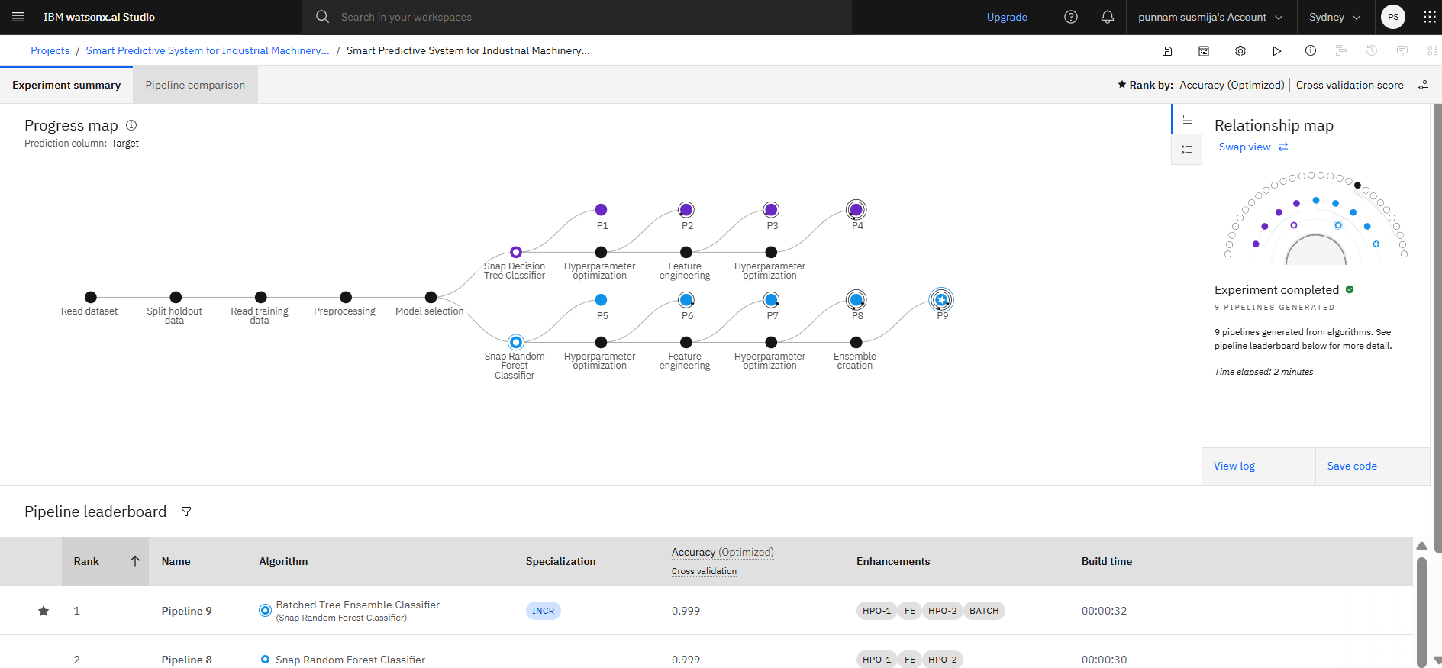
Training Screenshots-

Slide 7
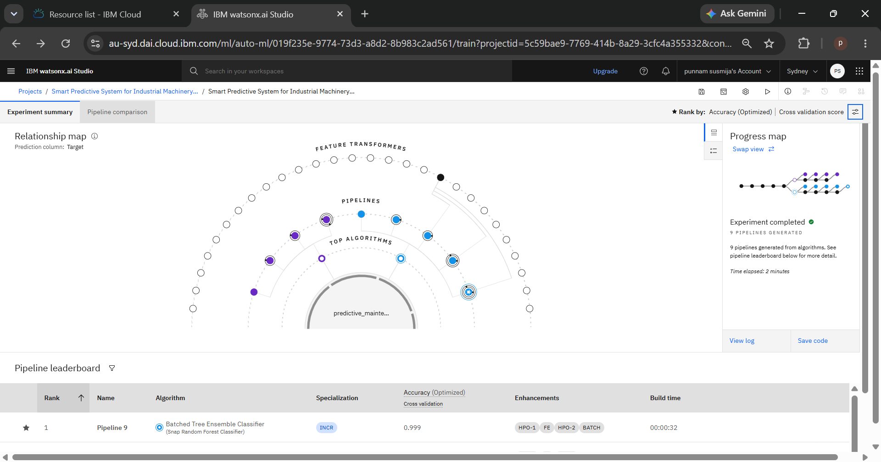
Best Model Screenshot:

Slide 8
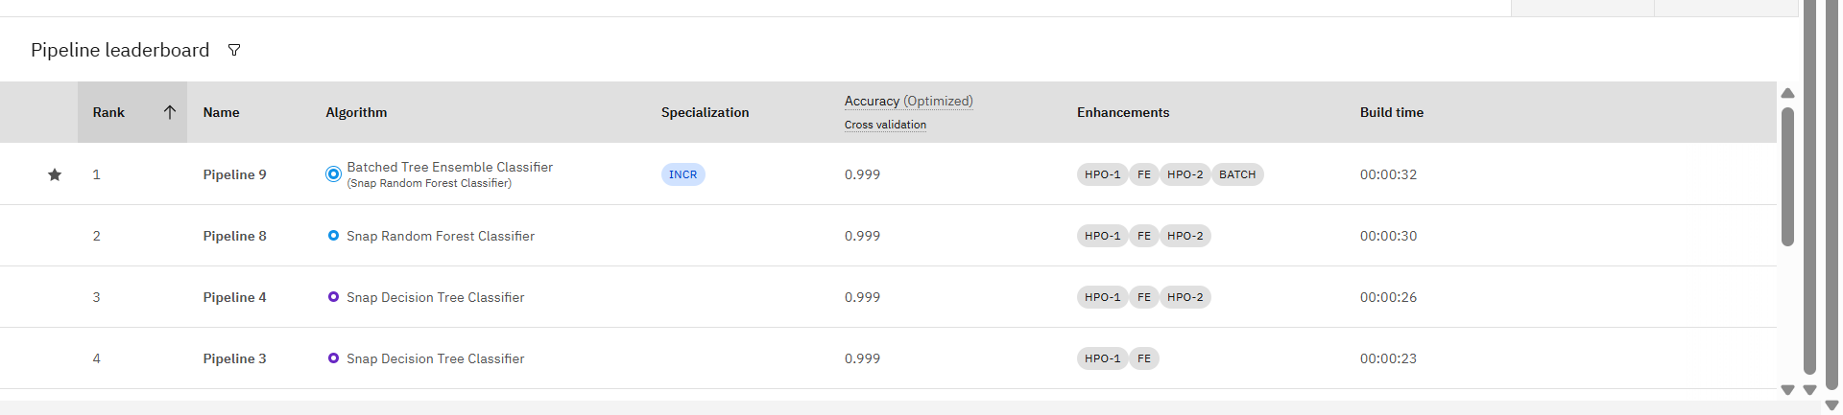
Best Model Screenshot:

Slide 9
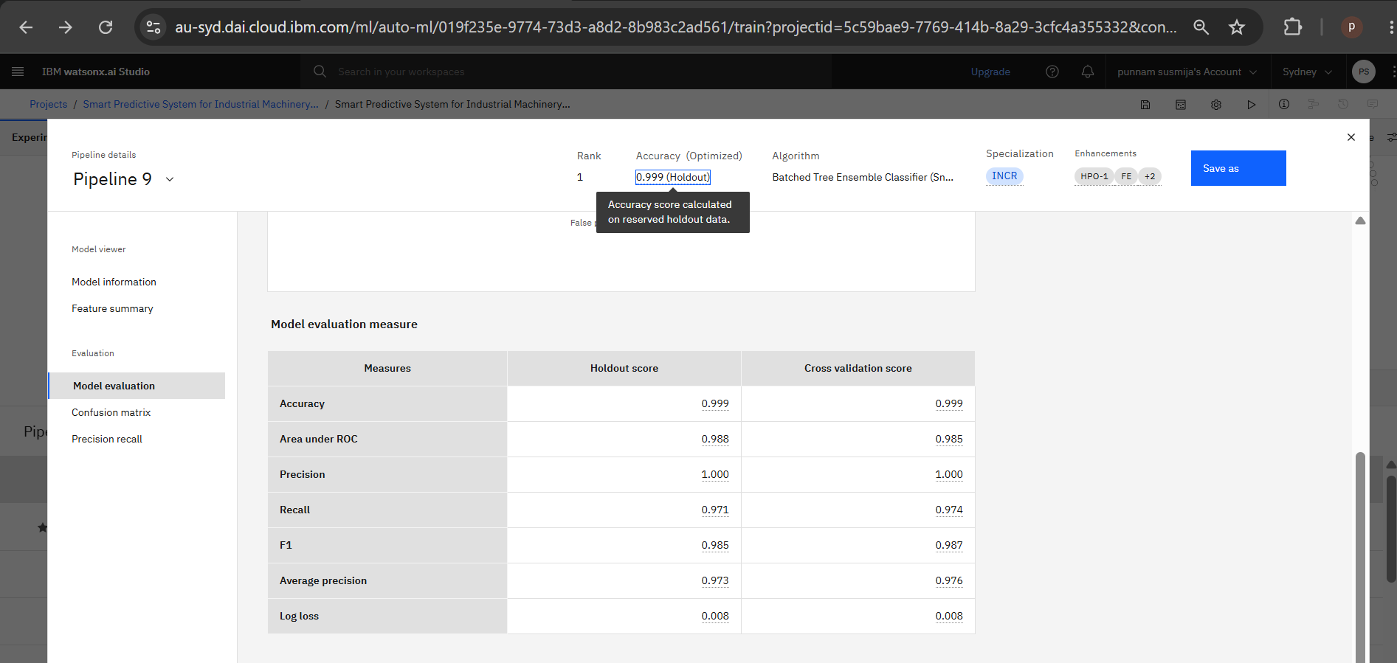
Model Evaluation Result -

Slide 10
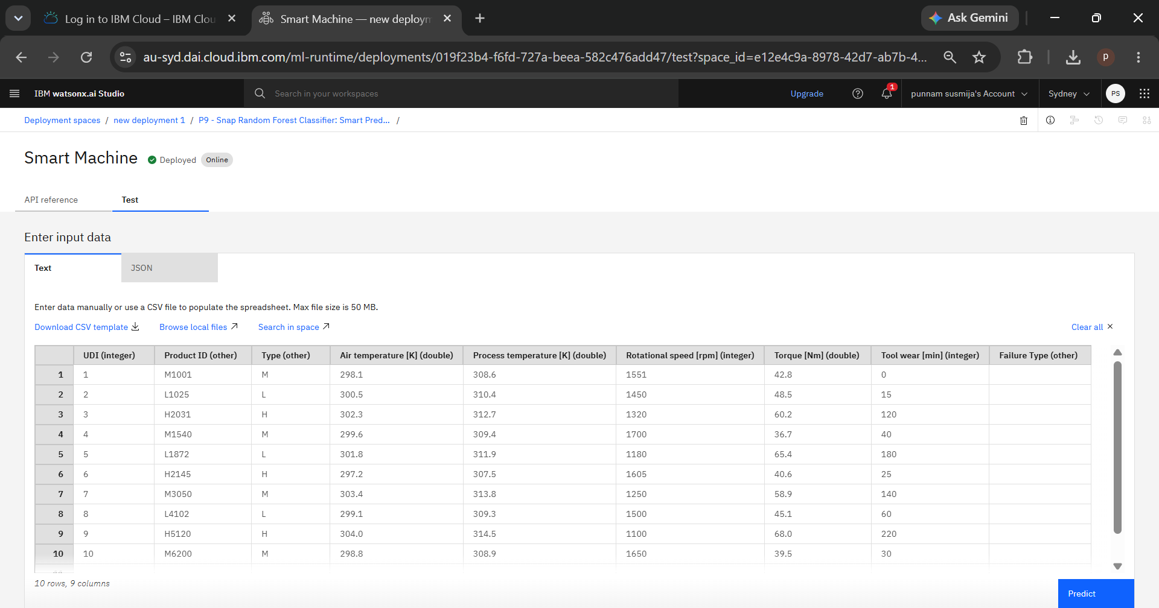
Testing Screenshot:

Slide 11
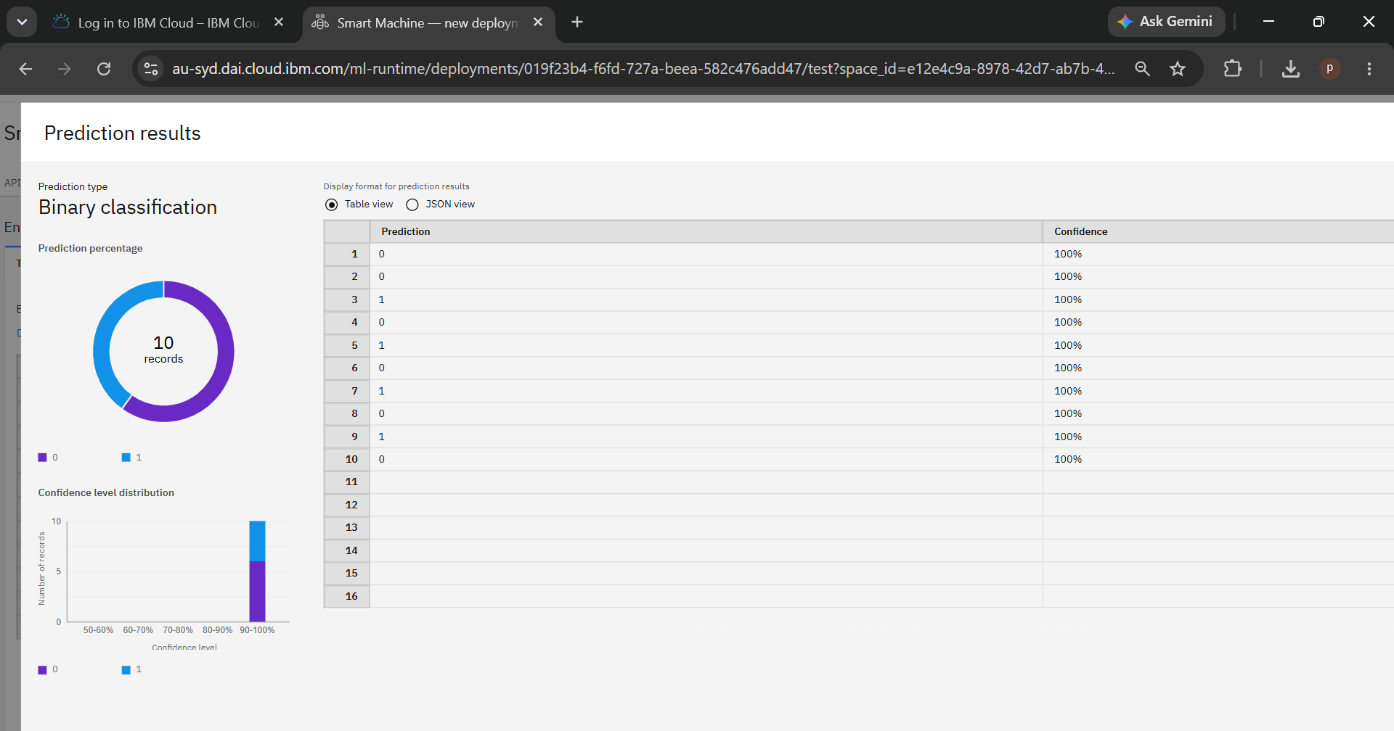
Testing Screenshot:

Slide 12
Novelty and Uniqueness
The proposed system predicts potential machine failures before they occur, enabling predictive maintenance, minimizing unexpected equipment downtime, reducing maintenance costs, and improving overall operational efficiency in industrial environments.
It leverages IBM watsonx.ai AutoAI to automatically identify, train, optimize, and select the best-performing machine learning model through automated feature engineering and hyperparameter tuning, eliminating the need for extensive manual model development.
The system analyzes multiple machine operating parameters, including air temperature, process temperature, rotational speed, torque, and tool wear, to accurately detect patterns associated with equipment failures.
By utilizing machine learning, the solution provides early warning alerts, allowing maintenance teams to take proactive actions before critical failures occur, thereby increasing machine reliability and productivity.
The solution is scalable and can be integrated with Industry 4.0 technologies, enabling future support for real-time IoT-based monitoring, cloud deployment, and intelligent predictive maintenance across multiple industrial machines.

Slide 13
Git Hub Link
Please create public github repository (Enable Add README button while creating repository) with format –
Please test and Paste the working Github URL –
Make sure you have Uploaded following three files into your github repository 1) Data.csv file, 2) yourproblemstatement.pdf file 3) your project presntation.pptx file 4) Python Notebook downloaded from IBM Cloud
·
·
·

Slide 14
Future Scope
Real-Time Machine Monitoring: Integrate IoT sensors to collect live machine data for continuous health monitoring and failure prediction.
Cloud-Based Deployment: Deploy the predictive maintenance system on IBM Cloud for remote monitoring and centralized management.
Deep Learning Models: Enhance prediction accuracy by implementing advanced deep learning algorithms such as LSTM and CNN for time-series sensor data.
Maintenance Scheduling: Develop an automated maintenance scheduling system that generates alerts and work orders before equipment failure.
Mobile & Web Dashboard: Create user-friendly web and mobile applications for maintenance engineers to monitor equipment health anytime.
Industry 4.0 Integration: Connect the system with existing ERP, MES, and SCADA systems for smart factory automation and intelligent maintenance planning.

Slide 15
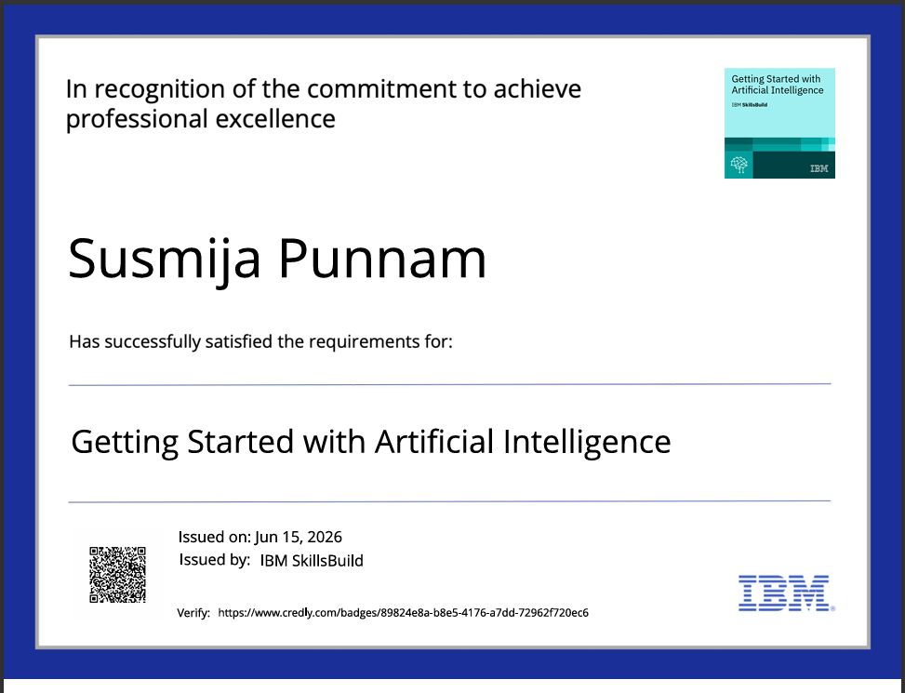
Certificates Earned:
Getting Started with Artificial Intelligence credly certificate

Slide 16
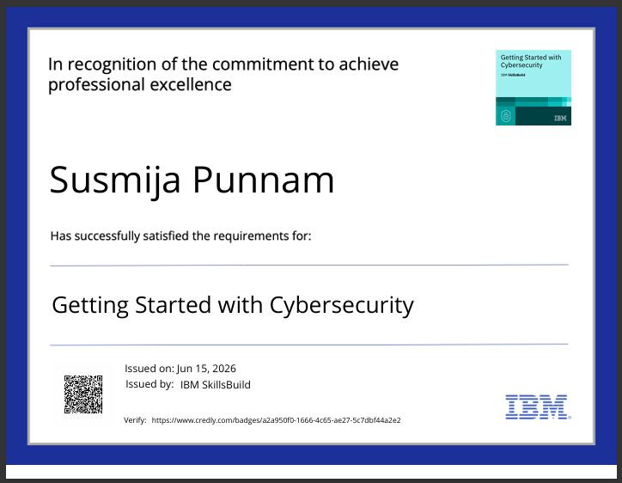
Certificates Earned:
Getting Started with Artificial Intelligence credly certificate

Slide 17
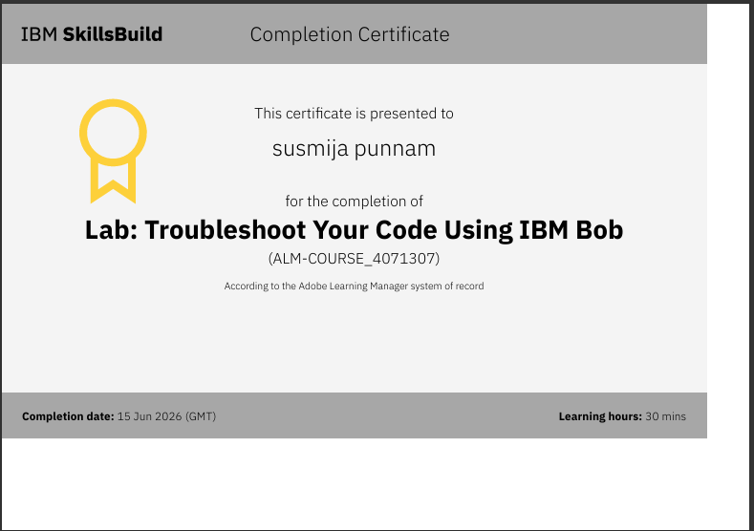
Certificates Earned:​
IBM BOB Certificate

Slide 18
Thank You!!!

