Slide 1
Markowitz Portfolio Optimization
Group 22
Susmit Neogi
Abhijit Giram
Arya Chaudhari
Yash Khedekar

Slide 2
Problem Overview
In this project we will use Markowitz model which is a popular Portfolio Optimization technique, to maximize returns while imposing a limit on risk.
Consider an investor who wishes to allocate capital among N securities at time t=0 and hold them over a single period of time until t = h.
We denote P0,i the (known) price of security i at the beginning of the investment period and Ph,i the (random) price of security i at the end of the investment period t = h.
The rate of return of security i over period h is then modeled by the random variable Ri=Ph,i/P0,i−1, and its expected value is denoted by μi = E(Ri).
The risk-averse investor seeks to maximize the return of the investment, while trying to keep the investment risk, i. e., the uncertainty of the future security returns Ri on an acceptable low level.

Slide 3

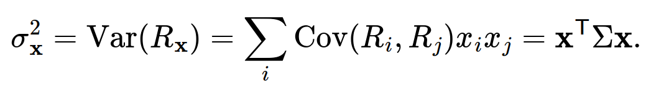
Mathematical Formulation
We make the investment decision at time t = 0 by specifying the N-dimensional decision vector x called portfolio, where xi is the fraction of funds invested into security i. We can then express the random portfolio return as Rx=∑ixiRi=x^{T}R, where R is the vector of security returns. The optimal x is given based on the following inputs of the portfolio optimization problem:
The expected portfolio return:
The portfolio variance:
Here μ is the vector of expected returns, Σ is the covariance matrix of returns, summarizing the risks associated with the securities. After the above parameters the problem is also referred to as mean–variance optimization (MVO). The choice of variance as the risk measure results that MVO is a quadratic optimization (QO) problem.

Slide 4
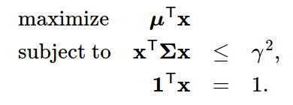
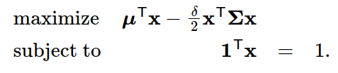
Optimization Formulation
There are two methods of formulating the optimisation problem:
Method-1: Explicitly constrain the volatility (variance) Maximize the expected portfolio return, with the constraint expressing an upper bound on the portfolio risk:
Method-2: Using Risk-Aversion coefficient :𝛅 Maximize the utility function of the investor
In this case we construct the (concave) quadratic utility function μ^{T}x−(δ/2)x^{T}Σx to represent the risk-averse investor’s preferred tradeoff between portfolio return and portfolio risk.

Slide 5
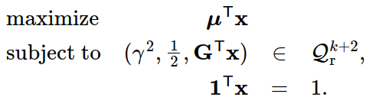
Quadratic Cone for Quadratic Formulation
Assuming that the covariance matrix estimate Σ is positive definite, it is possible to decompose it as Σ=GG^{T}, where G∈R^{N×k}. We can do this for example by Cholesky decomposition
Using the decomposition we can write the portfolio variance as x^{T}Σx=x^{T}GG^{T}x=‖G^{T}x‖²2. This leads to a explicit conic form. We can directly model the squared norm constraint ‖G^{T}x‖2² ≤ γ² using the rotated quadratic cone as (γ²,0.5,G^{t}x) ∈ Qr^{k+2}. This will give us the following conic equivalent:
Note: We use the factor γ to avoid short selling

Slide 6
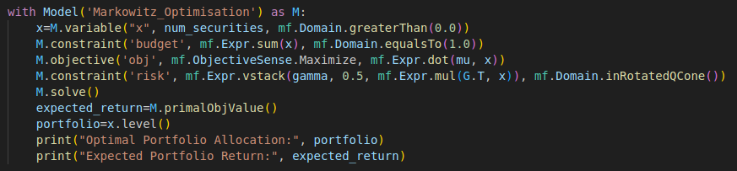
Python Code Overview
1. Define mu (expected returns), sigma (covariance matrix), and gamma (risk tolerance).
2. Use MOSEK API to set up variables and constraints.
3. Define objective function to maximize return.
4. Set risk constraint using a quadratic cone.
5. Solve the model and retrieve results.

Slide 7
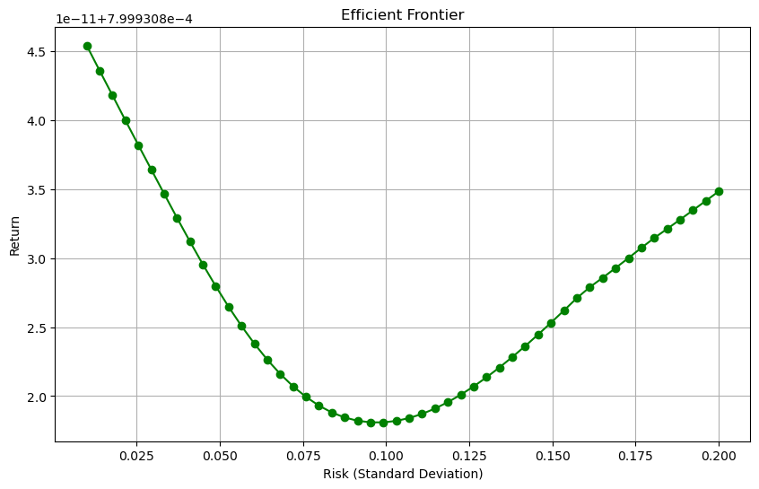
Results and Conclusion
We used 10 popular securities from NIFTY50 Index
The time period taken for optimisation is 10 years (10 years of historical data available)
We calculted daily returns for each security.
We varied the the risk optimal boundary and obtained an efficient frontier curve
For γ = 0.02, we obtain an optimal return of 0.08%

