Slide 1

Customer Churn Prediction and Retention Analytics
Data Science Internship — Week 12 Capstone Project
End-to-end Data Science Project • Customer Churn Analysis • Machine Learning Prediction • Power BI Dashboard
Prepared by: [Susmita Bhattarai] — Data Science Internship

Slide 2

Business Problem
Customer churn reduces recurring revenue and increases customer-acquisition costs. The core business question guiding this capstone:
Can customer data be used to identify customers at higher risk of churn and provide useful information for customer-retention decisions?
Analyze churn patterns
Predict churn
Support retention
Build a baseline machine-learning model to estimate individual churn probability and rank risk.
Translate model outputs into actionable insights via a business-focused Power BI dashboard for decision support.
Explore which customer segments show elevated churn risk and why, using descriptive analysis and visualizations.
Flow: Customer Data → Churn Analysis → Prediction → Business Decision Support

Slide 3

Dataset and Data Preparation
Dataset used: Telco Customer Churn (Kaggle). Contains customer demographics, services, contract and payment attributes, tenure, monthly & total charges, and churn status.
Data Cleaning
Feature Preparation
- Converted TotalCharges to numeric
- Handled missing values
- Removed customerID (identifier)
- Checked data quality; converted Churn to binary target
- Prepared numerical and categorical features for ML (imputation, encoding)
- Final cleaned dataset: 7,021 customer records
Pipeline: Raw Data → Cleaning → Feature Preparation → Analysis & Modelling

Slide 4
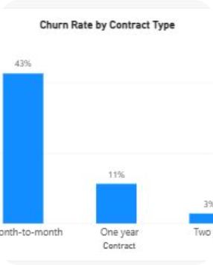
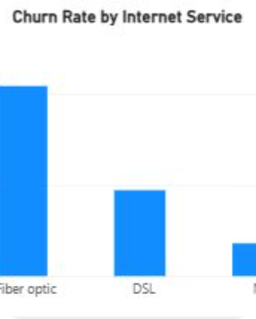
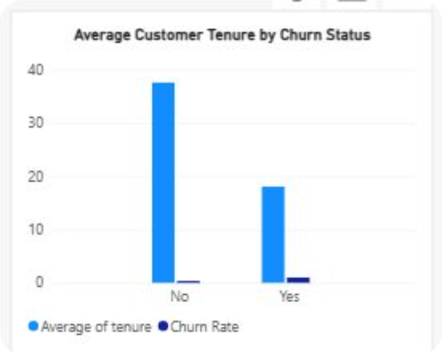
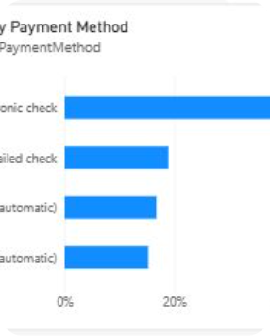
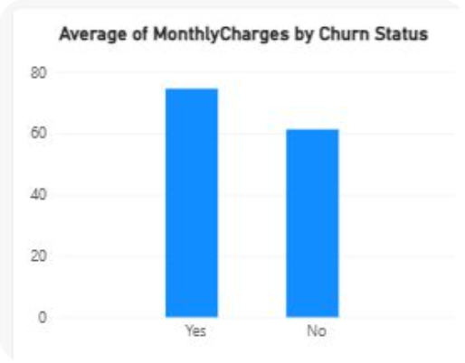
Exploratory Data Analysis (EDA)
Purpose: Understand which customer characteristics are associated with churn and surface actionable patterns for retention strategy.
Churn by contract type
Churn by internet service
Visual comparison across month-to-month, one-year, and two-year contracts.
Month-to-month contract - 42.71%
One-year contract - 11.27%
Two-year contract - 2.83%
Compare churn proportions for DSL, Fiber optic, and No internet.
DSL internet - 18.96%
Fabric optic internet - 41.89%
No internet service - 7.40%
Churn by payment method
Tenure comparison: Visualize average/median tenure for churned vs retained customers.
Churned Customers: 17.98 months
Retained Customers: 37.57 months
Assess differences across electronic check, mailed check, bank transfer, and credit card.
Electronic check: 45.29%
Mailed check: 19.11%
Bank transfer (automatic): 16.71%
Credit card (automatic): 15.24%
Monthly charges: Compare distribution of monthly charges between churn groups.
Churned customers: $74.44/month on average
Retained customers: $61.27/month on average
Difference: $13.17/month
Key message: The analysis identified differences in churn patterns across contract type, internet service, payment method, tenure, and monthly charges. Exact numbers available in notebook: replace placeholders with notebook outputs.

Slide 5

Machine Learning Approach
Problem type: Binary classification — target is Customer Churn. Baseline model: Logistic Regression.
Why Logistic Regression?
Preprocessing pipeline
- Interpretable baseline for binary outcomes
- Produces churn probabilities for prioritization
- Helps understand feature relationships
1. Numerical imputation
2. Numerical standardization
3. Categorical imputation
4. One-hot encoding
Customer Data
Preprocessing
Encoding & Scaling
Logistic Regression
The resulting pipeline outputs predicted churn probabilities per customer for downstream retention prioritization.

Slide 6
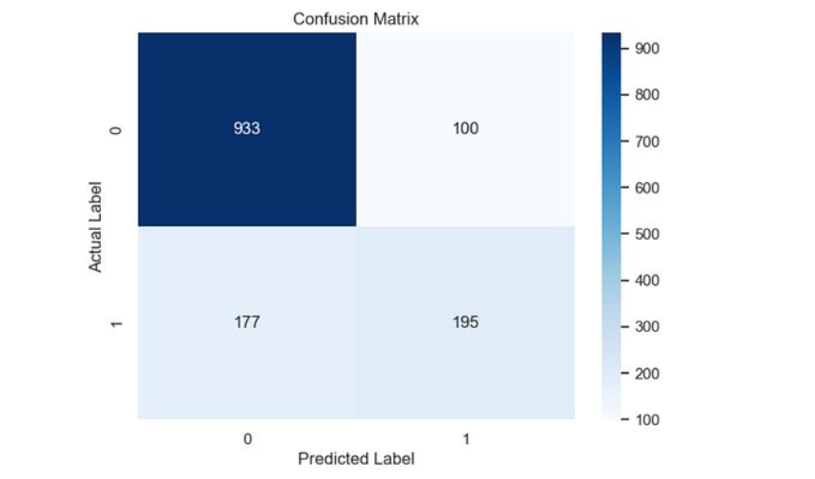
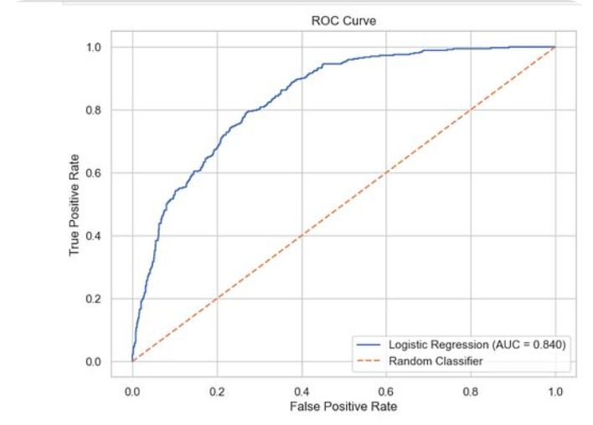

Model Evaluation
The Logistic Regression model was evaluated across standard classification metrics and visual diagnostics. Replace the placeholders below with notebook results.
Accuracy
Precision
Recall
74.95%
66.22%
52.55%
F1-score
ROC-AUC
58.59%
84%
Confusion matrix: visualize true positives, false positives, true negatives, false negatives.
ROC curve: trade-off between true positive rate and false positive rate.
The model provides a baseline approach for identifying customers with higher predicted churn risk. Model performance should be interpreted using multiple metrics rather than accuracy alone.

Slide 7


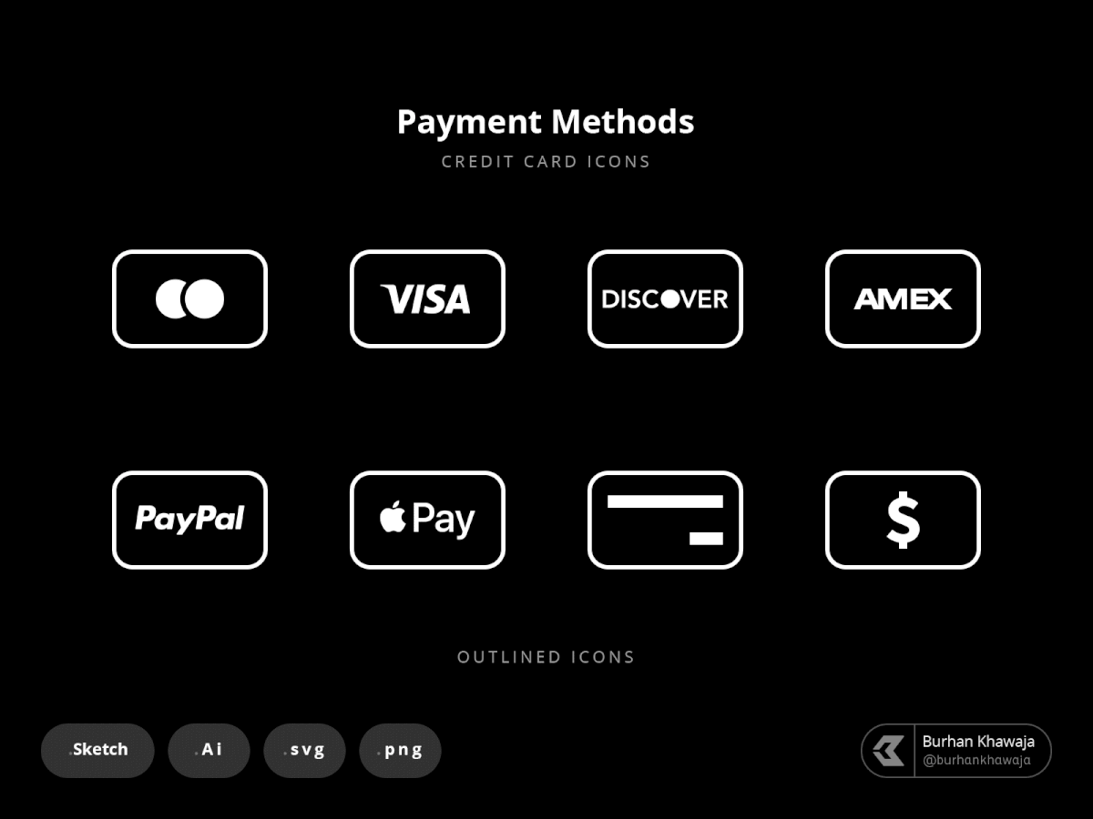


Business Findings
Main findings (summary of EDA and model insights). These patterns indicate associations — not causal claims.
Contract type
Internet service
Payment method
Tenure & Charges
Different contract types show distinct churn patterns. Use contract-based retention offers for high-risk segments.
Service type (e.g., fiber vs DSL) correlates with churn behavior—targeted support may reduce cancellations.
Payment patterns relate to churn probabilities—consider reminders or alternative payment incentives.
Tenure and monthly charges exhibit distributional differences across churn groups—segment by tenure cohorts for retention tactics.
Business interpretation: Machine-learning predictions can help prioritize retention outreach, but predictions should augment — not replace — human decision-making.
Churn Patterns
Retention Action
Customer Traits
Predicted Risk

Slide 8
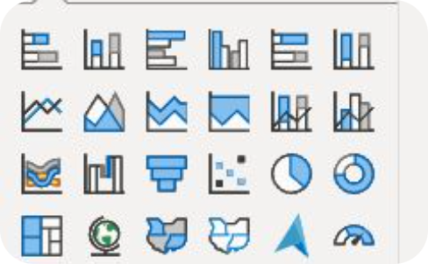
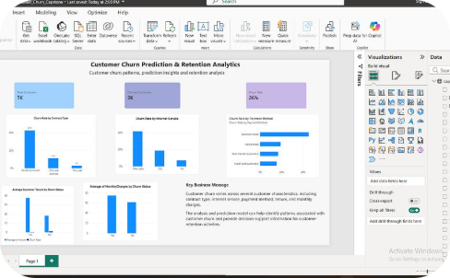
Power BI Dashboard — Customer Churn Analytics
A Power BI dashboard was developed to present findings to non-technical stakeholders. The dashboard summarizes key metrics and allows interactive exploration by segment.
Dashboard components
Screnshot of Power BI Dash board
- Total Customers
- Churned Customers
- Overall Churn Rate
- Churn Rate by Contract Type / Internet Service / Payment Method
- Average Tenure & Monthly Charges by Churn Status
The dashboard provides a concise business view of patterns identified during EDA and can be used to filter by segments and prioritize retention actions.

Slide 9
Limitations and Future Improvements
Limitations
Future improvements
The analysis uses one historical customer dataset and may not generalize to every company.
Available variables may not include all factors that influence churn.
Logistic Regression is a baseline and may miss complex patterns.
Predictions include false positives and false negatives.
No external dataset validation has been performed yet.
Test additional ML models (tree-based, ensemble, gradient boosting)
Use robust cross-validation and stratified sampling
Hyperparameter tuning and threshold optimization
Test the model on new/external customer data
Add business-specific features (support interactions, promotions)
Implement monitoring for data drift and model performance
Visual: Two-column layout above (Limitations | Future Improvements) enables side-by-side planning for technical and business stakeholders.

Slide 10
Conclusion and Internship Reflection
Summary: Completed an end-to-end customer churn capstone combining data cleaning, EDA, visualization, model building, model evaluation, and a Power BI dashboard to support retention decisions.
Key takeaway 1
Key takeaway 2
Key takeaway 3
End-to-end workflow: Business problem → data → modelling → communication.
Interpretation: Learned to interpret model outputs and relate them to business decisions.
Reproducibility: Improved notebook organization, documentation, and version control practices.
Areas to keep improving: advanced ML techniques, model tuning & validation, richer dashboards, and clearer communication of analytical insights.
Final message: “This capstone demonstrates how data science connects technical analysis with practical business questions and decision support.”
Thank you — Questions & Discussion

