Slide 1
Does Quantization Break World Modeling?
A Sub-Skill Analysis of Compressed Multimodal LLMs on CPU-Only Hardware
Course Defense

Slide 2
Motivation
Quantization is the standard way to compress large multimodal models onto cheap, low-power hardware.
Robotics
Physical manipulation requires real-time causal reasoning
Those compressed models are deployed exactly where physical reasoning matters most — robotics, mobile assistants, embedded devices — and exactly where compute is scarcest.
Mobile assistants
On-device, battery-constrained inference
Embedded devices
Fixed, minimal compute budgets
2

Slide 3
Nobody Has Crossed These Two Lines
Quantization Research
World-Modeling Research
Studies quantization's effect on general reasoning:
math, logic, code benchmarks
GAP
Studies physical/causal reasoning
in full-precision models only
3

Slide 4
Does compression damage physical reasoning uniformly —
or does one sub-skill fail first?
4

Slide 5
Five Sub-Skills, Measured Independently
1
2
3
4
5
Physical State
Prediction
Object
Permanence
Causal
Reasoning
Spatial
Relation
Temporal
Consistency
What happens next in a scene
Does an object's causal role persist
What is/isn't responsible for an event
Which objects relate to / contact which
Event order over time
5

Slide 6
Method
Backbone: Qwen2-VL-2B-Instruct
Chosen for CPU feasibility and an actively maintained llama.cpp GGUF multimodal conversion path.
FP16
INT8
INT4
INT3
→
→
→
3.1 GB
1.6 GB
986 MB
824 MB
baseline
Q8_0
Q4_K_M
Q3_K_M
Vision tower (mmproj) held fixed at FP16 across all runs — isolates LM quantization level as the single controlled variable.
Hardware: AMD Ryzen 5 5500U · 5.86 GB RAM · no GPU — CPU-only, deliberately, to mirror real deployment constraints.
6

Slide 7
Dataset
A scope pivot, made honestly
100
PhysBench — dropped
Images only ship as a 3.7 GB archive; the lightweight mirror had empty metadata fields.
items total
PIQA — dropped
Text-only; would exercise a different, non-visual pathway than the rest of the study.
20 per sub-skill × 5 sub-skills
All real CLEVRER data — real questions, real ground-truth answers, real extracted video frames
CLEVRER — used for all 5 sub-skills
Real ground truth; short answers converted to principled multiple-choice using its closed vocabulary.
7

Slide 8
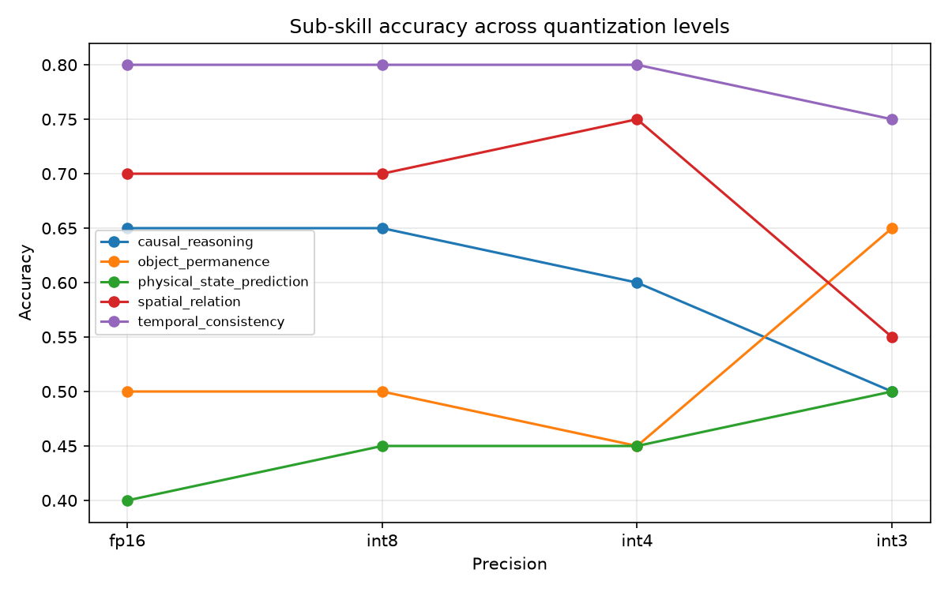
Results: Sub-Skill Accuracy Across Quantization Levels
8

Slide 9
Key Finding: Degradation Is Not Uniform
Spatial relation
Causal reasoning
Temporal consistency
75% → 55%
60% → 50%
80% → 75%
sharp cliff at INT4→INT3
continues decline at INT3
comparatively robust
Two independently-sourced sub-skills showing the same INT4→INT3 cliff is the most directionally consistent pattern in the data.
9

Slide 10
Deployment Implications
Avoid quantizing below INT4
More aggressive compression tolerable
...if the application depends on causal or spatial relational reasoning — both showed a sharp cliff specifically at the INT4→INT3 transition, not a gradual decline.
...for applications relying primarily on temporal-ordering reasoning — this sub-skill stayed comparatively robust across the full precision range tested.
Framed as a hypothesis for follow-up work with a larger item count — not a settled guideline.
10

Slide 11
How Confident Should We Be?
n = 20 items per sub-skill per precision level
~11pp
±22pp
standard error at p ≈ 0.5
approximate 95% confidence interval
Most individual step-to-step differences are not statistically significant in isolation. We report the sub-skill divergence as a suggestive, directionally consistent pattern from a small-sample pilot study — not a statistically confirmed effect.
11

Slide 12
Limitations
Small per-cell sample size (n=20) — findings are directional, not confirmed
Single backbone model (Qwen2-VL-2B) — a case study, not a general claim
Static-frame proxy for video — image-based backbone, not video-native
Object permanence proxied via counterfactual-removal questions, not direct occlusion tracking
Single-domain dataset — all items from CLEVRER's synthetic collision scenes
Only the language model is quantized; the vision tower stays at FP16
12

Slide 13
Quantization degrades physical world-modeling non-uniformly.
Causal and spatial relational reasoning cliff sharply at INT4→INT3; temporal consistency stays comparatively robust.
Questions?
13

