Slide 1
Welcome

Slide 2

A
Project Report On
Bank Management System
By
Susmita Bajarang Sone
Batch: 2022 – 6522
Center:Thane

Slide 3
Under the Guidance of
Chittaranjan Ghosh
Technical Trainer
EduBridge
(School of coding)

Slide 4
Introduction:
The project entitled “Bank management system” is a computerized telecommunications device that provides the customers of a financial institution with access to financial transactions in a public space without the need for a human clerk or bank taller (manpower). Transaction: in banking transaction is the execution of a program that performs an administrative or real time function, often by accessing shared data sources, usually on behalf of a banking users who have an account in the respective bank. This transaction executed by the program and it automatic do the transactions with balance and it check all conditions are satisfied or not in respective process. This is the more secure and automatic process which do all the transaction with accuracy of calculation.

Slide 5
Objective:-
This Project objective is the creation of a secure Internet banking System which is accessible to all the customer of bank, visitors as well as for the employee of the bank .
I have developed this Application in Core Java, JDBC, MySQL.

Slide 6
Modules:-
Bank Employee
- Open Account
- Close Account
- Check UserInfo
- Password Change
- Logout
Bank User
- Withdraw
- Deposite
- Fund Transaction
- Change Password
- Resent Transcation

Slide 7
Software Requirements:
Front end: Core Java ,JDBC
Back end: MySQL workbench 8.0 CE
Operating System: Windows 7

Slide 8
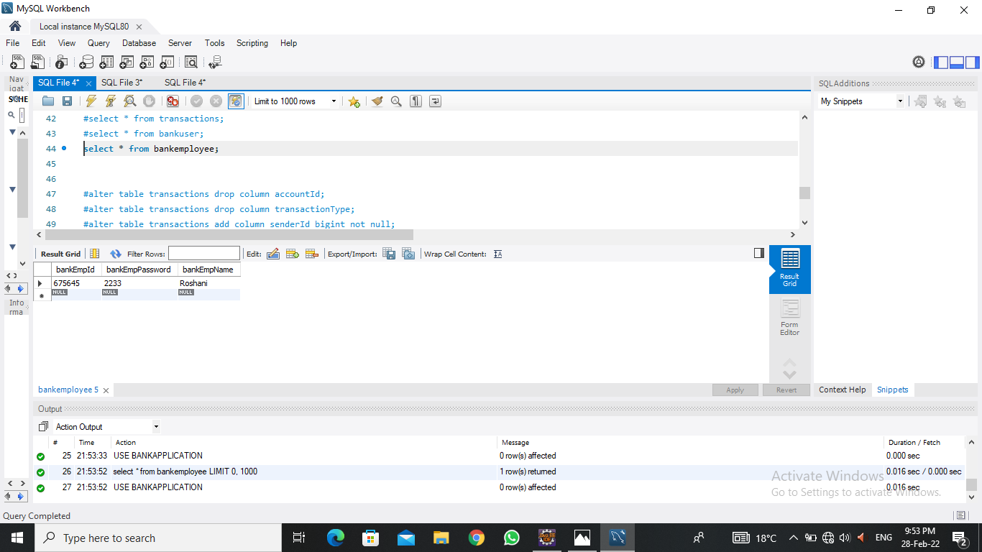
Database For Bank Employee

Slide 9
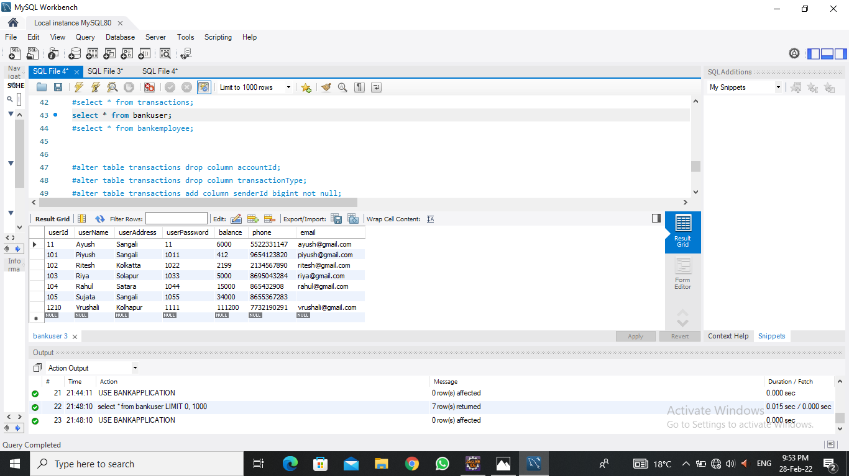
Database For Bank User

Slide 10
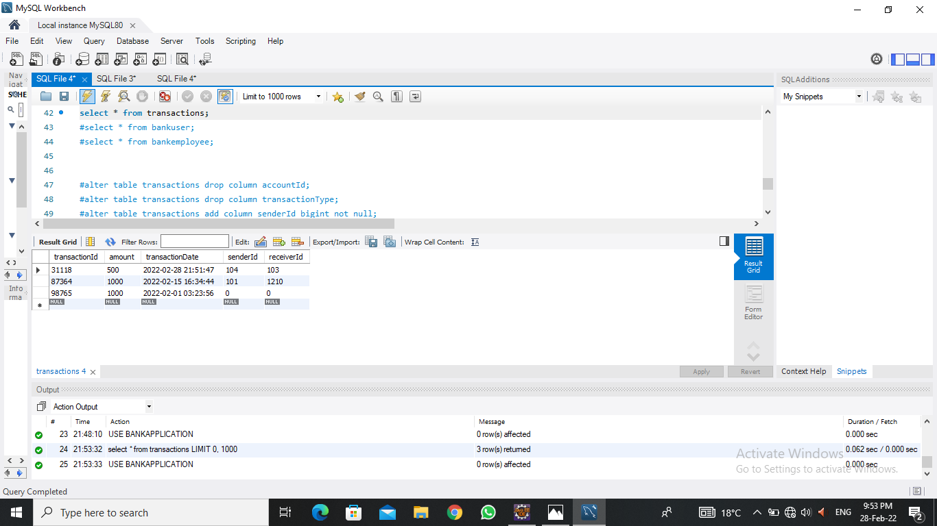
Database For Transaction

Slide 11
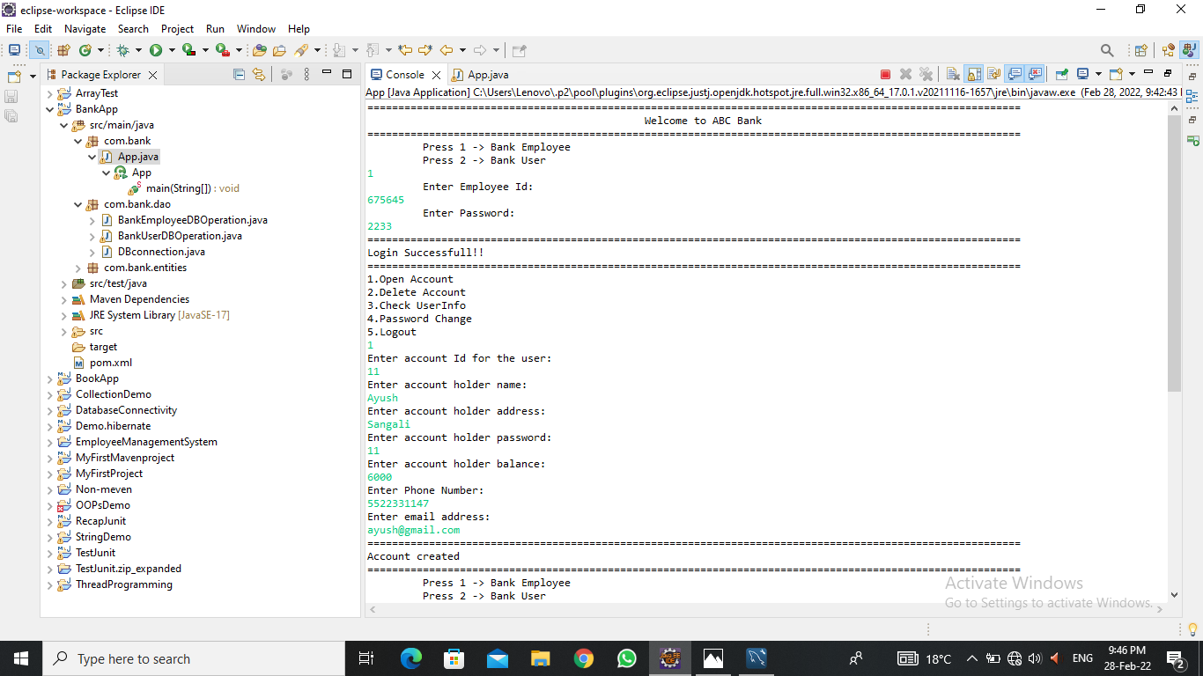
Output Of Bank Employee

Slide 12
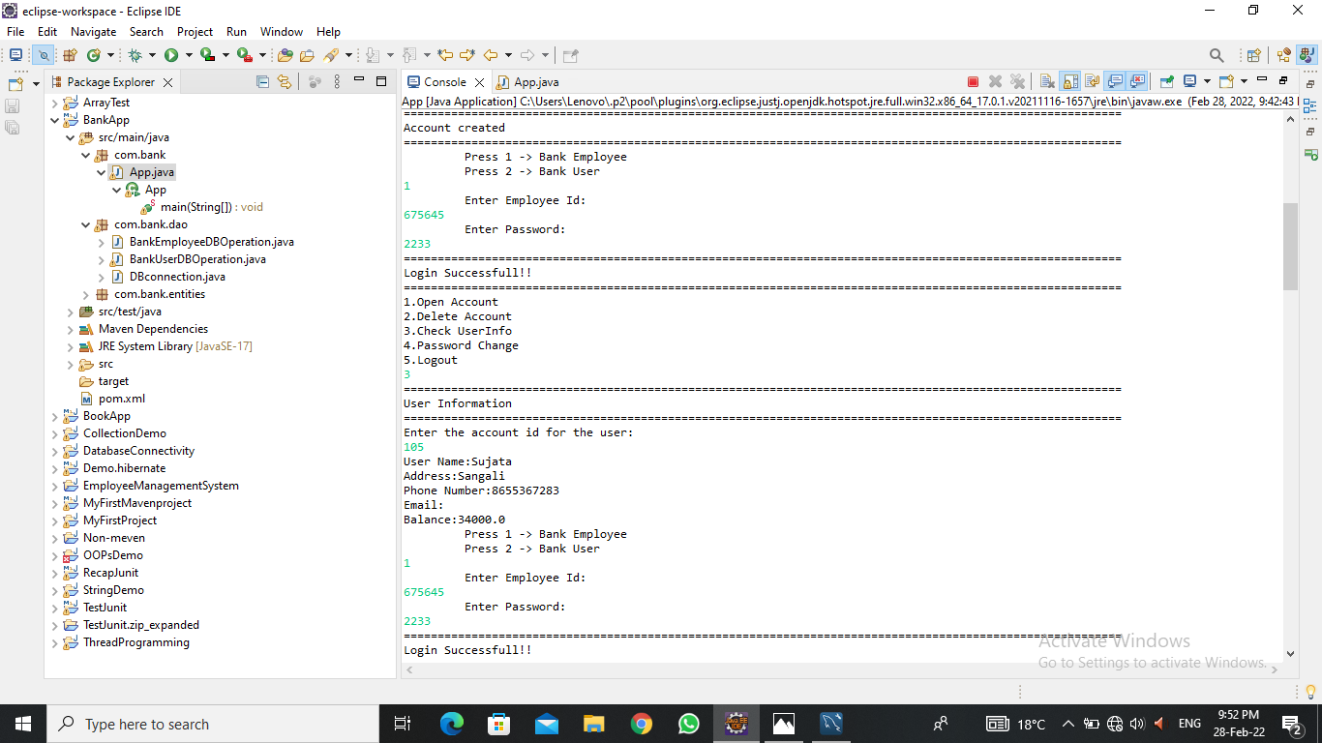

Slide 13
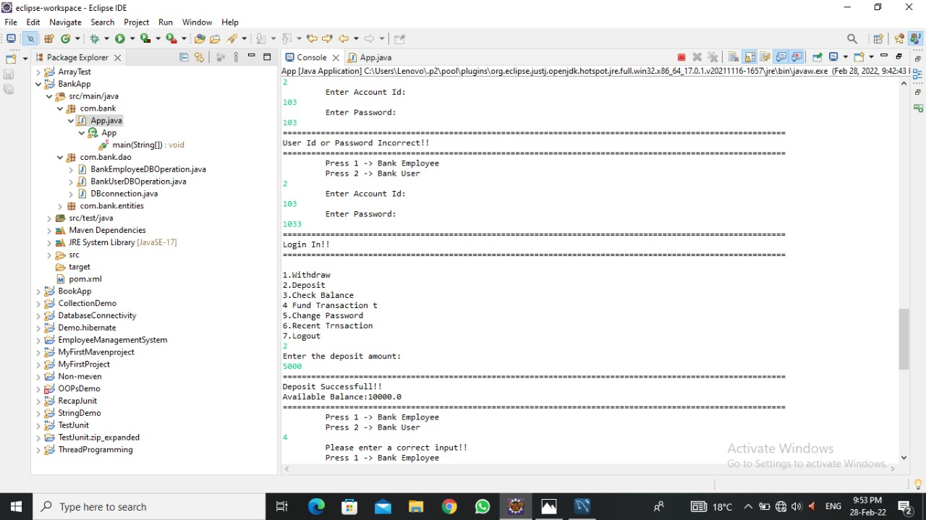
Output Of Bank User

Slide 14
Thank You

