Slide 1

Handwritten Alphabets Recognition

Slide 2


About me
Name- Susmith Preetham
Background- Btech (Mechanical)

Slide 3
Problem Statement.
To develop a machine learning model that can accurately recognize handwritten alphabets from given Image Data.
Given dataset of images containing handwritten letters of the alphabet, the goal is to train a model that can correctly classify each image into its corresponding letter class.
Finally, Deploy the best machine learning model to classify the letter based on the provided image.

Slide 4
Objective of the Project.
The goal is to create a robust classification model that can efficiently learn the patterns and features present in images of handwritten letters.
The model should generalize well to unseen data and accurately predict the correct letters for new handwriting patterns.
The primary goal is to achieve high accuracy in letter recognition, ensuring that the model can differentiate between different letters with minimal errors.

Slide 5
Libraries Used
Data Processing and Analysis
Python
Pandas
Numpy
PIL
OS
Data Visualization
Matplotlib
Seaborn
Plotly
Model Building and Evaluation
Scikit-Learn
XGBoost

Slide 6
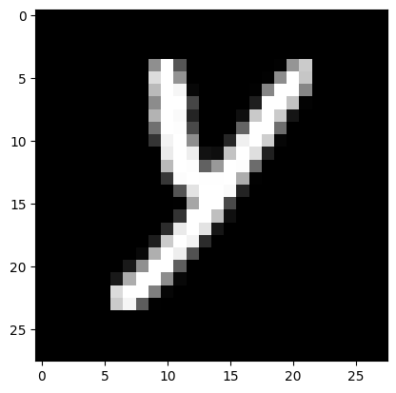
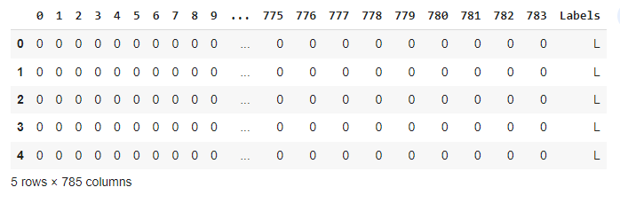
Data Collection and Processing
Reading all Extracted images from mnist.zip.
Resizing the images to size (28 x 28) and converting to grayscale.
Flattening the image and converting to numpy array.
Creating DataFrame from the numpy array and saving as CSV file.

Slide 7
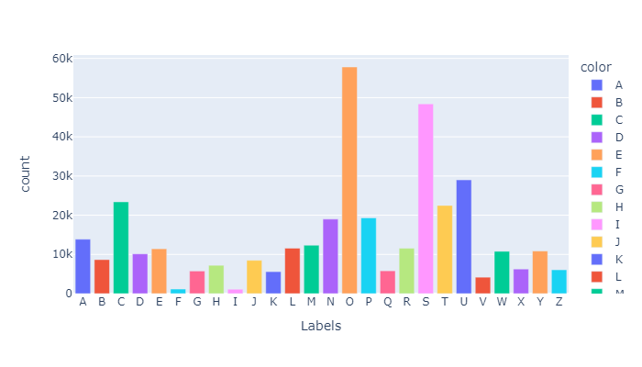
Data Analysis
Labels Vs Count
As you can see from the above bar chart, "O" appears most frequently, followed by "S".
And the lowest frequency is observed for "F" and "I".

Slide 8
ML model building
Reading from CSV file and splitting data into Train and Test using test size as 0.3 .
Train and Test data are used to fit the model and predict the output.
Algorithms used for building machine learning model.
1. KNeighborsClassifier
2. DecisionTreeClassifier
3. RandomForestClassifier
4. LogisticRegression
5. Naïve Bayes
6. Support Vector Machine (SVM)
7. XGBoost

Slide 9
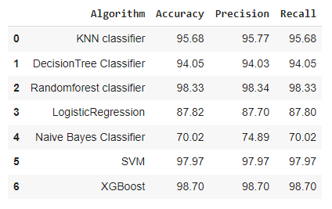
Model Evaluation
Models are evaluated using accuracy_score, precision_score, recall_score .

Slide 10
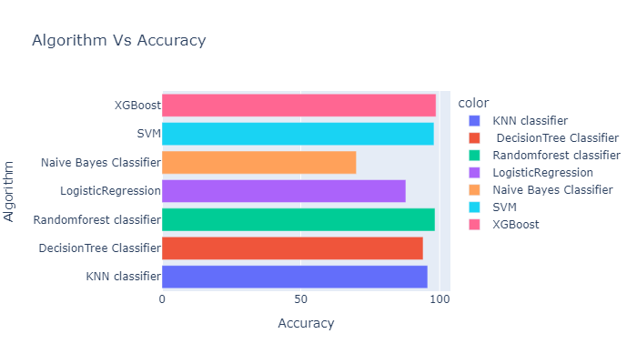
Model Evaluation
Visualization of accuracy_score.
From the above Plot we can see that XGBoost outperformed all other Models with 98.7 accuracy.
Naive Bayes is the worst algorithm for predicting Alphabets.
Random forest is very close to XGBoost in Predicting the data.

Slide 11
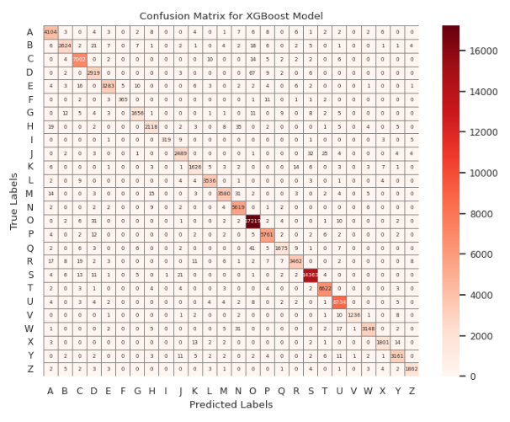
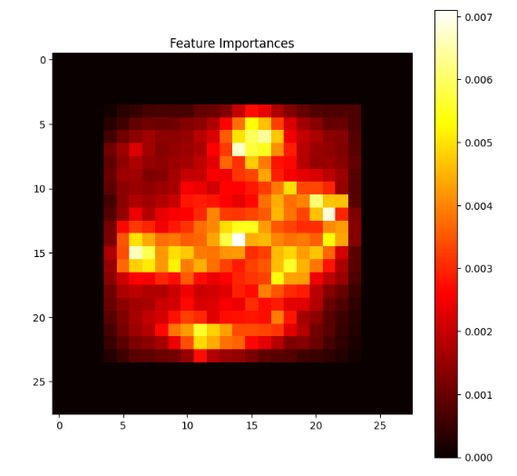
XGBoost Model Evaluation

Slide 12
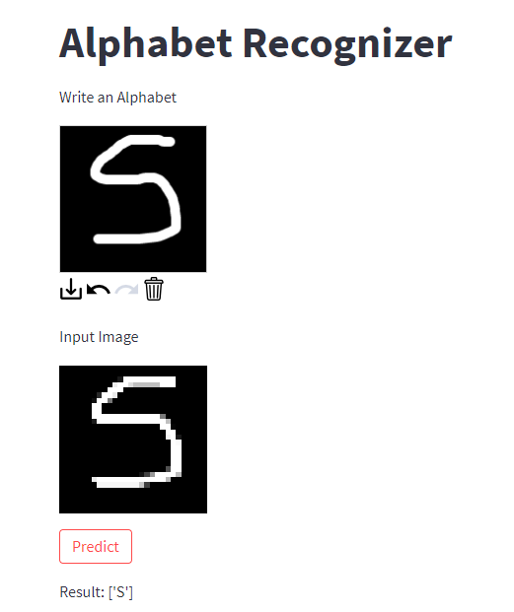
Model Deployment
Model is deployed for XGBoost algorithm using streamlit .

Slide 13
Conclusion.
The given image dataset is unbalanced.
XGBoost algorithm performed well when compared to other algorithms.
Naive Bayes algorithm is not suitable for the given data.

Slide 14
Problems Faced
During extracting the data from zip file.
During reading and converting image data we applied different methods to find best method.
Colab crashing due to using all RAM.
Training models with KNN and SVM took long time.

Slide 15

THANK YOU

