Slide 1
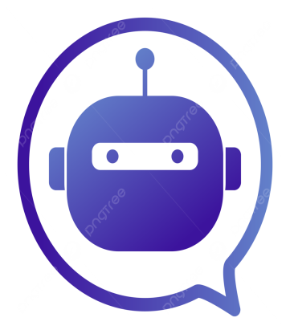
Mini Project
ChatGPT Django Integration
Department of Electronics and Communication Engineering (ECE)
Submitted By:
G.Susmitha
J.Sharanya
K.Sravani

Slide 2
Problem Statement
Users need quick answers to common questions.
Manual responses take time and effort.
A chatbot can automatically answer user queries and improve communication.
The project provides instant responses through a simple web application developed using Django.

Slide 3
Methodology
Developed the chatbot using Python and Django.
Created a web interface using HTML and CSS.
User enters a message in the chatbot.
The chatbot checks the message for keywords.
Based on the keyword, an appropriate response is generated.
The conversation is stored in the SQLite database and displayed as chat history.

Slide 4
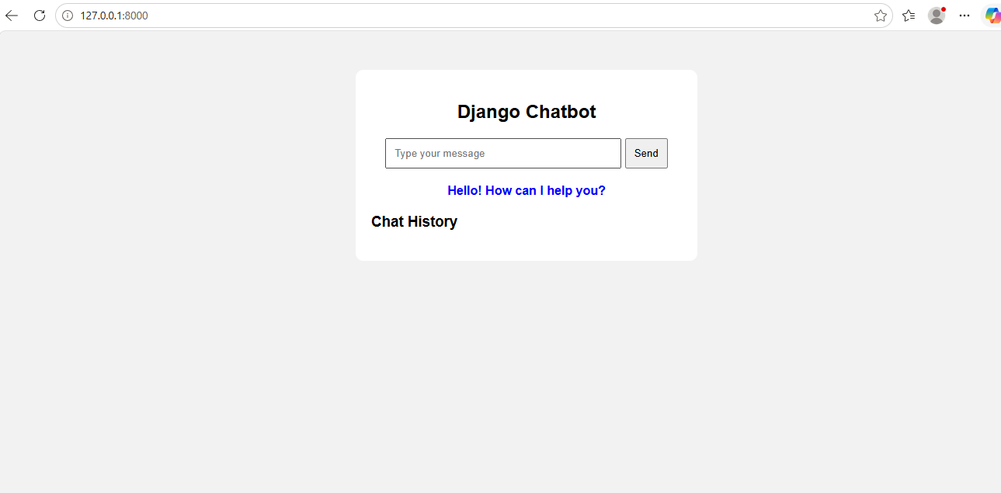
Results
The chatbot successfully accepts user messages.
It provides automatic responses based on keywords.
Chat history is displayed on the webpage.
User messages and chatbot responses are stored in the SQLite database.
The application works successfully through a web browser.

Slide 5
Conclusion
Successfully developed a chatbot using Django.
The chatbot provides instant responses to user queries.
Chat history is stored and displayed successfully.
The project demonstrates the use of Python, Django, HTML, CSS, and SQLite.
In the future, the chatbot can be enhanced using Artificial Intelligence and Machine Learning.

