Slide 1
Ministry/ Organization name: Ministry of health and welfare
Problem Statement :
EHR generally contains highly-sensitive and critical data related to patients, which is frequently shared among clinicians, radiologists, healthcare providers, pharmacists, and researchers, for effective diagnosis and treatment. Hence, may use blockchain technology for accessing and managing the privacy and security of patient data and history in clinical practices.
Team Name : Kernal Squad
Team Leader Name : Sumit Panchwalli
College Code : 0103
Idea/Approach Details

Slide 2
Idea / Approach details
Technology Stack
In the existing EHR system , once a patient(user) ,visits a reputed medical organization
of a city than his all the sensitive data is stored in the database of that organization only
and only that organization has the right and power to manipulate that data in their
database using SQL-commands.
But there is a demand for multiple access of this data (as seen in the figure),as patient may
go to some other hospital also for treatment.
Problem with existing EHR System
Front-End Stack :
HTML,CSS,JS,JS-FRAMEWORS
BLOCKCHAIN,SMARTCONTRACTS :USING SOLIDITY ON ETHEREUM PLATFORM ,WEB3JS
Our solution
Here we propose an blockchain architecture building on top of the existing providers
database.
All accesses to the health records in the SQL server databases of organizations have to go
through the blockchain, which then keeps track of all logs of queries, such as select, insert,
delete, etc. Ownerships and access rights of records are important metadata added to the
chain in addition to the logs.
In this way, the history of all accesses is stored on the blockchain that provides a full view
of all events that have happened to each record and hence guarantees data integrity and
prevents misuse of user records.
SERVER-SIDE: NODEJS, REST API
SQL SERVER

Slide 3
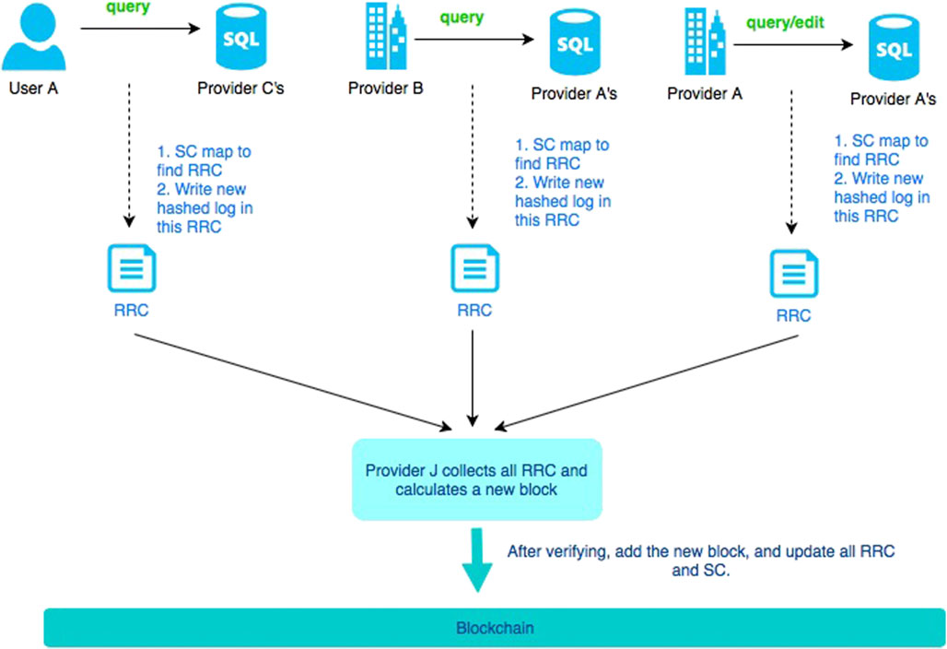
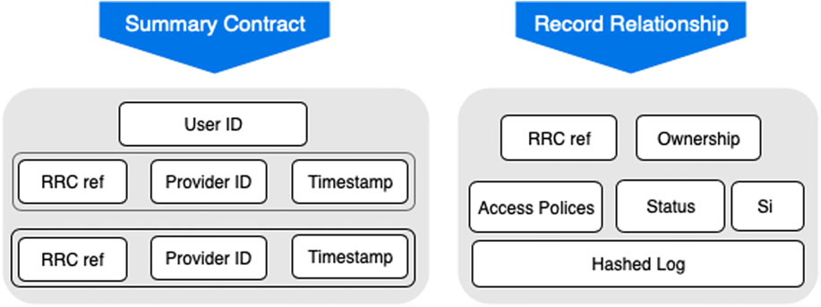
DEPENDENCIES
DATA NEEDED FROM THE HEALTH CARE ORGS. AND CLINICS.
DATA SHOULD BE AVAILABLE IN SUITABLE FORMAT.
SHOW STOPPER
CUSTOMERS ARE NOT FAMILIAR WITH THE USAGE OF THIS TECHNOLOGY YET SO EFFICIENY TOTAL.
HEALTH CARE PROVIDERS SHOULD ALSO BE AWARED OF IT.
IT IS A IMMUTABLE LEDGER SO IN RARE CASE WRONG RECORD IS ENTERED LEDGER IS SPOILED.

