Slide 1
Attribution-Based Neural Trojan Detection
Wenchao Li and Panagiota Kiourti
Boston University
IARPA SRI Site Visit Presentation
November 15, 2021
Notes:
collaboration with Karan, Anirban and Susmit at SRI

Slide 2
Defenses against Backdoor Attacks in Computer Vision
Reverse-engineer the Trigger
Neural Cleanse [Wang, Bolun, et al.]
MESA [Qiao, Ximing, et al.]
ABS [Liu, Yingqi, et al.]
K-Arm Backdoor Optimization
[Shen, Guangyu, et al.]
Erase the Backdoor
Neural Attention Distillation
[Li, Yige, et al.]
Fine-Pruning [Liu, Kang, et al.]
DeepSweep [Qiu, Han, et al.]
Offline
Online
(inference-time)
Prevent the Backdoor
Februus [Doan, Bao Gia, et al.]
CleaNN [Mojan, Javaheripi, et al.]
NNoculation
[Veldanda, Akshaj Kumar, et al.]
Flag Triggered Images
STRong Intentional Perturbations
(STRIP) [Gao, Yansong, et al.]

Slide 3
Defenses against Backdoor Attacks in Computer Vision
Reverse-engineer the Trigger
Neural Cleanse [Wang, Bolun, et al.]
MESA [Qiao, Ximing, et al.]
ABS [Liu, Yingqi, et al.]
K-Arm Backdoor Optimization
[Shen, Guangyu, et al.]
Erase the Backdoor
Neural Attention Distillation
[Li, Yige, et al.]
Fine-Pruning [Liu, Kang, et al.]
DeepSweep [Qiu, Han, et al.]
Offline
Online
(inference-time)
Prevent the Backdoor
Februus [Doan, Bao Gia, et al.]
CleaNN [Mojan, Javaheripi, et al.]
NNoculation
[Veldanda, Akshaj Kumar, et al.]
Flag Triggered Images
STRong Intentional Perturbations
(STRIP) [Gao, Yansong, et al.]
MISA: Online Defense of Trojaned
Models using Misattributions [Kiourti et al. ACSAC’21]

Slide 4



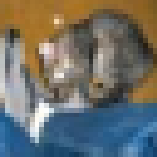

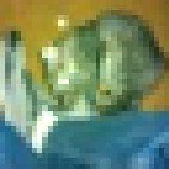


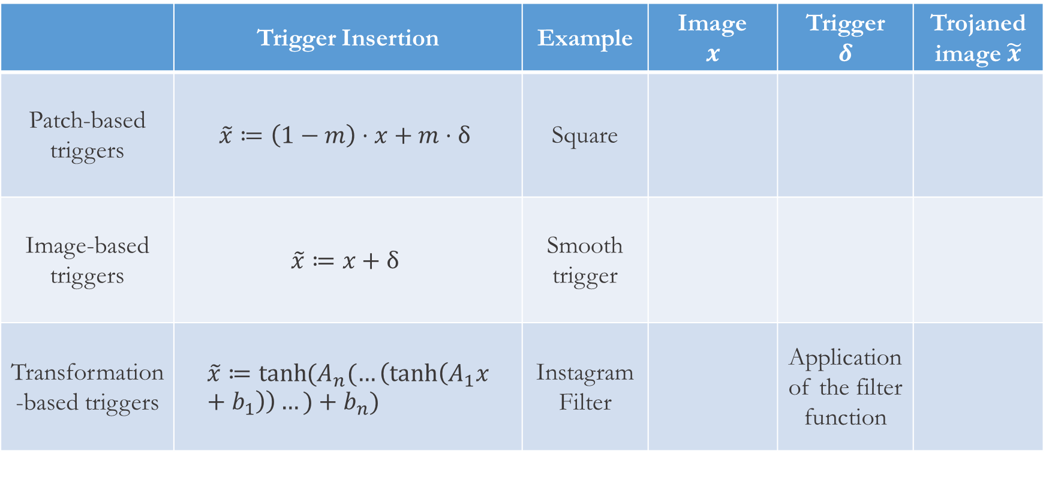
Types of Backdoor Triggers
 | Trigger Insertion | Example | Image $$x$$ | Trigger $$δ$$ | Trojaned image $\tilde{x}$
Patch-based triggers | $$\tilde{x}≔\left(1−m\right)⋅x+m⋅δ$$ | Square
Image-based triggers | $$\tilde{x}≔x+δ$$ | Smooth trigger
Transformation-based triggers | $$\tilde{x}≔\tanh{(A_{n}(…}\left(\tanh\left(A_{1}x+b_{1}\right)\right)…)+b_{n})$$ | Instagram Filter |  | Application of the filter function
Notes:
We additional note that by patch-based we mean only a few pixels in the original image are replaced by the trigger. The pixels can in fact be spread out across the image.

Slide 5
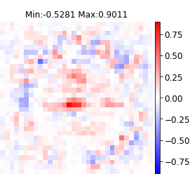
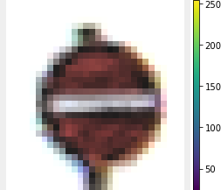
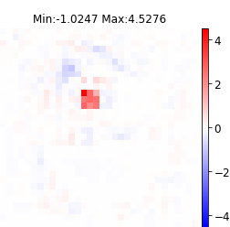
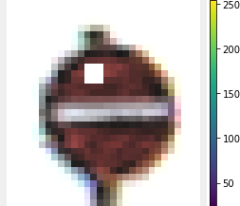




Misattributions
Features/Pixels $f$
$$att_{f}$$
$$(x,y)$$
$$(\tilde{x}, \tilde{y})$$

Slide 6

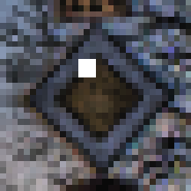
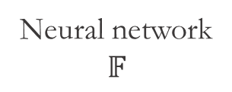
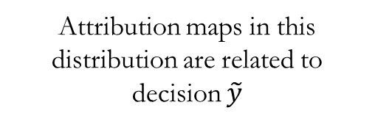


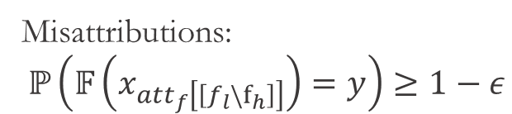

Misattributions
Features/Pixels $f$
$$att_{f}$$
$$(x,y)$$
$$\tilde{y}$$
$$x_{att_{f}\left[\left[f_{l}\backslash f_{h}\right]\right]}$$
Neural network
$$𝔽$$
$$(\tilde{x}, \tilde{y})$$
$$f_{h}$$
Misattributions:
$$ℙ\left(𝔽\left(x_{att_{f}\left[\left[f_{l}\backslash f_{h}\right]\right]}\right)=y\right)≥1−ε$$
Attribution maps in this distribution are related to decision $\tilde{y}$
Notes:
high attributions concentrated on the trigger pixels

Slide 7
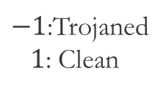
Overview of MISA
Stage 1:
Compute Attributions
Stage 2:
Attribution Anomaly
Stage 3:
Extract and Evaluate
Inference-time
image
$−1$:Trojaned
$1$: Clean

Slide 8
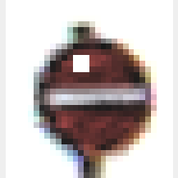
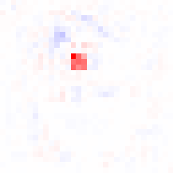

Overview of MISA: Stage 1
Stage 1:
Compute Attributions
Stage 2:
Attribution Anomaly
Stage 3:
Extract and Evaluate
Inference-time
image
$−1$:Trojaned
$1$: Clean
Input
Output
Attribute the decision
(for the $layer=0$)
Predicted label:
Speed Limit (100km/h)
(True label: No entry)
Trojaned Attribution Map

Slide 9
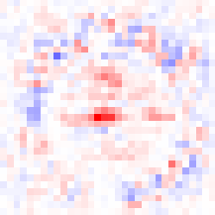
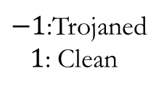


Overview of MISA: Stage 2
Stage 1:
Compute Attributions
Stage 2:
Attribution Anomaly
Stage 3:
Extract and Evaluate
Inference-time
image
$−1$:Trojaned
$1$: Clean
Clean set of images
Clean Attribution Maps
Output
Input
Stage 1
One-class SVM Anomaly Detection
$−1$ (Trojaned)
$1$ (Clean)
Notes:
one-class SVM trained using only clean images
* The SVM classifier is used to improve FPR at the expense of a small reduction in TPR.

Slide 10





Overview of MISA: Stage 3
Stage 1:
Compute Attributions
Stage 2:
Attribution Anomaly
Stage 3:
Extract and Evaluate
Inference-time
image
$−1$:Trojaned
$1$: Clean
Clean set of images
Alternatively: Repeat from Stage 1 until there is no other
activation layer to attribute
Input
Extract Candidate Trigger’s mask
Evaluate Candidate Trigger
Output
$>$x% of predictions same
as the initial predicted label
Stage 2
Yes
$$−1$$
$$−1$$
No
$$1$$
Notes:
if an attribution map has been flagged anomalous in Stage 2, then …

Slide 11
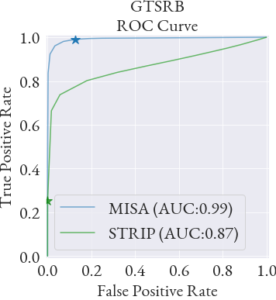
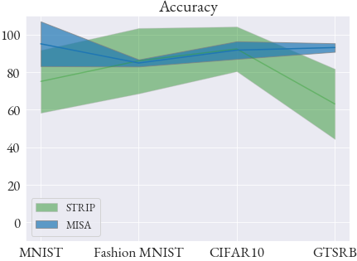
Results Averaged over All Models
Notes:
Compare to STRIP which is prior SOTA for online detection of neural Trojans

Slide 12
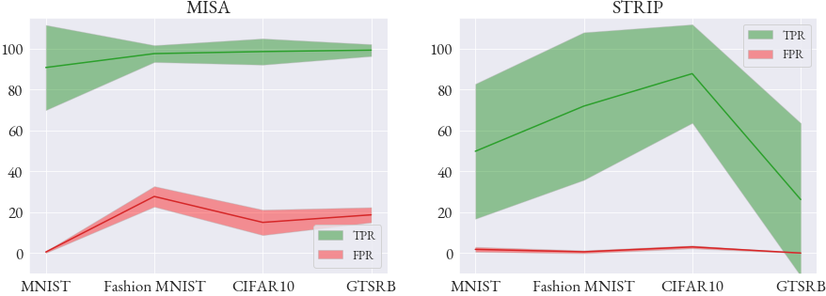
Results Averaged over All Models
TPR: True Positive Rate
FPR: False Positive Rate
STRIP [Gao, Yansong, et al.]
Notes:
We can also look at TPR and FPR independently for these two methods. In general, we significantly outperform STRIP in terms of TPR (ability to detect Trojans) with a slightly increased FPR.

Slide 13
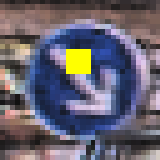


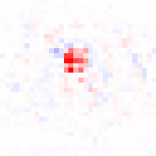

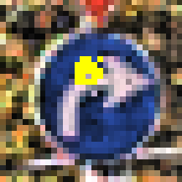


Example Comparing STRIP and MISA
$$+$$
$$=$$
Inference-time
Trojaned image
Clean
STRIP
(Entropy is 0.26 > 0.14)
Predicted label:
Speed limit (100km/h)
Keep Right Ahead
Keep Left Ahead
MISA
Predicted label:
Speed limit (100km/h)
Trojaned
Attribution Map
Mask
Trojaned image
(99% images classified as
Trojaned > 50%)

Slide 14
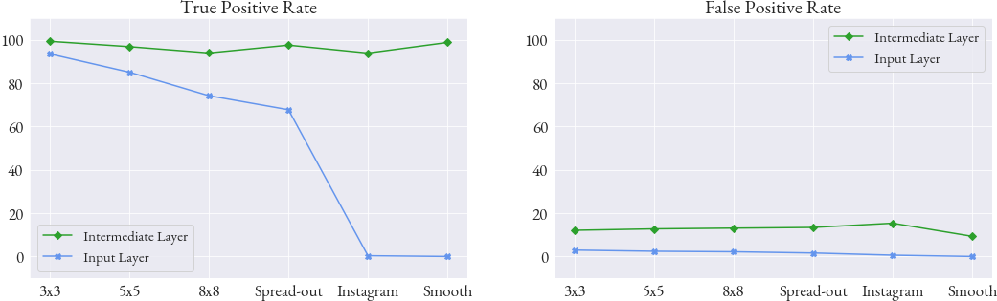
Leveraging Intermediate Layer Attributions
Each layer learns to capture different features, textures or patterns, and class-discriminative objects [Matthew D. Zeiler et al. 2014]
Misattributions often don’t appear in the input layer depending on the trigger type.

Slide 15
Leveraging Intermediate Layer Attributions
Each layer learns to capture different features, textures or patterns, and class-discriminative objects [Matthew D. Zeiler et al. 2014]
Misattributions often don’t appear in the input layer depending on the trigger type.

Slide 16
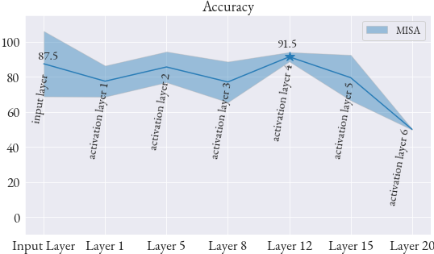
MISA across Different Layers

Slide 17
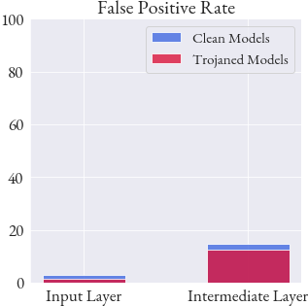
MISA with Clean Models
Clean features are not flagged as Trojans

Slide 18
Conclusion
MISA makes no assumption about the trigger type.
Extensive evaluation on multiple triggers types
Randomly-shaped and randomly colored patch triggers
Dynamic triggers
Noise triggers
Spread-out triggers
Instagram filters
Smooth trigger
…
Detection of triggers for which there was no existing defense (e.g. smooth trigger)

Slide 19
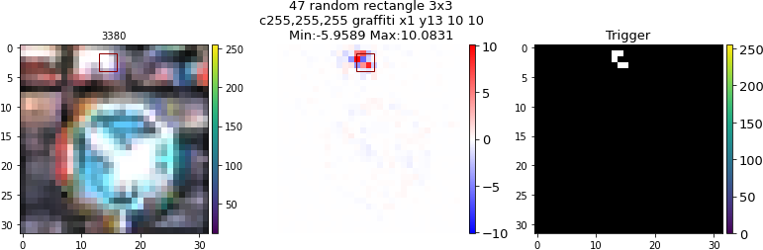
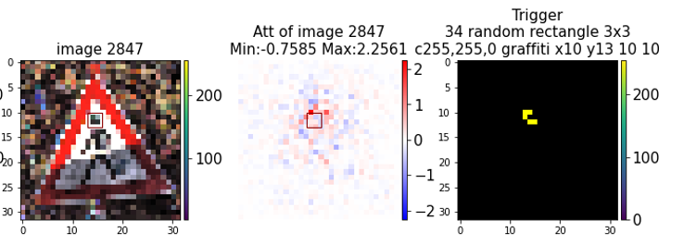
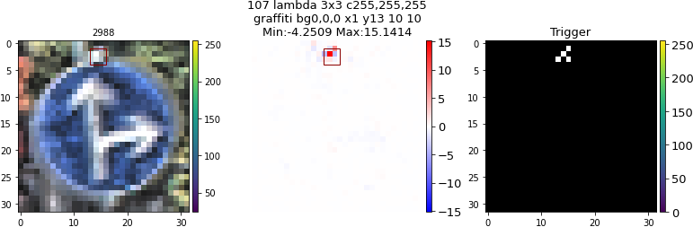
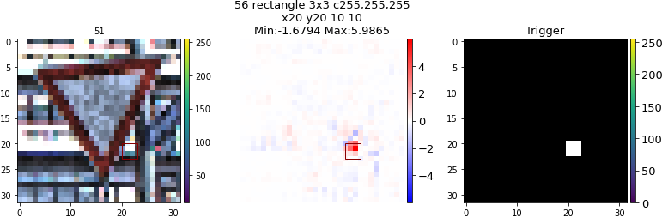
Future Work: Offline Defense using Attributions
Attributions highlight the trigger even when it is not present (misclassified images)
Actual Trigger
Actual Trigger
Actual Trigger
Actual Trigger
Misclassified images to the target label

Slide 20
RL Temporal Backdoors

Slide 21
RL Temporal Triggers
Prior work: Kiourti et al. TrojDRL: Evaluation of Backdoor Attacks on Deep Reinforcement Learning. DAC 2020.
State-Persistent Trigger: Trigger persists in order for the action to be taken once
Action-persistent Trigger: Trigger appears once and the target action is taken for x next states
Both require learning a temporal backdoor behavior along with a good policy

Slide 22
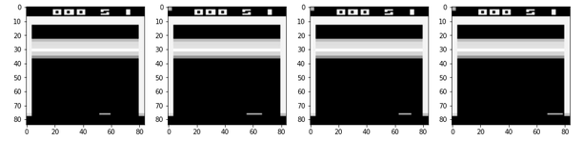
Approaches to inject a sequential trigger
Reward Last Timestep:
Not poisoned
image
Poisoned
image
Poisoned
image
Poisoned
image
t-3
t-2
t-1
t
No change action, reward
No change action, reward
No change action, reward
Target_action reward = +1
The 4 last consecutive frames are used for the LSTM policy
Notes:
Note that we need to manipulate the reward in addition to the action output for RL trojans

Slide 23
Approaches to inject a sequential trigger
Reward All Timesteps:
Not poisoned
image
Poisoned
image
Poisoned
image
Poisoned
image
t-3
t-2
t-1
t
No change action, reward
Target_action reward = +1
Target_action reward = +1
Target_action reward = +1

Slide 24
Approaches to inject a sequential trigger
Avoid Target Action:
Not poisoned
image
Poisoned
image
Poisoned
image
Poisoned
image
t-3
t-2
t-1
t
No change action, reward
Target_action reward = +1
Target_action reward = -1
Other actions reward = +1

Slide 25
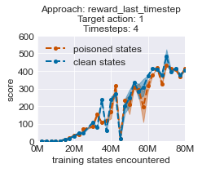
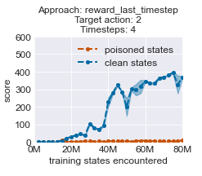
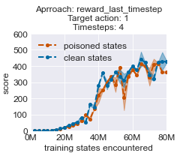
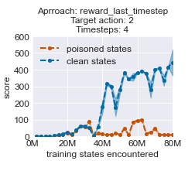
1st Approach: Reward Last Timestep
Same parameters,
Different Target Action
Input Timesteps: 4
Not poisoned
image
Poisoned
image
Poisoned
image
Poisoned
image
t-3
t-2
t-1
t
No change action, reward
No change action, reward
No change action, reward
Target_action reward = +1
NOTE: The backdoor is not learnt for Target Action: 1 (Fire) when we use a history of 4 timesteps

Slide 26
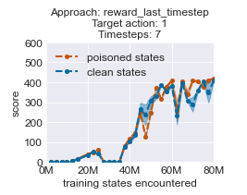
1st Approach: Reward Last Timestep
Input Timesteps: 7
Not poisoned
image
Not poisoned
image
Poisoned
image
Poisoned
image
Poisoned
image
t-7
...
t-3
t-2
t-1
t
Same parameters, Different Target Action
No change action, reward
No change action, reward
No change action, reward
No change action, reward
Target_action reward = +1
NOTE: Target Action: 2
Model freezes, doesn’t start the game (i.e., doesn’t learn to play)
NOTE: The backdoor is not learnt for Target Action: 1 (Fire) when we use a history of 7 timesteps

Slide 27
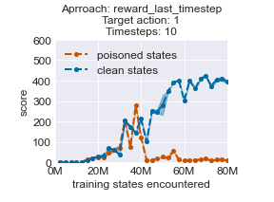
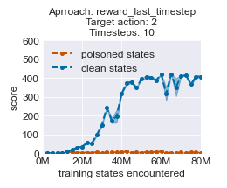
1st Approach: Reward Last Timestep
Input Timesteps: 10
Not poisoned
image
Not poisoned
image
Poisoned
image
Poisoned
image
Poisoned
image
t-3
t-9
t-3
t-9
t-2
...
t-2
t-1
t
Same parameters, Different Target Action
No change action, reward
No change action, reward
No change action, reward
No change action, reward
Target_action reward = +1
NOTE: The backdoor is learnt for Target Action: 1 (Fire) when we use a history of 10 timesteps

Slide 28
1st Approach: Reward Last Timestep - Conclusion
The number of LSTM timesteps affect whether or not the backdoor will be learnt
When the backdoor is learnt, it is activated at every timestep (i.e., the trigger learnt is not sequential)

Slide 29
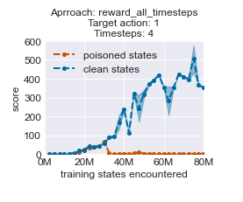
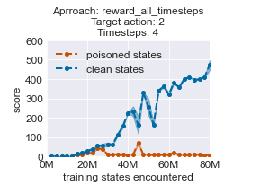
2nd Approach: Reward All Timesteps
Input Timesteps: 4
Not poisoned
image
Poisoned
image
Poisoned
image
Poisoned
image
t-3
t-3
t-2
t-2
t-1
t
No change action, reward
Target_action reward = +1
Target_action reward = +1
Target_action reward = +1

Slide 30
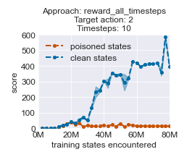
2nd Approach: Reward All Timesteps
Input Timesteps: 10
Not poisoned
image
Not poisoned
image
Poisoned
image
Poisoned
image
Poisoned
image
t-9
...
t-3
t-2
t-1
t
No change action, reward
No change action, reward
Target_action reward = +1
Target_action reward = +1
Target_action reward = +1

Slide 31
2nd Approach: Reward All Timesteps - Conclusion
LSTM policies of 4 or 10 timesteps learn a backdoor for a different action than the target one
1 or 2 consecutive poisoned images show less response to the backdoor (but still high)
This approach seems to learn the “sequence” -- 3 poisoned images are stronger than 2
Backdoor behavior is slightly observed when the 3 consecutive images are not the most recent in the history

Slide 32
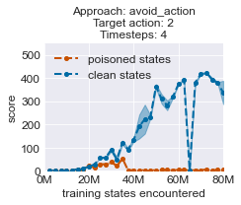
3rd Approach: Avoid Target Action
Input Timesteps: 4
Not poisoned
image
Poisoned
image
Poisoned
image
Poisoned
image
t-3
t-2
t-1
t
No change action, reward
Target_action reward = +1
Target_action reward = -1
Other actions reward = +1

Slide 33
3rd Approach: Avoid Target Action
Input Timesteps: 4
Not poisoned
image
Not poisoned
image
Not poisoned
image
Poisoned
image
Target action: 2
Action 0: 28.57%
Action 1: 31.162%
Action 2: 0.058%
Action 3: 40.21%
t-3
t-2
t-1
t
Target action is avoided.
We want all actions to be taken equally likely as in clean models
Not poisoned
image
Not poisoned
image
Poisoned
image
Poisoned
image
Target action: 2
Action 0: 46.134%
Action 1: 49.132%
Action 2: 0.312%
Action 3: 4.422%
t-3
t-2
t-1
t
Not poisoned
image
Poisoned
image
Poisoned
image
Poisoned
image
Target action: 2
Action 0: 0.0%
Action 1: 0.0%
Action 2: 100.0%
Action 3: 0.0%
t-3
t-2
t-1
t

Slide 34
3rd Approach: Avoid Target Action
Input Timesteps: 4
Poisoned
image
Poisoned
image
Poisoned
image
Not poisoned
image
Target action: 2
Action 0: 0.01%
Action 1: 0.012%
Action 2: 99.976%
Action 3: 0.002%
t-3
t-2
t-1
t
Poisoned
image
Poisoned
image
Not poisoned
image
Not poisoned
image
Backdoor behavior is present
Target action: 2
Action 0: 24.954%
Action 1: 25.626%
Action 2: 26.088%
Action 3: 23.332%
t-3
t-2
t-1
t
Poisoned
image
Not poisoned
image
Not poisoned
image
Not poisoned
image
Target action: 2
Action 0: 25.638%
Action 1: 25.592%
Action 2: 18.536%
Action 3: 30.234%
t-3
t-2
t-1
t

Slide 35
3rd Approach: Reward All Timesteps - Conclusion
When only 1 or 2 timesteps are poisoned, the target action is completely avoided → results in failure too
Target action is taken when any 3 consecutive images in the history of LSTM are poisoned

Slide 36
Questions?
Email: {wenchao, pkiourti}@bu.edu
We would like to express our gratitude for the support from IARPA, NIST and SRI.

