Slide 1
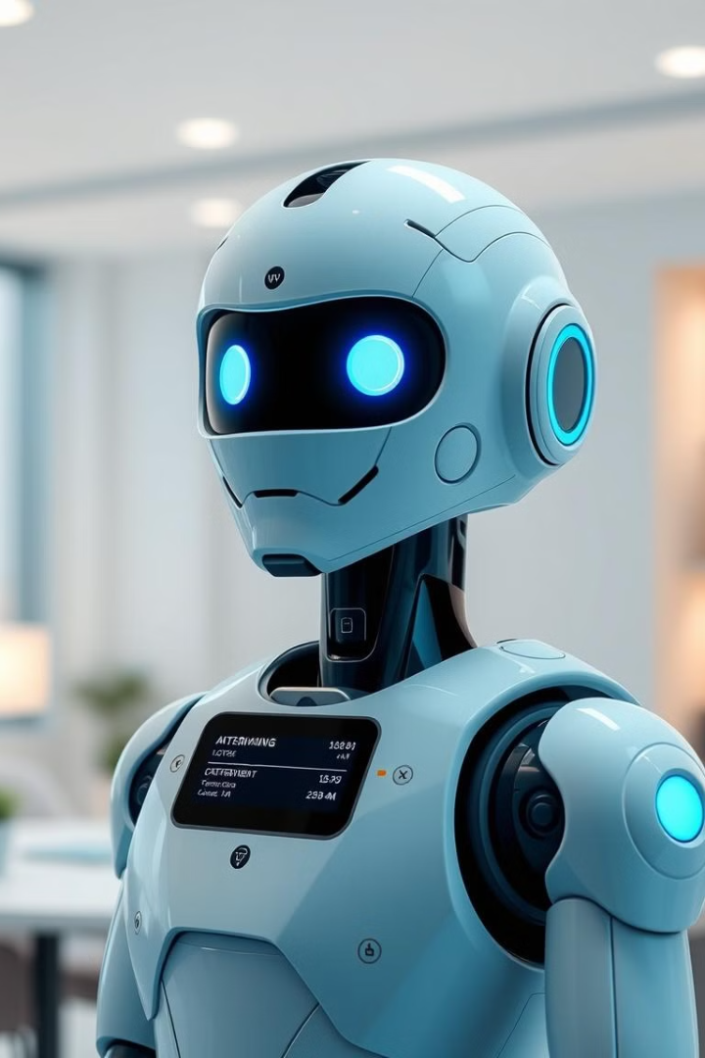

AI Power Scheduling BOT
Automated Interview Scheduling Solution
Presented by TEAM 7/G
by Susnata Das Mahapatra
Notes:
1

Slide 2
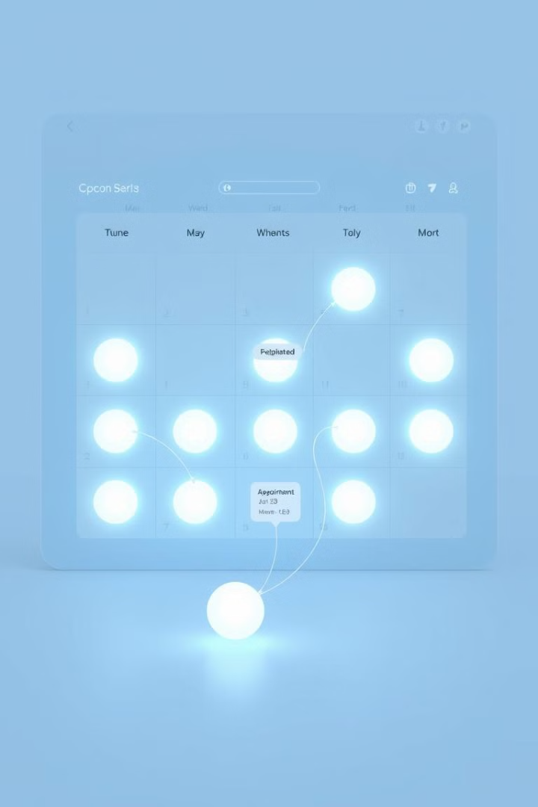
Solution Overview
Key Functionality
Problem Addressed
1
2
Automates scheduling with NLP, Google Calendar, and email.
Reduces manual effort, avoids conflicts, boosts efficiency.
Architecture
3
Flask web interface; Python, SQLAlchemy, SendGrid, Google API; spaCy.
Notes:
2

Slide 3
Live Demonstration
Key Features
Core Components
UI submission of emails
Calendar Integration: Google Calendar API
Email-based availability parsing
NLP Parsing: spaCy (en_core_web_sm-3.8.0)
Automated scheduling
Automation Logic: Matching and notification
Notes:
3

Slide 4
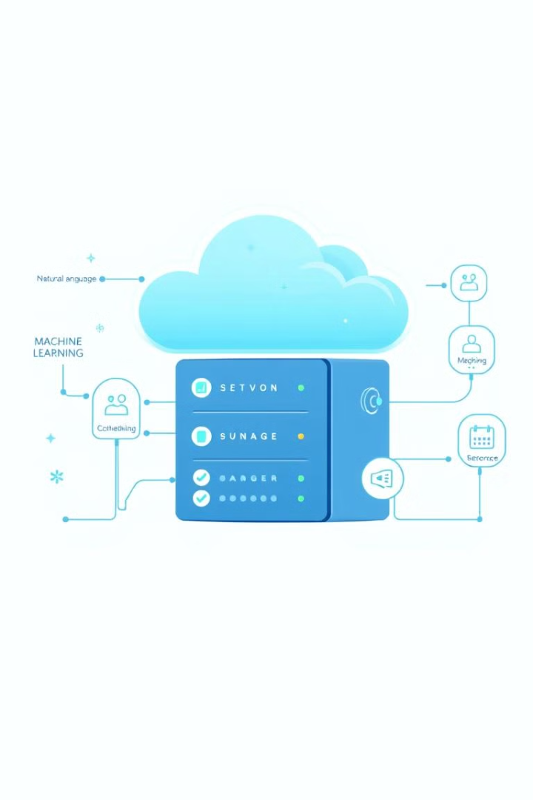




Tech Stack
Python
Flask
SQLAlchemy
Primary Language
Web Framework
Data Management
spaCy
NLP Model
Notes:
4

Slide 5

Questions & Discussion
We’re happy to answer your questions!
Notes:
6

