Slide 1

Dark Matter Simulation

Slide 2
N-body Simulations
By Trayan Momkov (Own work) [CC-BY-SA-3.0 (http://creativecommons.org/licenses/by-sa/3.0)], via Wikimedia Commons

Slide 3
N-body Simulators
NEMO Stellar Dynamics Toolbox
  Many flexible tools
  People use it
MilkyWay@Home
  Much faster
  Easy 3d visualization

Slide 4
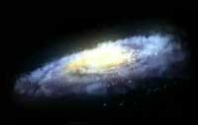
Galactic Components
Disk
  Miyamoto-Nagai
Bulge
  Plummer
Dark Matter Halo
  NFW
  Log
  Caustics
Artist's Conception of the Milky Way (NASA)

Slide 5
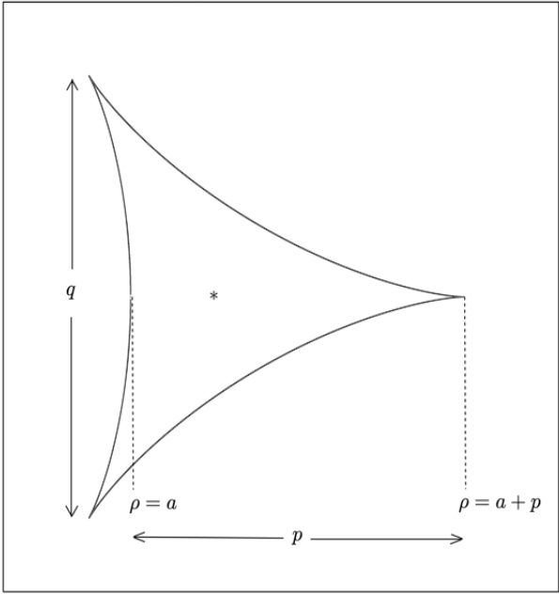
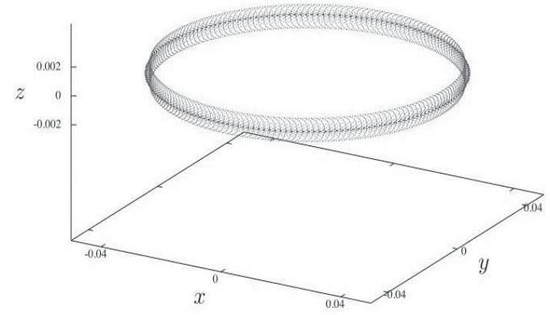
Caustic Halo
Outer caustics (spheres)
Inner caustics (rings)
  20 tricusp rings pointing outward
Duffy & Sikivie 2008
Natarajan & Sikivie 2006

Slide 6
Monoceros Ring
What is the Monoceros Ring?
  Ring-shaped filament of stars outside the galaxy
How could it be relevant to caustics?
  Radius very close to n=2 caustic ring
  Lies in galactic plane

Slide 7
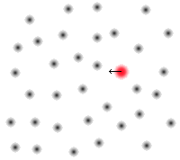
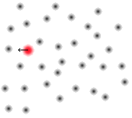
Dynamical Friction
Objects lose energy when traveling through a “sea” of particles
Energy loss depends on density and relative velocity

Slide 8
Current Challenges and
Future Goals
Construct density profile near and far
  Deal with “infinite” densities
Create relative velocity function
Create representations of larger bodies
Run simulations, release results, release code

Slide 9
Questions?

