Slide 1

Dark Matter Simulation

Slide 2
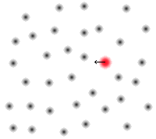
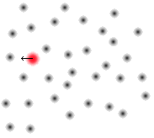
Dynamical Friction
Objects lose energy when traveling through a “sea” of particles
Energy loss depends on density and relative velocity

Slide 3
Current Challenges and
Future Goals
Construct density profile near and far
  Deal with “infinite” densities
Create relative velocity function
Create representations of larger bodies
Run simulations, release results, release code

Slide 4
Solution 1: Analytical Solutions
Advantages:
  As exact as you can get
Disadvantages:
  Can be very hard or even impossible
  Can take a long time to produce or to discover that it is impossible
Results:
  None

Slide 5
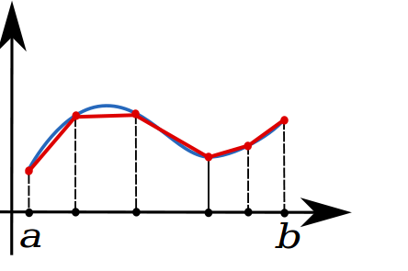
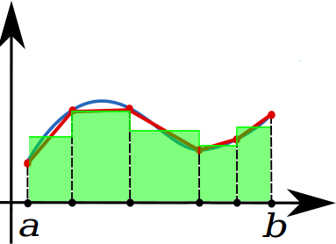
Solution 2: Numerical Integration and Averaging
Oleg Alexandrov (Wikipedia)

Slide 6
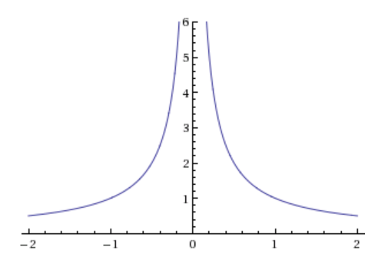
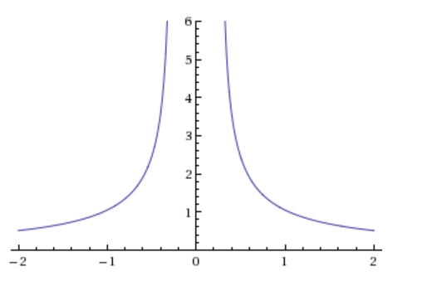
Solution 2: Why it Fails Utterly

Slide 7
Solution 2: Numerical Integration and Averaging
Advantages:
  Easy and quick, can be applied to many problems
Disadvantages:
  Does not work at all
Results:
  None; it doesn't work

Slide 8
Solution 3: Ignore the Problem
Advantages:
  Quick
  Easy
Disadvantages:
  Function's influence can massively differ arbitrarily
  Can be either under or overestimate
Results:
  Weak dynamical friction

Slide 9
Solution 4: Make it More Infinite
Advantages:
  Still not too hard
  All mass can act
  Does not depend much of time steps
Disadvantages:
  Needs total area under the function
  Only good when most of the function's area lies near the spike
Results:
  Weak dynamical friction

Slide 10
Questions?

