Slide 1

Distributed version control with Git
Part 1:
Working locally
Daniel Sussman
https://gitlab.com/dmsussman/workingWithGit/

Slide 2
Common commands / outline of talk
Command | Description
git init | Initialize a git repository / this talk
git add files | Add the files to the staging area
git status | View the status of files in working directory and staging area
git commit –m “message” | Record a snapshot of the staging area
git checkout | Switch branches or checkout a file / commit
git log, git diff | View a record of commits; see what is different between versions of a file
git help [verb] | Get help on the specified command

Slide 3
What is version control?
A (systematic) way of managing multiple versions of programs, documents, databases, etc.
Theorem: Almost all real projects use some kind of version control.
Corollary: ....

Slide 4
Why use version control?
Team work:
* Makes working collaboratively much easier
Individual work:
* Scientific reproducibility of code
* Magical time machine for reverting to previous version of code

Slide 5
Git is a distributed system
for version control
Distributed:
No copy of a repository is more important than others (except by convention)
Get version control even if offline
Git advantages:
Very resilient (because it’s distributed)
Very fast
Very compressed (favors frequent, small updates)
Very widely used (every git question, ever, has been asked on Stack Overflow)

Slide 6
Git stores a “repository” as a
graph of snapshots
HEAD
master
C0
C1
C4
C6
C2
C3
C5
This is what git thinks repositories look like
...and what we’ll understand in this talk
latexBranch

Slide 7
Step 0: install git
Is git already on your computer?
Type ”git –version” on the command line to find out
If not...
Windows: https://git-for-windows.github.io/
Mac: https://sourceforge.net/projects/git-osx-installer/files/ or “brew install git” or...
Linux: “sudo apt-get install git” or “sudo yum git” or ...
Set default user name and email
$ git config --global user.name ”My Name”
$ git config --global user.email ”myEmail@email.email"

Slide 8
Starting a new repository: the plan
Our basic workflow will be:
(start a repository)
Edit some files
Stage those changes
Review those changes
Commit those changes
... and repeat

Slide 9
Starting a new repository: git init
Let’s navigate to a blank directory and begin...
$ git init
We’ve just initialized an empty repository!

Slide 10
Starting a new repository: git init
Hey, it turns out I’m writing my Ph.D. thesis... in vim
...let’s start with a few mystical commands
$ vim chapter1.rtf
$ git add chapter1.rtf
$ git commit -m “Chapter 1 finished”
Version control does not just have to be code!
We’ll follow this pretend project for the rest of the talk

Slide 11
Git’s thoughts about this repository
HEAD
A special pointer referencing
current commit
master
The branch that snapshot is on
(will be clearer soon!)
C0
A snapshot of the repository...
(i.e., “chapter1.rtf”)

Slide 12
The (local) trees of git
The “HEAD”
The last committed snapshot of the repository
The “Staging area” (or “Index”)
A proposed next snapshot
The “Working directory” (or “working tree”)
Where you do work!

Slide 13
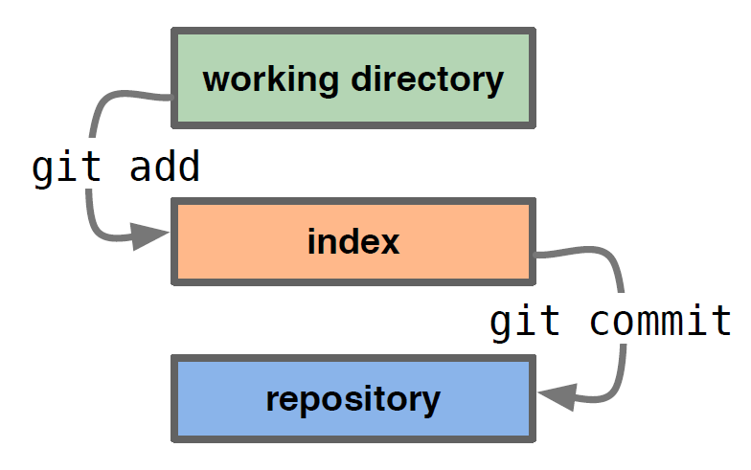
The (local) trees of git
HEAD /
repository
Index
Working Directory
Checkout project... make changes
Stage changes
Commit changes
Modified and
unmodified files
Committed files
Staged files

Slide 14
Looking at the current status: git status
HEAD
$ git status
On branch master
nothing to commit, working tree clean
master
C0
HEAD
Index
Working Directory
chapter1.rtf

Slide 15
Life cycle of a commit: Editing files
HEAD
$ vim chapter2.rtf
master
C0
HEAD
Index
Working Directory
chapter1.rtf
chapter2.rtf

Slide 16
Life cycle of a commit: seeing changes
HEAD
$ git status
On branch master
Untracked files: (use "git add <file>..." to include in what will be committed)
chapter2.rtf
nothing added to commit but untracked files present (use "git add" to track)
master
C0
HEAD
Index
Working Directory
Look at all those helpful messages!
chapter1.rtf
chapter2.rtf

Slide 17
Life cycle of a commit: git add
HEAD
$ git add chapter2.rtf
$ git status
On branch master
Changes to be committed: (use "git reset HEAD <file>..." to unstage)
new file: chapter2.rtf
master
C0
HEAD
Index
Working Directory
git add stages files
to be committed
chapter1.rtf
chapter2.rtf

Slide 18
Life cycle of a commit: git status
HEAD
$ vim chapter3.rtf
$ git status
On branch master
Changes to be committed:
new file: chapter2.rtf
Untracked files:
chapter3.rtf
master
C0
HEAD
Index
Working Directory
chapter1.rtf
chapter2.rtf
chapter3.rtf

Slide 19
Life cycle of a commit: git status
HEAD
$ git add chapter3.rtf
$ git status
On branch master
Changes to be committed:
new file: chapter2.rtf
new file: chapter3.rtf
master
C0
HEAD
Index
Working Directory
chapter1.rtf
chapter2.rtf
chapter3.rtf

Slide 20
Looking at the current status: git status
HEAD
$ git commit -m "Chapters 2 and 3 written"
$ git status
On branch master
nothing to commit, working tree clean
master
C0
C1
HEAD
Index
Working Directory
git commit takes a new snapshot
...commit messages are mandatory
(and useful!)
chapter1.rtf
chapter2.rtf
chapter3.rtf

Slide 21
Branches!
After much thought, I’ve decided “.rtf” format is terrible for a thesis...
...if only I could experiment with an alternative

Slide 22
Making a new branch: git checkout
$ git checkout -b latexBranch
Switched to a new branch 'latexBranch'
master
C0
C1
The “-b” option tells git to make a new branch... we’ll see that checkout is quite powerful
latexBranch
HEAD
Index
Working Directory
HEAD
chapter1.rtf
chapter2.rtf
chapter3.rtf

Slide 23
Rescuing me from myself: git checkout
$ rm chapter1.rtf
master
C0
C1
latexBranch
HEAD
Index
Working Directory
HEAD
chapter1.rtf
chapter1.rtf
chapter2.rtf
chapter3.rtf

Slide 24
Rescuing me from myself: git checkout
$ git status
On branch latexBranch
Changes not staged for commit: (use "git checkout -- <file>..." to discard changes in working directory)
deleted: chapter1.rtf
no changes added to commit
master
C0
C1
latexBranch
HEAD
Index
Working Directory
HEAD
chapter1.rtf
chapter1.rtf
chapter2.rtf
chapter3.rtf

Slide 25
Rescuing me from myself: git checkout
$ git checkout -- chapter1.rtf
$ mv chapter1.rtf chapter1.tex
$ vim chapter1.tex
master
C0
C1
latexBranch
HEAD
Index
Working Directory
HEAD
chapter1.rtf
chapter1.tex
chapter2.rtf
chapter3.rtf

Slide 26
Preparing for a new commit...
$ git status
On branch latexBranch
Changes not staged for commit:
deleted: chapter1.rtf
Untracked files:
chapter1.tex
master
C0
C1
latexBranch
HEAD
Index
Working Directory
HEAD
chapter1.rtf
chapter1.tex
chapter2.rtf
chapter3.rtf

Slide 27
Preparing for a new commit...
$ git add --all
master
C0
C1
latexBranch
HEAD
Index
Working Directory
HEAD
chapter1.rtf
chapter1.tex
chapter2.rtf
chapter3.rtf

Slide 28
Committing the new branch
$ git commit -m "re-wrote chapter 1 in tex”
$ git status
On branch latexBranch
nothing to commit, working tree clean
master
C0
C1
C2
HEAD
Index
Working Directory
latexBranch
chapter1.tex
HEAD
chapter2.rtf
chapter3.rtf

Slide 29
Extending the branch
$ mv chapter2.rtf chapter2.tex
$ vim chapter2.tex
$ git add --all
$git commit -m ”converted chapter 2 to tex”
master
C0
C1
C2
C3
HEAD
Index
Working Directory
latexBranch
chapter1.tex
HEAD
chapter2.tex
chapter3.rtf

Slide 30
Moving around the git tree: git checkout
My advisor just asked for another chapter, and I haven’t finished converting everything to TeX yet!

Slide 31
Moving around the git tree: git checkout
$ git checkout master
Switched to branch 'master'
HEAD
master
All of our old .rtf files are still there, in exactly the state we left them in!
C0
C1
HEAD
Index
Working Directory
C2
C3
chapter1.rtf
latexBranch
chapter2.rtf
chapter3.rtf

Slide 32
Moving around the git tree: git checkout
HEAD
$ vim chapter4.rtf
$ git add chapter4.rtf
$ git commit -m “Chapter 4 written in garbage format”
master
C0
C1
C4
HEAD
Index
Working Directory
C2
C3
chapter1.rtf
chapter2.rtf
latexBranch
chapter3.rtf
chapter4.rtf

Slide 33
“Where am I?”: git branch
HEAD
$ git branch
latexBranch
* master
master
I guess we’re on the “master” branch
C0
C1
C4
HEAD
Index
Working Directory
C2
C3
chapter1.rtf
chapter2.rtf
latexBranch
chapter3.rtf
chapter4.rtf

Slide 34
“What have I done?”: git diff
Let’s edit one of our files
HEAD
$ vim chapter4.rtf
$ git status
On branch master
Changes not staged for commit: modified: chapter4.rtf
master
C0
C1
C4
HEAD
Index
Working Directory
C2
C3
chapter1.rtf
chapter4.rtf
chapter2.rtf
latexBranch
chapter3.rtf
chapter4.rtf

Slide 35
“What have I done?”: git diff
Let’s edit one of our files
HEAD
$ git diff
--- a/chapter4.rtf
+++ b/chapter4.rtf
@@ -1,4 +1,4 @@
-Chapter 4: When the going gets tough
+Chapter 4: When the going gets tough...really tough
master
C0
C1
C4
HEAD
Index
Working Directory
C2
C3
chapter1.rtf
chapter4.rtf
chapter2.rtf
latexBranch
chapter3.rtf
chapter4.rtf

Slide 36
Undoing changes: git checkout
That edit wasn’t so edifying.... let’s undo it and switch back to the latexBranch
$ git checkout -- chapter4.rtf
$ git checkout latexBranch
master
C0
C1
C4
HEAD
Index
Working Directory
C2
C3
chapter1.tex
HEAD
latexBranch
chapter2.tex
chapter3.rtf

Slide 37
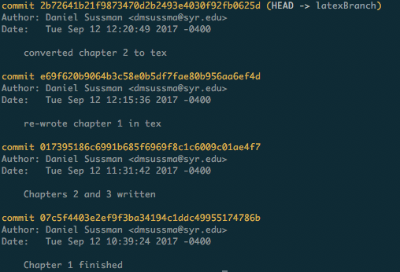
“What have I done?”: git log
C2
C3
$ git log
latexBranch
HEAD
Just like files and branches, specific commits can also be checked out by their commit hash:
$ git checkout e69f620
(typically just the first 7 characters needed)
This would put you in a “detached head” state...

Slide 38
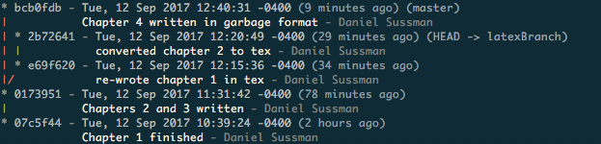
“What have I done?”: git log
$ git lg2
lg2 = log --graph --abbrev-commit --decorate --format=format:'%C(bold blue)%h%C(reset) - %C(bold cyan)%aD%C(reset) %C(bold green)(%ar)%C(reset)%C(bold yellow)%d%C(reset)%n'' %C(white)%s%C(reset) %C(dim white)- %an%C(reset)' --all
...git is extraordinarily feature-rich, and can take a very long time to learn. The most essential features, though, are straightforward

Slide 39
Let’s finish this thesis...
$ git checkout latexBranch
$ mv chapter3.rtf chapter3.tex
$ vim chapter3.tex
$ git add --all
$git commit -m ”converted chapter 3”
master
C0
C1
C4
C2
C3
C5
HEAD
HEAD
latexBranch
chapter1.tex
chapter2.tex
chapter3.tex

Slide 40
Bringing branches back together: git merge
Okay, I think it’s time to merge the experimental laTeX branch with the rest of my thesis!

Slide 41
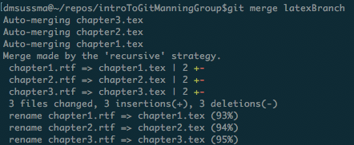
Bringing branches back together: git merge
$ git checkout master
$ git merge latexBranch
HEAD
This creates a new snapshot that points to the last commits on both branches
chapter1.tex
chapter2.tex
chapter3.tex
chapter4.rtf

Slide 42
Git stores a “repository” as a
graph of snapshots
HEAD
master
C0
C1
C4
C6
C2
C3
C5
latexBranch

Slide 43
This is just scratching the surface!
More git resources:
Git’s own documentation!
Just type “git help” or ”git help [command]”
The “Pro Git” book
https://git-scm.com/book/en/v2
TryGit for an interactive walkthrough of basic commands
https://try.github.io/
Atlassian has some nice tutorials for learning git
https://www.atlassian.com/git/tutorials/learn-git-with-bitbucket-cloud

Slide 44
In addition to the above references, I drew inspiration and/or stole slide ideas from:
Zachary Ling, “Fundamentals of Git”
http://slideplayer.com/slide/6171599/
Ruth Anderson’s CSE 390a lecture:
https://courses.cs.washington.edu/courses/cse390a/
https://github.com/ldfaiztt/CSE390A/blob/master/Week%2011/390aGitIntro_12au.pdf

