Slide 1
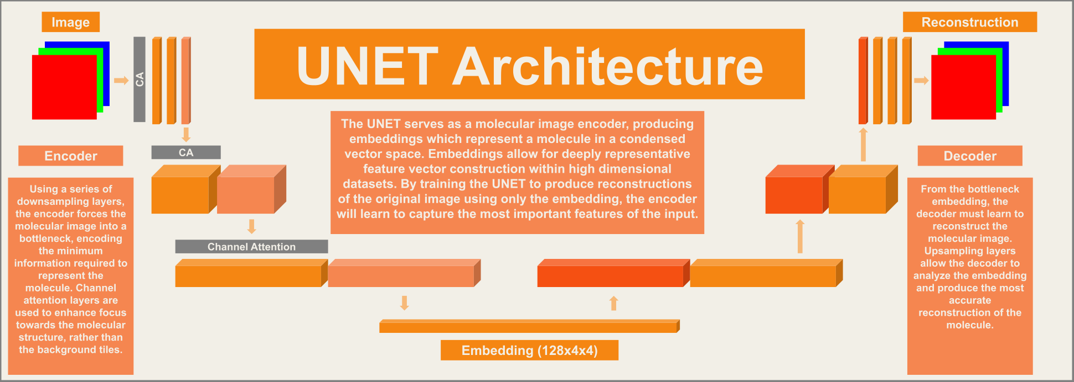
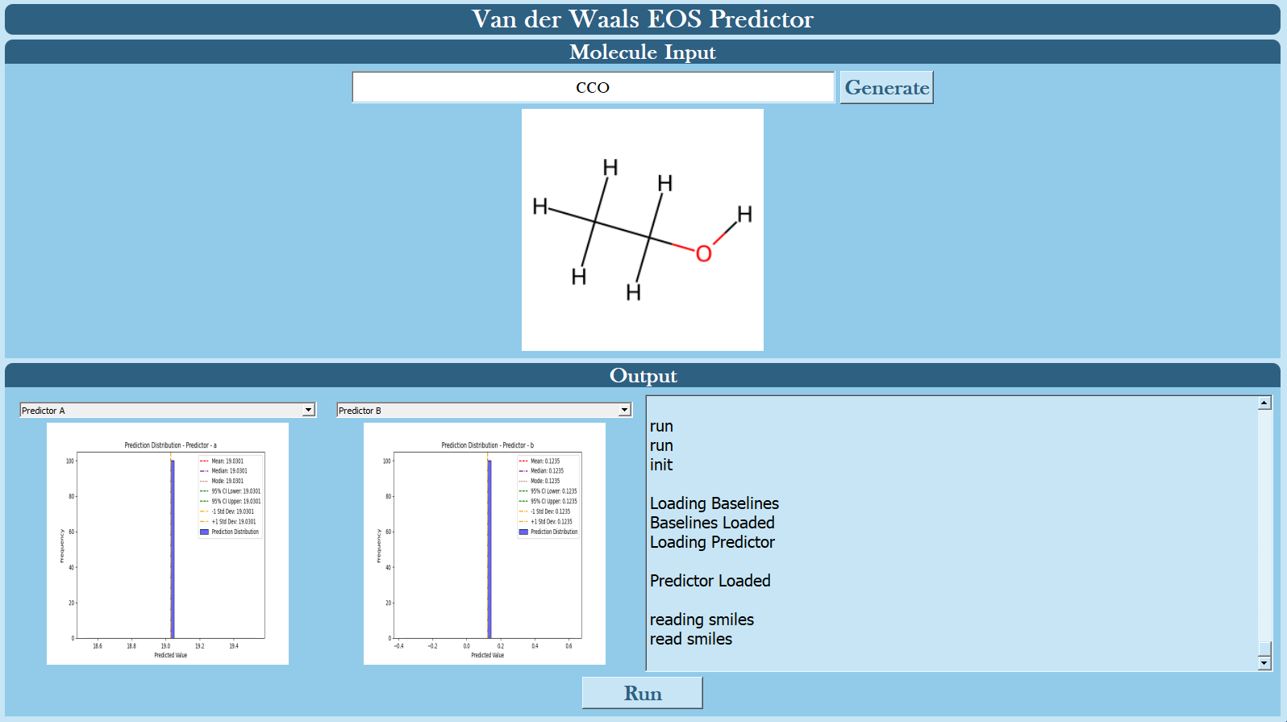
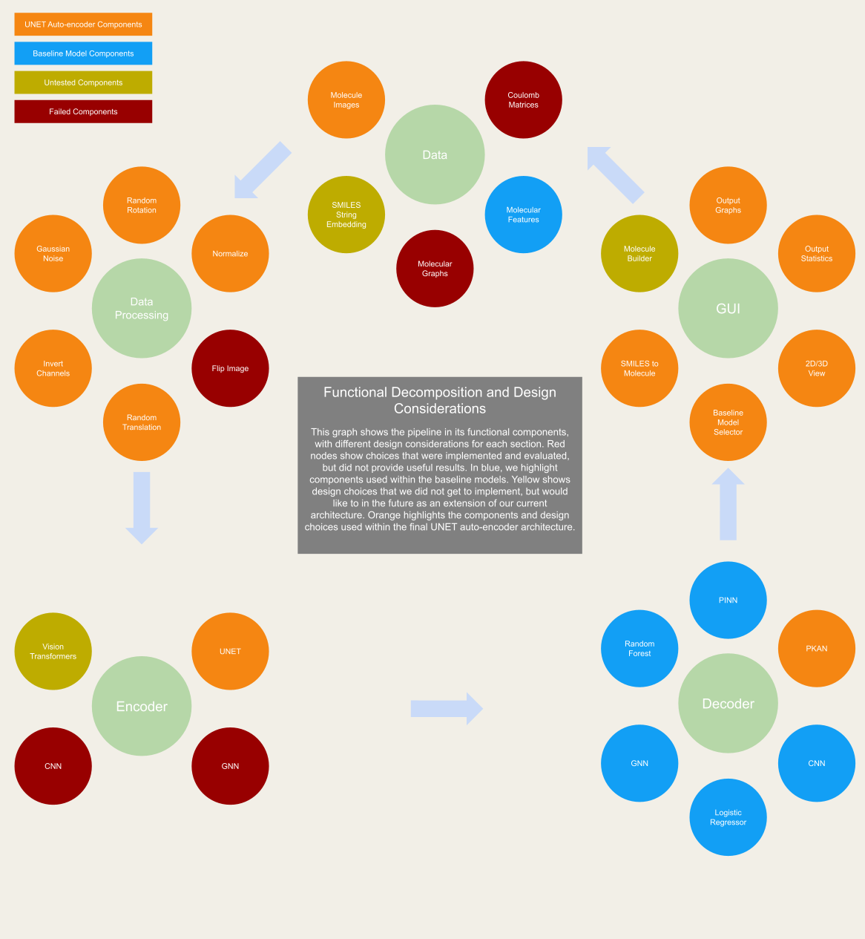
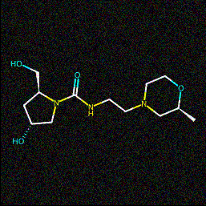
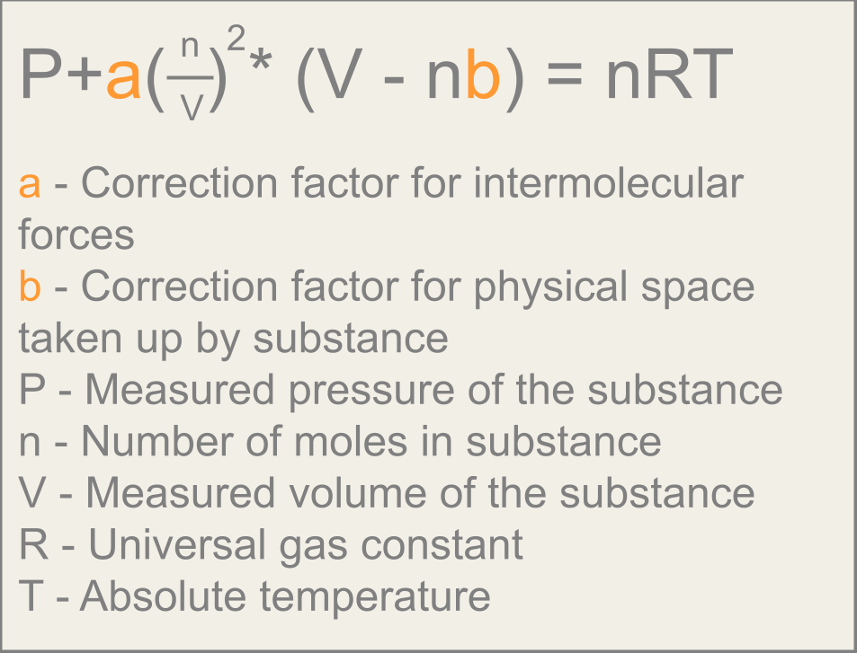
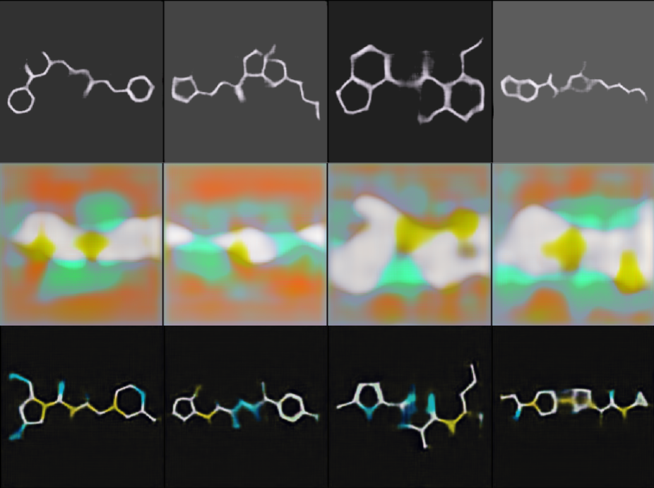
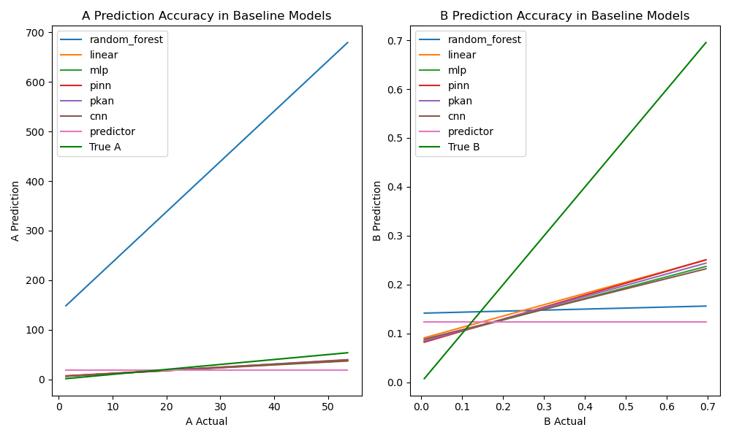
Van der Waals Equation of State Coefficient Predictor
Blake Milstead, Karim Chmayssani, Turner Heath
Introduction
The Van der Waals equation, also known as the Real Gas Law, extends the Ideal Gas Law, accounting for the physical properties of individual molecules within the substance. This provides results that more accurately match experimental data. The corrective factors in the VDW equation, a and b, are determined by the molecule being measured. These constants cannot be calculated and must be experimentally derived. We aim to design a machine learning pipeline which can accurately provide estimations for the a and b constants.
Our customer requirements include a simple standardized method of molecule generation, the ability to process and predict with arbitrary molecules, transparent access to prediction results, and a model that can produce prediction confidence intervals that contain the true values of a and b within the test data.
Applications of VDW
Chemical & Petrochemical Engineering: Predicting gas behavior under non-ideal conditions.
Material Science: Designing processes involving supercritical fluids or gas absorption.
Pharmaceuticals: Modeling solvent-gas interactions in drug formulation and delivery.
Thermodynamics Education: Demonstrating real gas deviations from ideal gas laws.
GUI
Input
Results
The original goal was to outperform simple baseline models by leveraging a novel masked autoencoding U-Net architecture. However, while our U-Net-based embedding generator introduced a unique approach to image-based molecular representation, it underperformed relative to our baselines.
Random Forest: MAE for a: 310.11, b: 0.057
Logistic Regression: MAE for a: 5.09, b: 0.057
MLP: MAE for a: 4.55, b: 0.029
PINN: MAE for a: 4.65, b: 0.028
PKAN: MAE for a: 4.42, b: 0.028
CNN: MAE for a: 5.072, b: 0.033
U-Net + PKAN: MAE for a: 10.48, b: 0.055
The PKAN achieved the best performance on predicting a and b. The U-Net embeddings showed limited diversity, leading to predictions clustered around the dataset mean, failing to meet our original accuracy expectations. However, the architecture demonstrates potential for refinement in future work.
Embeddings
Dataset
A dataset containing 226 non-ionic molecules and their corresponding features was used to train all predictive models.
Reconstructions
Baseline Models To benchmark our novel architecture, we developed baseline models of increasing complexity. All models were trained to directly predict a and b:
Random Forest: A traditional ensemble method for feature-based regression trained on molecular features.
Logistic Regression: A simple linear model trained on molecular features.
MLP: A basic feedforward neural network without domain knowledge trained on molecular features.
PINN: Adds physics-based constraints to the loss function of an MLP.
PKAN: Adds a learnable activation layer to the PINN.
CNN: A simple CNN model trained on molecular images.
Implementation
We implemented a Masked Auto-Encoder (MAE) U-Net architecture, enhanced with channel attention to improve feature extraction. Traditionally, U-Net architectures feature skip connections, which add corresponding input from the encoder to the decoder. As our goal involved generating powerful and representative embeddings, we removed skip connections from the model, forcing the encoder to capture only the most relevant information. The model was trained on 50,000 standardized molecular images from the ZINC15 dataset that were generated from RDKit,. A combined loss function was used: Smooth L2 loss was foreground-weighted to emphasize molecular regions, while Smooth L1 loss promoted the reconstruction of fine edges and structural details. Both losses were applied simultaneously with tuned weighting.
After training, we froze the shallow layers of the U-Net and used it as an embedding generator for our smaller Van der Waals dataset. The resulting embeddings served as input to a PKAN-like model, which produced the final predictions for the a and b constants.
Conclusion
Our novel U-Net-based model underperformed compared to baseline methods, likely due to low diversity in its learned embeddings. RDKit images provide sparse data, while containing a vast amount of information. which resulted in predictions clustering around the mean. In contrast, the PKAN achieved the best performance for predicting a and b. While prediction results did not meet customer requirements, we managed to achieve all other project goals. These results suggest future work should explore richer embedding strategies, such as transformer models trained directly on SMILES strings, to better capture molecular complexity.
[1] M. Rupp, A. Tkatchenko, K.-R. Müller, and O. A. von Lilienfeld, "Fast and Accurate Modeling of Molecular Atomization Energies with Machine Learning," Phys. Rev. Lett., vol. 108, no. 5, p. 058301, 2012.
[2] D. Duvenaud, D. Maclaurin, J. Iparraguirre, R. Bombarell, T. Hirzel, A. Aspuru-Guzik, and R. P. Adams, "Convolutional Networks on Graphs for Learning Molecular Fingerprints," in Advances in Neural Information Processing Systems, vol. 28, 2015.
[3] M. Raissi, P. Perdikaris, and G. E. Karniadakis, "Physics-informed neural networks: A deep learning framework for solving forward and inverse problems involving partial differential equations," J. Comput. Phys., vol. 378, pp. 686–707, 2019.
[4] Unknown, "A sample schematic of a PINN architecture for the linear transport equation," ResearchGate, 2024. [Online]. Available: https://www.researchgate.net/figure/A-sample-schematic-of-a-PINN-architecture-for-the-linear-transport-equation-u-t-u-x_fig5_344783581. [Accessed: Dec. 03, 2024].
[5] Microsoft Research, "VisNet: A General Molecular Geometry Modeling Framework for Predicting Molecular Properties and Simulating Molecular Dynamics," 2024. [Online]. Available: https://www.microsoft.com. [Accessed: Dec. 03, 2024].
[6] Santa Monica College, "10: Experimental Determination of the Gas Constant (Experiment)," LibreTexts, 2020. [Online]. Available: https://chem.libretexts.org/Ancillary_Materials/Laboratory_Experiments/Wet_Lab_Experiments/General_Chemistry_Labs/Online_Chemistry_Lab_Manual/Chem_10_Experiments/10%3A_Experimental_Determination_of_the_Gas_Constant_%28Experiment%29. [Accessed: Dec. 03, 2024].
[7] S. Genheden, A. Reymer, P. Saenz-Méndez, and L. A. Eriksson, "Computational Chemistry and Molecular Modelling Basics," in Computational Tools for Chemical Biology, S. Martín-Santamaría, Ed. Royal Society of Chemistry, 2017, pp. 1–38, doi: 10.1039/9781788010139.
[8] T. N. Kipf and M. Welling, "Semi-Supervised Classification with Graph Convolutional Networks," arXiv preprint arXiv:1609.02907, 2016.
[9] Z. Liu, Y. Wang, S. Vaidya, F. Ruehle, J. Halverson, M. Soljačić, T. Y. Hou, and M. Tegmark, "KAN: Kolmogorov-Arnold Networks," arXiv preprint arXiv:2404.19756, 2024.
[10] The RDKit community, "RDKit Documentation," 2025. [Online]. Available: https://www.rdkit.org/docs/source/rdkit.Chem.html. [Accessed: Mar. 06, 2025].
[11] M. Fey and J. E. Lenssen, "Fast Graph Representation Learning with PyTorch Geometric," arXiv preprint arXiv:1903.02428, 2019. [Online]. Available: https://arxiv.org/abs/1903.02428. [Accessed: Mar. 06, 2025].

