Slide 1
Standard Operating Procedure (SOP) Faculty Guide
Operational guidelines for the ramp-up of research/scholarship in University laboratories, studios, offices and other related workspaces.
Office of the Vice Provost for Research
Notes:
Purpose: To operationalize guidelines for the ramp up of research/scholarship in University laboratories, studios, offices and other related workspaces. Note that these guidelines also apply to currently approved “critical” on-campus research/scholarly activity. All personnel who can perform their work remotely should continue to do so, and those returning to work should only perform tasks that must be done on site as opposed to from home.
You can take off my name. Please add Office of the Vice Provost of Research instead

Slide 2




Standard Operating Protocol (SOP) Faculty Guide
Objectives
HEALTH AND SAFETY of our University and wider community
PHASED RAMP UP of research and scholarly activity
SUPPORT FACULTY AND STAFF
CONSISTENT COMPLIANCE with guidelines
Notes:
Objectives are to:
Ensure the population health and safety of our University and South Florida community during the COVID-19 epidemic
Describe a phased ramping up of research and scholarly activity, guided by key public health principles of physical distancing, use of personal protective equipment, and appropriate disinfection/ hygiene control
Support faculty and staff in achieving stated guidelines for the ramp up
Encourage consistent compliance with guidelines among faculty, students and staff and across campuses
SOPs must be shared with all team members and physically posted in a central, readily visible location for ongoing reference and review.

Slide 3
Training Requirements and Return-to-Work Screening
1.0
Notes:
1.0 Training Requirements and Return-to-Work Screening

Slide 4


1.0 Training Requirements and Return-to-Work Screening
RAMPING UP RESEARCH/ SCHOLARSHIP SOP
ALL TEAM MEMBERS ON MEDICAL CAMPUS are required to complete the screening tool developed by HR before obtaining Return-to-Work approval. A similar tool for Gables/RSMAS will be forthcoming.
REQUIRED reading for all faculty, staff/trainees involved in basic, clinical, and/or translational research, or any other campus-based scholarly activity *
* including artistic and creative endeavors
Along with any changes in their protocols that are necessary to accommodate SOP expectations
To assess COVID-19 exposure and/or symptoms to promote a maximally healthy workforce.
Notes:
All faculty, staff/trainees involved in basic, clinical, and/or translational research, or other campus-based scholarly activity, including artistic and creative endeavors, are required to review the “Ramping Up Research/Scholarship SOP,” as well as any changes in their protocols that are necessary to accommodate SOP expectations.
Faculty or project/lab managers must require that their team members complete the screening tool developed by HR before obtaining Return-to-Work approval (insert HR TOOL link). This tool assesses the presence of any COVID-19 symptoms to promote a maximally healthy workforce.

Slide 5
Population Density
2.0
Notes:
2.0 Population Density

Slide 6
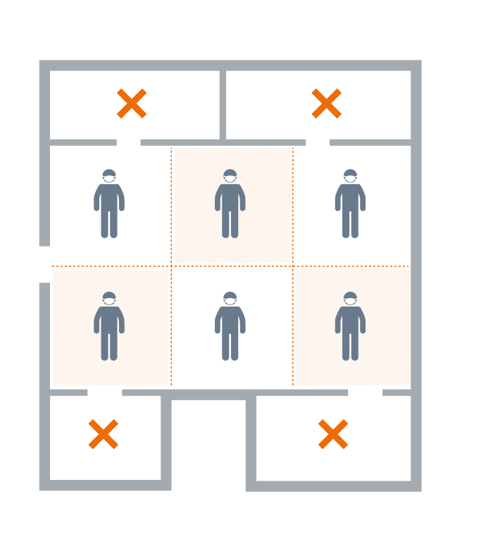
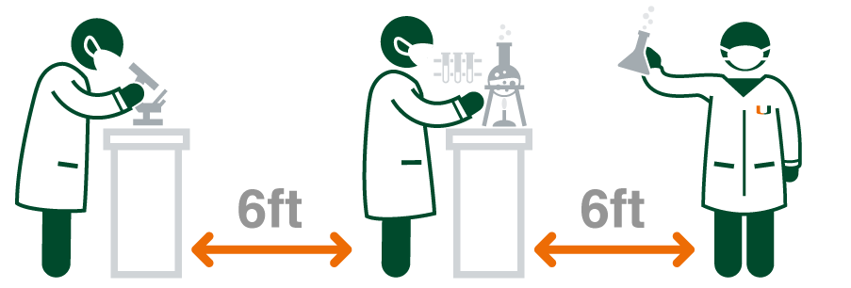
2.0 Population Density
Per University guidelines, only one team member can occupy 200 ft² at at time (including benches or desks).
If necessary and feasible, move common laboratory and/or office equipment so that users maintain at least 6 ft. of space between them.
NOTE: Faculty offices do not count towards the total Laboratory/Studio/Workspace square footage. These spaces should not be used if the work can be done remotely
Notes:
The size of (Enter Faculty Name) Laboratory/Studio/Workspace is XXXX square feet including benches or desks. Faculty offices do not count towards the total Laboratory/Studio/Workspace square footage. These spaces should not be used if the work can be done remotely.
Per University guidelines, only one team member can occupy 200 square feet of any space at a time to ensure appropriate physical distancing, associated with reduced risk of infection and/or transmissibility of disease. The (Enter Name) has XXXX of laboratory/studio and/or working space. This translates to X team members working at any one time.

Slide 7
Shift Work
3.0
Notes:
3.0 Shift Work

Slide 8

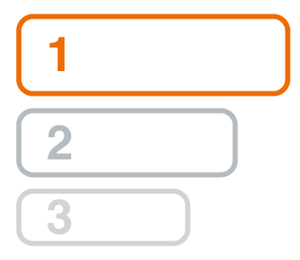
3.0 Shift Work
GIVE PRIORITY (when appropriate) to graduate students, postdocs, and other trainees who have timely requirements for graduation and/or starting a new position.
Faculty lead and/or lab/project manager will establish a calendar for shift work among team members*
* This includes boats and core facilities / shared resources.
Shift organization should be determined in a manner that is methodologically acceptable/feasible.
Notes:
To achieve stated population density goals, the faculty lead and/or lab/project manager will establish a calendar for shift work among team members.*
* This includes boats and core facilitites/shared resources.
Shift organization should be determined by the faculty and/or lab/project manager in a manner that is methodologically acceptable/feasible and give priority, when appropriate, to graduate students, postdocs, and other trainees who have timely requirements for graduation and/or starting a new position.

Slide 9

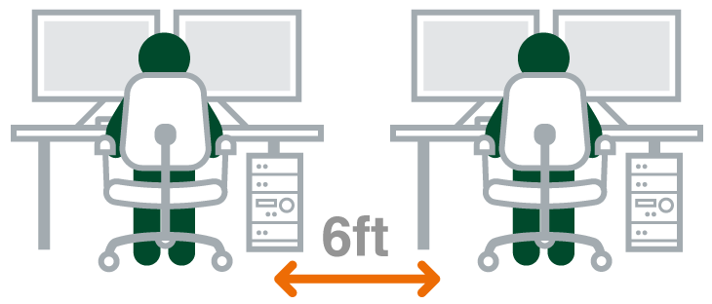

3.0 Shift Work
Shifts must also include shared spaces, such as art/creative studios, film editing rooms, animal facilities, and/or cell culture rooms
Faculty lead and/or lab/project manager must coordinate with the other teams who also use these shared spaces and report their plan for scheduling in their SOP.
**
Personal safety is still a key consideration during times of low-staff density. Those working with hazardous chemicals or materials are reminded not to work alone and not to work at off hours when fewer people are present. Establish a buddy system with a neighboring space or lab, or use check in/check out by phone or text with the PI or another research team member, especially if coming to work early in the morning or late in the evening.
Notes:
Shifts must also account for work that occurs in shared spaces, such as art/creative studios, film editing rooms, animal facilities, and/or cell culture rooms and requires coordination with the other teams who also use these spaces for their research/scholarly purposes. Faculty lead and/or lab/project manager must report: The (Name of Group) shares use of (Name of XXX facility or culture room and Room Number) with (Names of other labs/workgroup). (Name of PI or Lab or Project manager) has coordinated with (Names of personnel from other labs/workgroups) on (enter date) to ensure appropriate physical distancing can be maintained. **
**Personal safety is a key consideration during times of low-staff density. Those working with hazardous chemicals or materials are reminded not to work alone and not to work at off hours when fewer people are present. Establish a buddy system with a neighboring space or lab, or use check in/check out by phone or text with the PI or another research team member, especially if coming to work early in the morning or late in the evening when there is likely even less foot traffic.
(Enter #) Faculty Members
(Enter #) Staff Members, including laboratory/project manager, technicians, etc.
(Enter #) Post Docs
(Enter #) Graduate Students
Given the amount of square footage for the (Enter Name) Laboratory/Studio/Workspace, only X team members can be scheduled for work simultaneously.

Slide 10
Other Physical Distancing Requirements
4.0
Notes:
Other Physical Distancing Requirements

Slide 11
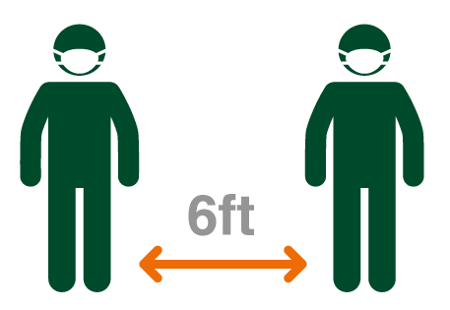


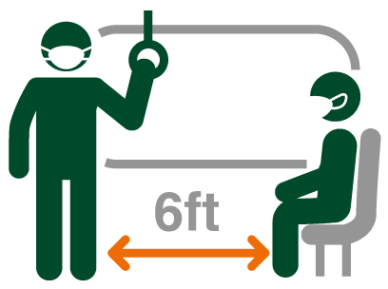

4.0 Other Physical Distancing Requirements
KEEP A DISTANCE of 6ft between individuals
If this is not possible, APPROPRIATE PPE MUST BE WORN
Avoid close interactions and surface contamination
during commutes, building entry and exit, elevator rides, movement in stairways, and bathroom breaks
One person per bathroom at a time
Notes:
When feasible, keep a distance of 6 feet between individuals. In cases in which this is not possible, appropriate PPE must be worn.
Avoid close interactions and surface contamination during commutes, building entry and exit, elevator rides, movement in stairways, and bathroom breaks. One person per bathroom at a time; leave and return later if you find that a bathroom is occupied.

Slide 12

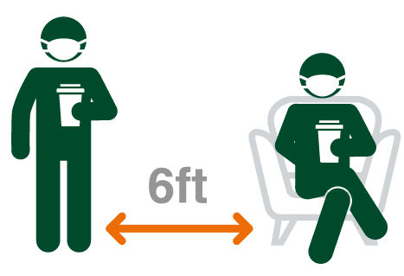

4.0 Other Physical Distancing Requirements
Maintain appropriate SOCIAL DISTANCING
In common areas used during lunch and coffee breaks
Protective face coverings MUST be worn unless eating.
Develop a safety protocol for deliveries to all offices/studios/ research labs/workspaces.
Use only disposable plates/cups/flatware etc.
or bring your own, which must be washed and removed after each use.
Follow all other safety guidelines articulated by Executive Leadership, Emergency Management and Environmental Health and Safety. (https://coronavirus.miami.edu/updates-and-messages/index.htm). Procedures and guidelines may change, so please stay up to date with email and other University communications.
Notes:
Maintain social distancing during lunch and coffee breaks. Common areas can be used for breaks; however, appropriate physical distancing must be maintained. Protective face coverings must be worn unless eating. Use only disposable plates/cups/flatware etc. or bring your own, which must be washed and removed after each use.
Follow all other safety guidelines articulated by Executive Leadership, Emergency Management and Environmental Health and Safety. (https://coronavirus.miami.edu/updates-and-messages/index.htm). Procedures and guidelines may change, so please stay up to date with email and other University communications

Slide 13
Personal Safety Requirements
5.0
Notes:
5.0 Personal Safety Requirements

Slide 14
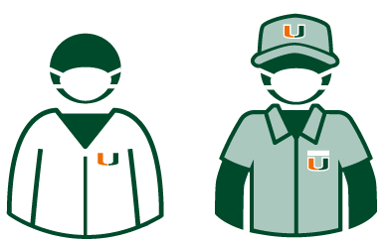



5.0 Personal Safety Requirements
ALL faculty, staff, and students are required to wear approved face coverings while on campus.
ALL faculty, staff, and students working in CLINICAL AND/OR COMMUNITY SETTINGS are also required to wear face coverings when interacting with other team members and/or research subjects.
Lab coats MUST be worn in RESEARCH LABS. Donned upon entering the lab and doffed just prior to leaving.
Please look to signage or Emergency management communications for pick up locations
DO NOT share lab coats. DO NOT pile used lab coats with clean ones
MUST be professionally laundered
Notes:
All faculty, staff, and students are required to wear approved face coverings while on campus including in buildings except when eating or alone in a private office. Masks for (Enter name of Building) on (name of campus) are available at X location—should be auto-populated in Redcap or infoready).
All faculty, staff, and students working in clinical and/or community settings, including boats, are also required to wear approved face coverings as part of their interactions with other team members and/or research subjects. Protective face coverings for such activities should be acquired at the (Building name) for the primary lab or office location.
Lab coats must be worn in BL1 (and above) research labs, These should be donned upon entering the lab and doffed just prior to leaving. Do not share lab coats, and do not pile used lab coats with clean ones. Lab coats must be professionally laundered.
Change bottom-–masks for…
please look to signage or Emergency Management communications for pickup locations.

Slide 15



5.0 Personal Safety Requirements
ALL studios/laboratories and/or other workspaces should use EPA listed disinfectants or wipes to wipe down any benches, desktops, and/or equipment*
Other PPE use will be determined by the type of work being conducted and Environmental Health and Safety standards
* Especially doorknobs and any other high touch surfaces
** Use disposable gloves when cleaning/disinfecting.
PPE ordering for laboratory will be coordinated centrally using https://umiami.qualtrics.com/jfe/form/SV_0SzxGefUHu9eylD
The location of disinfection spray, wipes, cleaning supplies should be specified in each group’s SOP
Notes:
Other PPE use will be determined by the type of work being conducted and Environmental Health and Safety standards. For clinical research, PPE use must be consistent with the standards for a given clinic and/or clinical setting (e.g., CTU). PPE ordering for laboratory will be coordinated centrally using LINK.
All studios/laboratories and/or other workspaces should prepare XXXX or acquire XXXX from XXXX to wipe down any benches, desktops, and/or equipment at the beginning and end of each shift with attention to doorknobs or any other high touch surfaces. The location of disinfection spray bottles, wipes, cleaning supplies should be specified in each group’s SOP.
Input from Jess
LNK https://umiami.qualtrics.com/jfe/form/SV_0SzxGefUHu9eylD

Slide 16







5.0 Personal Safety Requirements
DO NOT share Personal Computers and Telephones
Common equipment to be used by one person at a time
KEEP DOORS CLOSED to individual labs to avoid air flow
DO NOT share pens/pencils.
Carry your own
Use elbow/knuckle to operate buttons. Leave the lights on
DO NOT use railings in the staircases
Notes:
Remember the following cleaning/disinfection guidelines:
Personal computers and telephones are not to be shared. In instances where this is not possible, please wipe them down before and after use.
Common equipment, including printers/copiers, is to be used by one person at a time and must be disinfected before/after each use.
In wet lab buildings, keep doors to individual laboratories closed to avoid air flow between rooms that are positively vs. negatively pressurized
Do not share pens/pencils. Carry a pen with you for your own use.
Use an elbow or a knuckle on elevator or other buttons, and leave the light switches on.
Use the automatic door openers (elbow or knuckle); do not use railings in the staircases.

Slide 17







5.0 Personal Safety Requirements
Wear disposable gloves to reduce touching your face
Clean your phone/cellphone - do not take to the restroom
Sneeze/cough into your ELBOW
Dispose of tissues immediately
DO NOT reuse tissues
DO NOT put on lip balm or makeup outside of your home
WASH your hands
Notes:
When possible, wear disposable gloves to reduce your propensity to touch your face.
Clean your phone/cellphone, and do not take your cell phone with you to the restroom. Do not leave your phone on surfaces in common use areas.
Sneeze/cough into your elbow.
Do not reuse tissues; dispose of immediately after single use and wash your hands (preferred) or use hand sanitizer.
Do not put on lip balm or makeup outside of your home.
Wash your hands, even when you think you do not need to do so.

Slide 18
Personal Health and Well Being
6.0
Notes:
6.0 Personal Health and Well Being

Slide 19
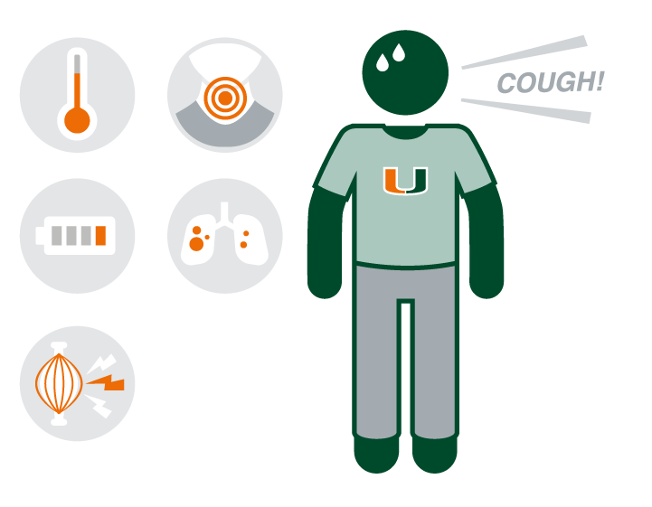
6.0 Personal Health and Well Being
ANY faculty, staff member, or a trainee with any signs of illness, no matter how mild, MUST NOT perform work of any kind in labs, studios, or other workspaces.
They should notify their supervisor and/or Division Director and, then, Employee Health
COVID-19 testing is available to ALL UM employees with symptoms of illness through Employee Health by contacting: 305-243-TEST
Notes:
If a faculty, staff member, or a trainee feels any signs of illness, no matter how mild, they must not perform work of any kind in laboratories, studios, or other workspaces. They are encouraged to notify their supervisor and/or Division Director and, then, Employee Health. COVID-19 testing is available to all UM employees who have symptoms of illness through Employee Health by contacting 305-243-TEST, option # X.

Slide 20
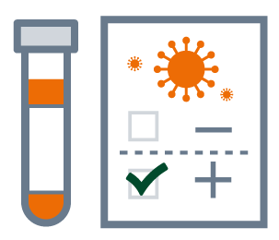


6.0 Personal Health and Well Being
ALL UM PERSONNEL testing positive or have tested positive for COVID-19 must
MUST self-report the positive COVID-19 test result to utrace@miami.edu
ARE REQUIRED to participate in UM’s contact tracing initiative
ARE REQUIRED to self-quarantine at home for at least 14 days
Notes:
All personnel working or learning at UM who test positive or have tested positive for COVID-19 at an outside facility must self-report the positive COVID-19 test result to utrace@miami.edu
All personnel who test positive for COVID-19, either through UM or an outside agency, are required to participate in UM’s contact tracing initiative to ensure that anyone with whom they had close contact is appropriately notified, monitored for symptoms, and can self-quarantine to avoid further unnecessary transmission of infection.
Individuals who test positive for COVID-19 will be required to self-quarantine at home for at least 14 days. Return-to-work must be approved by Human Resources, reported to the Employee Hotline (305-243-TEST) and requires adherence to the personal safety requirements described above.

Slide 21
Additional Research Guidance for Phase I
7.0
Notes:
7.0 Additional Research Guidance for Phase I

Slide 22



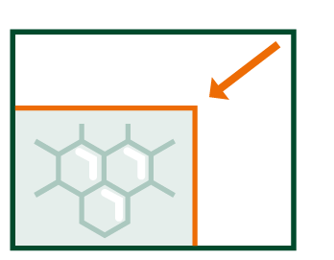
7.0 Additional Research Guidance for Phase I
For clinical, and/or population research:
Non-critical, clinical research activities will REMAIN SCALED BACK
Community-based/ face to face data collection will remain “ON PAUSE”
Subject recruitment should occur via phone and/or social media*
Data collection should occur via phone or online REDCAP platform*
* when possible and given IRB approval
Notes:
For clinical, and/or population research:
Other non-critical, clinical research activities will remain scaled back during this phase to avoid interfering with, or unnecessarily complicating, the ramping up of elective procedures and outpatient visits.
Community-based data collection that involves face to face contact or in-home visits (as opposed to participant observation or community mapping) remain “on pause” to avoid unknown exposures to infection that may occur in such settings.
Subject recruitment efforts should occur via phone and/or social media when possible and given IRB approval.
Data collection, particularly questionnaire or survey based, should occur via phone or online REDCAP platform, when possible, given IRB approval.

Slide 23




7.0 Additional Research Guidance for Phase I
For clinical, and/or population research:
Intervention delivery should move to an ONLINE PLATFORM*
ANY research in UHealth facilities must conform to volume requirements/ needs
Clinical research team members must take necessary precautions to reduce exposure to infection.
Similar protections will be required for those engaged in community-based research
* when possible and given IRB approval
Notes:
Intervention delivery should move to an online platform, when possible, given IRB approval.
Any research in UHealth facilities must conform to, or follow, the volume requirements/needs of a given clinic. Clinical research coordinators must get the approval of the clinic manager, prior to arriving, to ensure that their presence will not compromise necessary physical distancing guidelines for patients and/or providers. Patient care and the safety of our healthcare workforce must remain our top priority.
Clinical research team members must take necessary precautions to reduce exposure to infection. This includes wearing protective face coverings in and out of University buildings, as described below, and wearing a gown or other PPE that can be removed/discarded before travel between clinics and/or their office. If informed consent is signed by hand (vs. electronically), gloves must be worn and separate containers carried for used vs. sanitized pens. Used pens must be wiped down with 70% alcohol.
Similar protections will be required for faculty and staff engaged in community-based research that involves close contact with participants for recruitment and/or data collection purposes

Slide 24


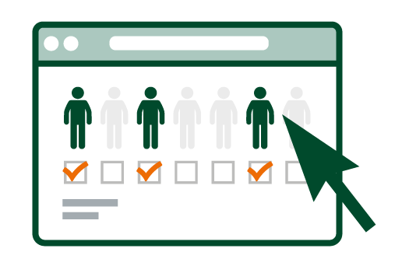
7.0 Additional Research Guidance for Phase I
For field research:
Field research should be delayed unless delaying will have substantial detrimental impact
Research on boats or while diving must maintain physical distancing and appropriate hygiene measures
Develop a means of designating who is present at the field research space at any given time
If safety guidelines for a specific project require more than one person, physical distancing should be followed
Notes:
For field research:
Field research should be delayed unless delaying the research will have a substantial detrimental impact on the research project or a student’s progression towards a degree.
Research performed on boats or while diving must maintain physical distancing and appropriate hygiene measures, as described below and in RSMAS COVID-19 diving memo (4/2/2020).
Develop a means of designating who is present at the field research space at any given time, preferably through an online sign-in tool, or other mechanism of controlling the number of people at the same location at the same time.
If safety guidelines for the specific field research project require more than one person to be present at a location at one time, individuals must maintain at least a 6-foot separation at all times. If the appropriate physical separation cannot be maintained, this work cannot be started.

Slide 25




7.0 Additional Research Guidance for Phase I
For field research:
Travel to and from such locations should ideally occur with one person/car
Field locations must not be used for social gatherings or group meetings
Transfer of items should be arranged by leaving them in a designated area for a no-contact approach
Research studies must be carefully and thoughtfully planned as support services will be reduced
Notes:
Travel to and from such locations should ideally occur with one person/car
Field locations must not be used for social gatherings or group meetings.
​Transfer of items should be arranged by leaving them in a designated area for a no-contact approach, as opposed to handing them over in person.
Research studies must be carefully and thoughtfully planned given the likelihood that support services will be operating at reduced levels.

Slide 26


7.0 Additional Research Guidance for Phase I
For shared resources/core facilities:
Necessary core facilities/shared resources should be staffed and resume operations consistent with the aforementioned guidelines.
Disinfect shared equipment/instruments between use
Use a shared calendar to determine when equipment is available and avoid unnecessary physical interaction
Notes:
For shared resources/core facilities:
Necessary core facilities/shared resources should be staffed and resume operations consistent with the aforementioned guidelines. Those that involve shared equipment and/or instruments require disinfecting between use, as well as, a shared calendar for all users to determine when equipment is available to avoid unnecessary physical interaction.

Slide 27
Compliance
8.0
All faculty, staff, and students are expected to follow these SOP guidelines as well as those recommended by University leadership for reducing disease risk. Deviation from the SOP will result in initial official warning to the lead faculty member involved, and any deviation thereafter may lead to a possible, temporary loss of on campus privileges for that faculty member and their team to ensure optimal public health. Faculty with concerns and/or observations about SOP non-compliance should feel comfortable contacting the Vice Provost for Research.
Notes:
8.0 Compliance
All faculty, staff, and students are expected to follow these SOP guidelines as well as those recommended by University leadership for reducing disease risk. Deviation from the SOP will result in initial official warning to the lead faculty member involved, and any deviation thereafter may lead to a possible, temporary loss of on campus privileges for that faculty member and their team to ensure optimal public health.

