Slide 1
INDiC: Improved Non-Intrusive load monitoring using load Division and Calibration
Nipun Batra
Haimonti Dutta
Amarjeet Singh

Slide 2
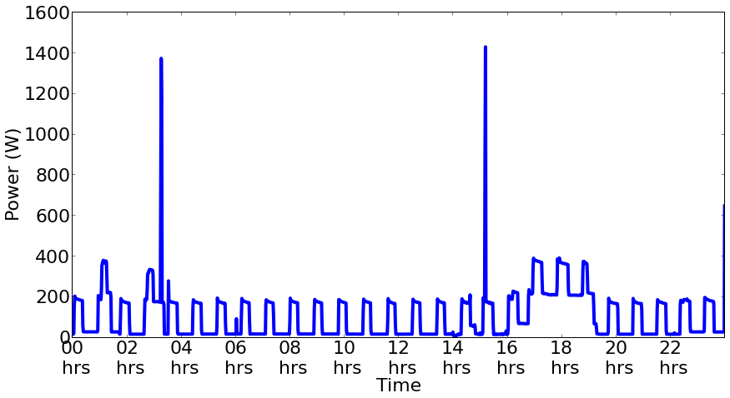
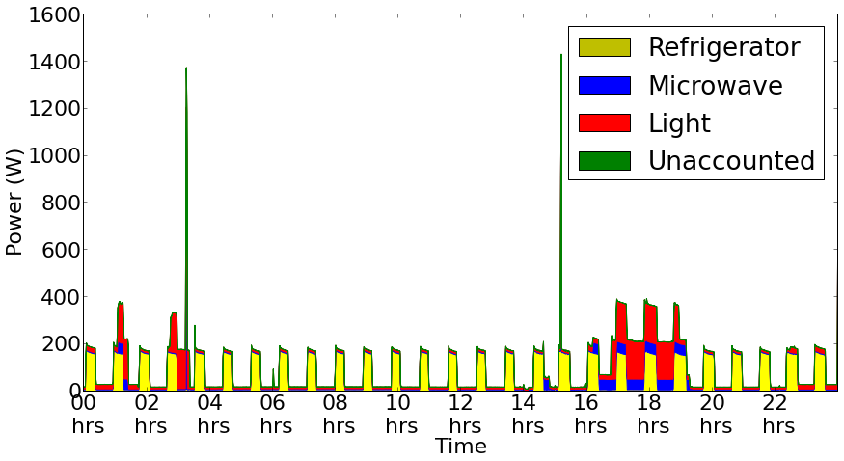
Non Intrusive Load Monitoring (NILM)
Breaking down aggregate power observed at meter into different appliances

Slide 3

Why India?
Different socio-economic settings
How is a residential deployment in India different?

Slide 4
Deployment Overview
Family characteristics:
Single family
3 members
Medium Income
Home characteristics:
3 storey
720 sq. feet

Slide 5
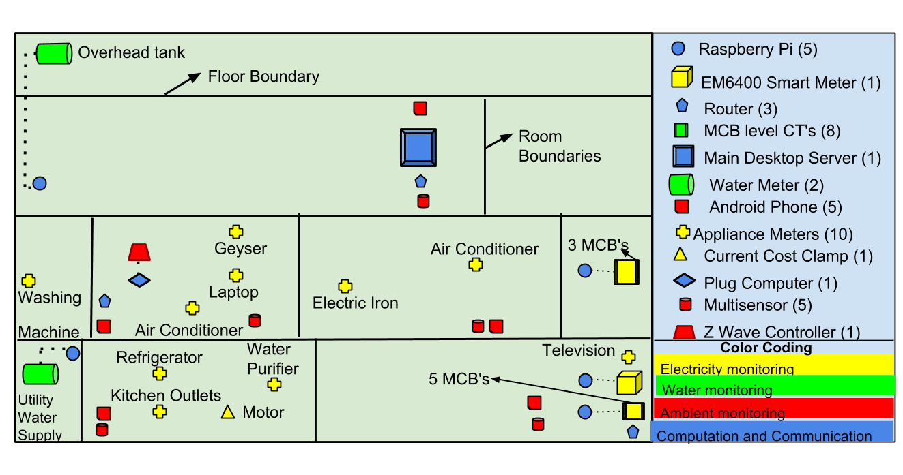
Deployment Overview: Sensing
Multiple sensing modalities: Electricity, Water, Ambient
Water Energy nexus provides interesting insights

Slide 6
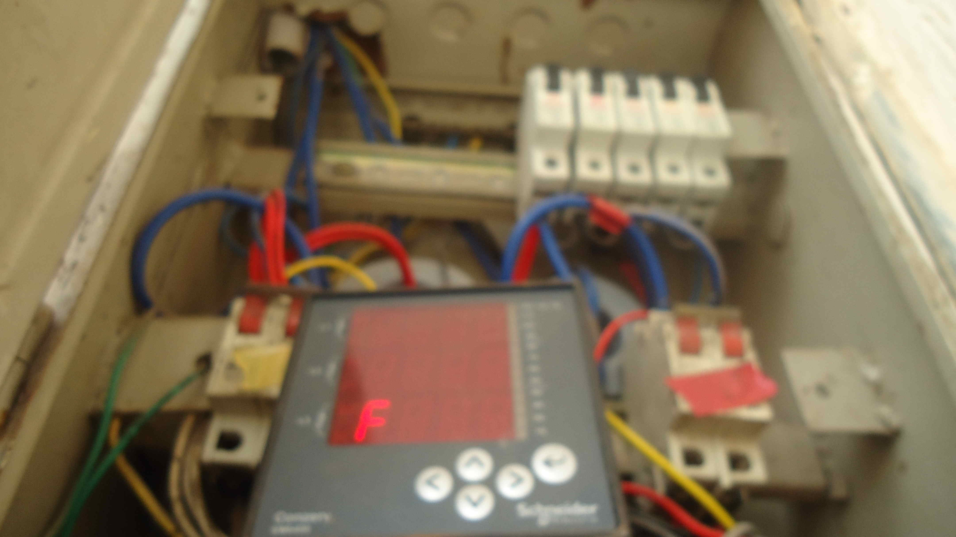
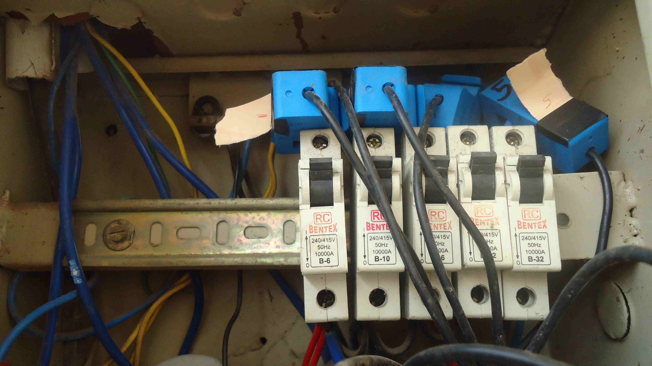
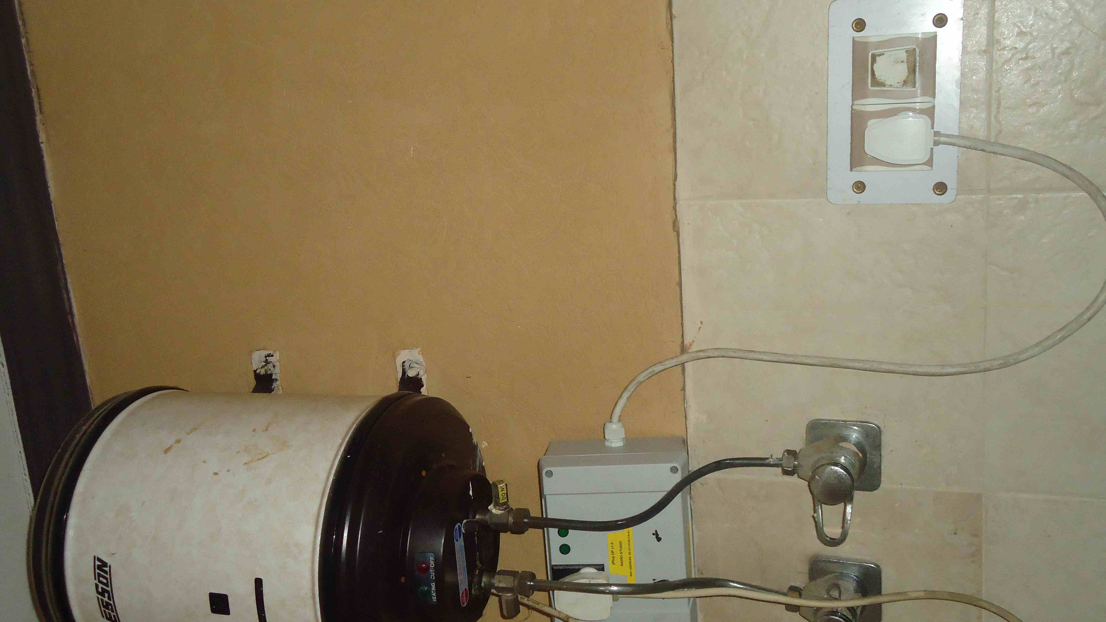
Electricity monitoring
Smart Meter
Circuit Breaker
Appliance Level
Measuring electricity consumption at Supply, MCB, Appliance
Research questions:
Value of additional information (and associated cost)?
What level of invasiveness?

Slide 7
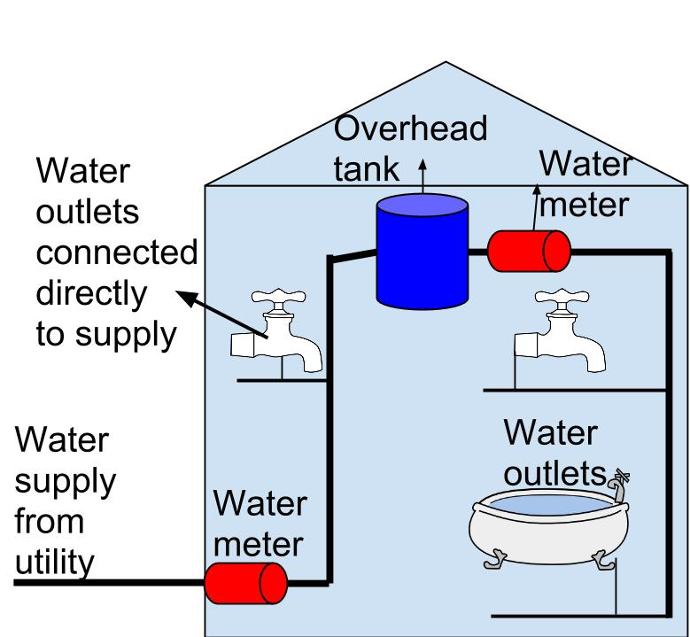
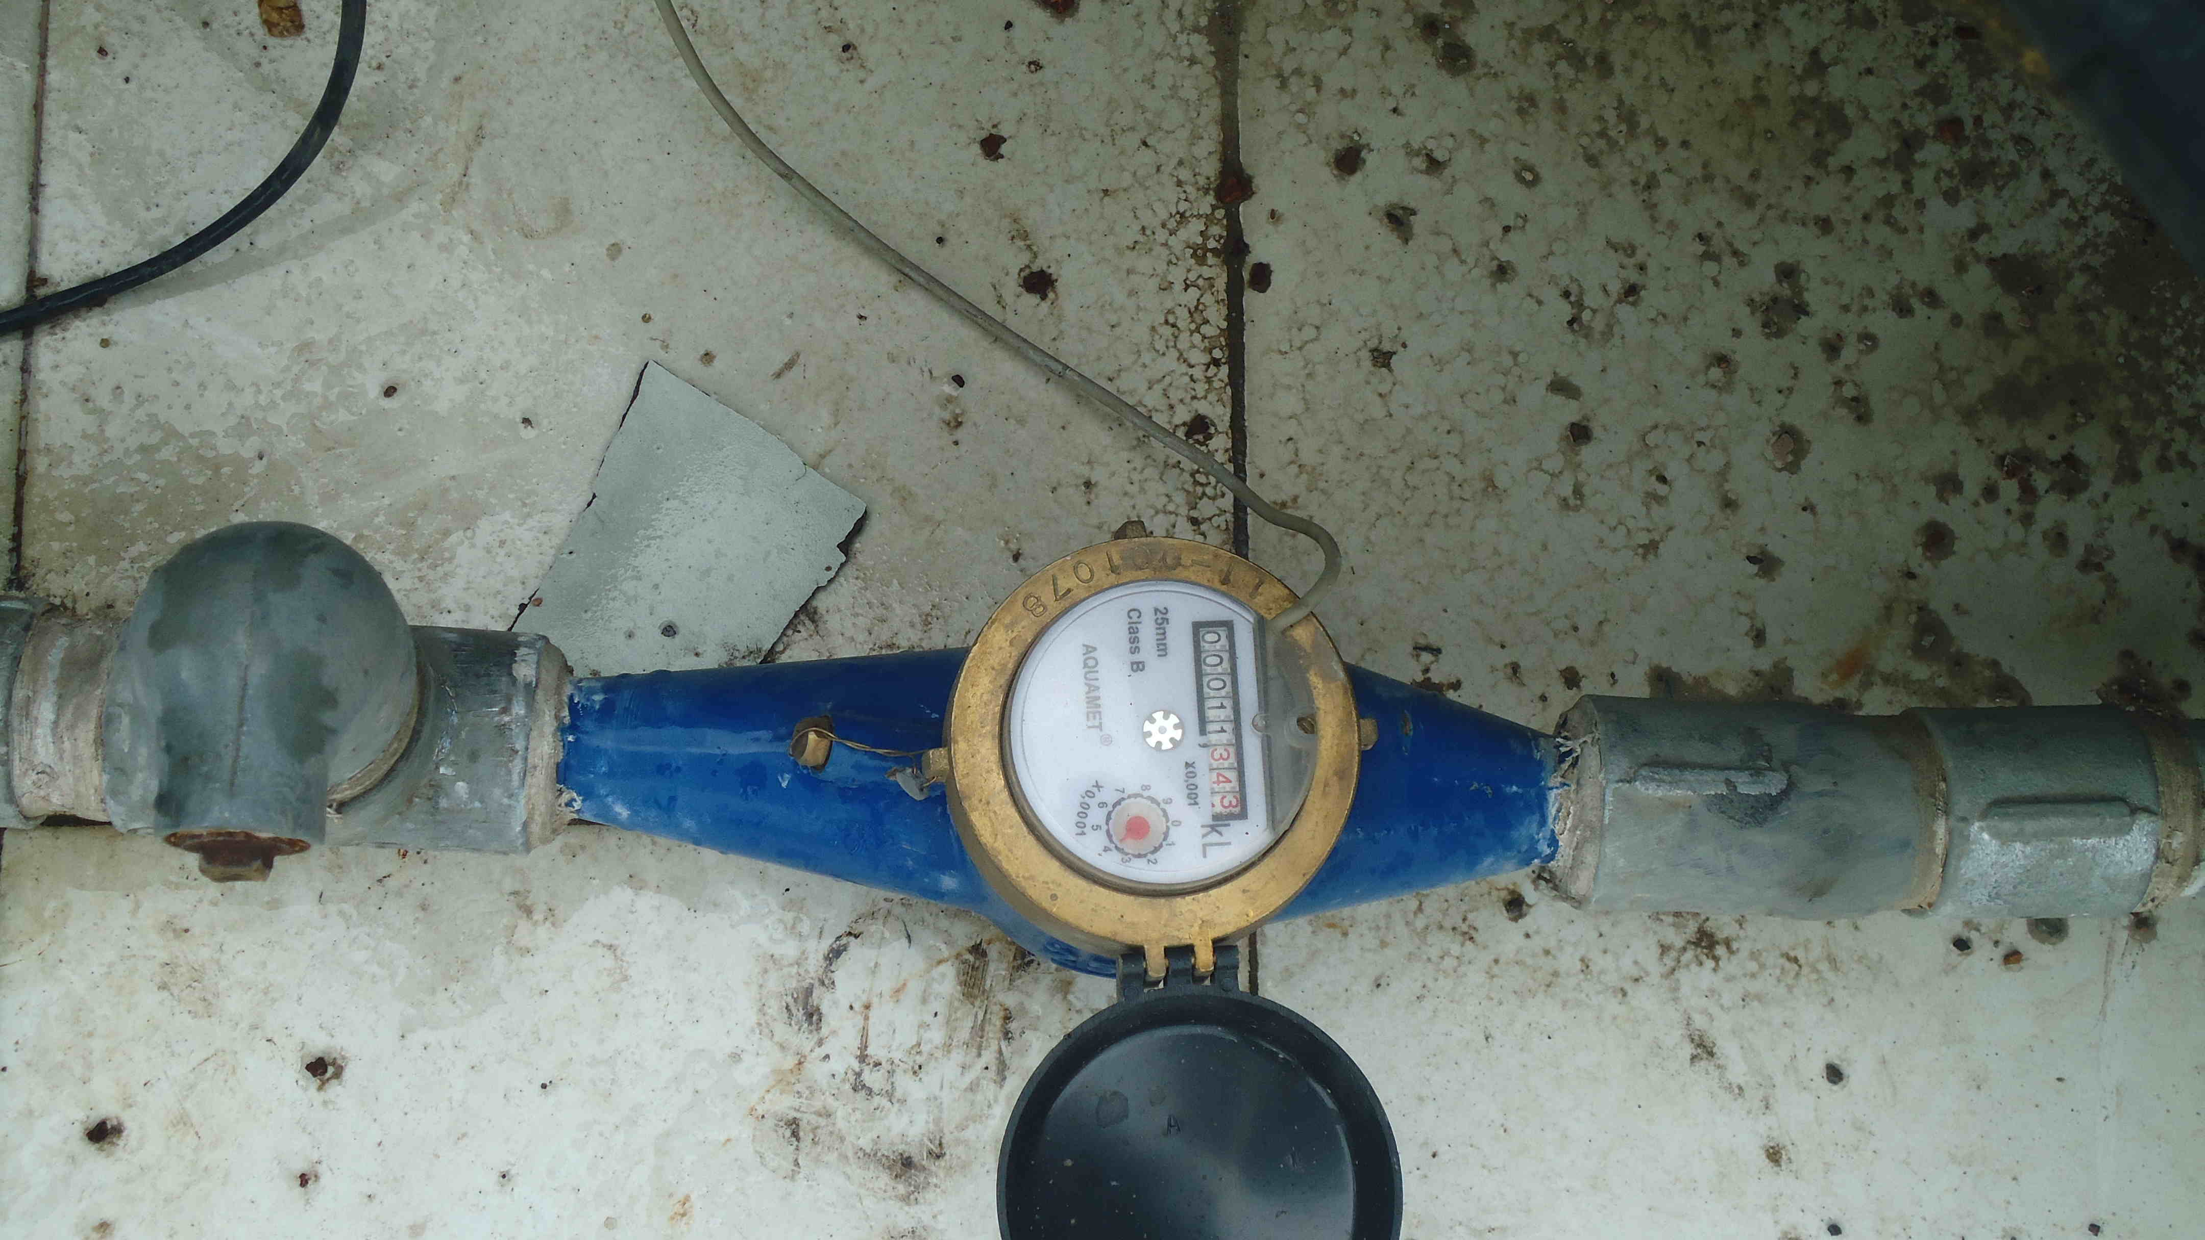
Water monitoring
Pulse based water meter
Water supply available only for 2 hours in a day
Pumps used to store water in tanks- Water has EMBEDDED Energy
Instrument the demand and the supply using Pulse based meters

Slide 8
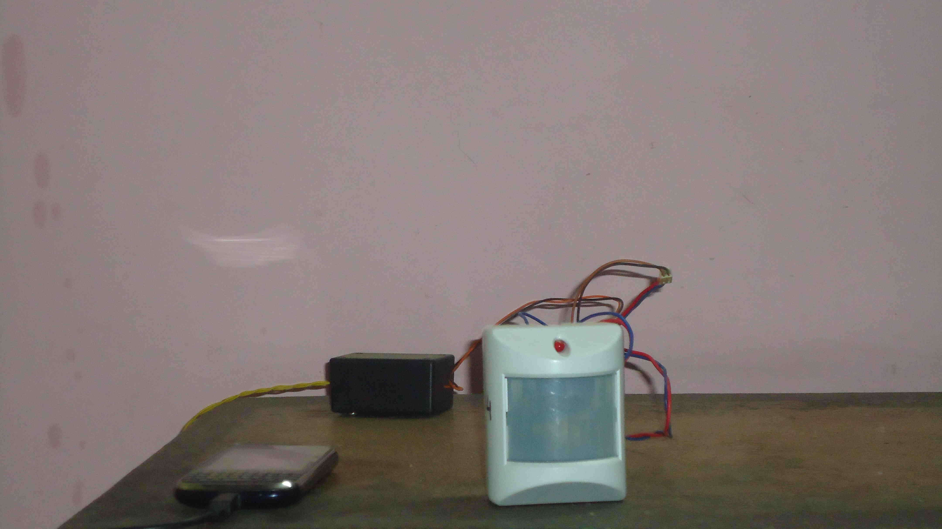
Ambient sensing
Energy consumption correlated with ambient settings
Measure following ambient parameters
Light
Temperature
Motion
Sound level
Bluetooth, WiFi
ZWave Multisensor +Android

Slide 9
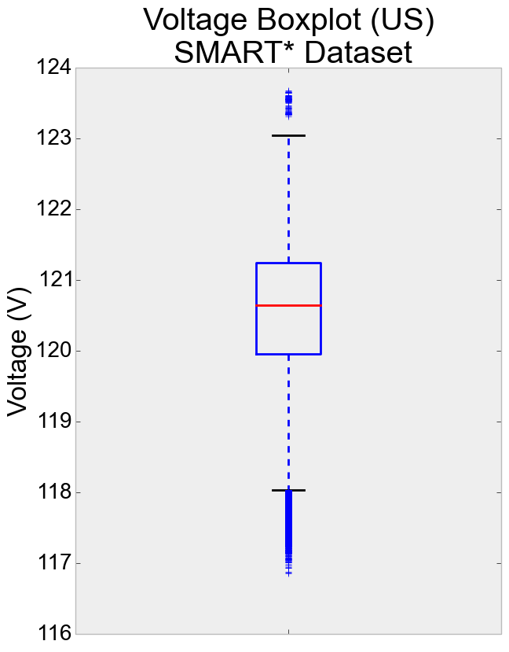
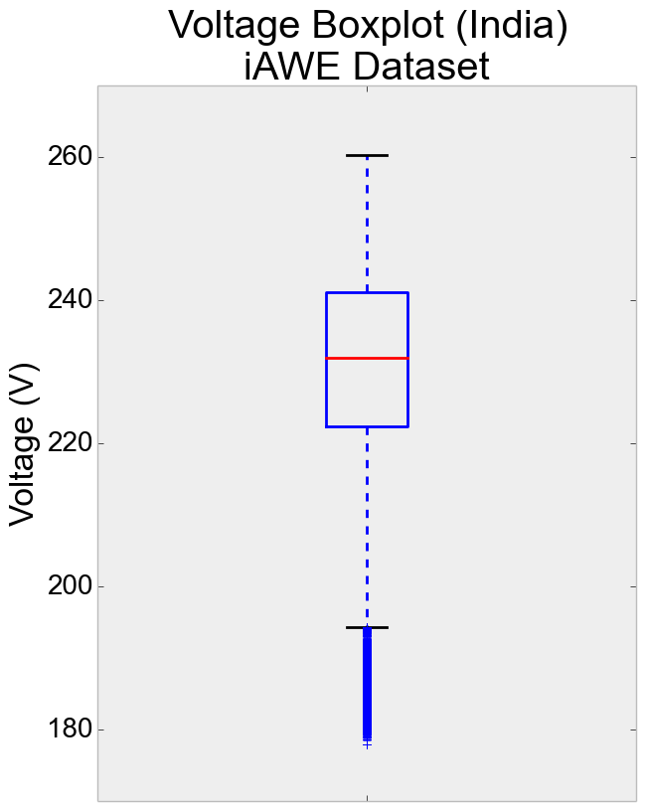
Unique Features in India Unreliable Grid
Voltage fluctuation
Quartile Spread: 9%
Quartile Spread: Less than 1%

Slide 10
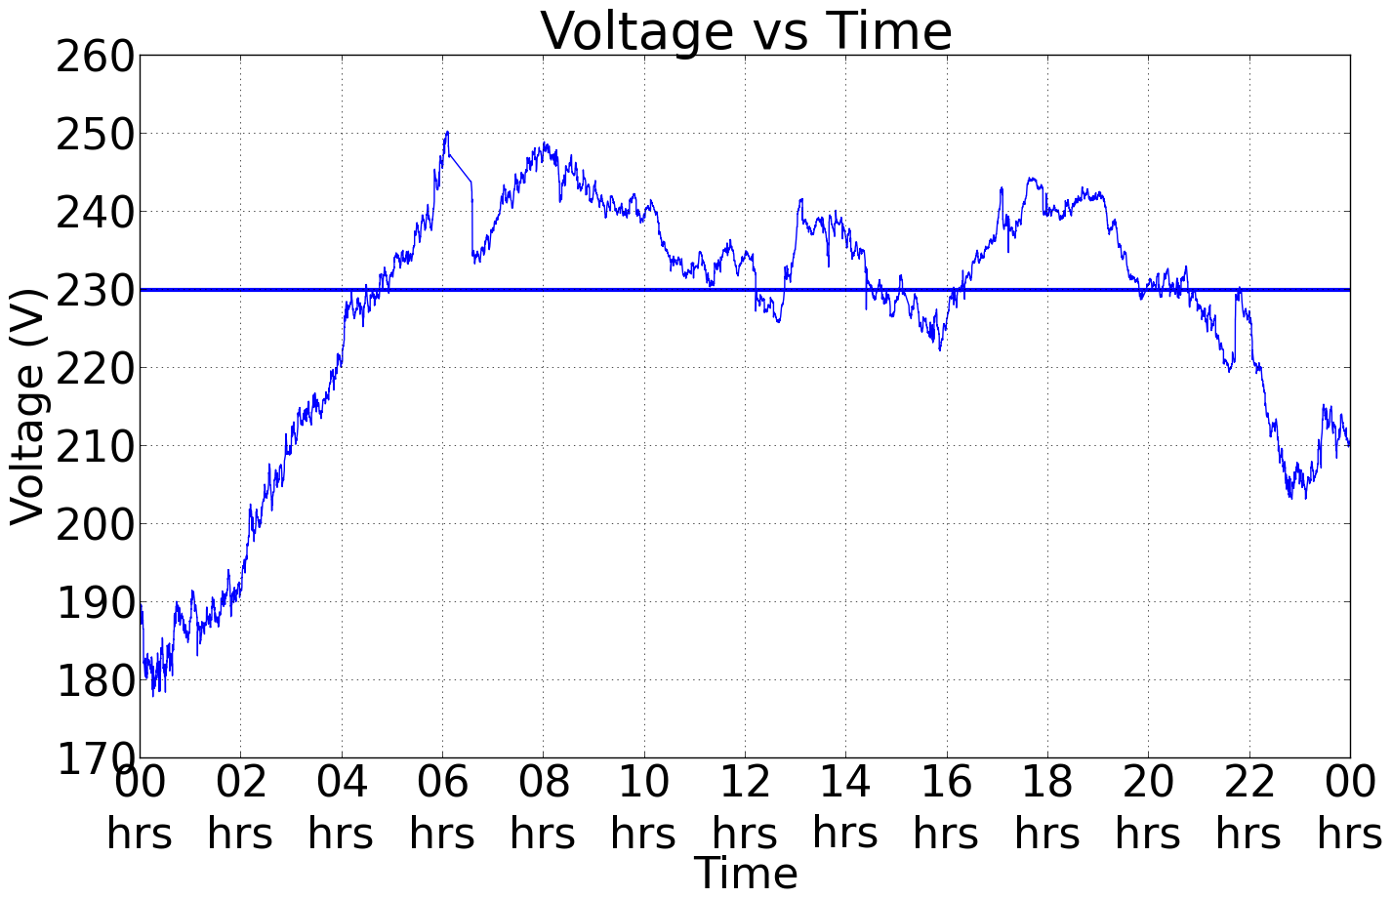
Unique Features in India Unreliable Grid
Voltage fluctuation
Highest voltage typically seen early morning
Lowest voltage typically seen around midnight- ACs in most home are ON

Slide 11
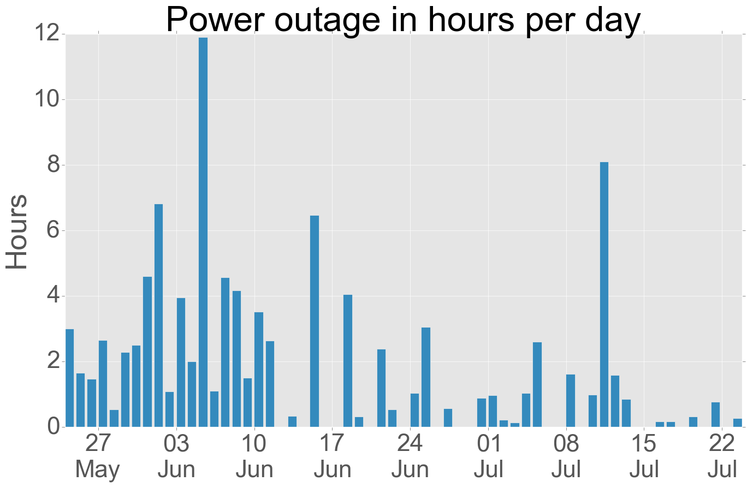
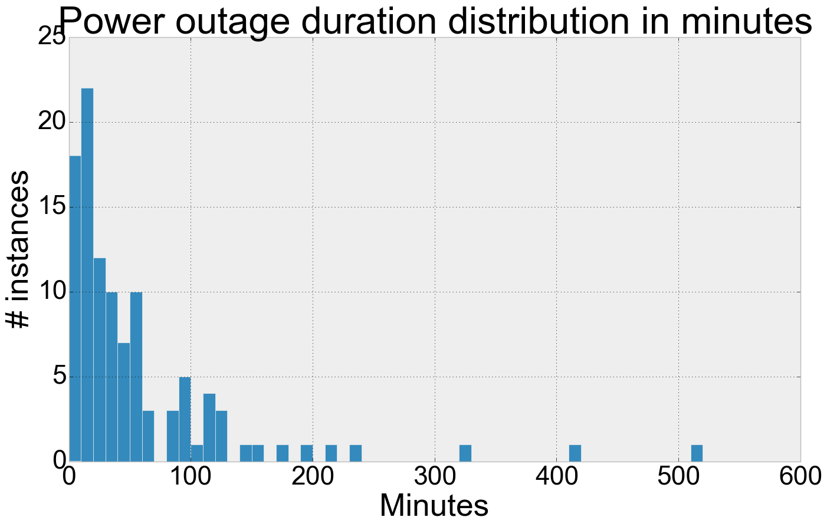
Unique Features in India Unreliable Grid
2. Blackouts
Observed power outages upto 12 hours a day!
Single power outages of upto 9 hrs observed!

Slide 12
Unique Features in India Unreliable Grid
3. Learning
System Design: System should be capable of resuming in same state as it was before outage (Batteries way too difficult to manage ☹)
Inferences: Need to measure voltage in addition to current for NILM approaches!

Slide 13
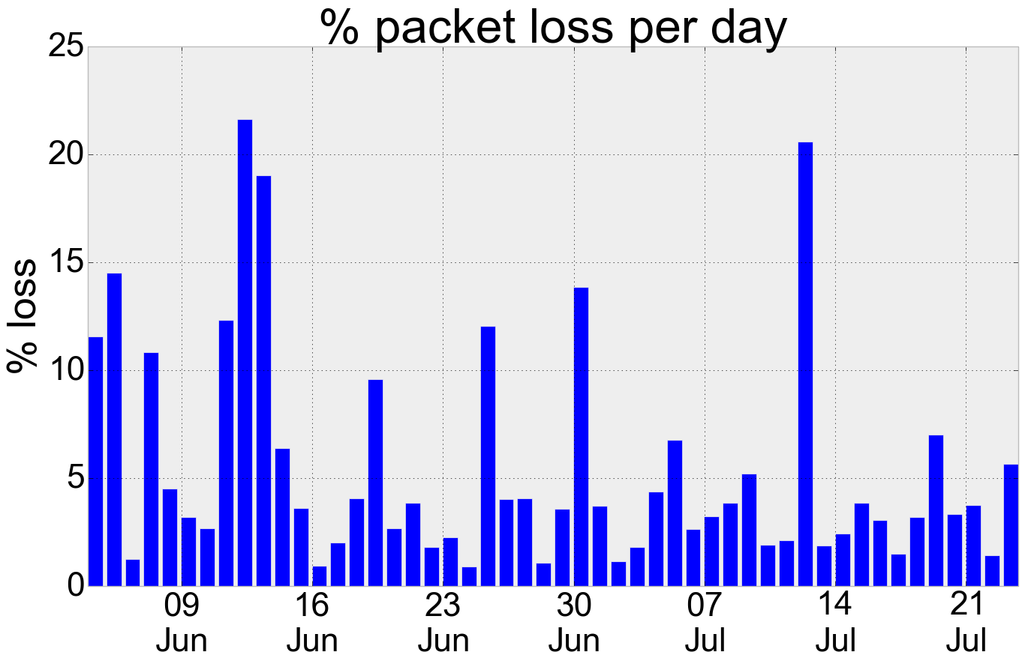
Unique Features in India Unreliable network- Internet
Observed up to 1/4th packet loss on some days
Learning
Need to account for unreliable internet
Need to do local storage of data
We followed Sense- Local store- Upload

Slide 14
Unique Features in India Load specifics
Bathroom level water heating-
Runs off electricity as opposed to gas
Contributes ~60% of total energy in winters
Room level air conditioning
Used only in summers
Control is de-centralized
These two loads are fairly easy to disaggregate- Easy to act upon to reduce energy footprint

Slide 15
iAWE: Indian Dataset for Ambient, Water and Electricity sensing
2+ months of data
1 day fully labeled data
Rest semi-labeled
Electricity, Water, Ambient conditions at different granularities
Dataset released for public use

Slide 16
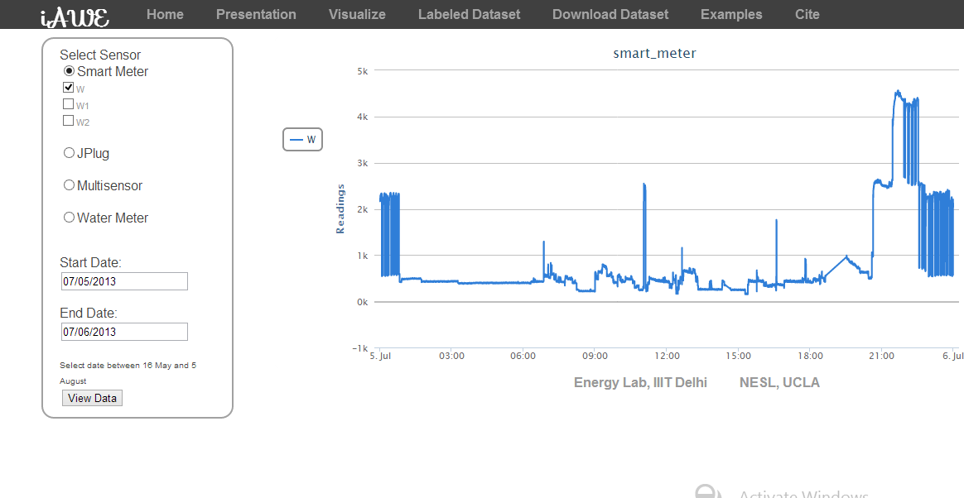
iAWE: Indian Dataset for Ambient, Water and Electricity sensing
Dataset explorer

Slide 17
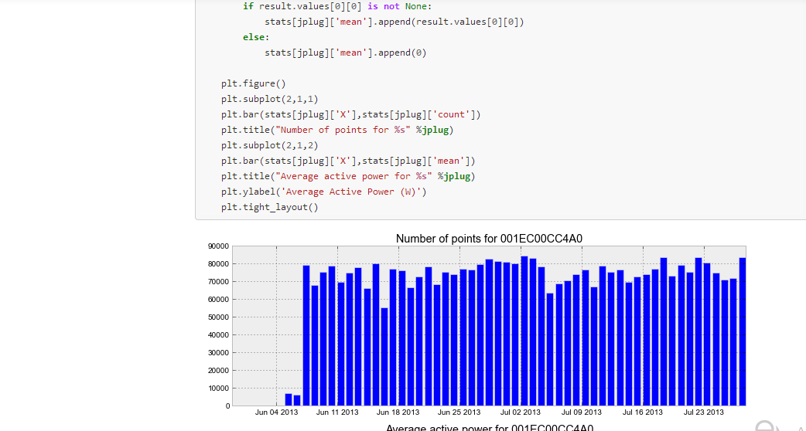
iAWE: Indian Dataset for Ambient, Water and Electricity sensing
Sample IPython notebooks- Code to interact with data and view results

Slide 18
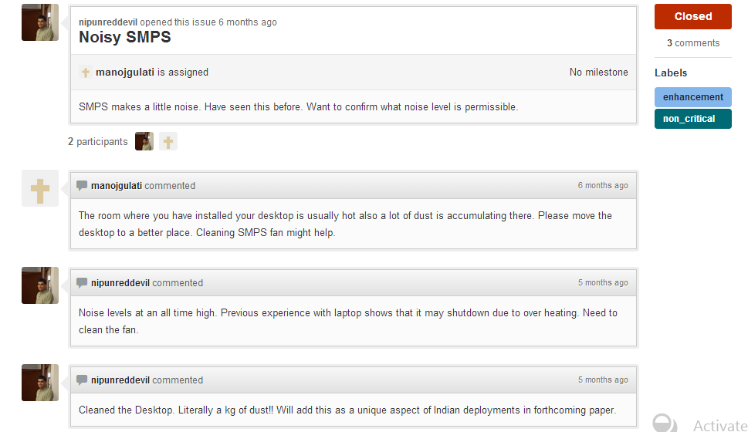
iAWE: Indian Dataset for Ambient, Water and Electricity sensing
Entire project maintained as open source on Github
https://github.com/nipunreddevil/Home_Deployment/
https://github.com/nipunreddevil/iawe-website

Slide 19
Demo
http://energy.iiitd.edu.in:5000/

Slide 20
Conclusions
Developing countries provide unique challenges for residential deployments
Unreliable grid
Unreliable network
Load specifics
Validated previous work in residential sensing
Release iAWE dataset
“Behind every successful residential deployment, there is a very cooperative (and angry ☺) family”

Slide 21
Acknowledgements
NSF- DEITy for funding
Milan Jain (MS IIITD) and Shailja Thakur (MS IIITD) for deployment support
TCS Research and Development for PhD fellowship

