Slide 1
INDiC: Improved Non-Intrusive load monitoring using load Division and Calibration
Nipun Batra
Haimonti Dutta
Amarjeet Singh

Slide 2
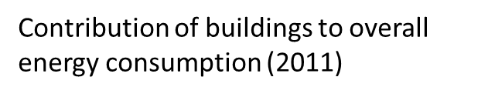
Motivation
Buildings contribute significantly to overall energy (electricity, gas, etc.) usage
New buildings constructed at rapid rate

Slide 3
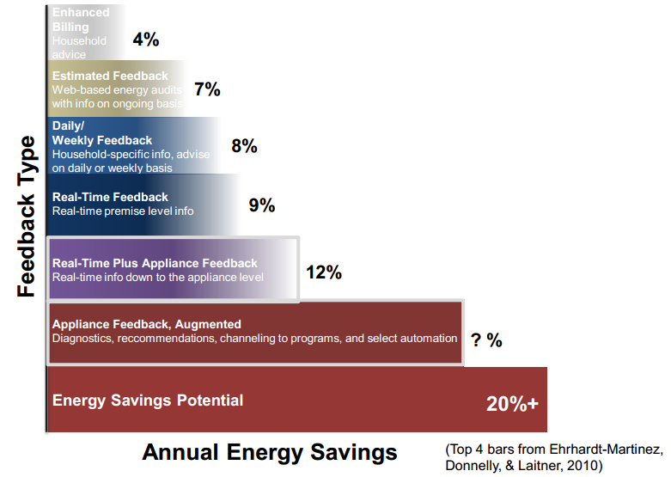
Efficacy of appliance specific feedback
Providing appliance specific feedback to end users can save upto 15% energy.

Slide 4
Systems for providing appliance specific feedback
Appliance monitors
Provide appliance specific information
Scale poorly
Cost increases with each appliance
Intrusive
Smart meter
Give whole home power information
Information must somehow be broken into different appliances
Non intrusive
Cost effective

Slide 5
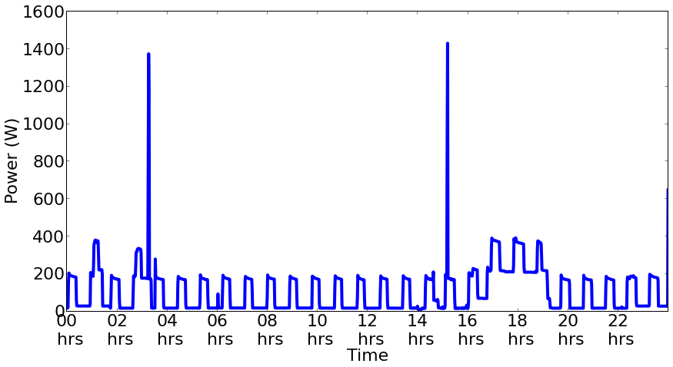
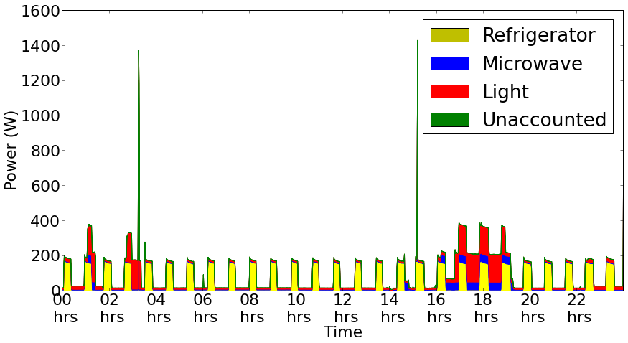
Non Intrusive Load Monitoring (NILM)
Breaking down aggregate power observed at meter into different appliances

Slide 6
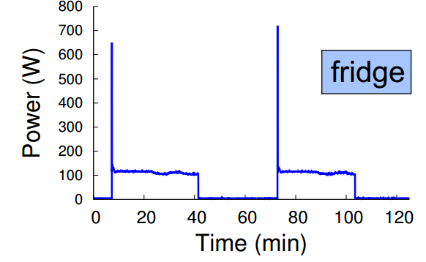
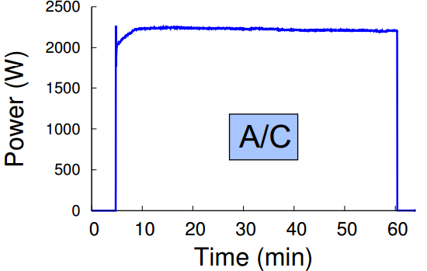
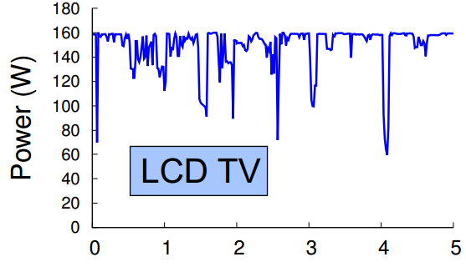
Why NILM works?
Each appliance has a unique signature
This is based on the appliance circuitry
Borrowed from Empirical Characterization and Modeling of Electrical Loads in Smart Homes, Barker et. al

Slide 7
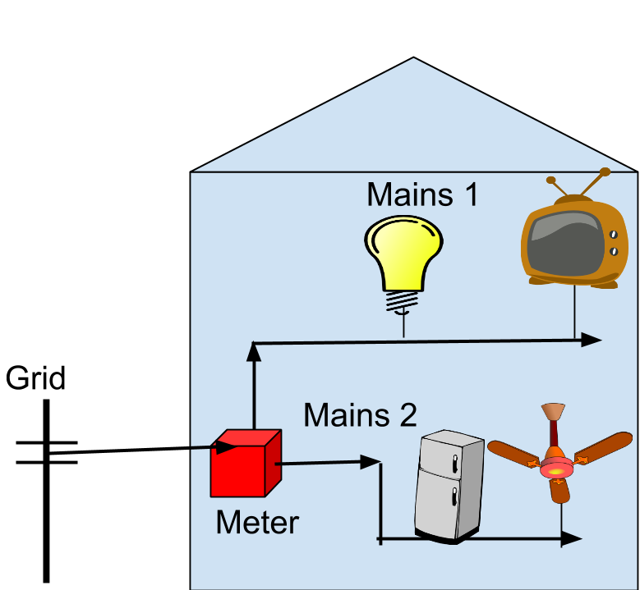
Key Idea I-Load division
Different loads are assigned to different mains
Smart meter capable of measuring individual mains

Slide 8
Key Idea I-Load Division
Instead of doing NILM on Mains 1+ Mains 2, as done before, perform NILM on both separately
Intuition:
Separating out independent components
Less noise (as noise is distributed too!)
More scalable

Slide 9
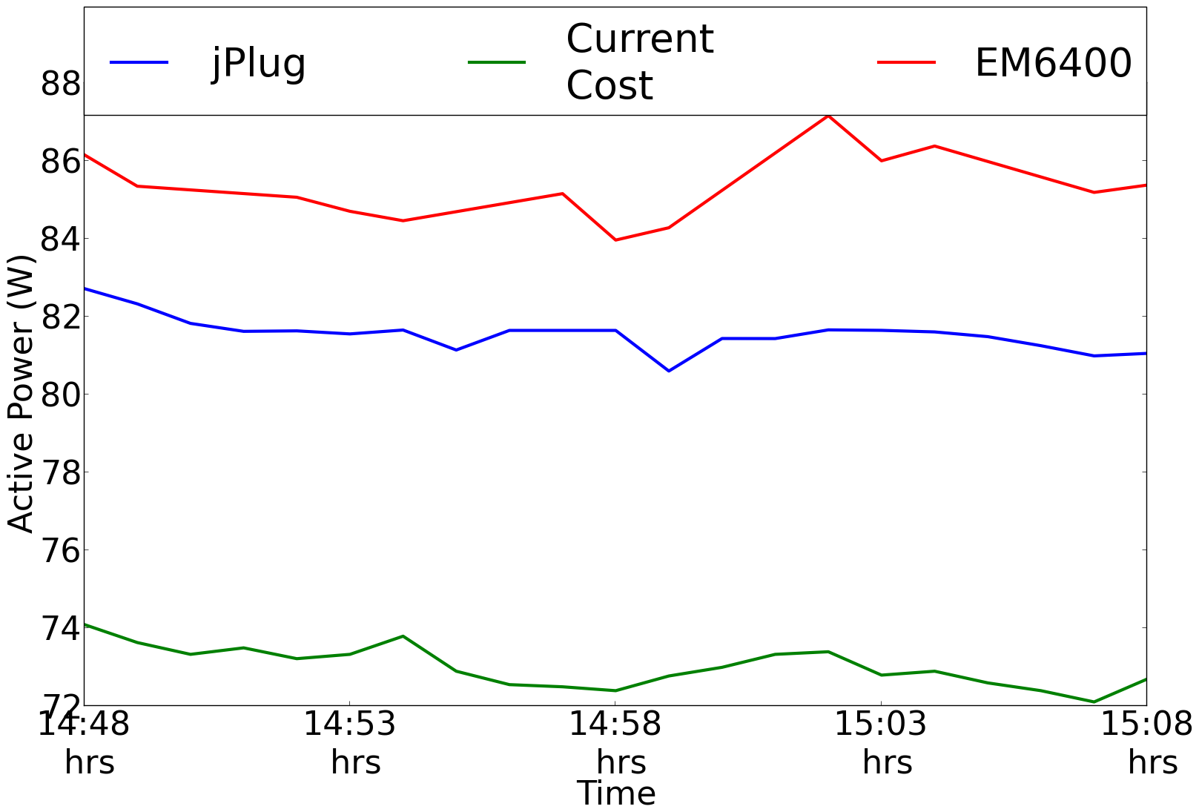
Key Idea II- Calibration
Different appliance monitors may measure different power for the same appliance

Slide 10
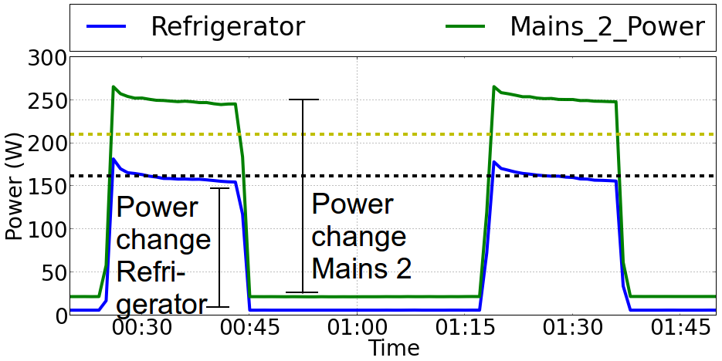
Key Idea II- Calibration
Power change measured by appliance monitor is significantly lesser than the measurement done at mains

Slide 11

INDiC
Calibrate
Processed Mains 1 data
Apply NILM
Raw data
Mains 1 data
Load division
Calibrate
Processed Mains 2 data
Apply NILM
Mains 2 data

Slide 12
Experiments-I Load Division
REDD dataset from MIT
Problem complexity almost halved!
Overall
Mains 1
Dishwasher
Stove
Mains 2
Refrigerator
Kitchen
Microwave
Lighting

Slide 13
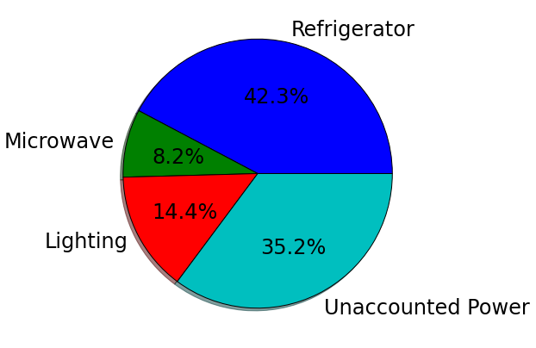
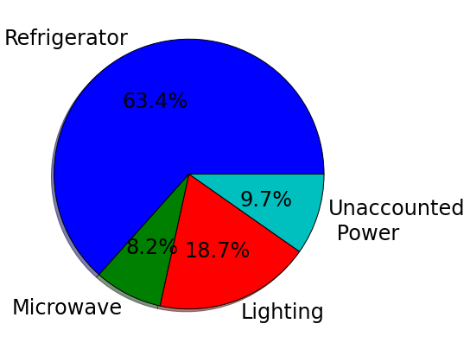
Experiment II Calibration
Unaccounted power or noise reduces after calibration
Should improve accuracy
Before calibration
After calibration

Slide 14
Combinatorial Optimization (CO) based NILM
Take all possible combinations of appliances in different states and match to total power
Exponential in number of appliances
Load division gives exponential improvements!!
Toy example illustrating CO
Fan | AC | Total Power (W)
OFF | OFF | 0
OFF | ON | 1000
ON | OFF | 200
ON | ON | 1200

Slide 15

Evaluation Metrics
Mean Normalized Error (MNE)
Normalized error in energy assigned to an appliance
Given by $\sum_{t}{|Predicted Powert−Actual Powert}$|/$\sum_{t}{|Actual Powert}|$
RMS Error (RE (Watts))
RMS error in power assigned to an appliance

Slide 16
Results
Refrigerator Confusion Matrix
[i,j] entry:
Number of instances in i^{th} state predicted in j^{th} state
Refrigerator’s accuracy improves significantly
Without INDiC
With INDiC
 | State 1 | State 2 | State 3
State 1 | 4740 | 288 | 41
State 2 | 1775 | 2860 | 176
State 3 | 112 | 63 | 25
 | State 1 | State 2 | State 3
State 1 | 4541 | 430 | 98
State 2 | 221 | 4434 | 156
State 3 | 5 | 44 | 151

Slide 17
Results -II
Both MNE and RE reduce significantly after applying INDiC
Appliance | Without INDIC |  | With INDiC
 | MNE (%) | RE (W) | MNE (%) | RE (W)
Refrigerator | 52 | 91 | 25 | 67
Dishwasher | 662 | 131 | 73 | 52
Lighting | 176 | 64 | 63 | 43

Slide 18
Acknowledgments
TCS Research and Development for supporting Nipun Batra through PhD fellowship
NSF-DEITy for project fund

