Slide 1
TileMask: A Passive-Reflection-based Attack against mmWave Radar Object Detection in Autonomous Driving
CCS’ 23
Chunming Qiao

Slide 2
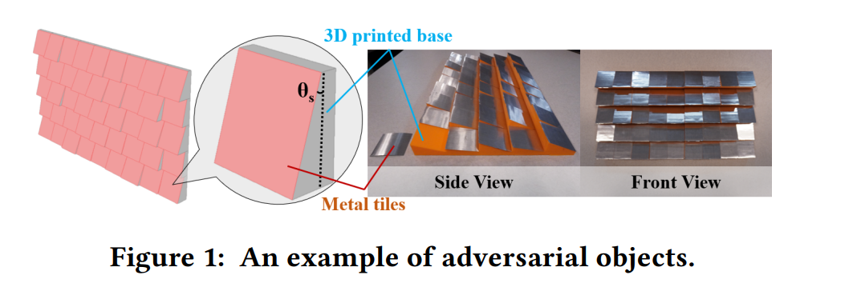
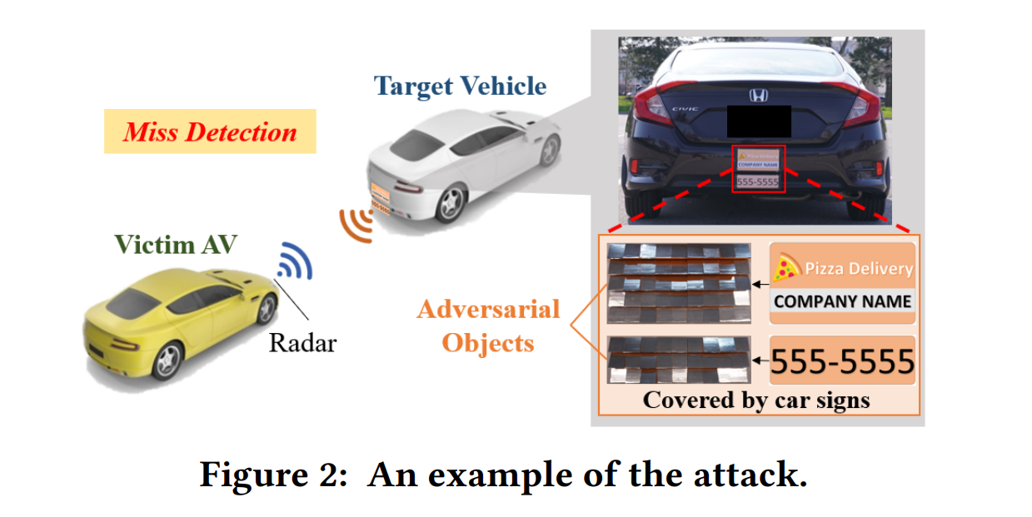
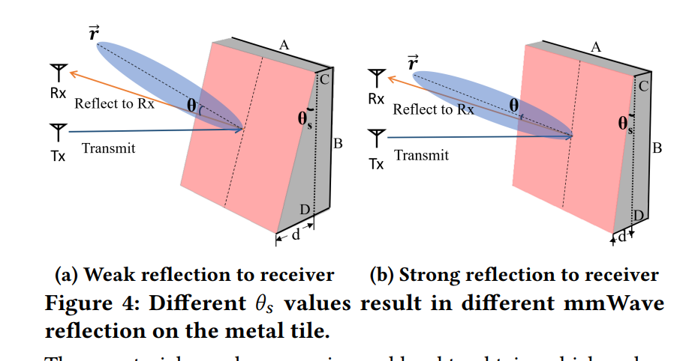
Basic idea: the metal surface can change the echo signal into different amplitudes.

Slide 3
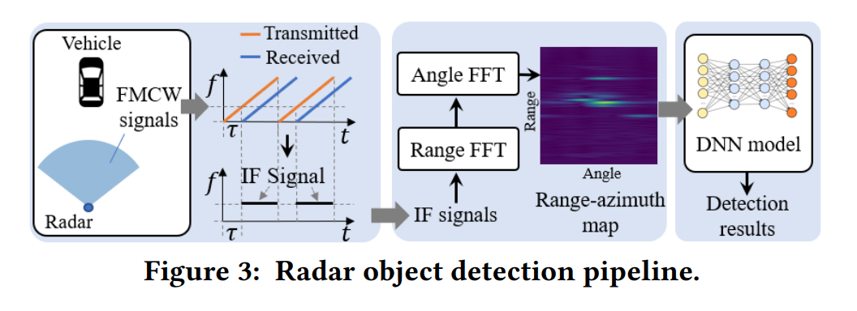
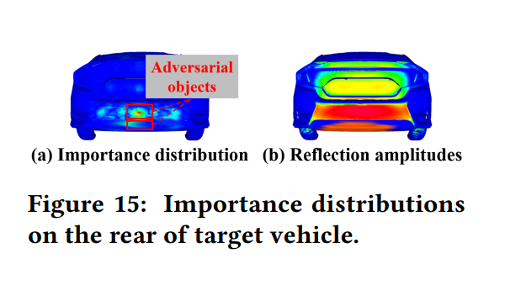
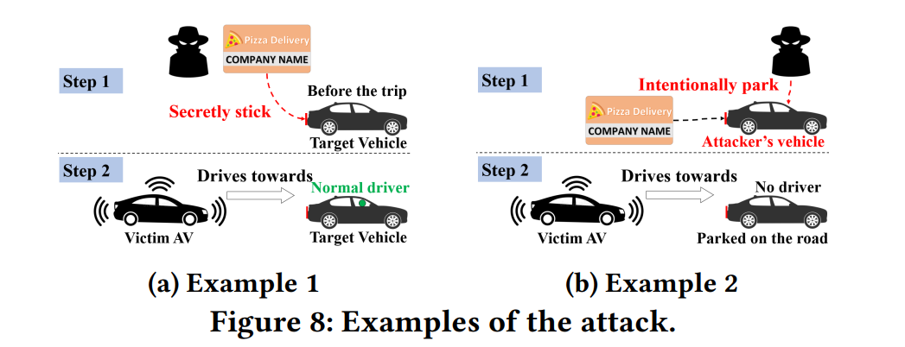
Premise: Attacker knows the detection object system, but can’t obtain the original radar data collected by victim.
The model had been trained and update the Importance score with the dataset.
When attacker attacks, the place with high Importance scores was blocked by the Adversarial object.

Slide 4
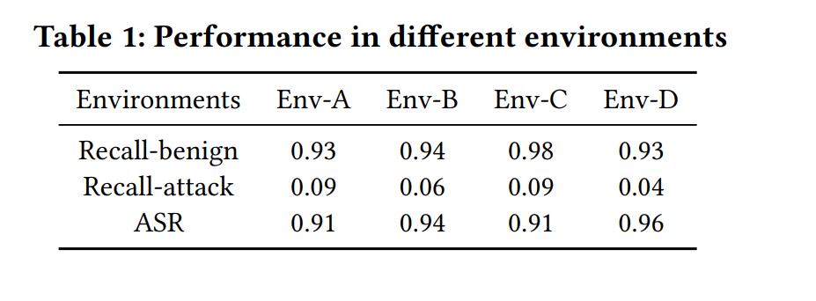
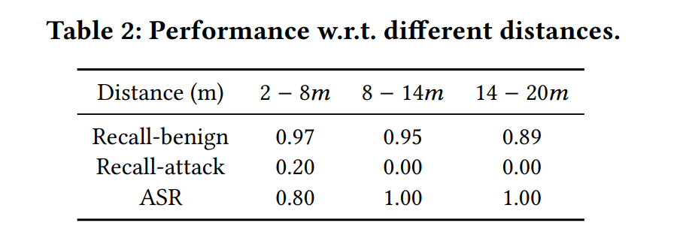

Slide 5
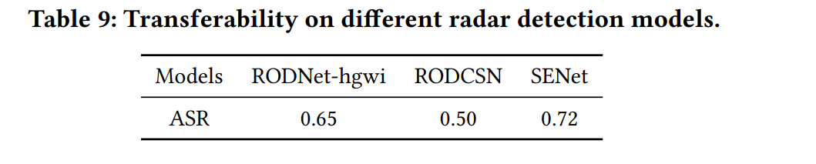
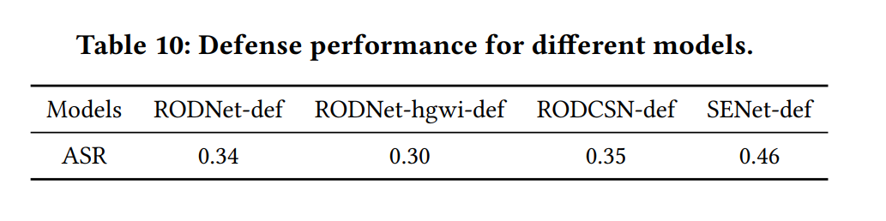
A possible way to defense is to make the important area less concentrated and make the attacker harder to find the effective locations.
Still have a 34% attack success rate based on the original data.

Slide 6
Reference
Yi Zhu, Chenglin Miao, Hongfei Xue, Zhengxiong Li, Yunnan Yu, Wenyao Xu, Lu Su, and Chunming Qiao. 2023. TileMask: A Passive-Reflection-based Attack against mmWave Radar Object Detection in Autonomous Driving. In Proceedings of the 2023 ACM SIGSAC Conference on Computer and Communications Security (CCS '23). Association for Computing Machinery, New York, NY, USA, 1317–1331. https://doi.org/10.1145/3576915.3616661

