Slide 1
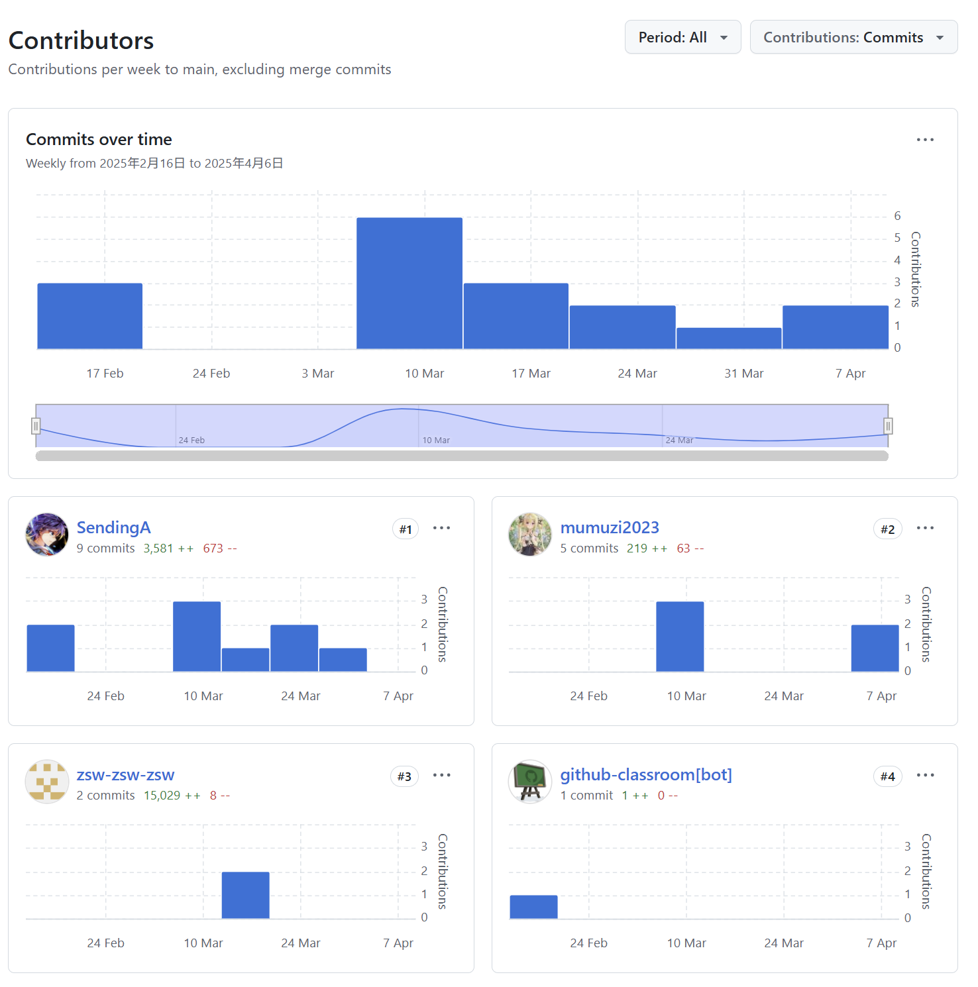

Slide 2
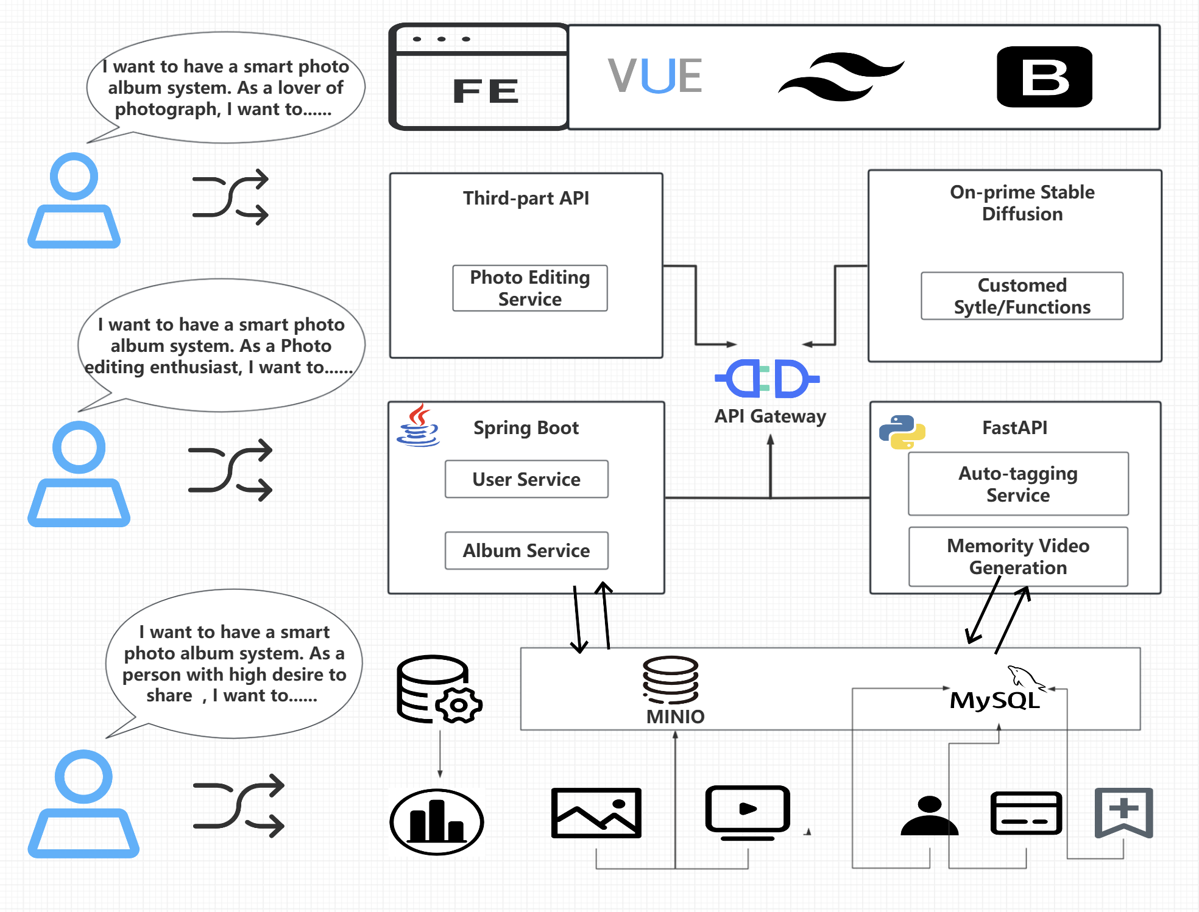

Slide 3


Novel (Chapter)
Backend 1
Prompts
Backend 2
Stable Diffusion
ControlNet
LLM Agent 1
Static
Illustrations
IF with characters
Outline
Scene 1: A boy fight by the side of the ocean …
Scene 2: It is about a group of bots rush into
…
Scene 3: Not only the master of force but those who are…
Immersity AI API
Motion
Illustrations
LLM Agent 2
Stage 3
Prompt 1:
Anime style, Prince in silver armor kneeling before glass-like crystal coffin, dawn light breaking through clouds,
Prompt 2:
Snow White's hand twitching as poisoned apple falls from lips, dwarfs cheering with tear-streaked faces,
Prompt 3:
dewdrops glittering on coffin surface, ethereal pink/gold sunrise palette, detailed embroidery on prince's cloak.
Voice Module
moviepy
Video Generation

