Slide 1
VISUALIZING … the EXTENT of HOMELESSNESS
#EARLHouston2018
November 9, 2018
Sudha Subramanian

Slide 2
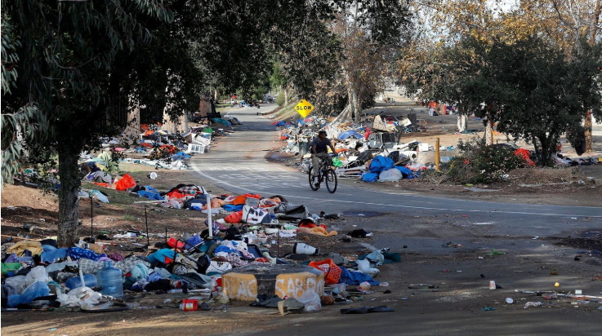
Sad State Of Affairs
LA Times – March 2018
Notes:
Recent report shows the extent of homelessness in LA county (March 2018)
An estimated # of 120K people are on the streets on a given night

Slide 3
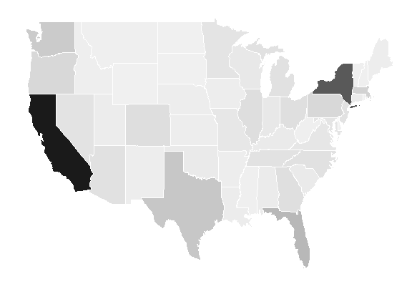
Homelessness (by raw counts)
Year: 2017
Notes:
Plot of homeless counts by state – as is (without any normalization)

Slide 4
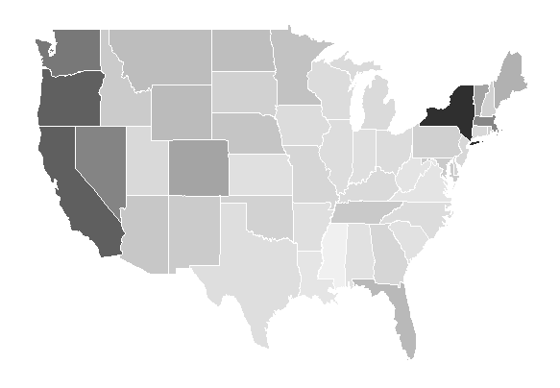
Homelessness (relative to population)
Year: 2017
Notes:
Viz shows the percentage homeless, relative to population in the sate

Slide 5
Housing First
New York – strategies adopted
Homeless Counts
Largest homeless population (77,000)
Exploded by over 100% since 1994
Other Factors
Rents gone up around 19%
Income gone down 6.3%
Innovative Approach
Close down low-quality shelters
Build new shelters + affordable housing units
Notes:
Where homelessness occurs
Rise in homeless counts in 4 states
Rise in bed counts, as seen across those states
Does housing first correlate with reduction in homelessness?

Slide 6
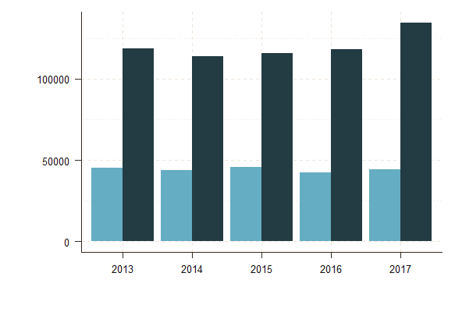
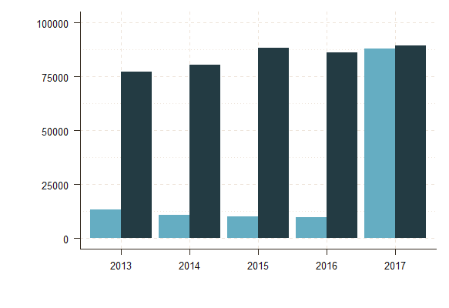
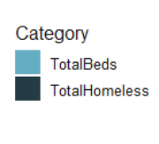
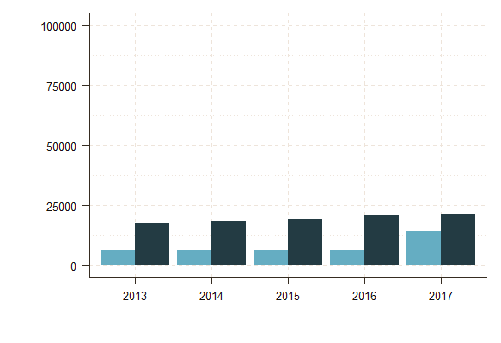
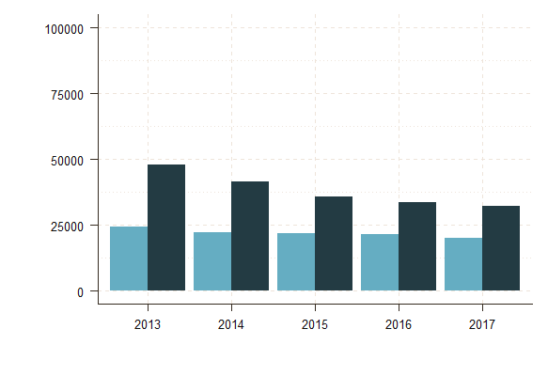
Homeless vs. Bed Counts
(2013 to 2016):
California
New York
Washington
Florida
Notes:
A simple way to show how bed counts compare to homeless counts
Beds – sheltered homeless counts
Homeless counts: Sheltered + Unsheltered

Slide 7
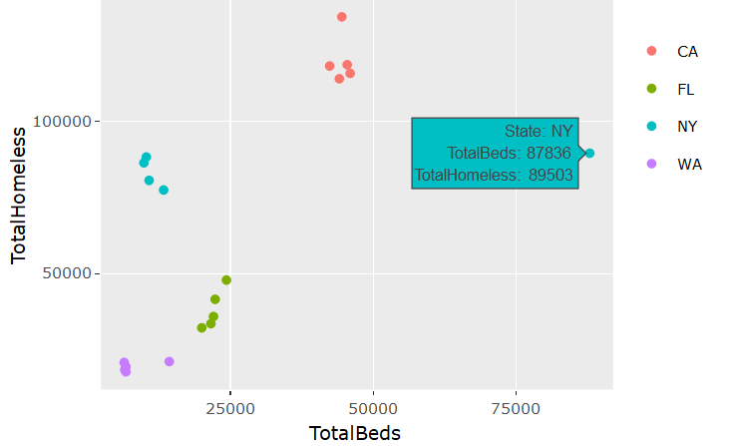
Total Homeless vs. Bed Counts
(2013 to 2017)
Notes:
Plot across states – shows very different structure across states

Slide 8
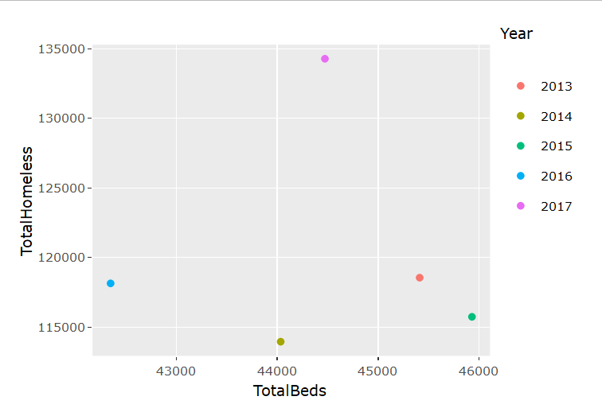
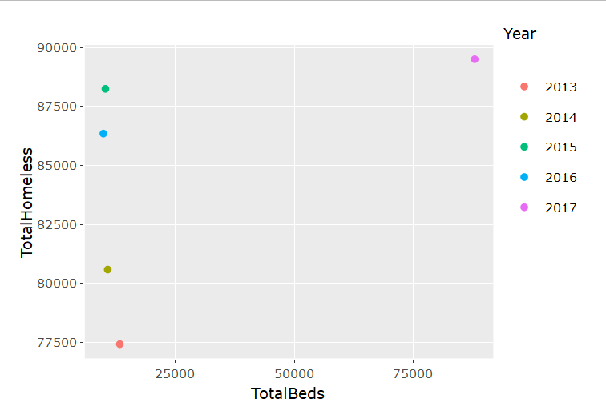
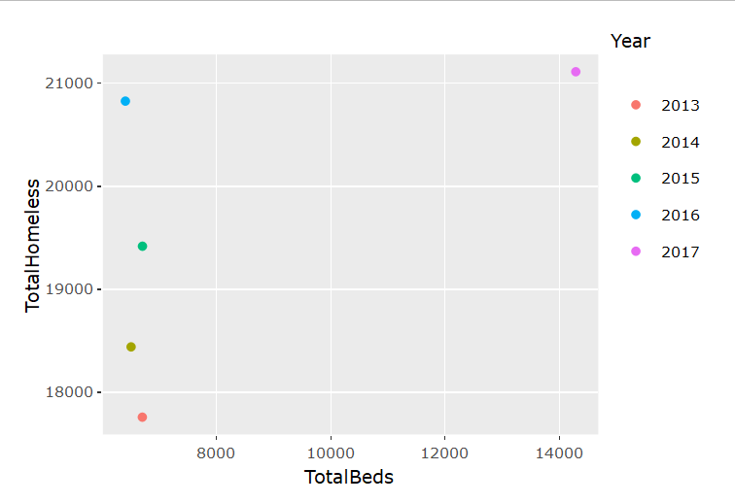
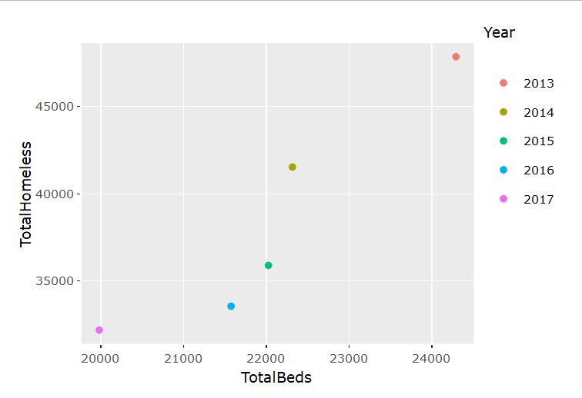
Homeless vs. Bed Counts
(2013 to 2016):
California
New York
Washington
Florida
Notes:
A simple way to show how bed counts compare to homeless counts
Beds – sheltered homeless counts
Homeless counts: Sheltered + Unsheltered

Slide 9
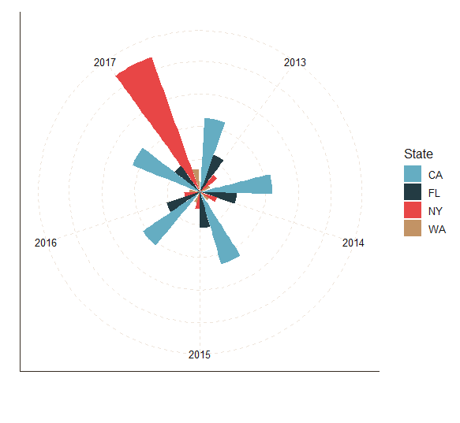
Change in Bed Counts (2013 to 2017):
Notes:
Sheltered – beds inside the units
NY has shown 9-fold increase in number of beds in 2017 compared to 2016
WA – also shows increase in bed counts in 2017

Slide 10
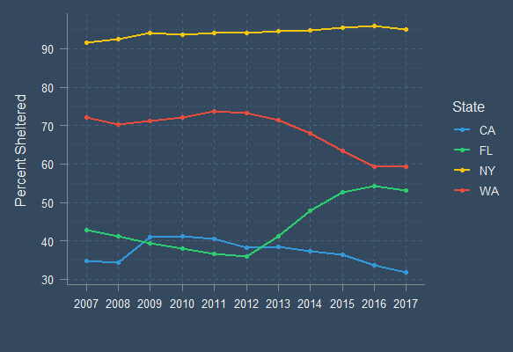
Change in % Sheltered
(2007 to 2017)
Source: HUD
Notes:
Percentage of sheltered relative to total homeless
How it has changed over a decade
Utah – decrease since 2010 due to adoption of ‘housing first’

Slide 11
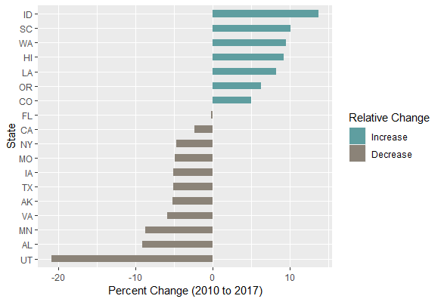
Chronically Homeless (% of total homeless)
(change from 2010 to 2017)
Notes:
Change in percentage of chronically homeless counts across states
Filtered a few where the change (+ve or –ve) is not very significant
Normalized by the median percentage change

Slide 12

How Can We Help
The Guardian – October 2018
Notes:
Sparkfish intends to conduct field experiment to see what is really effective among different measures to bring homeless counts down
Goal: build model to predict homeless counts in a region, taking into account various factors such as unemployment, housing, cost of living etc.

Slide 13
Next Steps
Observational
Inference
NY City adopts ‘Turning the Tide’ program
300,000 units of affordable housing by 2022
Observational
Inference
UT – 1st to take Housing First model statewide
91% drop in Chronically homeless counts
Field
Experiment
Shelters vs. Affordable Housing
Can we find which works better?
Proposed
Approach
Perform a randomized experiment
Validate our hypothesis
Notes:
Observational inference helps understand correlation on factors that help reduce homelessness
Field Experiment helps validate our hypothesis
Null Hypothesis is that effect is same for shelters vs. affordable housing
We can perform a randomized experiment to validate our hypothesis

Slide 14
References
https://www.hudexchange.info/resource/5639/2017-ahar-part-1-pit-estimates-of-homelessness-in-the-us/
http://time.com/money/5177566/average-income-every-state-real-value/
https://www.theguardian.com/us-news/2018/oct/12/jack-dorsey-marc-benioff-homelessness-twitter-san-francisco
https://www.npr.org/2015/12/10/459100751/utah-reduced-chronic-homelessness-by-91-percent-heres-how
https://www.businessinsider.com/new-york-homeless-crisis-deblasio-solutions-2018-2

Slide 15

THANK YOU
SUDHA SUBRAMANIAN AI/ML Consultant
ssubramanian@sparkfish.com
https://www.linkedin.com/in/sudha-subramanian/
https://github.com/susub31
@sudaspark

