Slide 1
VISUALIZING … the EXTENT of HOMELESSNESS
#EARLHouston2018
November 9, 2018
Sudha Subramanian

Slide 2
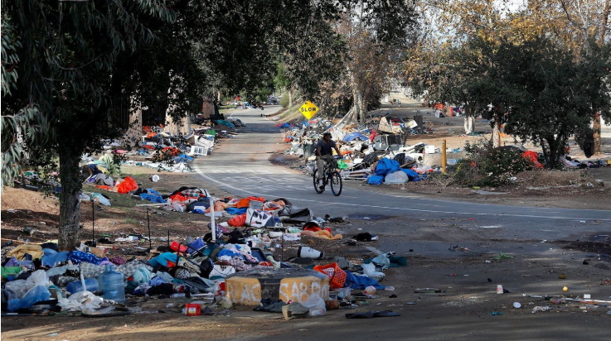
Sad State Of Affairs
LA Times – March 2018
Notes:
Recent report shows the extent of homelessness in LA county (March 2018)
An estimated # of 120K people are on the streets on a given night

Slide 3
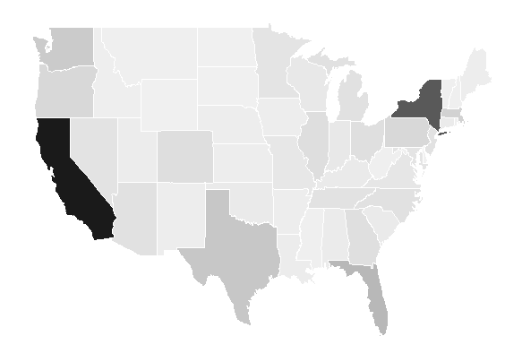
Homelessness (by raw counts)
Year: 2017
Notes:
Plot of homeless counts by state – as is (without any normalization)

Slide 4
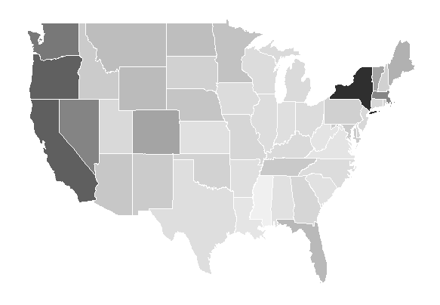
Homelessness (relative to population)
Year: 2017
Notes:
Visualization shows the percentage homeless, relative to population in the sate
Key points:
Where homelessness occurs & categories of homeless
Homeless counts, Bed counts, as seen across those states
Does housing first correlate with reduction in homelessness?

Slide 5
Housing First
Strategy – Offer Affordable Housing
& Supportive Services
HOUSTON
Provide affordable housing
Reduction in Unsheltered counts
ORLANDO
Housing First – shown positive results
Reduction in Chronically homeless
Notes:
https://www.npr.org/2015/12/10/459100751/utah-reduced-chronic-homelessness-by-91-percent-heres-how
A few other examples: Salt Lake City brought down its chronically homeless counts from 2500 (2005) to 400 (2013)

Slide 6
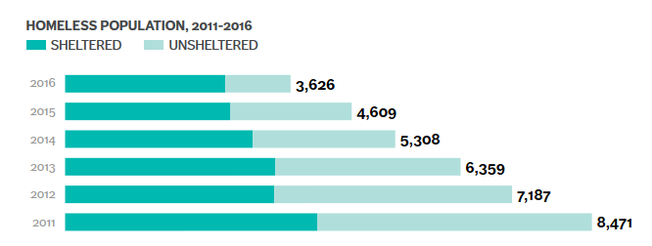
Houston
Unsheltered counts down by 75% since 2011
4418 – Unsheltered in 2011
1050 – Unsheltered in 2016
Seattle Times – October 2017
Notes:
https://www.seattletimes.com/seattle-news/homeless/houstons-solution-to-the-homeless-crisis-housing-and-lots-of-it/

Slide 7
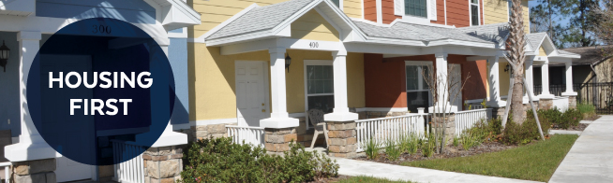
Orlando
Reduction in chronically homeless counts
City of Orlando – Mayor (Housing First) website
Goal in 2014 – move 300 chronically homeless individuals / veterans into permanent / supportive housing by 2017.
2017 – 385 chronically homeless individuals moved into permanent / supportive housing
Notes:
http://www.cityoforlando.net/mayor/housing-first/
Chronically homeless – Been homeless for over a year / in emergency shelter for long

Slide 8
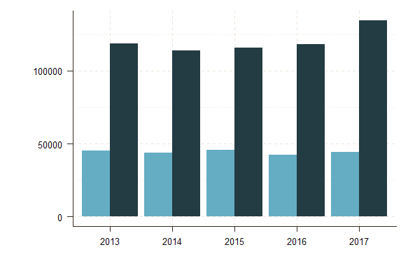
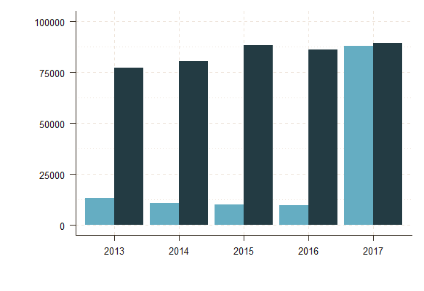
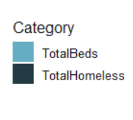
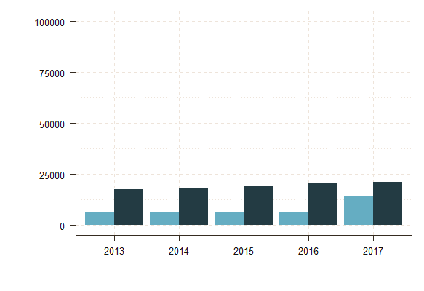
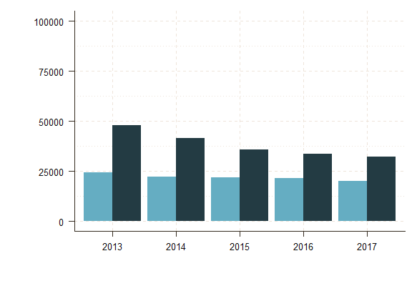
Homeless vs. Bed Counts
(2013 to 2016):
California
New York
Washington
Florida
Notes:
A simple way to show how bed counts compare to homeless counts
Beds – sheltered homeless counts
Homeless counts: Sheltered + Unsheltered

Slide 9
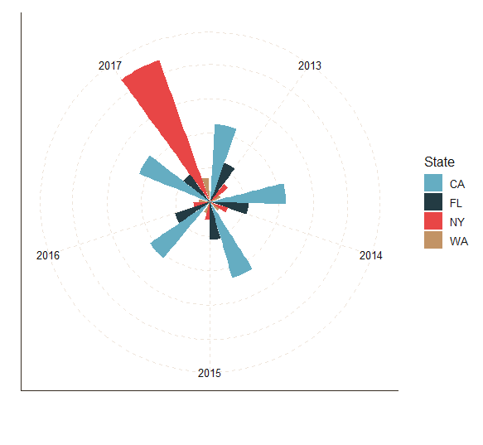
Change in Bed Counts (2013 to 2017):
Notes:
Sheltered – beds inside the units
NY has shown 9-fold increase in number of beds in 2017 compared to 2016
WA – also shows increase in bed counts in 2017

Slide 10
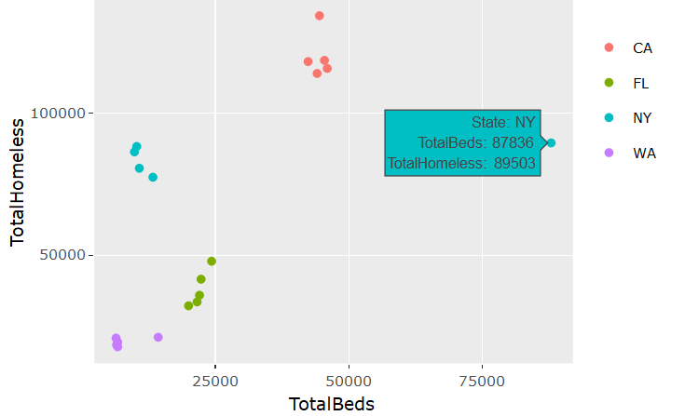
Total Homeless vs. Bed Counts
(2013 to 2017)
Notes:
Plot across states – shows very different structure across states

Slide 11
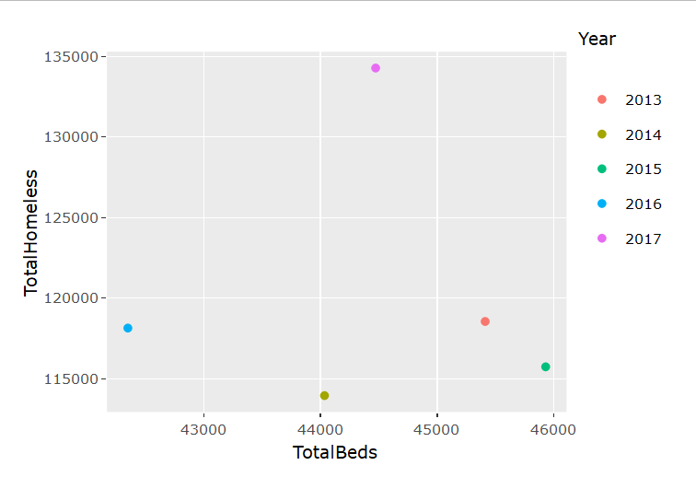
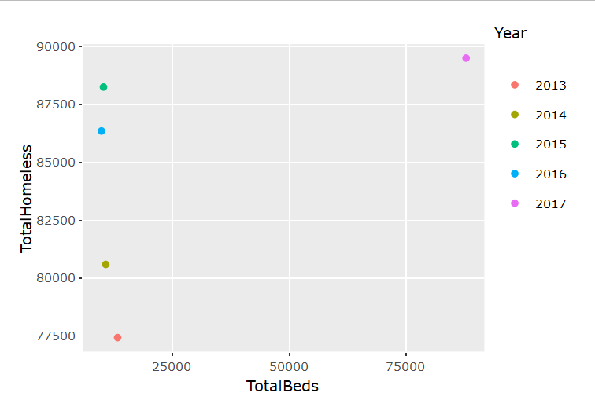
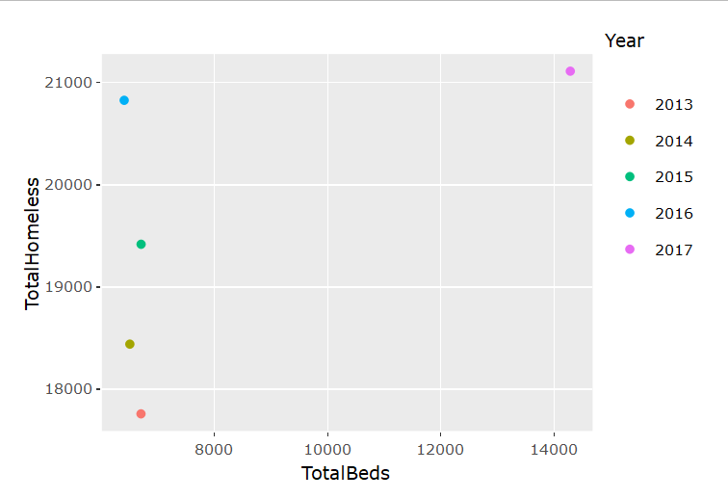
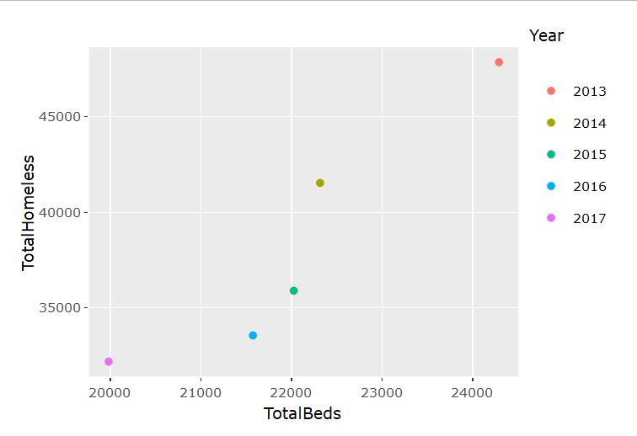
Homeless vs. Bed Counts
(2013 to 2016):
California
New York
Washington
Florida
Notes:
Plot of # beds vs. total homeless
Florida shows a decreasing trend (correlation) over the years
# bed counts have come down and so has the total homeless

Slide 12
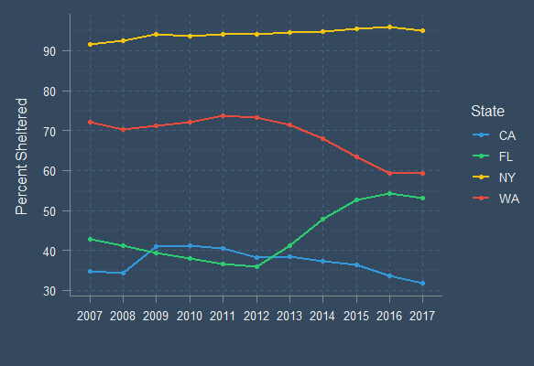
Change in % Sheltered
(2007 to 2017)
Source: HUD
Notes:
Percentage of sheltered relative to total homeless
How it has changed over a decade
Significant increase in % sheltered between 2012 and 2016 for Florida

Slide 13
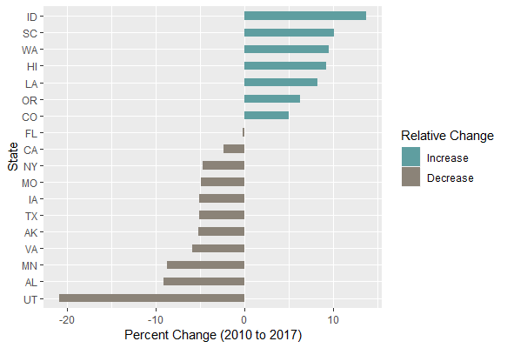
Chronically Homeless (% of total homeless)
(change from 2010 to 2017)
Notes:
Change in percentage of chronically homeless counts across states
Filtered a few states

Slide 14

How Can We Help
The Guardian – October 2018
Notes:
Sparkfish intends to conduct field experiment to see what is really effective among different measures to bring homeless counts down
Goal: build model to predict homeless counts in a region, taking into account various factors such as unemployment, housing, cost of living etc.

Slide 15
Next Steps
Recorded
Goals
NY City adopts ‘Turning the Tide’ program
300,000 units of affordable housing by 2022
Observational
Inference
Housing First model - Houston
Reduction in Unsheltered homeless by 75%
Observational
Inference
Homeless counts decline in Florida
Reduction in chronically homelessness counts
Field
Experiment
Shelters vs. Affordable Housing
Can we find which works better?
Notes:
Observational inference helps understand correlation on factors that help reduce homelessness
Field Experiment helps validate our hypothesis
Null Hypothesis is that effect is same for shelters vs. affordable housing
We can perform a randomized experiment to validate our hypothesis

Slide 16
References
https://www.hudexchange.info/resource/5639/2017-ahar-part-1-pit-estimates-of-homelessness-in-the-us/
http://time.com/money/5177566/average-income-every-state-real-value/
https://www.theguardian.com/us-news/2018/oct/12/jack-dorsey-marc-benioff-homelessness-twitter-san-francisco
https://www.seattletimes.com/seattle-news/homeless/houstons-solution-to-the-homeless-crisis-housing-and-lots-of-it/
http://www.cityoforlando.net/mayor/housing-first/
https://www.npr.org/2015/12/10/459100751/utah-reduced-chronic-homelessness-by-91-percent-heres-how
https://www.businessinsider.com/new-york-homeless-crisis-deblasio-solutions-2018-2

Slide 17

THANK YOU
SUDHA SUBRAMANIAN AI/ML Consultant
ssubramanian@sparkfish.com
https://www.linkedin.com/in/sudha-subramanian/
https://github.com/susub31
@sudaspark

