Slide 1
A CONTACT-CENTER NOTE TAKER
Hear the call.
Fill the note.
Ship the ticket.
Note Master · v0.2.25 · React 19 + Vite 8 + Whisper

Slide 2
Note Master
THE PROBLEM
Every agent juggles four things at once.
The customer on the line. The SOP they should be following. The CRM they must type into. And a 90-second QA checklist they cannot forget.
Notes get short, fields get skipped, and the next agent picks up a ticket that barely explains what just happened.
“The note is the product of a support call.”
Source: agent shadowing, 2026 Q3 — average handle time vs. note completeness.
02 / 18

Slide 3
Note Master
THE THESIS
Let the agent listen. The app does the typing.
HEAR
FILL
SHIP
On-device Whisper transcribes the mic and the call, speaker-tagged, in the browser.
A speaker-aware parser maps the transcript onto the ticket fields as the agent speaks.
One button turns the form into a Salesforce-ready note and pushes it back to the case.
Three engines, one pipeline — hear, fill, ship.
03 / 18

Slide 4
Note Master
SYSTEM
One pipeline, three engines, all in the browser.
→
→
→
→
→
Mic + Tab audio
Whisper (local)
Field extractor
LLM parser
Form
Salesforce
getUserMedia
transformers.js · WASM
speaker-aware regex
DeepSeek cloud / Qwen local
gridbox state
Chrome MV3 bridge
Audio is captured in the tab. Whisper runs on the device. Field extraction is shared between the live hook and the LLM worker. The form is the single source of truth, and a Tier-2 extension writes the result back to Salesforce.
No audio leaves the browser except the optional DeepSeek parse of the transcript text.
04 / 18

Slide 5
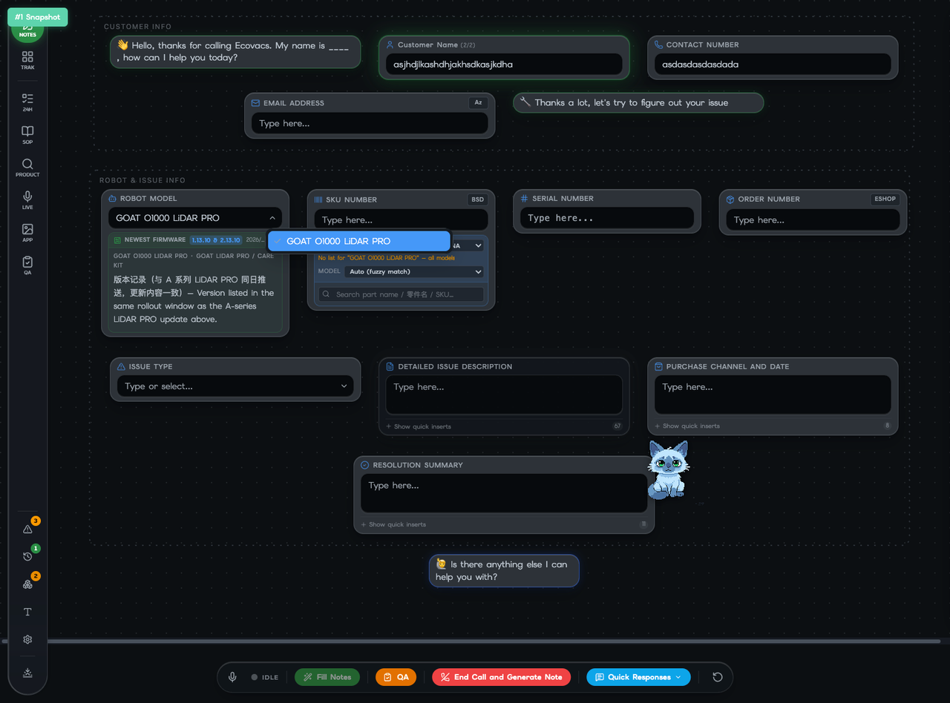
Note Master
THE WORKSPACE
A flowchart of the call, not a form to fill.
Gridbox canvas — every node is a ticket field; the bottom call bar drives capture.
05 / 18

Slide 6
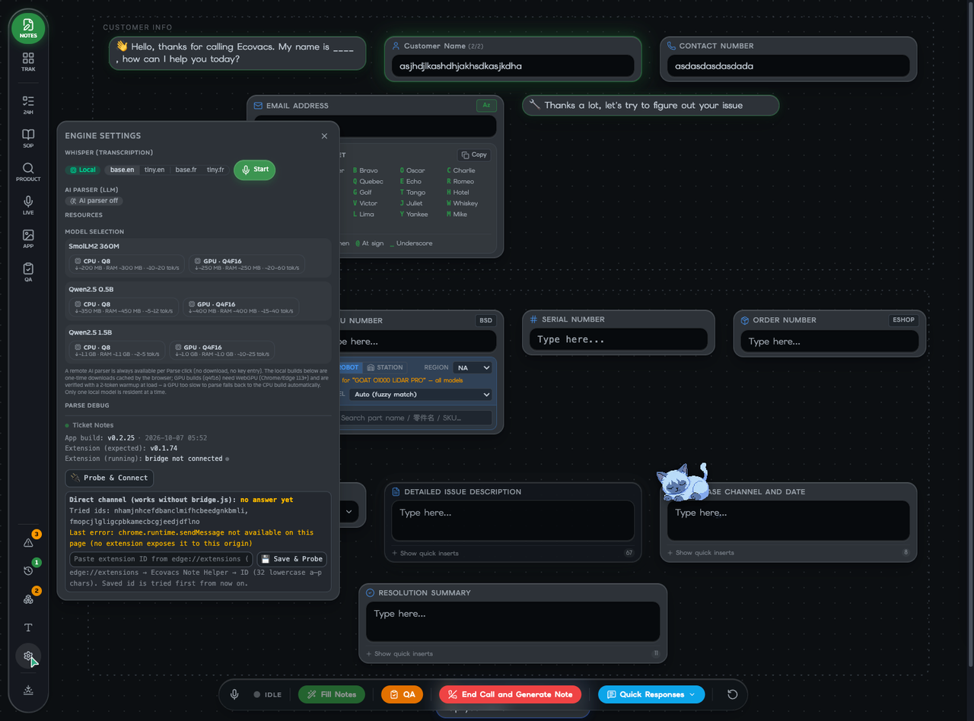
Note Master
MAJOR FEATURE · 01
On-device Whisper transcription.
Whisper runs entirely in the browser through transformers.js + ONNX Runtime Web (WASM). Models cache after the first download; nothing is sent to a server.
Mic channel = agent speech (Web Speech API).
Tab-audio channel = customer (CCP) — local Whisper.
base / tiny · en + fr multilingual variants.
Hallucination & repetition loops filtered live.
Live input meters + per-segment status.
Engine settings panel — Whisper model, dtype, downloads, RAM badge.
06 / 18

Slide 7
Note Master
MAJOR FEATURE · 02
Auto note filling that never overwrites a human.
A speaker-aware parser maps the transcript onto ticket fields. Customer first-person phrasings only parse from the customer's speech; agent dictation (“customer's number is…”) only from the agent's. Model names canonicalize against the combobox list.
regex
fills empty fields only
regex-grow
replaces regex / paraphrase
paraphrase
polished machine text
llm
authoritative over machine
mergeAutoFill() — lib/autofill-merge.ts · unit-tested in scripts/test-parser-trading.ts
human
never overwritten
07 / 18

Slide 8
Note Master
MAJOR FEATURE · 03
Cloud LLM parse + bilingual call TLDR.
PARSE
TLDR
Two buttons in the transcript header. Parse keeps every customer clause and every agent step; Concise trims to the 2–4 primary complaints and the 2–4 confirmed fixes.
On French-call captures the panel regenerates an English + Chinese 1–3-sentence summary of the whole conversation — so an agent can follow a call they may not fully understand.
DeepSeek backend (optional API key).
Refresh at 10s, 30s, then every 30s.
Streams progress inline.
One request in flight at most.
QA scoring runs alongside.
Persists as the whole-call summary.
use-cloud-parser.ts · use-call-tldr.ts — bilingual because the local Qwen 0.5B cannot write Chinese.
08 / 18

Slide 9
Note Master
MAJOR FEATURE · 04
A Chrome extension that reads and writes Salesforce.
A Tier-2 MV3 extension (“Ecovacs Note Helper”) bridges the React app and the agent's open Salesforce Console tab. Two transport channels, tried in order:
01
chrome.runtime.sendMessage
02
window.postMessage + bridge.js
official channel on blessed origins
fallback for any custom host
Pull: scrapeAll() imports the open case fields into the form, tagged source 'dom-ext'. Push: applyCaseFields() writes the post body + customer fields back to the case tab.
use-ccp-extension-bridge.ts · extension/ — externally_connectable + content-script fallback.
09 / 18

Slide 10
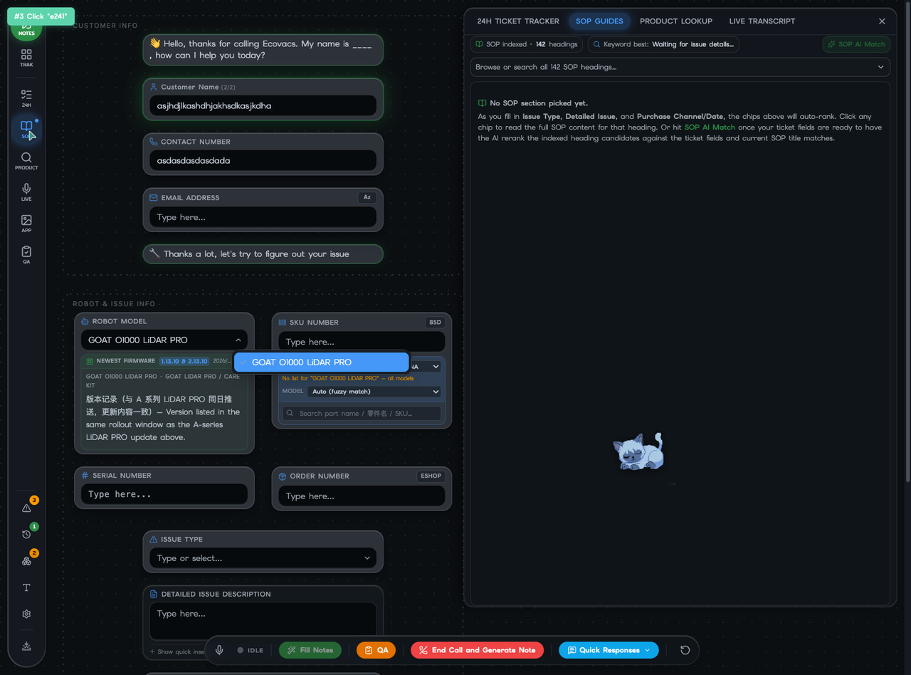
Note Master
MAJOR FEATURE · 05
Product lookup — ten knowledge tabs in one panel.
One panel, ten tabs: specs, error codes, FAQ, templates, news, firmware, app updates, scientist notes, free search, and selling tips. Everything an agent needs mid-call, auto-narrowed by the robot model selected on the form.
Fuzzy model match against the form.
Bilingual (EN + 中文) free search.
Spec comparison across models.
Error codes cross-checked vs. issue text.
Product Lookup panel — GOAT O1000 LiDAR PRO specs.
10 / 18

Slide 11
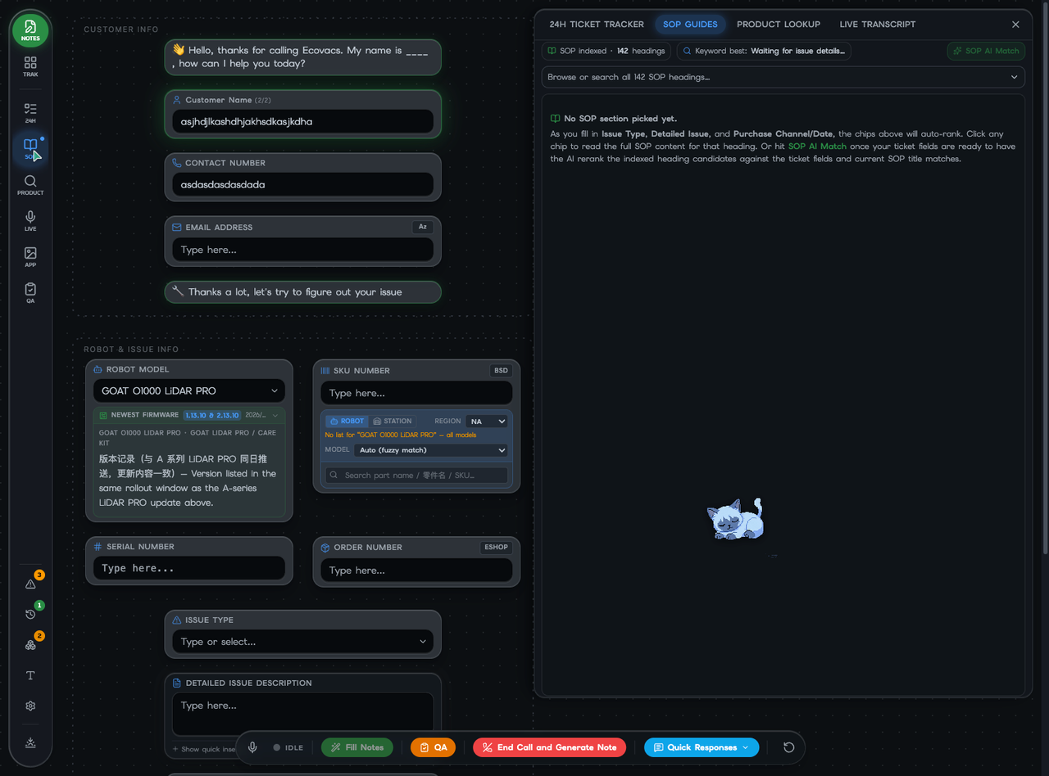
Note Master
MAJOR FEATURE · 06
The SOP handbook, indexed and AI-reranked.
The handbook ships as numbered markdown sections, lazy-loaded so the app shell paints first. A bilingual tokenizer (English words + Chinese 2-grams) indexes 142 headings; title matches weigh 4× body matches.
As the form fills, candidate chips auto-rank.
“SOP AI Match” reranks with DeepSeek.
Click a chip to read the full section.
Markdown rendered with theme styles.
SOP panel — 142 headings indexed, keyword candidates pending.
11 / 18

Slide 12
Note Master
MAJOR FEATURE · 07
SKU spare-parts lookup across 11,800 parts.
A four-stage classifier chain narrows the ~11.8k-part database to the one part the agent needs, then auto-fills the SKU field with “SKU — English part name.”
1
Robot Model
→
2
Robot ↔ Base
→
3
Region
→
4
Free text
fuzzy: “T30S PRO” → DEEBOT T30S PRO list
workbooks ship separate sheets per side
NA / EU / JP … · untagged always kept
EN + 中文, debounced 250 ms
One match → auto-fills the field. Multiple matches → a dropdown to pick from, with a part-picture preview at the bottom of the card.
SkuLookupCard.tsx · utils/skuData.ts — 11.8k parts, region-bucketed.
12 / 18

Slide 13
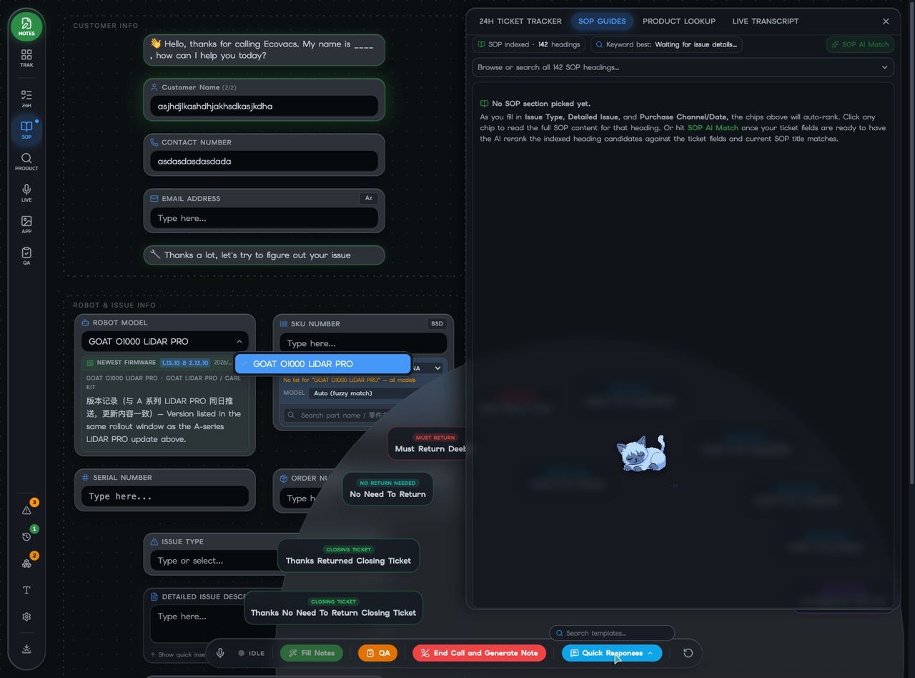
Note Master
QUALITY OF LIFE · 01
Quick replies — a radial dial of email templates.
Hover the bottom-bar button and HTML email templates fan out onto a frosted radial disc, smart-grouped by intent. Click to copy; hover a card 2.5s to preview the rendered HTML.
Loaded from /quick_reply/*.html via import.meta.glob.
Groups: Closing Ticket, Must Return, Collect Info…
Click-to-copy into Salesforce's rich-text editor.
Centered portal preview auto-dismisses.
Quick Replies expanded — categorized reply templates.
13 / 18

Slide 14
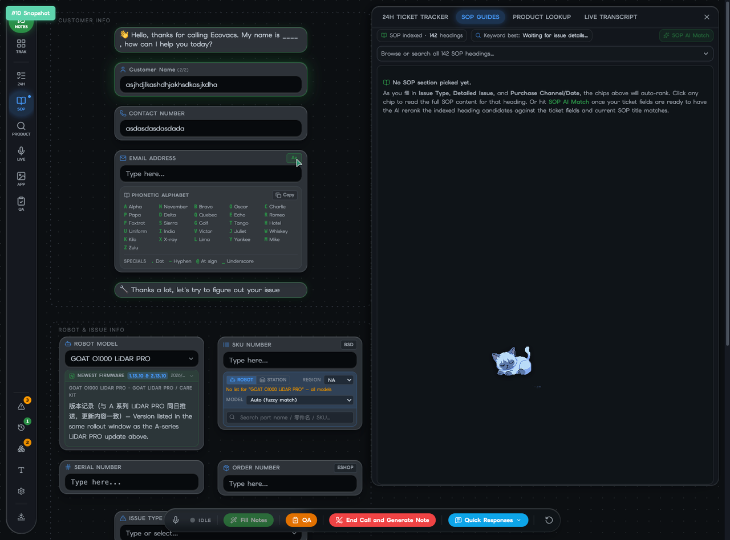
Note Master
QUALITY OF LIFE · 02
Phonetic alphabet, inline in the email field.
A tiny “Az” toggle on the Email Address gridbox expands the node downwards to reveal the NATO alphabet plus specials (dot, hyphen, at-sign, underscore). Inline — never covers neighbouring fields — and one click copies the whole reference.
A = Alpha … Z = Zulu, always at hand.
Specials for email-safe characters.
Copy-to-clipboard for the full table.
Frosted inset, matches gridbox chrome.
Phonetic alphabet expanded inline under the Email field.
14 / 18

Slide 15
Note Master
QUALITY OF LIFE · 03
A cat that watches the call with you.
A draggable pixel-art sprite (128px, six states × three frames each) lives on the canvas and pops thought bubbles. It is a Clippy-style nudge layer — never steals focus, auto-dismisses, and dozes off after 20s of inactivity.
resting
standby
side
dozed off after 20s idle
calm default, sitting
glancing at a thought bubble
thinking
alert
dragged
LLM advice request in flight
live call capture running
pointer down, being moved
Bonus: a keyword-alert dictionary. Add a word; when the transcript hears it, the cat pops an amber bubble with your custom reminder.
15 / 18

Slide 16
Note Master
QUALITY OF LIFE · 04
Eleven themes, glass panels, and a canvas you control.
Eleven themes (5 time-of-day + 3 neutral greys + 3 tints) cycle from the left rail. Every panel is a frosted-glass surface — backdrop-blur, saturation, hairline ring — and the canvas itself is composable.
Daylight
Morning
Afternoon
Slate
Neutral
Breezy
Evening
Midnight
Zinc
Amethyst
Moss
Gridbox toggles hide or show canvas nodes — Shipping address, 24h tracker, SKU, Order number, Additional notes — without losing their values. A larger-text toggle scales the whole UI for the back of the room.
themes.ts · FloatingControls.tsx — 11 themes, glass-panel class, gridbox visibility.
16 / 18

Slide 17
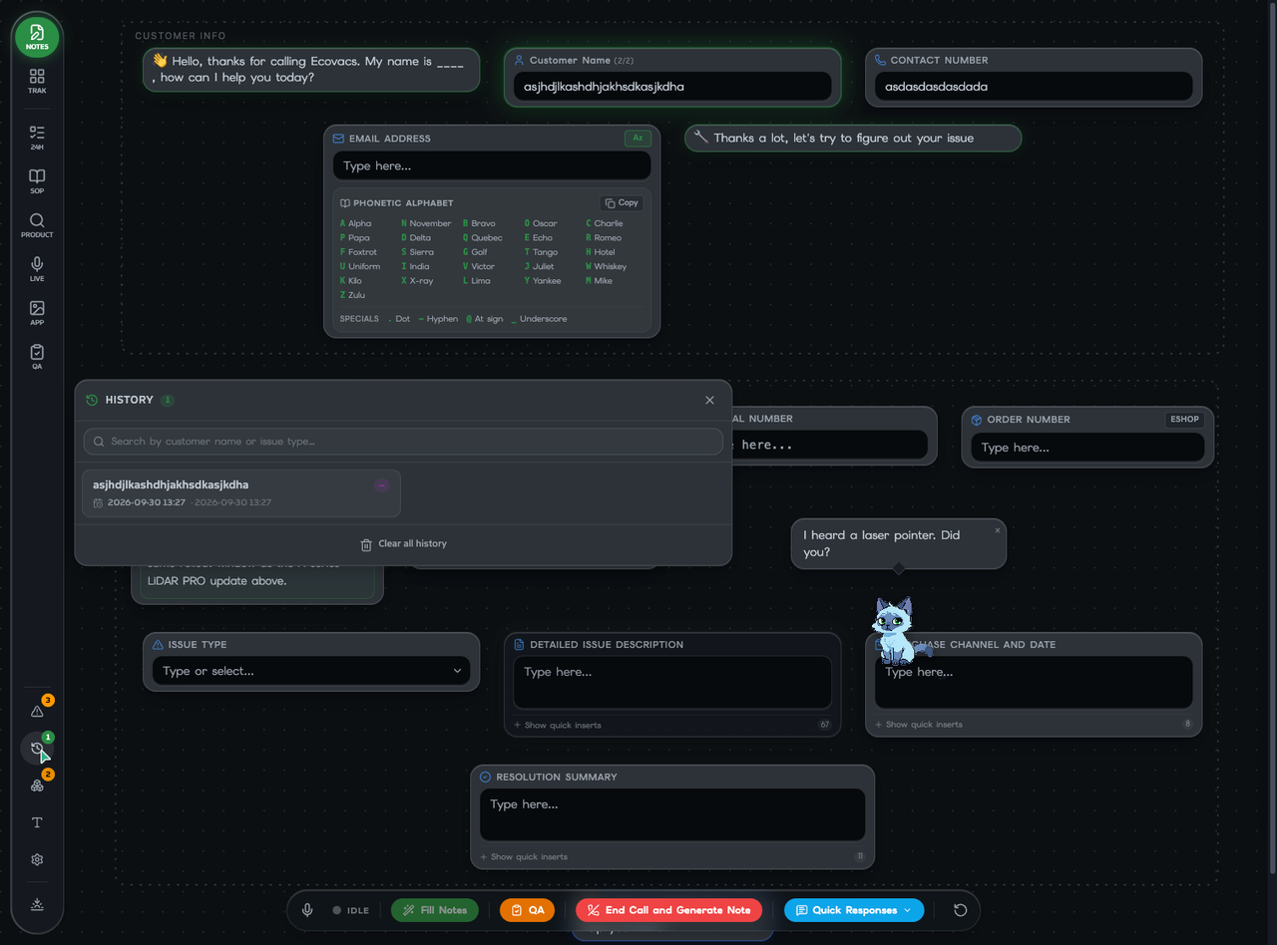
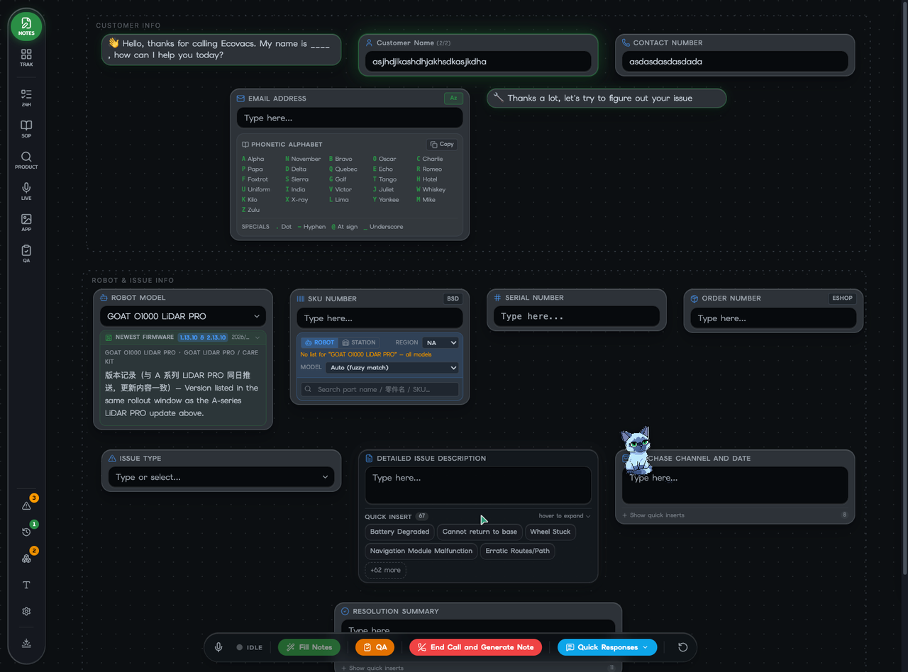
Note Master
QUALITY OF LIFE · 05
Dozens of smaller touches.
History panel
Quick inserts
Searchable archive of past notes by customer or issue.
67 one-click chips for the common issue descriptions.
QA checklist
Case board
Weighted call-channel items, red/amber/green bars, scored by the LLM pass.
Kanban for the team — 28 agents, drag-and-drop, persists to localStorage.
17 / 18

Slide 18
Note Master
STACK & SUMMARY
Built on a modern, fully-typed stack.
UI
React 19 · Vite 8 · Tailwind 4 · Radix UI
VOICE
transformers.js · ONNX Runtime Web · Web Speech API
AI
DeepSeek (cloud) · Qwen 0.5B / 1.5B (local, Web Worker)
CONTENT
Markdown + import.meta.glob · bilingual tokenizer
BRIDGE
Chrome MV3 · externally_connectable + content script
NOTES
v0.2.25 · ~90 components, hooks, libs, workers
Hear. Fill. Ship.
/Users/susul/Dev/econote/note-master
18 / 18

