Slide 1
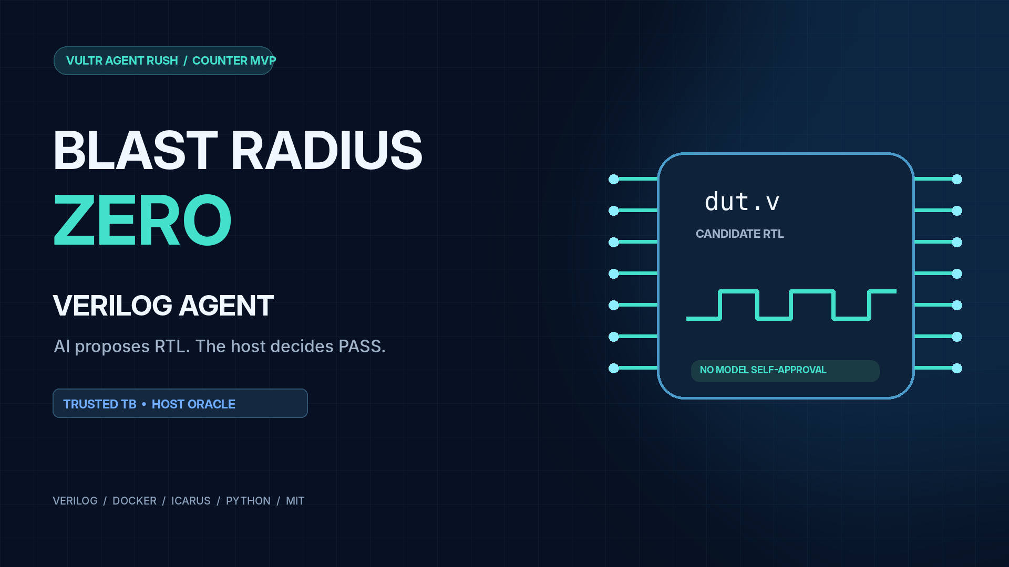

Slide 2
The trust problem
A self-testing generator can assert success without establishing correctness.
UNTRUSTED MODEL
OUR SEPARATION
Generates RTL
Generates its own tests
Prints “PASS”
Model emits dut.v only
Host owns TB + vectors
Python oracle issues verdict
A printed PASS string is just text—not verification.
BLAST RADIUS ZERO / VERILOG AGENT
02

Slide 3
Trusted verification pipeline
A frozen reference path sits outside the LLM’s control.
VULTR INFERENCE
PREFLIGHT
DOCKER SANDBOX
HOST ORACLE
FINAL VERDICT
Candidate dut.v
→
Policy + interface
→
Icarus + fixed TB
→
Compare VLTB1
→
PASS / FAIL
Only RTL can change during repair; trusted TB, vectors, oracle and criteria stay frozen.
BLAST RADIUS ZERO / VERILOG AGENT
03

Slide 4
Failure is visible. Repair is bounded.
Counter MVP · fixed MOCK demonstration (not a live inference claim).
ATTEMPT 1
REPAIR
ATTEMPT 2
Enable ignored
HOST FAIL
→
Edit dut.v only
No test changes
→
Correct enable
HOST PASS
Passing one fixed simulation suite is not formal verification.
BLAST RADIUS ZERO / VERILOG AGENT
04

Slide 5
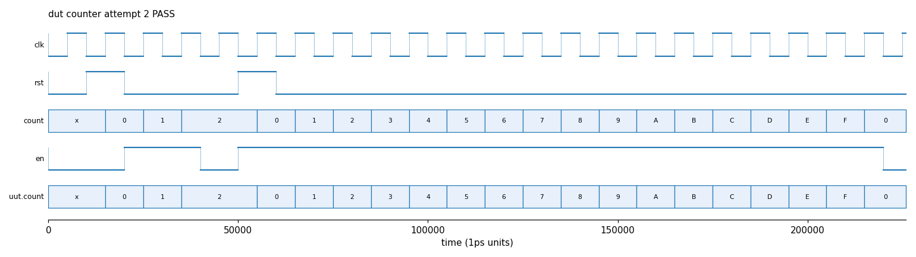
Actual counter waveform
Sample artifact from a local MOCK self-heal run; not proof of a live model call.
Observed: reset → enable hold → increment → modulo-16 rollover.
Source: docs/samples/37b2f00269_attempt2_wave.png
BLAST RADIUS ZERO / VERILOG AGENT
05

Slide 6
Bound the execution environment
Target-VM containment evidence belongs in the operator-recorded terminal footage.
NO NETWORK
LIMITED RESOURCES
READ-ONLY ROOTFS
--network none
CPU • RAM • PID • timeout
tmpfs scratch only
HOST SENTINEL
ANTI-FORGERY
CLEANUP
Cannot read token
Fake PASS rejected
No leftover containers
Proof requirement: VM logs + original capture. Rootful Docker socket remains a control-plane risk.
BLAST RADIUS ZERO / VERILOG AGENT
06

Slide 7
Vultr generates. The host judges.
Separate the fixed public MOCK demonstration from genuine private live inference.
PUBLIC DEMO
PRIVATE INFERENCE
FIXED MOCK IDs
No API call
No arbitrary RTL submissions
Real Vultr API response
Only generates candidate RTL
Independent host verdict
Live proof must be supplied by an actual redacted response capture.
BLAST RADIUS ZERO / VERILOG AGENT
07

Slide 8
Open-source, reviewable, constrained
The point is independent evidence—not a self-reported success banner.
MIT • FastAPI • Icarus Verilog • Docker • Python
Repository
github.com/sususu-su11/verilog-agent-counter-mvp
Public demo URL: add only after operator verifies it.
Counter MVP • Trusted verdicts • Bounded simulation
BLAST RADIUS ZERO / VERILOG AGENT
08

