Slide 1
LEESA: Embedding Strategic and XPath-like Object Structure Traversals in C++
Sumant Tambe
Aniruddha Gokhale
Vanderbilt University, Nashville, TN, USA
Contact : sutambe@dre.vanderbilt.edu
IFIP Working Conference on Domain Specific Languages
(DSL WC), 2009, Oxford, UK
This work was supported in part by NSF CAREER award 0845789

Slide 2
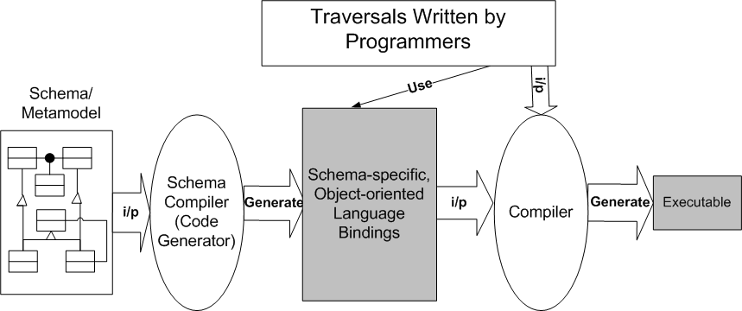
Schema-first Applications
Manipulate richly-typed composite data structures
  XML documents
  Domain-specific Models
Governed by statically known schema of the data structure
  E.g., XSD, MOF, Ecore, MetaGME etc.
Follow a well-known schema-driven development process
Using schema-specific OO API and design patterns
  E.g., Composite, Visitor
Common operations
  Queries (search), traversals (visit), selection, accumulation, sorting, and transformations
Large code-bases exist
  E.g., Component deployment infrastructures, model interpreters etc.

Slide 3
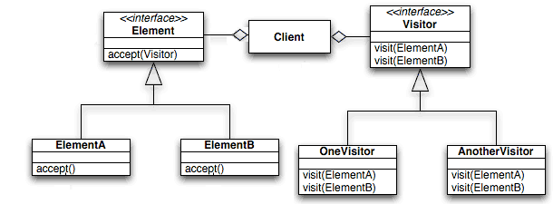
Key Challenges
Highly repetitive, verbose traversal code
  Reason: schema-specificity - each class has different interface.
  Intent is lost due to code bloat
Tangling of traversal specifications with type-specific actions
  “visit-all” semantics of the classic visitor are inefficient and insufficient
Lack of reusability of traversal specifications and visitors
Supporting Structure-shyness
  Traversals that are loosely coupled to the underlying structure
  Resilience to schema evolution
Traversal
Type-specific actions
getElementB()
getElementC()
getElementX()
getElementY()

Slide 4
Comparison of Existing Solutions
Approach | Advantage | Limitation
XPath, XSLT, XQuery | Domain-specific, intuitive, succinct, structure-shy, schema-aware (XSD v2.0) | Tangling persists, XML-specific, “string-encoded” integration in GPL, only run-time error identification
External DSLs (e.g., Gray, Ovlinger et al.) | Tangling addressed, intuitive, domain-specific, schema-aware | extra code generation step, high language development cost, coarse granularity of integration with existing code
Strategic programming (e.g. Stratego, Visitor-based) | Tangling addressed, generic reusable traversals, structure-shy | Efficiency concerns, limited schema conformance checking
Adaptive Programming (Lieberherr et al.) | Tangling addressed, efficient, early schema conformance checking, structure-shy | Limited traversal control

Slide 5
Solution: LEESA
LEESA: Language for Embedded quEry and traverSAl
  A domain-specific embedded language (DSEL) in C++ for writing queries and traversals over object graphs
  XPath-like succinct and expressive syntax for axis-oriented traversals
  Decouples type-specific actions from traversal specifications
  Generic, reusable traversals using Strategic Programming
  Structure-shy
  Compile-time schema conformance checking
  Intuitive domain-specific error reporting
  Integration at statement level
  Interoperable with the C++ standard library and other popular DSELs
    E.g., Blitz++, Boost.Spirit, Boost.Lambda
  Cheap to develop
    Reuses C++ lexer, parser and a whole slew of standard libraries

Slide 6
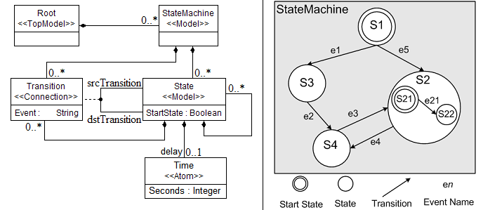
LEESA by Examples
State Machine: A simple composite object structure
  Recursive: A state may contain other states and transitions

Slide 7
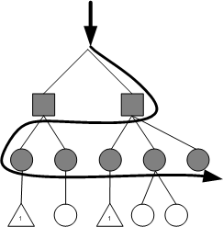
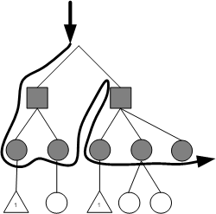
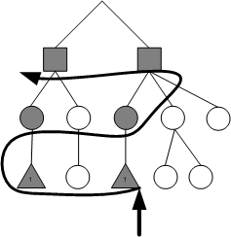
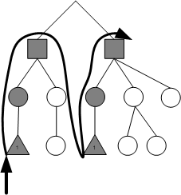
Axis-oriented Traversals (1/2)
Child Axis (breadth-first)
Child Axis (depth-first)
Parent Axis (breadth-first)
Parent Axis (depth-first)
Root() >> StateMachine() >> v >> State() >> v
User-defined visitor object
Root() >>= StateMachine() >> v >>= State() >> v
Note
depth-first operator
Time() << v << State() << v << StateMachine() << v
Time() << v <<= State() << v <<= StateMachine() << v

Slide 8
Axis-oriented Traversals (2/2)
Descendant and ancestor axes (structure-shyness)
  E.g., Find all the State objects under Root (recursively) and visit them all
Sibling Axis
  E.g., Visit all States and Transitions (in that order) in a StateMachine.
Association Axis
  E.g., Visit all States (top-level) having at least one incoming Transition.
Root() >> DescendantsOf(Root(), State()) >> v
StateMachine() >>= MembersOf(StateMachine(),State() >> v,
Transition() >> v)
StateMachine() >> Transition()
>> Association(Transition::dstTransition) >> v

Slide 9
Intermediate Results Processing
Programmer-defined selection, sorting, filtering of intermediate results
Key features of axis-oriented expressions
  Separation of type-specific actions from traversals
  Succinct and expressive
  Composable
  First class support (can be named and passed around as parameters)
Programmer-defined C++ functions/functors
In C++0x, lambda functions can be used
int comparator (State, State);
bool predicate (Time);
Root() >> StateMachine() >> State()
>> Sort(State(), comparator)
>> Time()
>> Select(Time(), predicate)

Slide 10
Layered Architecture of LEESA
Application Code
Programmer-written traversals
Strategic Traversal Combinators and Schemes
Schema independent generic traversals
Focus on schema types, axes, & actions only
Axes Traversal Expressions
A C++ idiom for lazy evaluation of expressions
LEESA Expression Templates
(Parameterizable) Generic
Data Access Layer
Schema independent generic interface
Object-oriented Data
Access Layer
OO Data Access API (e.g., XML data binding)
In memory representation of object structure
Object Structure

Slide 11
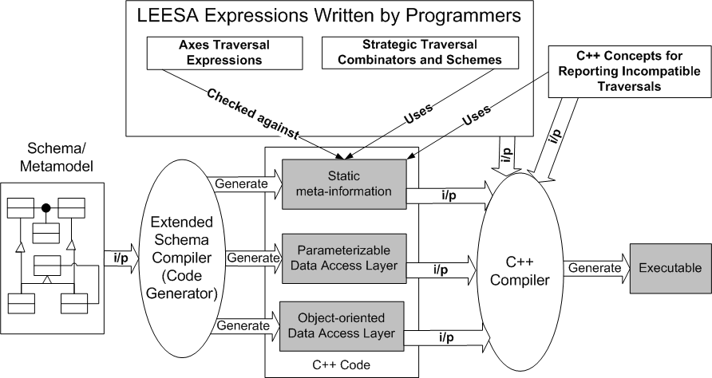
Extension of Schema-driven Development Process
We extended Universal Data Model (UDM) code generator

Slide 12
Generic Data Access Layer / Meta-information
Automatically generated C++ classes from the StateMachine meta-model
T determines child type
class Root {
set<StateMachine> StateMachine_kind_children();
template <class T> set<T> children ();
typedef mpl::vector<StateMachine> Children;
};
class StateMachine {
set<State> State_kind_children();
set<Transition> Transition_kind_children();
template <class T> set<T> children ();
typedef mpl::vector<State, Transition> Children;
};
class State {
set<State> State_kind_children();
set<Transition> Transition_kind_children();
set<Time> Time_kind_children();
template <class T> set<T> children ();
typedef mpl::vector<State, Transition, Time> Children;
};
Externalized meta-information using C++ metaprogramming

Slide 13
C++ Metaprogramming and Expression Templates
  C++ templates – A turing complete, pure functional, metaprogramming language
  Boost.MPL – A de facto library for C++ metaprogramming
    Typelist: Compile-time equivalent of run-time data structures
    Metafunction: Search, iterate, manipulate typelists.
    Answer compile-time queries such as “is T present is the list?”
      State::Children = mpl::vector<State,Transition,Time>
      mpl::contains<State::Children, State>::value is TRUE
  Expression Templates
    A C++ idiom that supports lazy evaluation of expressions
    Pass an expression -- not the result of the expression -- as a parameter to a function E.g., foo (x + y * z);
    Uses operator overloading and recursive template composition
    LEESA has overloaded >>, >>=, <<, <<=, and comma operators

Slide 14
Mapping Expression Templates to Generic Interface
Root() >> StateMachine() >>= State() >> Time()
Root::Children<StateMachine>()
StateMachine::children<State>()
State::children<Time>()
BreadthFirstChildren<Root,StateMachine>
DepthFirstChildren<StateMachine,State>
Axis-oriented expressions are statically checked against the schema

Slide 15
Schema Compatibility Checking and
Domain-specific Error Reporting
Implemented using C++ Concepts
  Part of the upcoming C++ language standard C++0x
  A type system for early type checking of C++ templates
  Simplifies compilation of templates and corresponding error messages
LEESA’s expression templates are constrained by concepts that use metaprogramming
  Invalid traversals are identified at compile-time
  Consider a LEESA child axis expression: X() >> Y()
concept ParentChildConcept <typename Parent, typename Child> {
typename Children = typename Parent::Children;
typename IsChild =
typename mpl::contains<Children, Child>::type;
requires std::SameType<IsChild, true_type>;
};
Externalized meta-info
Boost.MPL

Slide 16
Adopting Strategic Programming
But all these axis-oriented expressions are hardly enough!
  LEESA’s axes traversal operators (>>, >>=, <<, <<=) are reusable but …
  Programmer written axis-oriented traversals are not!
  Also, where is recursion?
Adopting Strategic Programming (SP) design method
  Began as a term rewriting language: Stratego
  Generic, reusable, recursive traversals independent of the structure
  A small set of basic combinators
Identity | No change in input | Choice <S1, S2> | If S1 fails apply S2
Fail | Throw an exception | All<S> | Apply S to all children
Seq<S1,S2> | Apply S1 then S2 | One<S> | Apply S to only one child

Slide 17
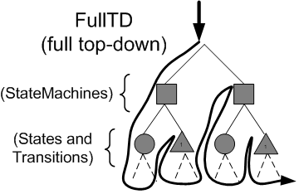
Strategic Programming Continued
Higher-level traversal schemes can be composed
Try<S> | Choice<S,Identity> | Repeat<S> | Try<Seq<S,Repeat<S>>
TopDown<S> | Seq<S,All<TopDown>> | BottomUp<S> | Seq<All<BottomUp>,S>
Root() >> StateMachine()
>> TopDown(StateMachine(), VisitStrategy(v))
LEESA’s SP primitives are generic yet schema-aware!

Slide 18
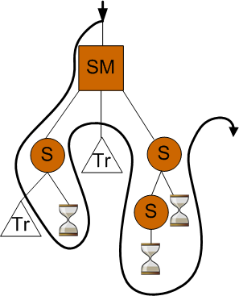
Generic yet Schema-aware SP Primitives
LEESA’s All combinator uses externalized static meta-information
  All<Strategy> obtains children types of T generically using T::Children.
  Encapsulated metaprograms iterate over T::Children typelist
  For each child type, a child-axis expression obtains the children objects
  Parameter Strategy is applied on each child object
Opportunity for optimized substructure traversal
Eliminate unnecessary types from T::Children
DescendantsOf implemented as optimized TopDown.
DescendantsOf
(StateMachine(), Time())

Slide 19
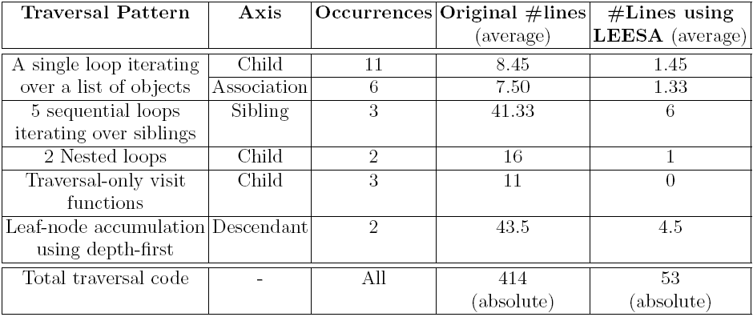
Reduction in Boilerplate Traversal Code
Experiment: Existing traversal code of a UDM-based model interpreter was changed easily
87% reduction in traversal code

Slide 20
Future Work and Concluding Remarks
Future work
  Performance results
    Upcoming C++0x features such as rvalue references, movable types may give free performance boost!
  Supporting declarative queries (more metaprogramming!)
  Encapsulated parallel query execution
Concluding remarks
  Pure embedding is cost-effective if syntax tradeoffs are acceptable
  A DSEL-friendly host language = agile syntax (not just operators), well-designed metaprogramming, good error reporting, and debugging
  C++/C++0x has a powerful DSEL toolset except debugging
    E.g., Scientific computing (Blitz++, PETE, MTL), Regular Expressions (Boost.Expressive), Parsing (Boost.Phoenix), Relational Algebra (ARARAT), Linear Algebra (Boost.Basic), Typed traversals (LEESA), Finite State Machines, and more …

Slide 21

Thank you!

Slide 22
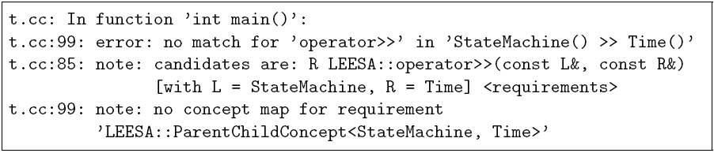
ConceptGCC Error Reporting
StateMachine() >> Time()

Slide 23
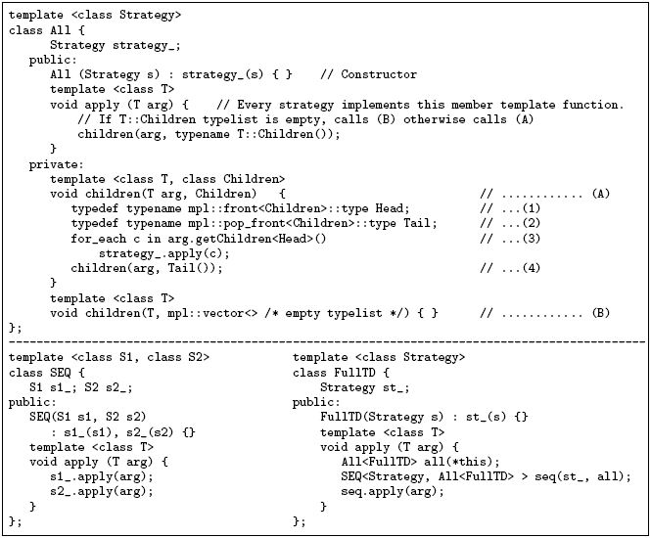
LEESA’s Strategic Programming Primitives

