Slide 1
An Embedded Declarative Language for Hierarchical Object Structure Traversal
Sumant Tambe*
Aniruddha Gokhale
Vanderbilt University, Nashville, TN, USA
*Contact : sutambe@dre.vanderbilt.edu
2nd International Workshop on Domain-Specific Program Development (DSPD), GPCE 2008, Nashville, TN, USA

Slide 2
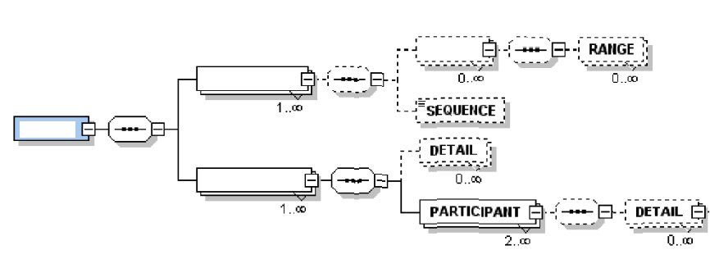
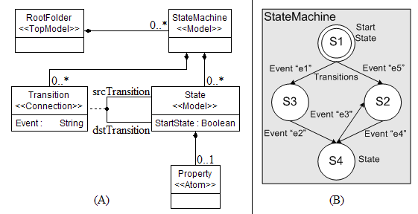
Object Structures and Operations
Object Structures
  Hierarchical data structure (XML)
  Object Graph/Network (e.g., Domain-specific Models)
Uses of object structures
  Domain-specific modeling language (DSML) interpreters, transformations
  Systems using XML data binding
    Component deployment & configuration engines
    Web services
Common operations
  Queries (search)
  Traversals (visit each element)

Slide 3
Existing Approaches and Their Limitations
Approach | Limitations
Imperative object-oriented API Implemented using classes, interfaces, and collections of objects in Java, C++ Visitor pattern: separates visitation actions from traversal (Good!) XQuery / XSLT / XPath W3C standards Suitable for hierarchical structures Traversal/Visitor Language (TVL) Separate specification language Autogenerates traversal code LINQ (Language Integrated Query) Used in C# and VB Based on Microsoft .NET framework | Imperative object-oriented API Code bloat while using large/complex data models. Intent is lost In multiple traversals: traversals are coupled with visitation actions – limits reusability XQuery / XSLT / Xpath Only hierarchical. No support for object graphs. No static checking Traversal/Visitor Language (TVL) High cost of development of lexer/parser Must learn new language (syntax, semantics) and code generation step LINQ Depends on .NET framework features

Slide 4
Solution: LEESA
LEESA: Language for Embedded Query and Traversal
Features of LEESA
  A domain-specific embedded language (DSEL) for writing queries and traversals over object graphs (models)
  Provides short and expressive syntax for traversal
  Supports multiple traversal strategies
  Traversal is checked statically by that compiler
  Supports Visitor: decouples visitation actions from traversal
  Cheap to develop because it is embedded in C++
    Reuses C++ lexer, parser and whole slew of standard libraries
  Much flatter learning curve than external DSLs
    Seamless transition between LEESA and traditional C++

Slide 5
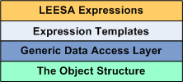
Layered Architecture of LEESA
DSL for query and traversal
A C++ generative programming technique
OO access API (UDM, XML data binding)
In memory representation of object structure

Slide 6
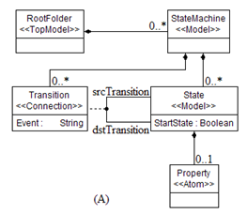
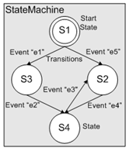
LEESA Expressions
Examples based on the StateMachine meta-model =>
Example 1: Give all the States under RootFolder
RootFolder() >> StateMachine() >> State()
Returns a std::set<State>
Labeling and later composition of expressions is possible
S
=
RootFolder() >> StateMachine() >> State()
Example 2: Select states whose name start with “S”
S >> SelectByName(State(),”S?”)
Returns a std::set<State>

Slide 7
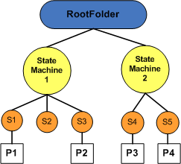
Object Structure Visitation Using LEESA
Visitor pattern is supported
  Add visitor object inside square bracket
  Calls corresponding Visit* function
  Separates visitation actions from traversal order
Example 3: Visit each StateMachine, State, and Property and count them
CountVisitor cv;
RootFolder()
>> StateMachine()[cv]
>> State()[cv]
>> Property()[cv]
Example 4: Same as before but in depth-first order
“>>” visits in breadth-first order
“>>=” visits in depth-first order
Query operators work with both strategies
Traversal strategies can be mixed together
RootFolder()
>>= StateMachine()[cv] >>= State()[cv]
>>= Property()[cv]

Slide 8
Layered Architecture of LEESA
DSL for query and traversal
A C++ generative programming technique
OO access API (UDM, XML data binding)
In memory representation of object structure

Slide 9
Overview of Expression Templates
  First developed in 1994 by Todd Veldhuizen
  Known uses: Boost.Spirit parser, Blitz++ scientific computing library
  Based on the idea of lazy evaluation
    Execute expressions much later in the program from the point of their definition
  Pass an expression -- not the result of the expression -- as a parameter to a function
  E.g., foo (x * y + z);
  The result of expression is computed before calling the function
  Instead, an abstract syntax tree (AST) is created at compile-time using templates and operator overloading
+
*
Z
X
Y

Slide 10
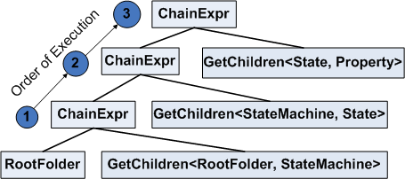
LEESA’s Expression Templates
LEESA defines a couple of expression templates and many operators
  We’ll consider GetChildren operator
  ChainExpr expression template
Returns a set of R
RootFolder() >> StateMachine() >> State() >> Property()
GetChildren<L, R> ➔ L.children<R>();
GetChildren<StateMachine, State> ➔ StateMachine.children<State>();
ChainExpr<L,R> creates an AST that embodies traversal

Slide 11
Future Work
How to improve error reporting?
  Promising solution: C++ concept checking
How to make it less dependent on structure?
  Structure-shyness property
  Promising solution: template metaprogramming
RootFolder() >> ***** >> Property()
Questions?

