Slide 1
Approximate Graph Querying

Slide 2
Big drivers
Querying trillion-scale graphs with time and accuracy constraints
Option 1
Option 2

Slide 3
Let’s understand how Approximate Relational Database Querying works
Data is partitioned
Compute a function for each partition
Given a query, determine which partitions should be touched
For each partition, determine access time

Slide 4
Can we port this to graphs?
How about we partition the graph?
Given a trillion edge graph, we partition that into 1000 billion scale graphs
Then we decide which graphs to query?
Assume we can query a 100M/1B scale graph fast
If we are able to partition the graphs into 1000 or even 100000 separate graphs, we should be able to query them simultaneously with more machines by scaling horizontally, right?
Our problem would be solved! We just have query 100M/1B graphs fast!

Slide 5
Is that perfect?
Not totally unreasonable I guess, but there are some hidden assumptions
A) That we can partition a trillion-scale labeled (or heterogeneous, whatever you prefer to call) graph
B) That we can query the billion-scale graph-blocks very efficiently
C) And our answers will be localized within partitions, we will not see what falls across partitions. So we can quantify the loss across partitions
B is generally where we see. We don’t have expertise in A. If A is doable, then C becomes the big question.

Slide 6
Key Takeaway - 1
If there are classes of queries which would be largely contained into big clusters, then trillion-scale graph querying problem becomes a graph partitioning problem
Not a surprise, considering this is how Google and Facebook scales
Partitioning of data and horizontal scaling

Slide 7
What is the other option?
Data is not partition-able
In other words, our query accuracy will dip significantly if we split the trillion-edge graph into 10000 100M edge graphs
Really? Let’s see where this would break

Slide 8
Keep the following questions in mind
First, see the questions for each data type
Is the data patitionable?
Will it hurt answer quality if data is partitioned?
Is enumeration really necessary, where can we count?

Slide 9
Who cares about trillion-scale graphs and what are their querying needs?
Facebook
Today they won’t let users run a query with high complexity- FB graph search is all about indexing
You got 1.25 billion-ish active users
Each user has posts, pictures, conversations
Relations: friendships, likes, conversations

Slide 10
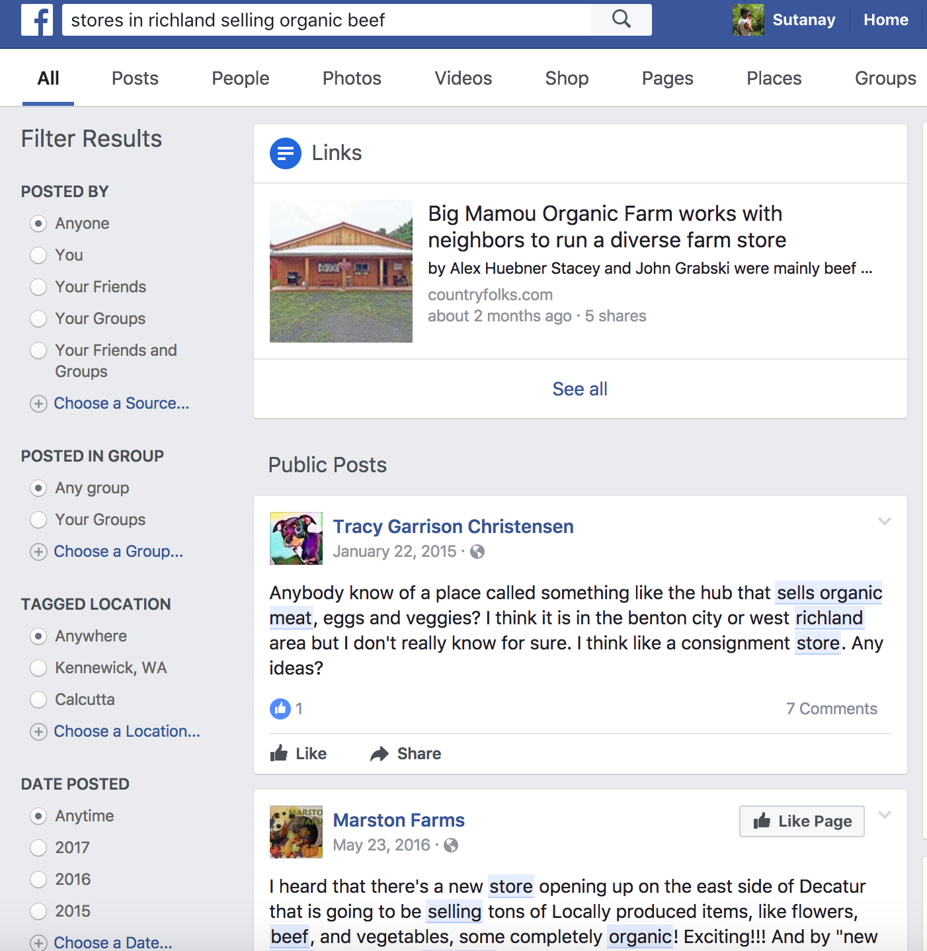
2-edge query
They are doing pretty well!
At least time-wise
Accuracy?
Not so sure!

Slide 11
Restaurants in Seattle liked by people working at PNNL
Seattle <-[local]- restaurant? <-[liked]- person? –[works]-> PNNL

Slide 12
Who cares? Cont.
Security (govt - DoD/industry - Charter)
Suppose you could see the entire traffic entering US through a Seattle Data Center
Brain research – let’s not go there! ☺

