Slide 1

Customer Shopping Behavior Analysis
Uncovering insights from 3,900 transactions across product categories to guide strategic business decisions.

Slide 2
Dataset at a Glance
3,900
18
Transactions
Features
$59.76
3.75
Avg. Purchase
Avg. Rating
Demographics · Purchase details · Shopping behavior · Subscription status

Slide 3


Data Preparation in Python
Load & Explore
pandas, df.info(), .describe()
Clean & Impute
Median-filled Review Ratings; dropped redundant promo_code_used
Feature Engineering
age_group bins · purchase_frequency_days
Export to SQL
Loaded cleaned data into Microsoft SQL Server

Slide 4
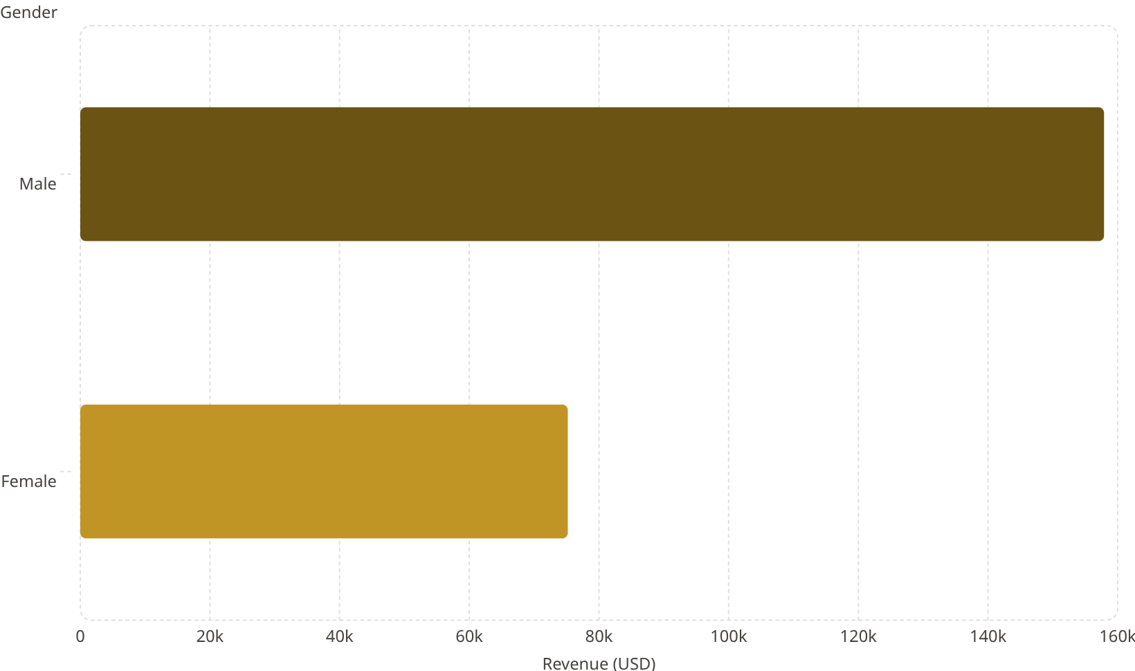
Revenue & Spending Insights
Key Findings
Male customers generate 2× more revenue than female customers.
158k
Express shipping users average $60 vs. Standard at $58 — a small but notable premium.
75.2k

Slide 5
Top-Rated Products
🥇 Gloves
🥈 Sandals
🥉 Boots
Avg. Rating: 3.86
Avg. Rating: 3.84
Avg. Rating: 3.82
Hat
Handbag
Avg. Rating: 3.80
Avg. Rating: 3.78

Slide 6

Customer Segmentation
2.13%
Segment Breakdown
17.97%
Loyal — 3,116
Loyal·79.9%
>5 purchases; 958 are subscribers
·79.9%
·
Returning·17.97%
·17.97%
·
New·2.13%
·2.13%
·
Returning — 701
79.9%
Engaged but not yet loyal
New — 83
Acquisition pipeline

Slide 7


Subscriptions & Discounts
27%
73%
Subscribers
Non-Subscribers
1,053 customers · $62,645 revenue
2,847 customers · $170,436 revenue
Most Discount-Dependent Products
Product
Discount Rate
Hat
50%
Coat
49%
Sneakers
49%
Sweater
48%
Pants
47%

Slide 8
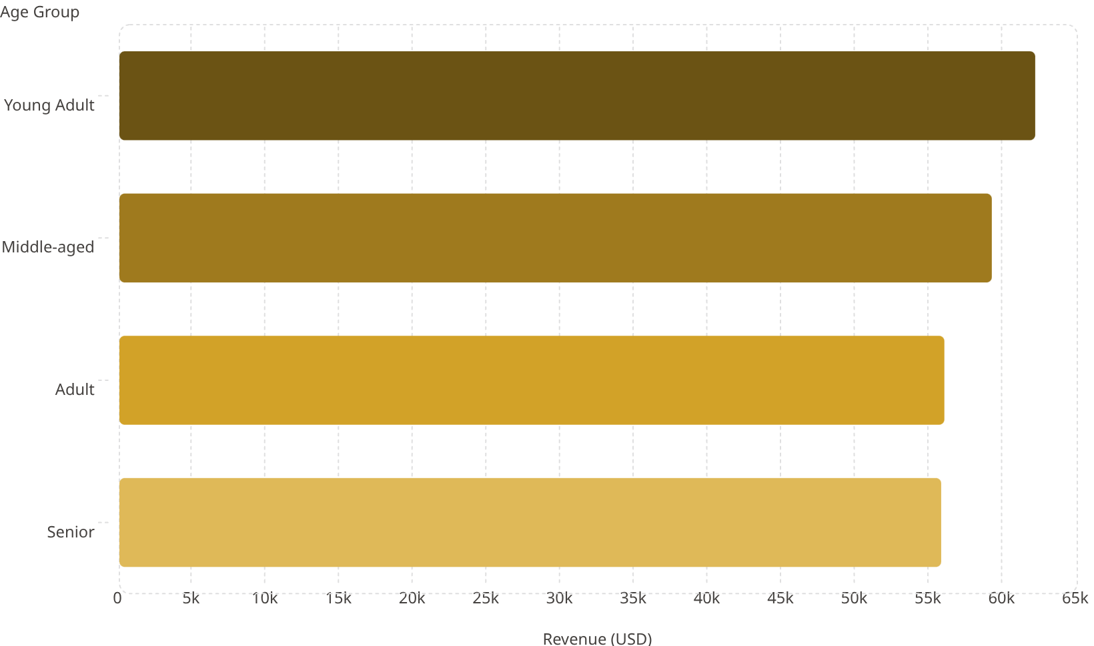

Revenue by Age Group
Top Products by Category
62.1k
Category
#1 Product
Orders
59.2k
Clothing
Blouse / Pants
171
56k
Footwear
Sandals
160
Outerwear
Jacket
163
55.8k
Young Adults lead revenue at $62,143.
Notes:
• Revenue peaks with Young Adults at $62,143 — about $3,000 more than Middle-aged customers • Notice the decline is gradual across age groups, with Senior customers at the lower end but still generating meaningful revenue at $55,763 • All age groups are within a relatively tight range, suggesting consistent purchasing power across demographics
• Top products tell an interesting story by category:
Clothing dominates with Blouses/Pants leading at 171 orders
Footwear close behind with Sandals at 160 orders
Outerwear competitive with Jackets at 163 orders
• Key takeaway: Young Adults are our revenue drivers, but we shouldn't overlook the other age segments — they're all performing similarly in terms of order volume, so the revenue difference may reflect higher average order values from younger customers rather than volume differences

Slide 9
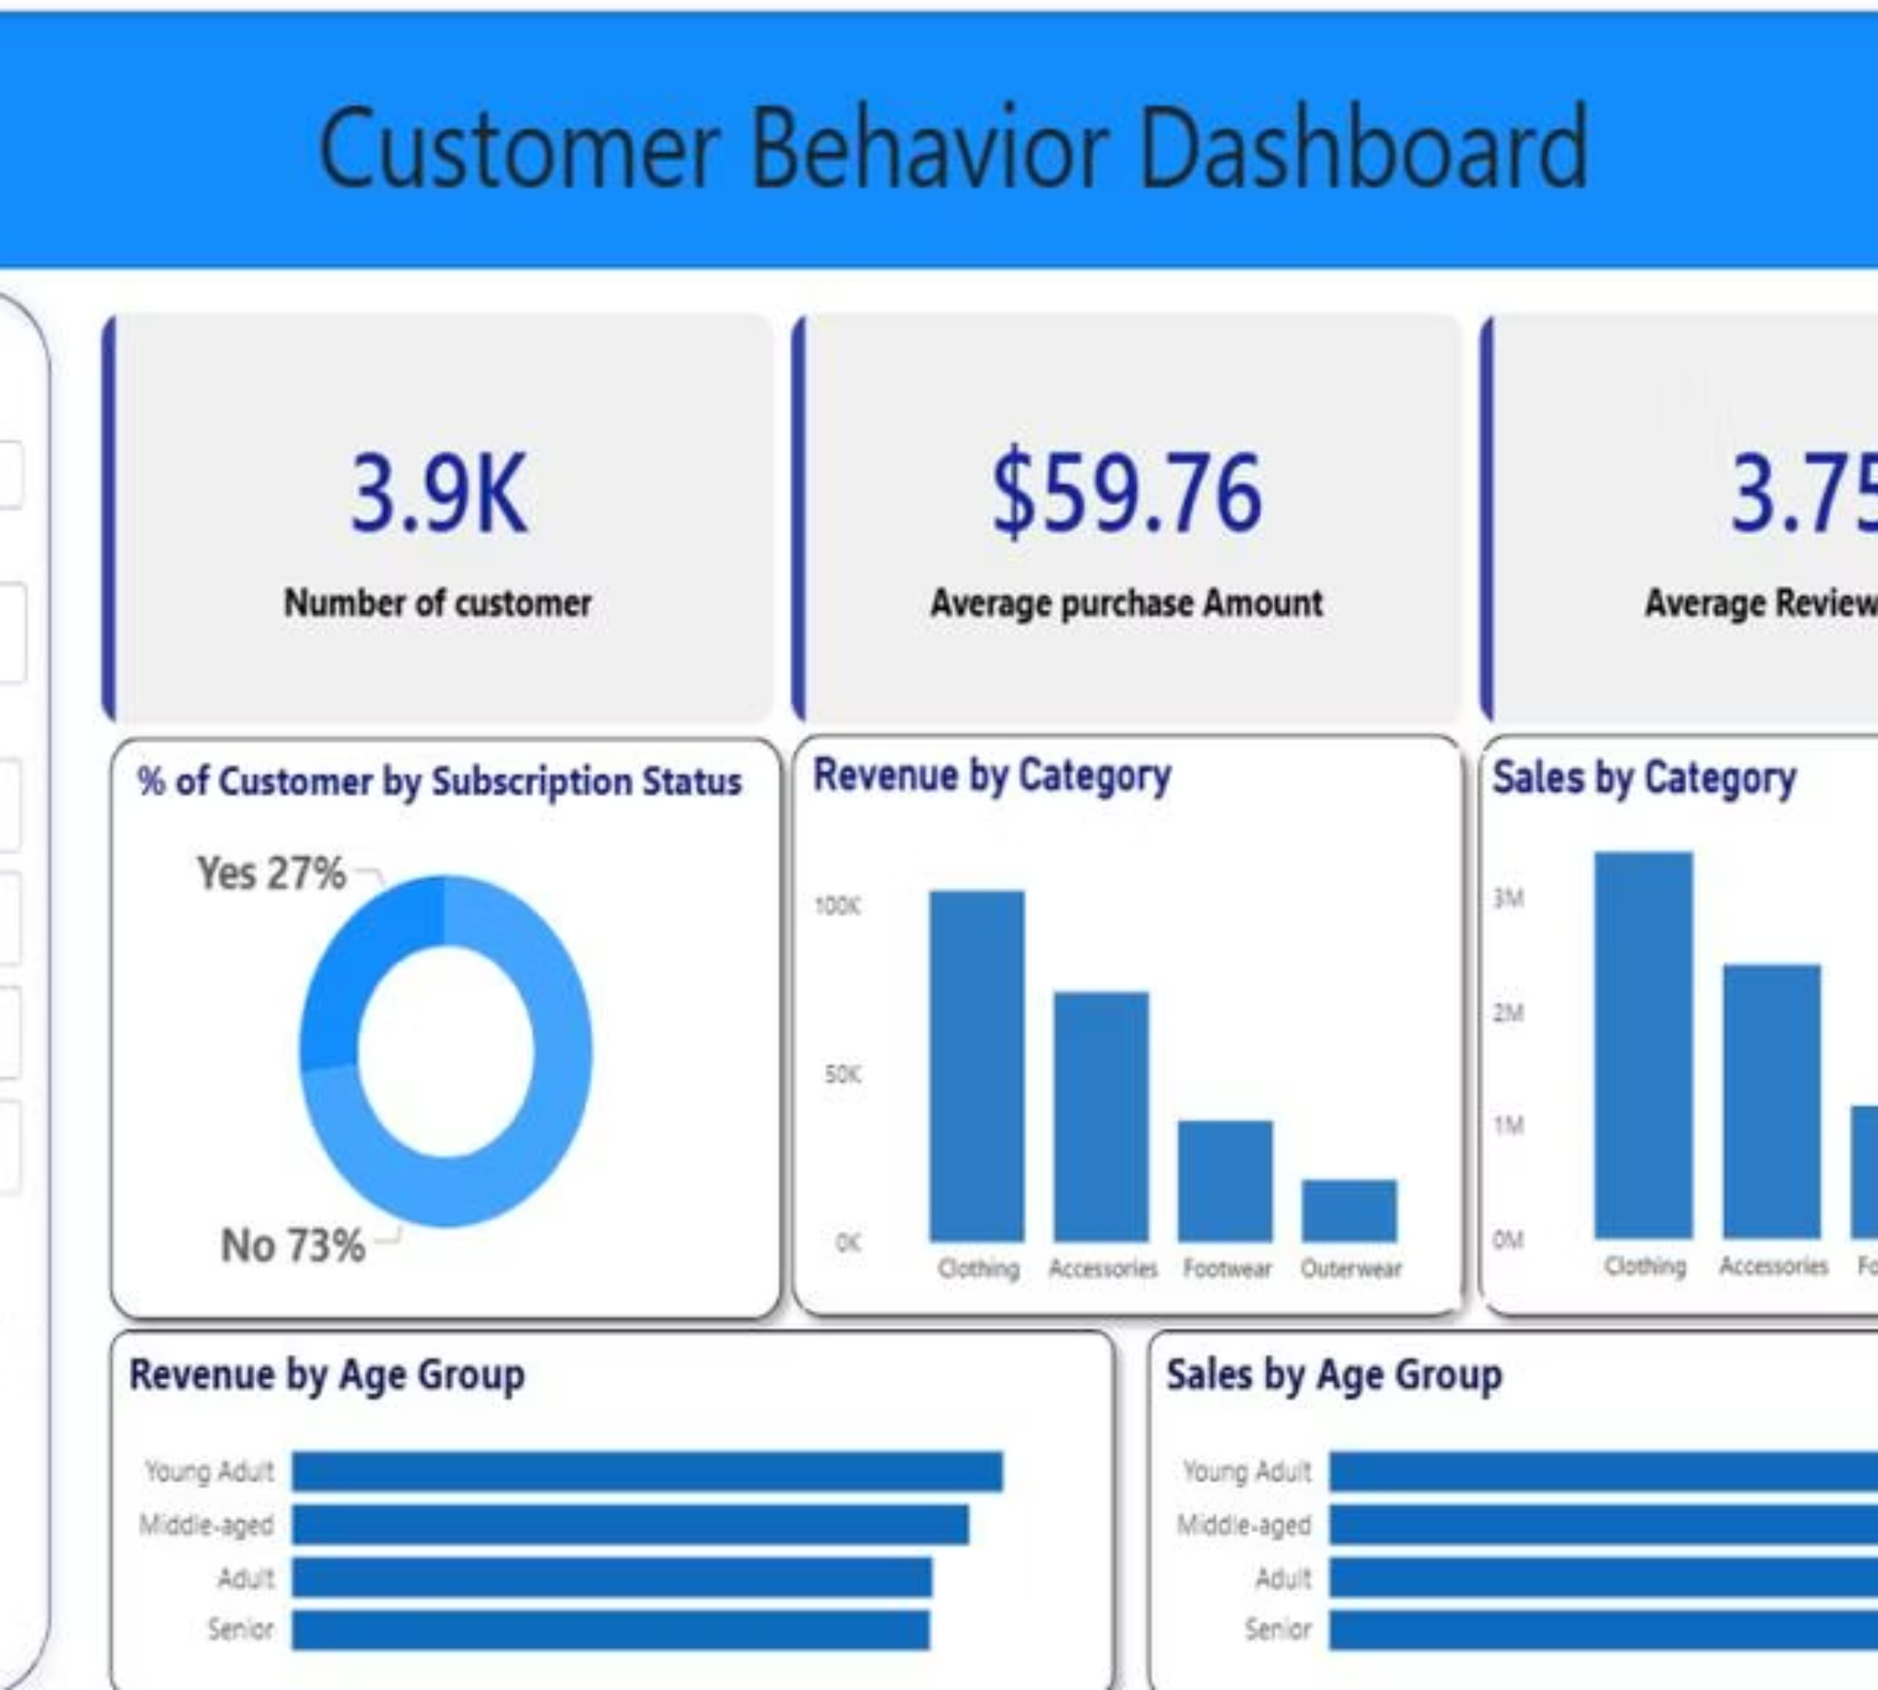
Power BI Dashboard
Interactive filters for Subscription Status, Gender, Category & Shipping Type — six live visualizations in one view.
Notes:
• This is our Power BI Dashboard — the central hub for all our key metrics and insights
• Notice the interactive filters at the top — you can slice the data by Subscription Status, Gender, Category, and Shipping Type
• These filters work across all six visualizations simultaneously, so you can drill down into specific segments in real-time
• All the charts update instantly as you adjust the filters, making it easy to explore different scenarios and answer questions on the fly
• This dashboard gives us a complete view of our business performance in a single, interactive interface

Slide 10
Business Recommendations
Boost Subscriptions
Loyalty Programs
Review Discount Policy
Promote exclusive subscriber benefits
Reward repeat buyers → move to Loyal segment
Balance sales boosts with margin control
Targeted Marketing
Product Positioning
Focus on high-revenue age groups & express-shipping users
Highlight top-rated & best-selling items in campaigns

