Slide 1

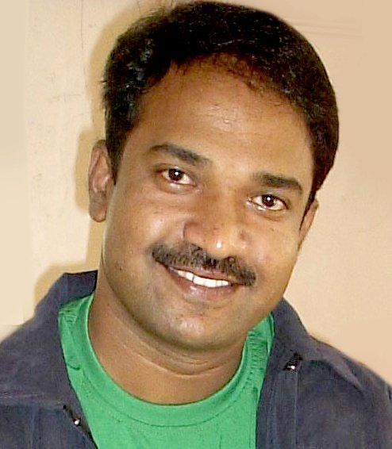

Portfolio
Anil Sutar
Team Lead (User Interface Design)
CUA (Certified Usability Analyst
- HFI Mumbai)
My website:
www.anilsutar.com
LinkedIn:
http://in.linkedin.com/pub/anil-sutar/24/535/476

Slide 2

Specialties
• Visual Design
• Design Evaluation
• Creative Direction
• Conceptual Thinking
• Analytical Thinking
• Interaction Design
• Information Architecture
• User Research
• User Experience Design
Design & Organization
  Information Design & Architecture
  Finalizing navigation
  Creating Wireframes, if required – Diagrammatic Representations of Design
  Creating Prototypes – Visual Samples of Design
  Design Finalization
  Creating HTML pages & CSS, using standard compliant code
Requirement Gathering
  Getting to know Client Business Model
  Identifying Target Audience
  Determining Goals and Prioritizing them
  Understanding design specifications or limitations as per Technology in which design is to be integrated
  Creating Scope & Project Plan
  Creating Effort Estimations & Schedules

Slide 3
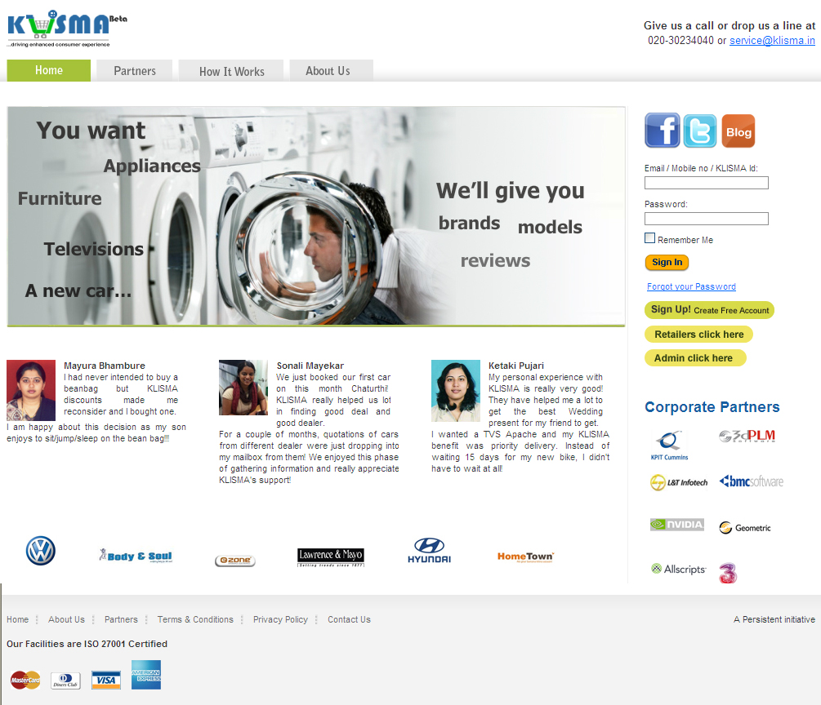
1. Web Portal for Klisma

Slide 4
1. Web Portal for Klisma (Business Concept and My Involvement)
Business Concept:
Most Indian Retailers pay very limited attention to their IT processes, which could be used in a very effective way to understand customers and improve business. The same is the case with alternatives available to the Indian retail consumer. They have very limited avenues, to help optimize spending and get the best value for money. KLISMA is a service targeted towards connecting retailers and consumers in an innovative fashion, which could eventually lead to a healthy retail ecosystem.
Target Audience: Consumers, Retailers
My Involvement in overall project Life Cycle
Requirement capturing from Klisma stakeholders and understanding of basic concepts of business objective.
Prepared project estimations and proposals
Developed a Business strategy. (Internal Business and marketing team was also involved in step 1 and step 2)
Created low fidelity prototypes for initial screens in the form of paper diagrams and evaluate it with Klisma stakeholders if it matches with their expectations or not.
Created some visual designs alternatives for initial few screens. (Jr. Designer was involved)
Created some concepts for Logo on paper and designed the final approved concept in photoshop and Ilustrator for web and printing purpose.
Created some functional high fidelity prototypes and evaluate it with Stakeholders and internal team with managers and developers.
Conversion into HTML/CSS for visual design screens for next development (Jr. Designer was involved)

Slide 5
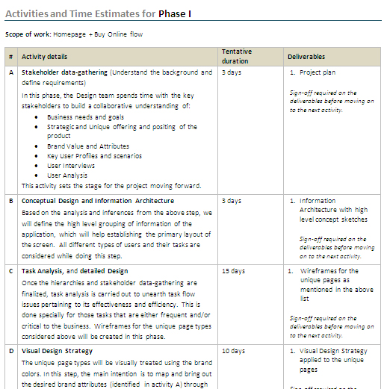




1. Web Portal for Klisma (Project Estimations and Proposal sample, Logo variations)
Final Approved Logo:

Slide 6
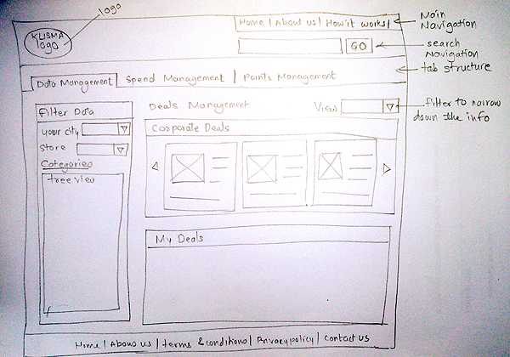
1. Web Portal for Klisma (Initial Sample of Prototype Homepage)
Low Fidelity Prototype Sample for Klisma
Initially the low prototype samples and conceptual sketches were created to cross check my understanding of business concept in the form of paper wireframes. Below is one of the prototype sample which went under many iteration process during meetings with stakeholders and managers and development team.

Slide 7
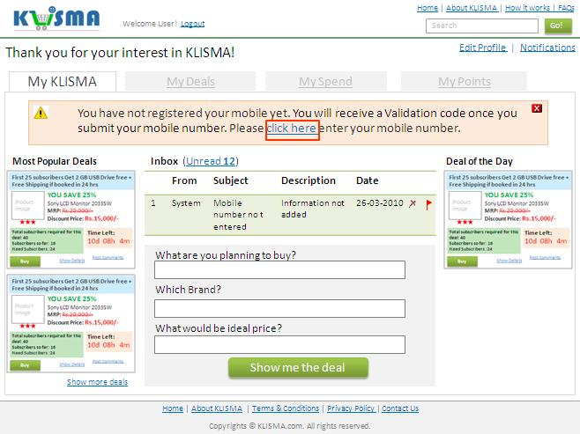
1. Web Portal for Klisma (Initial Sample of Prototype for Internal page)
Advanced Fidelity Prototype Sample for Klisma
Advanced prototypes were created with high fidelity which includes a greater depth detailing, visual quality and functioning complexity.

Slide 8
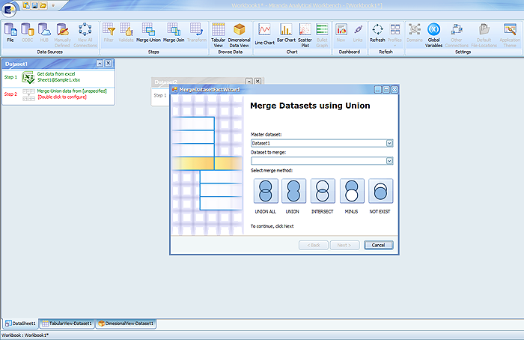
2. Desktop Application – Miranda for Quest (Project details)
Miranda is a desktop BI tool for the business analysts to connect to their data, perform analysis (view dashboards, charts/reports and interact with them) and collaborate by sharing those reports with other users. The objective of Miranda is to eliminate the need for professional skills and enable the business analyst to perceive data without worrying about the technical aspects of the BI tool such as data-cleansing, creating a dimension, etc.
Miranda primarily focuses on facilitating a simplified data-browsing, analysis and data-visualization capability for the business-analyst.
My Involvement in overall
project Life Cycle:
Design treatment to the default interface of Devexpress template as per the visual standards set by Quest
Creation of icons for Miranda application based on the storyboard shared by client. Around 70 icons are created which includes normal, disabled and selected states.
Initially created design options for Dashboard page but later it was dropped due to technological constraints.

Slide 9
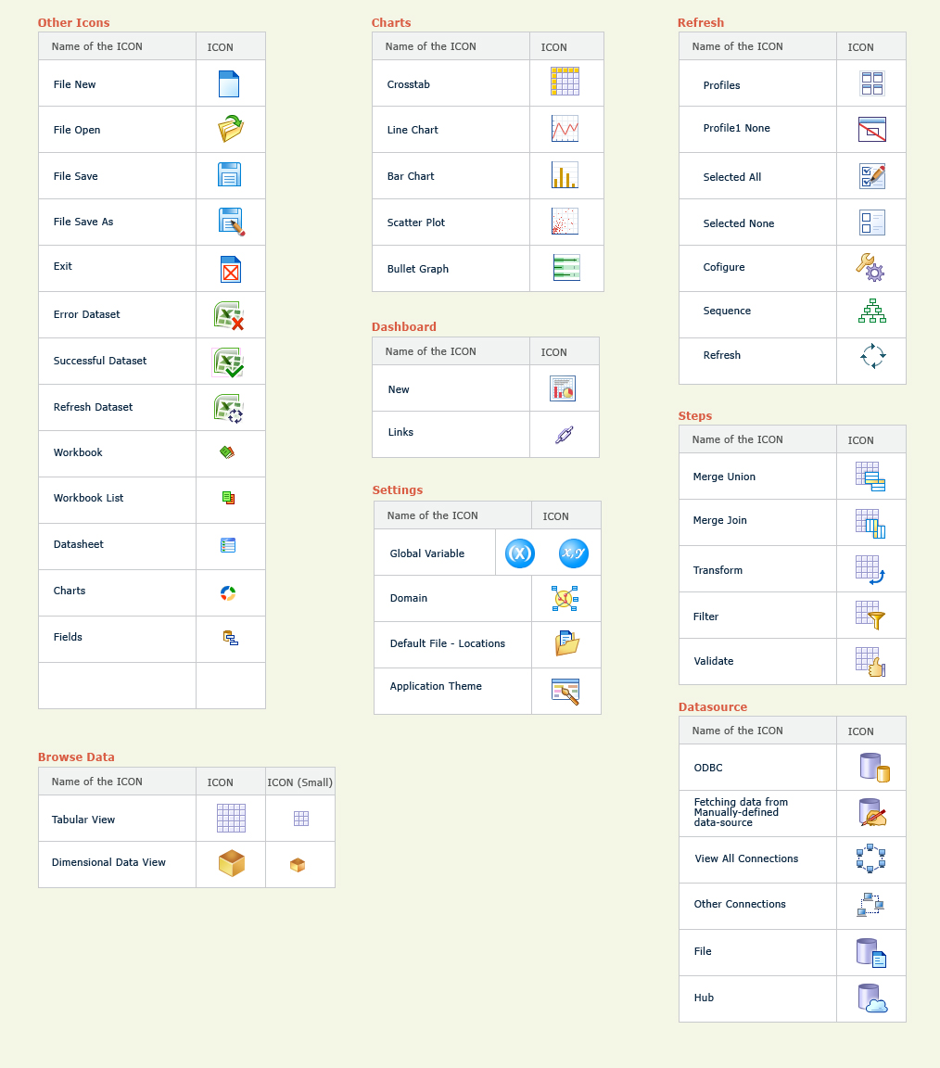
2. Desktop Application – Miranda for Quest (Icon Design)
About 70 icons are designed for Miranda

Slide 10
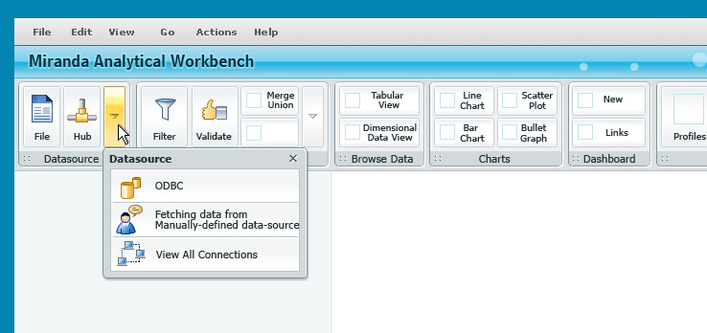
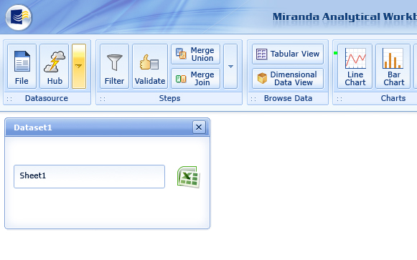
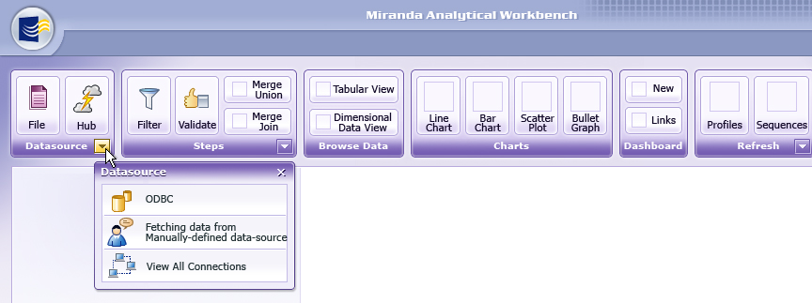
2. Desktop Application – Miranda for Quest (UI design)
Different design approaches for User Interface
of Miranda application

Slide 11
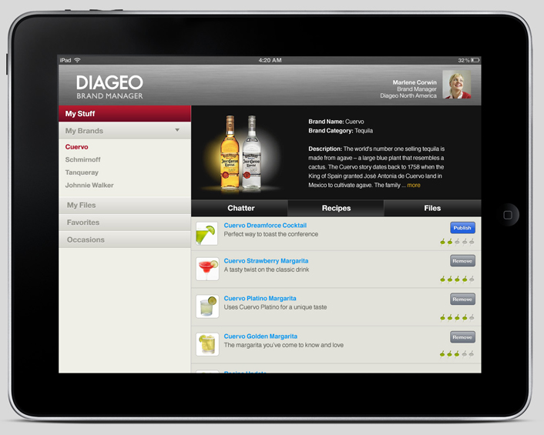
3. iPad design for Digeo (Business requirement)
Business Requirement
RecipeDB is existing Force.com application. Diageo wants an iPad application for the same. The new iPad application should have user experience similar to that of theBar.com iPhone application.
My Job Role
Understand the Business requirements in detail and analyze recipeDB site in detail. Capture the requirements from clients while analyzing the site .
Create the wireframes for iPad application and review it with client
Design the visual screens for the mockups which are final and make them ready for next development process by cropping the images.

Slide 12
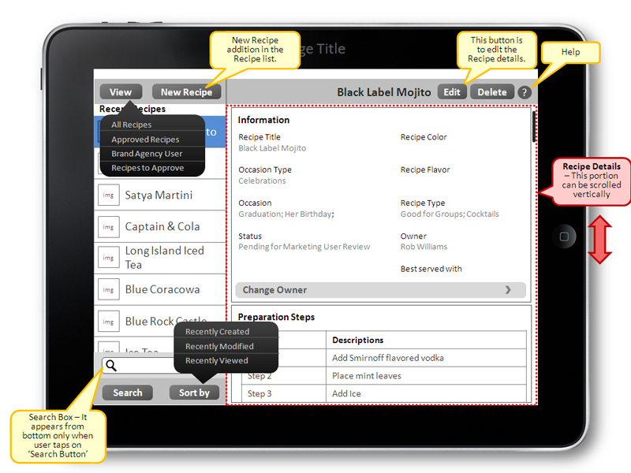
3. iPad design for Digeo (Wireframe sample)
Sample wireframe screen for Diageo iPad design

Slide 13
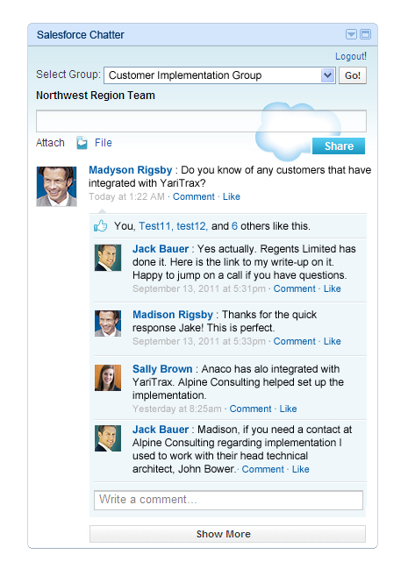
4. UI design for Salesforce Chatter
Chatter is a collaboration application that helps you connect with coworkers inside your Salesforce organization and share business information securely and in real time.
My Involvement
Understand the project requirements in detail and analyze the existing chatter boxes for reference.
Create the wireframes for chatter box
Design the visual screens for the mockups which are final and make them ready for next development process
Conversion of the screens into HTML/CSS for next development process

Slide 14
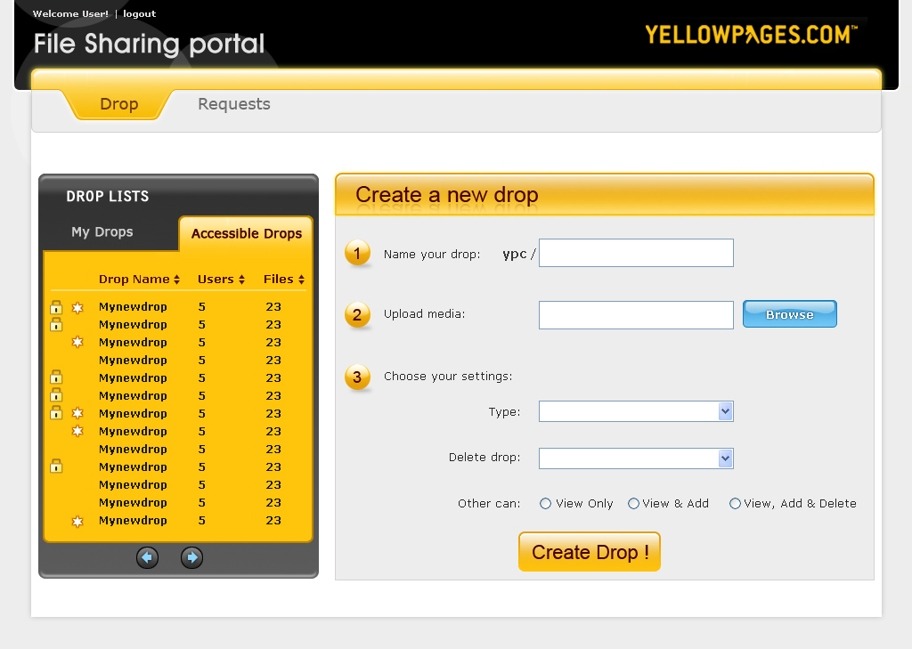
5. UI Design for Yellow pages
Target audience:
Internal to the client within the organization
Visual Design Goals:
Visual design was to get the UI inline with other application developed by the client.
It should have a web 2.0 look and AJAX incorporated.
Business Goals:
Goal of the application was to provide a internal application to the clients where users can upload files and share it for public or for a set of users.
Administrator of the system gets various reports for these drops to maintain them.

Slide 15
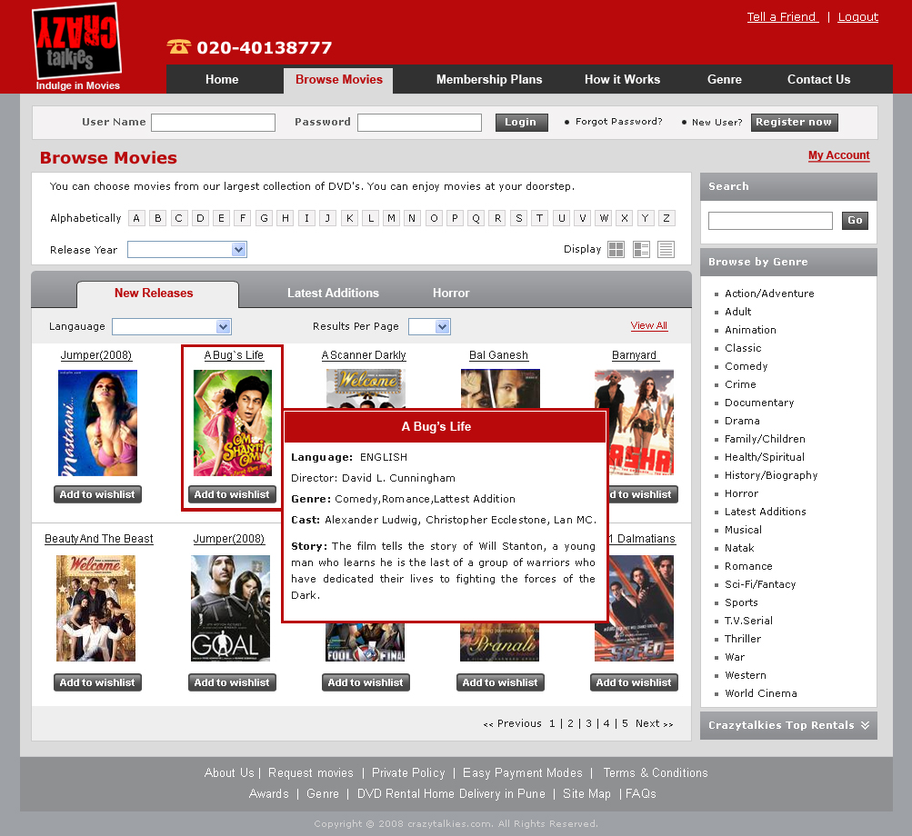
6. Web application for Crazy Talkies
Project Details:
To provide and online way to get the CDs and DVDs on rental basis. The users will be able to browse the CDs. The product list page will display a list of all available CDs.
My Involvement:
Requirement gathering
Wire framing
Visual designing of the screens
HTML/CSS for next development

Slide 16
Other details
Background
Bachelor of Engineering (Mechanical)
CUA (Certified Usability Analyst) training at HFI Mumbai.
Diploma in Advanced Computer Arts (National Multimedia Resource Center, C-DAC Pune
B1/B2 visa approved for USA till 2020.
Other Expertise
Design logos, brochures, newsletters, application UI, icons, collaterals, and other promotional material (print and web) like newspaper and magazine advertisements.
Demo of flash interactive presentations
2D /3D animations
3D Modeling
Proficient in Photoshop, Illustrator, Dreamweaver, XHTML/CSS, Flash design, basic flash action-scripting,
Working knowledge of 3D studio max, Sound forge, Fireworks, Director etc.

