Slide 1
50.003 Elements of Software Construction
Introduction to Agentic Software Development

Slide 2
Agentic AI
An LLM
Has access to read the environment
Given limited control to modify the environment

Slide 3
Why Agentic AI in ESC (when you are learning SWE)
Not to circumvent your thinking and learning.
You should practice SW design and development manually when you are learning.
You will develop senior dev sense, experience, good "taste".
Offer you some "sneak preview" into what Agentic AI in Software Development is like.
What to use
When to use
How to use

Slide 4
Learning Outcomes

Slide 5
Why Agentic AI in Software Development?
Hype and Vibe?
Reduce (re)search time?
Reduce boilerplate code?
SE guys say: why not turning common patterns into a library
Shorten time-to-market process
https://www.youtube.com/watch?v=RNJCfif1dPY&t=1046s
SE guys say: well because you are building a startup app.
Reduce SWE dev workload?
Can the AI codes survive in the production?

Slide 6
What is Software Engineering? (Wikipedia)
Software engineering is a branch of both computer science and engineering focused on designing, developing, testing, and maintaining software applications.
It involves applying engineering principles and computer programming expertise to develop software systems that meet user needs.
The terms programmer and coder overlap software engineer, but they imply only the construction aspect of a typical software engineer workload.
A software engineer applies a software development process, which involves defining, implementing, testing, managing, and maintaining software systems, as well as developing the software development process itself.

Slide 7
Which parts can't be done by LLM?
Software engineering is a branch of both computer science and engineering focused on designing, developing, testing, and maintaining software applications.
It involves applying engineering principles and computer programming expertise to develop software systems that meet user needs.
The terms programmer and coder overlap software engineer, but they imply only the construction aspect of a typical software engineer workload.
A software engineer applies a software development process, which involves defining, implementing, testing, managing, and maintaining software systems, as well as developing the software development process itself.

Slide 8
“Coding is to programming, what typing is to writing”
-- Leslie Lamport

Slide 9
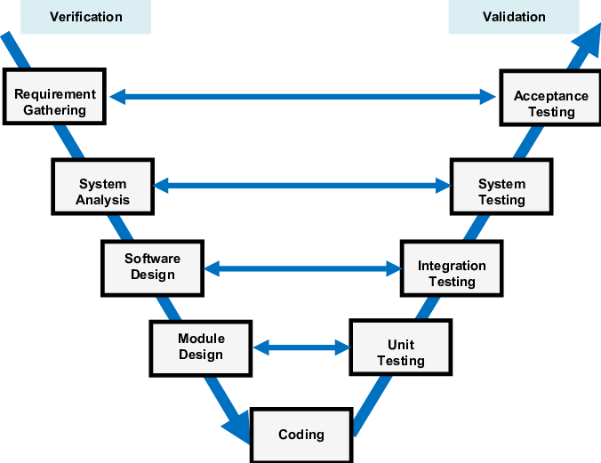
The V-Model for SWE
src: https://medium.com/software-engineering-kmitl/v-model-3a71622b3d82

Slide 10
The V-Model for SWE
Human
AI Agents
The good old days – the "traditional" way!

Slide 11
The V-Model for SWE
Human
AI Agents
We have to do the detailed designs, up to function signatures, and type annotations, input and expected outputs

Slide 12
The V-Model for SWE
Human
AI Agents
Autonomous agents that pick up a task, a ticket, a PR.

Slide 13
The V-Model for SWE
Human
AI Agents
You are a team lead over a swarm of AI agents, probably a lot of unused tokens in your account.

Slide 14
The V-Model for SWE
Human
AI Agents
Vibe coding? Are you a CEO?

Slide 15
The V-Model for SWE
Human & AI
Human & AI
Human & AI
Human & AI
Human & AI
Why not every component? Probably no productivity gain, you just need a smarter auto complete.

Slide 16

Concerns
Accountability
Reliability
Maintainability
Security

Slide 17

A sandwich approach
Human First
Divide a task into small pieces
Give a clear intention and specification, as detail as possible
Develop some examples by hand
AI second
Based on the specification, follow the examples, develop the missing one
Human again
Verify the developed components
How to verify?
Credit: freepik.com

Slide 18
Human First (Setting the context)
Divide a task into small pieces
System and component level design
Give a clear intention and specification, as detail as possible
UC, User Story, Sequence Diagram, ER diagram, Class Diagram, Product Requirement Document
Test Case Documents
Project directory guides, System component guides, Existing API docs
Develop some examples by hand
Feature Development 50%-90%
Unit Testing 10%-20%

Slide 19
AI Second (Agent workflows)
Based on the specification, follow the examples, develop the missing one
set clear and general rules, best practices, DOs and DONTS in an AGENTS.md file.
e.g. always adhere to the type signature, don’t delete codes, compile and test before moving on to the next step.
context prompts should be you’re the design docs, PRD and existing codes, function signatures etc.
e.g. what to build, what is considered task completed.
keep instructional prompts simple and short.
create a sandbox environment.
separate git branch
separate container
separate database / API access, via MCP.

Slide 20
Human Again
Verify the developed components
Rule #1: AI is not thinking, it is always guessing, every model hallucinate ➔ Always be skeptical.
Rule #2: You must always review and test the AI output, every single line every single file.
Rule #3: if you don’t understand the AI output, only two possibilities:
You are not knowledgeable enough to review ➔ Stop using AI, you should learn first.
AI is hallucinating ➔ Stop using AI, you probably need to do it yourself.
Rule #4: The detailed your spec, the smaller the task, the easier to review process ➔ Don’t throw a big task at AI and expecting it to complete perfectly.
More techniques will be discussed in Term 6-8 electives.

