Slide 1
Computer Networks: A Systems Approach, 5e
Larry L. Peterson and Bruce S. Davie
Chapter 1
Foundation
Copyright © 2010, Elsevier Inc. All rights Reserved
Notes:
IFSC3315 - Applied Networking
Spring 2012
CHAPTER 1 - FOUNDATION

Slide 2
Problems
How to build a scalable network that will support different applications?
What is a computer network?
How is a computer network different from other types of networks?
What is a computer network architecture?
Notes:
IFSC3315 - Applied Networking
Spring 2012
Early internetworking experiments were conducted in a laboratory environment but the designers had the foresight to build an infrastructure that lasted and endured a monumental expansion. The only shortcoming was the choice of 32 bits for the networking address. It took over 30 years for this to cause problems. The problem of scalability, what happens when you add nodes or increase the spans of the links, is an important consideration for designers.
Other systems use what could be called a network to deliver services: mail, voice telephone, electric power, even natural gas and water systems can be analysed as networks.
CHAPTER 1 - FOUNDATION

Slide 3

Website for Book
Go to http://www.mkp.com and search for the author’s name: Peterson. Click on the book link then go to the ‘Web Enhanced’ section.
The site contains links to most of the slides and the C source code for the material in the book.
Notes:
IFSC3315 - Applied Networking
Spring 2012
This link is on the IFSC3315 website. The book website contains most of the slides used in the class. Also other resources such as the C code listed in the text. The authors teach networking at Princeton using this text. The text was recently updated to focus on more modern topics and emphasizes studying of networks as components of Information Systems.
CHAPTER 1 - FOUNDATION

Slide 4
Grade Policy
Grading
  Class Tests 3 at 15% 45%
  Homework approx 10 at 2% 20%
  Final Exam 20%
  Lab experiment reports 15%
Each student is expected to do his/her own work, homework assign-ments are not team efforts in this class. Late assignments will be sub-ject to a grade penalty of at least 10%. Work more than two classes late will be graded at 0%.
Notes:
IFSC3315 - Applied Networking
Spring 2012
CHAPTER 1 - FOUNDATION

Slide 5
Chapter Outline
Applications
Requirements
Network Architecture
Implementing Network Software
Performance
Notes:
IFSC3315 - Applied Networking
Spring 2012
Building Blocks – Terminology and concepts used to describe networks
Statistical Multiplexing – Multiple/shared access to network resources
Inter-process Communication –Setup and Tear down of ‘transparent’ interface between processes on two or more hosts.
ex: telnet
Network Architecture - Standardization(OSI, IEEE, etc)
Compartmentalization (layers)
Encapsulation (protocols)
Performance Metrics Throughput, capacity, queuing, delay, latency
CHAPTER 1 - FOUNDATION

Slide 6
Chapter Goal
Exploring the requirements that different applications and different communities place on the computer network
Introducing the idea of network architecture
Introducing some key elements in implementing Network Software
Define key metrics that will be used to evaluate the performance of computer network
Notes:
IFSC3315 - Applied Networking
Spring 2012
The term architecture, when applied to a building, refers to the different components necessary for a complete structure. They are added in a definite order, starting with the foundation, progressing through the frame, exterior, and roof, and ending with the interior finishing and furnishing.
Like the building, the network can be built from separate pieces assembled in order. We will call the pieces layers since they are stacked on top of each other.
CHAPTER 1 - FOUNDATION

Slide 7
Applications
Most people know about the Internet (a computer network) through applications
  World Wide Web
  Email
  Online Social Network
  Streaming Audio Video
  File Sharing
  Instant Messaging
  …
Notes:
IFSC3315 - Applied Networking
Spring 2012
The term internet is short for internetworking, the descriptor for interconnection of multiple networks. When the first letter of the term is capitalized it usually is referring to the commercial internet which now has world wide support.
CHAPTER 1 - FOUNDATION

Slide 8
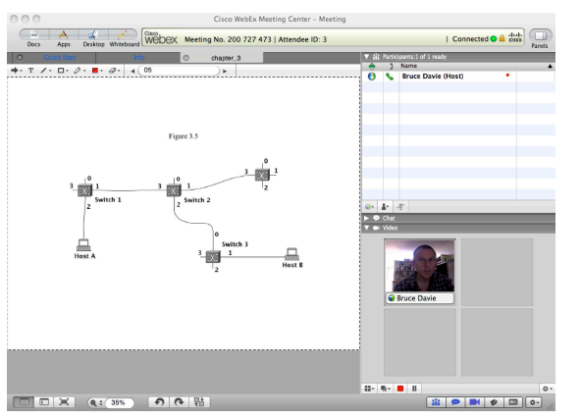
Example of an application
A multimedia application including video-conferencing
Notes:
The network considerations of operating an application over a network are based on two fundamental characteristics: Sensitivity to bandwidth and sensitivity to delay. Secondary characteristics are lossy or lossless. An example of a bandwidth dependent application would be file transfer where if the ‘width’ of the channel, like that of a road, has a direct effect on the possible throughput of data from source to destination. Delay would also affect such an application but the overall performance will be dictated by the bandwidth. An application where delay is critical would be voice or video conferencing. For interaction during a conversation to be normal the delay from when someone speaks or gestures must be sent to the other end in less than 300ms. At higher delays each interruption will likely confuse the participants as to who is speaking. A voice or video application can be ‘lossy’ where part of the data is dropped to improve the performance of the connection. If chosen judicially, quite a bit of the redundant voice or video data can be deleted while still providing acceptable quality to the far end user. A file transfer, however, must be lossless since even a single bit of loss could render the file useless or even dangerous.
IFSC3315 - Applied Networking
Spring 2012
CHAPTER 1 - FOUNDATION

Slide 9
Application Protocol
URL
  Uniform resource locater
  http://www.cs.princeton.edu/~llp/index.html
HTTP
  Hyper Text Transfer Protocol
TCP
  Transmission Control Protocol
17 messages for one URL request
  6 to find the IP (Internet Protocol) address
  3 for connection establishment of TCP
  4 for HTTP request and acknowledgement
    Request: I got your request and I will send the data
    Reply: Here is the data you requested; I got the data
  4 messages for tearing down TCP connection
Notes:
IFSC3315 - Applied Networking
Spring 2012
Many view the internet as Web Browsing or email. These are applications running on top of network processes in a layered manor such that interaction, stability, and error handling are handled in the background. Web browsing can be thought of as real-time, with responses to requests occurring immediately. Email is an example of store and forward communication, where the message is locally stored, later transferred to a ‘server’ and passed between servers before eventually being read by the recipient using a client application again locally to the user. The URL is used to allow human readable identifiers to be used to refer to machine readable resources. A translation occurs from URL to IP, which is then used to establish a connection via TCP. A request from the local client is made in HTTP (Ex: Get ) and the far end responds with HTTP describing the desired page. The local browser then interprets the data and produces a screen display. In the background of a typical page many back and forth transactions have occurred while each text, image, or display control packet is received and acknowledged. You can notice the interaction in some browsers where the current file being transferred is listed at the lower left corner of the display during the page makeup. The page may be partially displayed as the reception continues until eventually the entire page is displayed.
CHAPTER 1 - FOUNDATION

Slide 10
Requirements
Application Programmer
  List the services that his application needs: delay bounded delivery of data
Network Designer
  Design a cost-effective network with sharable resources
Network Provider
  List the characteristics of a system that is easy to manage
Notes:
IFSC3315 - Applied Networking
Spring 2012
CHAPTER 1 - FOUNDATION
The application developer commonly uses a local setup to do testing. If a network is included in the testing it is usually a local network and may have high bandwidth. For this reason, the performance of many applications will be negatively affected by being used over a network and, equally common is the blaming of the network for the poor performance.
A network designer usually has a tight budget and limited knowledge of the network needs for individual applications, unless the network is dedicated to a specific application. This is not normally the case as a network is normally designed to fulfill all data communications needs of a business. With the exception of on-demand bandwidth networks (Chapter 6) a company pays 24-7 for the bandwidth of its network, whether usage is 99% or .099%. Network design is almost always a compromise between performance and cost.
Network providers are selling end-to-end or portal services and need tools to facilitate planning and maintaining the reliability and efficiency of the network. Their view will always be on matching billing costs to the quality of service that must be delivered. Quality of service (more in Chapter 6) is both a description of the service level and the name for protocols used to implement the service levels.

Slide 11
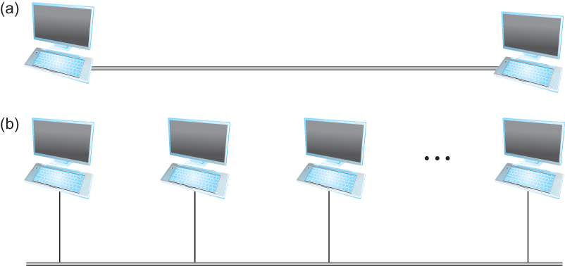
Connectivity
Need to understand the following terminologies
  Scale
  Link
  Nodes
  Point-to-point
  Multiple access
  Switched Network
    Circuit Switched
    Packet Switched
  Packet, message
  Store-and-forward
Point-to-point
Multiple access
Notes:
IFSC3315 - Applied Networking
Spring 2012
CHAPTER 1 - FOUNDATION
Nodes Endpoints(hosts running applications)
Intermediate(hosts running network software ( switches, routers, etc)
Links Dedicated (ex: fiber pair )or shared media ( ex: non-switched Ethernet)

Slide 12
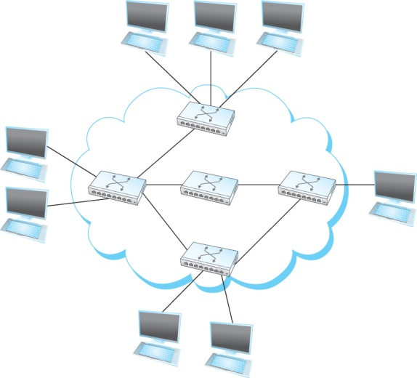
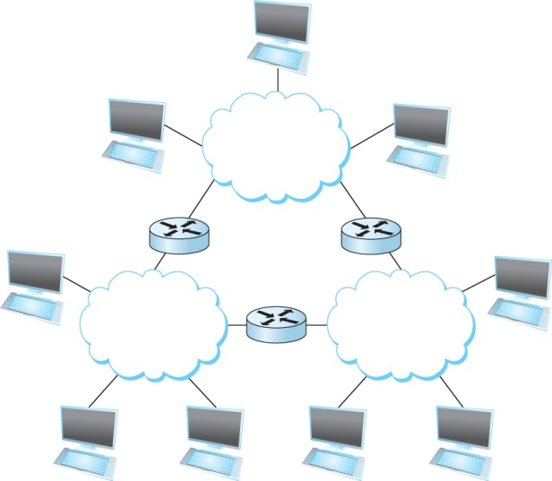
Connectivity
Terminologies (contd.)
  Cloud
  Hosts
  Switches
  internetwork
  Router/gateway
  Host-to-host connectivity
  Address
  Routing
  Unicast/broadcast/multicast
(a)
(b)
A switched network
Interconnection of networks
Notes:
IFSC3315 - Applied Networking
Spring 2012
CHAPTER 1 - FOUNDATION
The shared network resources providing multiple path opportunities between peripheral nodes are typically referred to as a ‘cloud’ shown here by the green outlines.
This usage of the term cloud precedes the current buzzword that refers to cloud-computing with processing being provided as needed by ‘virtual’ servers.

Slide 13
Strategies
Circuit switching: carry bit streams
  original telephone network
Packet switching: store-and-forward messages
  Internet
Notes:
IFSC3315 - Applied Networking
Spring 2012
CHAPTER 1 - FOUNDATION
In circuit switching there is a dedicated, non-shared path between the endpoints that is initiated prior to the first transmission and terminated at the completion of the transfer. The data is a continuous bit stream carried un-altered by the network. Examples are the original non-digital telephone network. Today only the section of the telephone network connecting the user to the first switching office is dedicated and, in fact, the first multiplexing(sharing) hardware may be located in a manhole or ground mounted pedestal close to the users home or business.
In packet switching the network processes are responsible for the breaking up of the bit stream at the transmitting host into discrete segments(packets) and the re-assembling of the packets correctly into the stream at the destination host. During the transmission parts of the data may be stored temporarily within the network until delivery is completed.

Slide 14
Addressing and Routing
Address: byte-string that identifies a node
  usually unique
Routing: process of forwarding messages to the destination node based on its address
Types of addresses
  unicast: node-specific
  broadcast: all nodes on the network
  multicast: some subset of nodes on the network
Notes:
IFSC3315 - Applied Networking
Spring 2012
CHAPTER 1 - FOUNDATION
Address – Can be physically assigned by manufacturer (MAC) or, using software, can be logically assigned either as either static or dynamic. Different protocol layers of the same host will have different addresses.
Routing – Used to forward messages across the boundaries of a network. Like logical addressing, routing tables can be static or dynamic.
Types of addresses – Different classes of address differ in scope of application. Unicast is to a specific destination, broadcast is to all stations on a network partition. Multicast is from one source host to a specific group of destination hosts. Broadcasts are typically used during the setup of a unicast connection to logically define the members of the connection. Multicast is most commonly used for deliv-ering unidirectional programs, such as lectures or concerts.

Slide 15
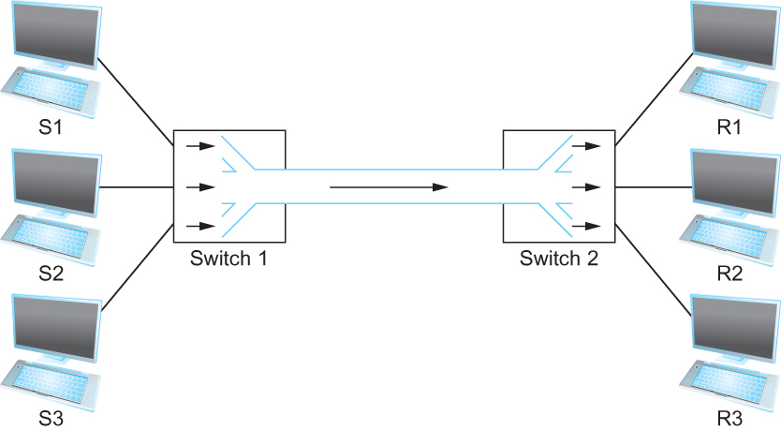
Cost-Effective Resource Sharing
Resource: links and nodes
How to share a link?
  Multiplexing
  De-multiplexing
  Synchronous Time-division Multiplexing
    Time slots/data transmitted in predetermined slots
Multiplexing multiple logical flows over a single physical link
Notes:
IFSC3315 - Applied Networking
Spring 2012
CHAPTER 1 - FOUNDATION
Time-Division Multiplexing – Bit stream is split up into packets and interspersed with packets from other streams. Total bit stream capacity must be >= the sum of individual streams.
Frequency division multiplexing – Data is modulated on different carrier frequencies. (ex. Radio stations ). Used in fiber systems by using different colors ( wavelengths ) of light to form multiple channels on a single fiber.

Slide 16
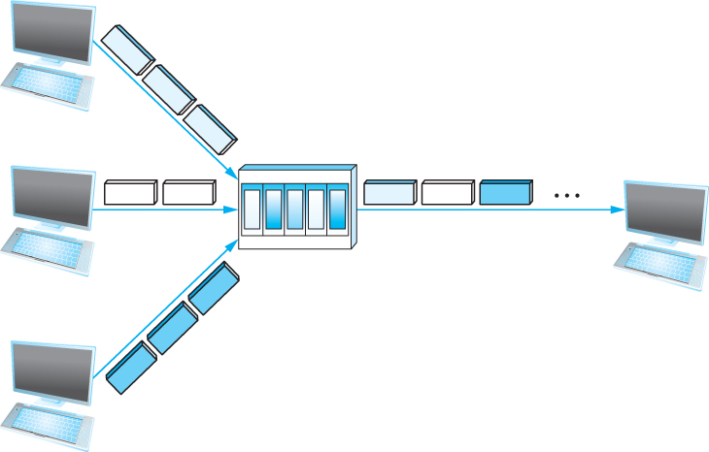
Cost-Effective Resource Sharing
FDM: Frequency Division Multiplexing
Statistical Multiplexing
  Data is transmitted based on demand of each flow.
  What is a flow?
  Packets vs. Messages
  FIFO, Round-Robin, Priorities (Quality-of-Service (QoS))
  Congested?
LAN, MAN, WAN
SAN (System Area Networks
A switch multiplexing packets from multiple sources onto one shared link
Notes:
IFSC3315 - Applied Networking
Spring 2012
CHAPTER 1 - FOUNDATION
Each channel is ‘live’ all the time. If no data is available on a channel it’s time slot in the frame is filled with a constant ( either 1’s or 0’s ) Each frame has a ‘framing’ sequence at the front to identify the beginning of a frame. The owner of the bits in a frame is identified solely by it’s position in the frame.
Ex: Standard T1 frame:
24 channels x 8 bits/channel/frame + 1 framing bit = 193 bits/frame.
8000 frames/sec x 193 bits/frame = 1.544 Mbps
Each channel = 8 bits/frame x 8000 frames/sec = 64 Kbps
Disadvantage: Idle Channels take up same bandwidth as active channels. Advantage: low overhead for framing

Slide 17
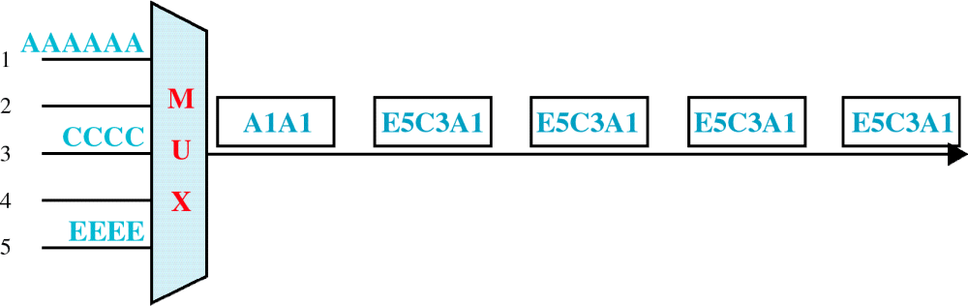
Asynchronous TDM
Only three lines actively sending data
Notes:
Only channels with data are sent on line. Different channel rates possible. Each sample from channel has address header identifying source channel.
Advantage: All bandwidth available on first come first server basis.
Disadvantage: More overhead due to the addition of channel address bits to each frame.

Slide 18
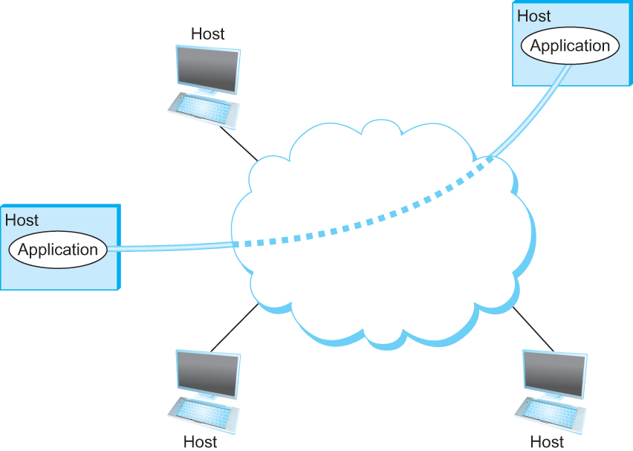
Support for Common Services
Logical Channels
  Application-to-Application communication path or a pipe
Process communicating over an abstract channel
Notes:
From an application point of view the ‘Network’ is responsible for providing a logical ‘channel’ between processes on different physical hosts. This is very similar to the logical channels used within hosts (shared memory) for communication between linked processes. The question that must be answered for all concerned in the distribution of application services over the network is how ‘transparent’ must the network be to the application. Obviously the goal would be fully transparent: the application runs the same either locally or remotely. The solution will fall at a lower level determined by the limitations of both technology and available resources.
IFSC3315 - Applied Networking
Spring 2012
CHAPTER 1 - FOUNDATION

Slide 19
Common Communication Patterns
Client/Server
Two types of communication channel
  Request/Reply Channels
  Message Stream Channels
Notes:
IFSC3315 - Applied Networking
Spring 2012
One of the earliest applications distributed via networks were remote file access. Either FTP, which allows sending or receiving files under remote control, or via NFS, which emulates record by record access to files on remote systems. FTP and NFS systems are classic definers of client/server relationships. The client is the requester of the service, the server is the provider of the service.
The other main class of network applications involves the delivery of streams of data over the network. Most, like video or speech, come along with timing spec-fications for delay and packet loss. Unlike file access systems, which cannot tolerate data loss but can usually tolerate reasonable delay, streaming systems can tolerate moderate data loss without significant quality degradation but are sensitive to excessive delay. In the example ¼ of a typical video frame (single image) would be 352x256 pixels. Add in 24 bit color and 247.5 Kbytes per frame are required. At 30 frames/sec a 60 Mbps link would be necessary to carry this stream unaltered. Probably the only place where totally uncompressed video makes sense is over the air. Examples: vic (unix) and NetMeeting (MS)
Note that the definition of ‘quality’ is almost diametrically opposed for file access and streaming network applications. If a new set of ‘quality’ specifications is required for an application a new type of ‘channel’ will be defined to handle it.
CHAPTER 1 - FOUNDATION

Slide 20
Reliability
Network should hide the errors
Bits are lost
  Bit errors (1 to a 0, and vice versa)
  Burst errors – several consecutive errors
Packets are lost (Congestion)
Links and Node failures
Messages are delayed
Messages are delivered out-of-order
Third parties eavesdrop
Notes:
IFSC3315 - Applied Networking
Spring 2012
Impulse noise, such as lightning or power surges from large machinery cycling, can obliterate 1 or more individual bits of the message. This can result in the re-transmission of part or all of the message.
As each packet is presented for transmission it is placed in a queue. The actual priority may be determined by many factors but usually it is first-in first-out. When the queue memory is exhausted before packets can be transmitted, sub-sequent packets will be dropped.
Since an end-to-end connection may involve multiple links through different nodes a failure of power at one node or physical damage to the link hardware (truck collision with pole, etc.) can cause an outage. Packets presented during the outage may be lost.
We will discuss error correction and redundant network paths later but even with these procedures present it is obvious that at the least, network errors will delay the message compared to the speed in an error free environment. If packets flow on different paths from source to destination, the original time ordering may not be maintained.
Lastly, if we are sharing any part of the end-to-end channel with any other organization we must be concerned with copying of the packets while they are in transit. Even without sharing, extremely sensitive data may need protection during network transmission. Encryption, to be studied in chapter 8, is a common mechanism for increasing data security.
CHAPTER 1 - FOUNDATION

Slide 21
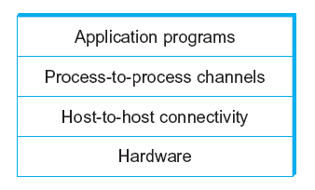
Network Architecture
Example of a layered network system
Use abstractions to hide complexity
Abstraction naturally leads to layering
Alternative abstractions at each layer
Notes:
In this example of layers, the physical connection between the hosts is specified by the Hardware layer. The addressing and hand-shaking (flow-control) methodology is specified by the Host-to-Host layer. The Request/Reply and Message Stream Channels each keep track of progress of data flow and status messages, respectively. And the application program, usually a client and server end, make use of the services of the lower layers to accomplish their function across the network interface.
IFSC3315 - Applied Networking
Spring 2012
CHAPTER 1 - FOUNDATION

Slide 22
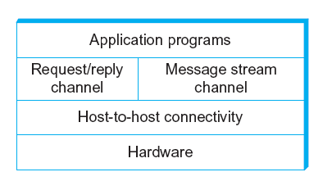
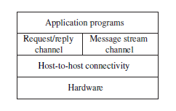
Network Architecture
Layered system with alternative abstractions available at a given layer
Notes:
Using levels of abstraction provides two nice features: it decomposes the network design problem into manageable components. These components, or modules, can be reused as necessary for other applications or replaced by different channels without changing the other levels.
IFSC3315 - Applied Networking
Spring 2012
CHAPTER 1 - FOUNDATION

Slide 23
Protocols
Protocol defines the interfaces between the layers in the same system and with the layers of peer system
Building blocks of a network architecture
Each protocol object has two different interfaces
  service interface: operations on this protocol
  peer-to-peer interface: messages exchanged with peer
Term “protocol” is overloaded
  specification of peer-to-peer interface
  module that implements this interface
Notes:
IFSC3315 - Applied Networking
Spring 2012
The objects that make up the layers of a network system are called protocols. A simplified way of looking at protocols is that they implement a peer-to-peer interface between the two hosts participating in the connection. This is an indirect connection. The only direct peer-to-peer connection will be at the physical(hardware) layer. The service interface defines the catalog of operations that can be provided by the protocol.
Example: A Request/Reply protocol could provide a means for an application to send and receive messages to a peer on a remote machine.
CHAPTER 1 - FOUNDATION

Slide 24
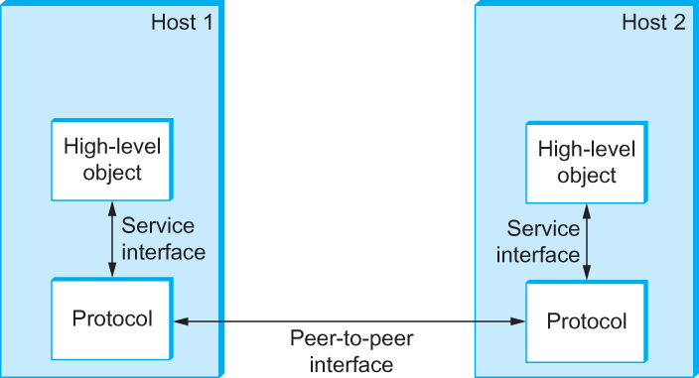
Interfaces
Service and Peer Interfaces
Notes:
In this figure the two protocol instances exchange information over a peer-to-peer link The application objects exchange information using the service interface defined by the protocol
IFSC3315 - Applied Networking
Spring 2012
CHAPTER 1 - FOUNDATION

Slide 25
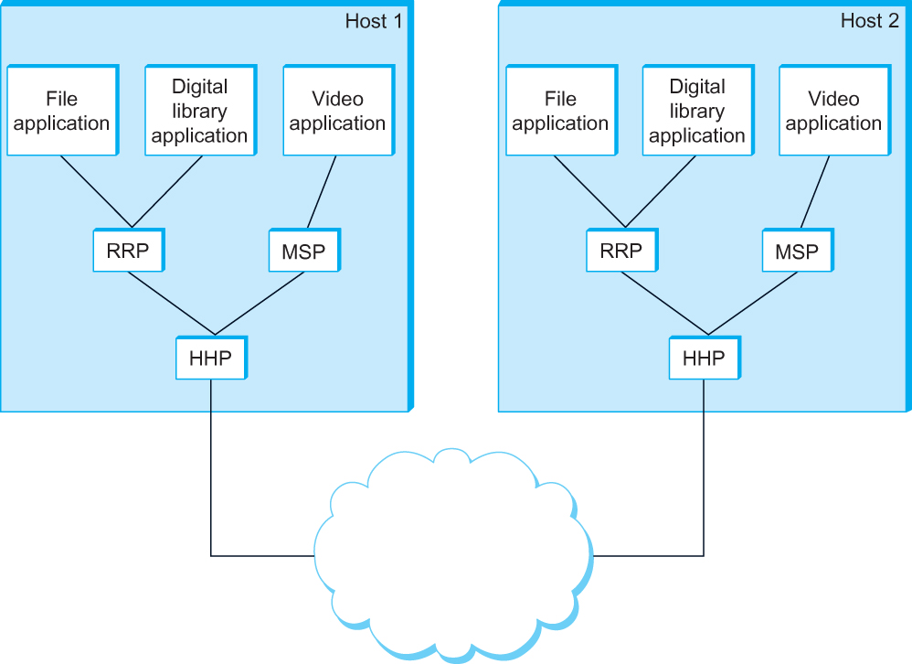
Protocol Graph
Example of a protocol graph
nodes are the protocols and links the “depends-on” relation
Notes:
This diagram shows the applications discussed earlier and the channels shown in the layering model as part of a complete system. The File applications in host 1 use the Request/Reply Protocol (RRP) to move information. This information is essentially a byte stream that has meaning only to the corresponding application in host 2. The RRP puts a wrapper (encapsulation) around the data then uses the Host to Host Protocol (HHP) to talk to it’s peer in host 2. The HHP again adds a wrapper to the data from the RRP and uses the hardware layer, represented by the cloud to move the data across to the remote. The HHP protocol in host 2 removes it’s wrapper that host 1 placed around the data and moves the data to the RRP of host 2. The RRP of host 2 removes it’s wrapper and passes the application data stream to the File application on host 2.
IFSC3315 - Applied Networking
Spring 2012
CHAPTER 1 - FOUNDATION

Slide 26
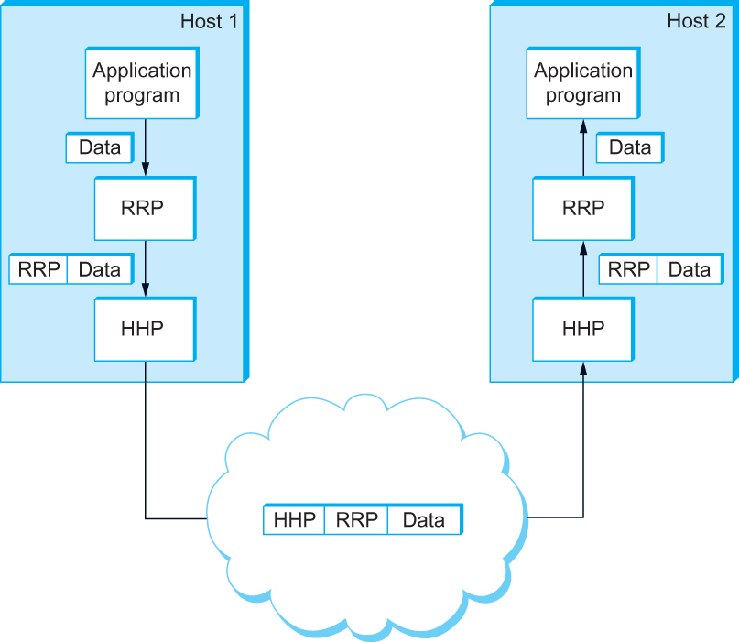
Encapsulation
High-level messages are encapsulated inside of low-level messages
Notes:
It is appropriate to consider the service interface provided by the RRP in the previous example as a multiplex interface since more than one application could pass information across to corresponding application on the remote host. Even multiple instances of a single application(Ex:multiple independent file transfers) could use the same RRP
The encapsulation added to application data as it passes down the layers towards the physical interface usually consists of data headers. This header identifies the identity of the source so that the proper destination can be selected at the remote end of the connection. Some layers may add a trailer, usually for error detection correction purposes. In general the data portion of the frame, passed from the layer above, is not altered. An exception is made for encryption, which may be added at intermediate layers.
IFSC3315 - Applied Networking
Spring 2012
CHAPTER 1 - FOUNDATION

Slide 27
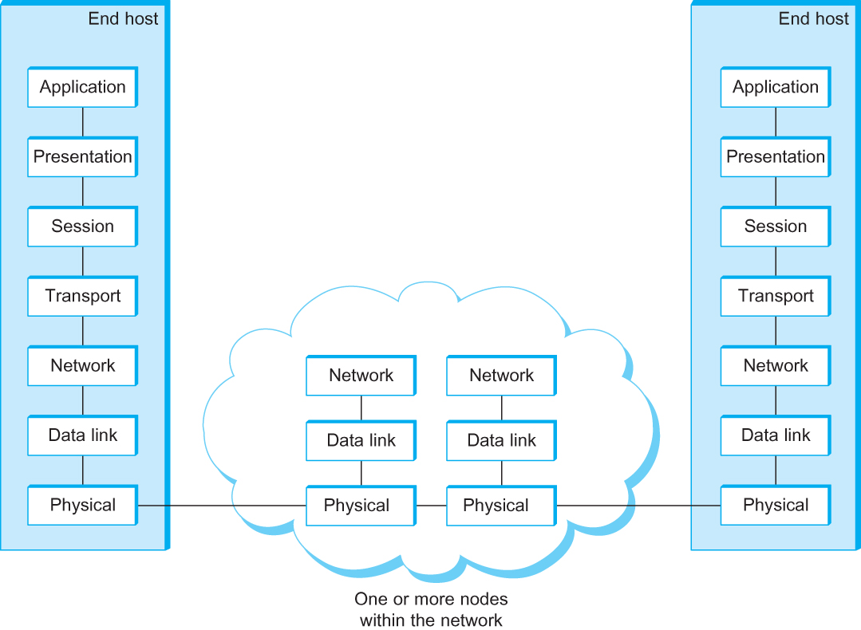
OSI Architecture
The OSI 7-layer Model
OSI – Open Systems Interconnection
Notes:
The International Standards Organization(ISO) first proposed the Open Systems Interconnection (OSI) model in 1977. Several iterations later, in 1985, it was accepted by 12 European and most American standards organizations.
Physical Layer: Transmission and Reception of raw bits over a physical link
Data Link Layer: Aggregates the bits into a frame. Typically implemented by a hardware network interface (NIC)
Network Layer: Handles routing among nodes. The unit of data here is called a packet but it is not fully distinguished from the frames of the data link layer.
Intermediate network nodes in the connection path only need to run the first three layers since they will not be acting on the actual encapsulated data.
The transport layer: Implements the process-to-process layer from our previous examples. Here the unit of data may be called a message.
The higher layers have less specified characteristics than the lower layers and will be discussed later.
The application layer is where the services for application programs will be resident. For the File Application, there would be an application layer running the File Transfer Protocol(FTP).
IFSC3315 - Applied Networking
Spring 2012
CHAPTER 1 - FOUNDATION

Slide 28
Description of Layers
Physical Layer
  Handles the transmission of raw bits over a communication link
Data Link Layer
  Collects a stream of bits into a larger aggregate called a frame
  Network adaptor along with device driver in OS implement the protocol in this layer
  Frames are actually delivered to hosts
Network Layer
  Handles routing among nodes within a packet-switched network
  Unit of data exchanged between nodes in this layer is called a packet
  The lower three layers are implemented on all network nodes
Notes:
IFSC3315 - Applied Networking
Spring 2012
The use of the word ‘frame’ to denote the grouping of bits on a physical medium is one way to acknowledge the different protocols used at this layer. The make up of the frame may include bits before and after the actual payload of the frame. For example, an Ethernet frame has a preamble of alternating ones and zeros used to allow receivers of the frame to detect the presence of data on the line and to synchronize the receiver with the transmitter to optimize the reception of the data. The end of the frame contains a ‘trailer’ consisting of redundant data computed during the processing at the transmitter of the data payload. The computation is repeated at the receiver and compared to that sent with the frame to judge whether any errors have occurred during transmission.
The ‘packets’ exchanged at the network layer are derived from the frames received from the data link layer and can thus be assumed to be free from transmission errors.
CHAPTER 1 - FOUNDATION

Slide 29
Description of Layers
Transport Layer
  Implements a process-to-process channel
  Unit of data exchanges in this layer is called a message
Session Layer
  Provides a name space that is used to tie together the potentially different transport streams that are part of a single application
Presentation Layer
  Concerned about the format of data exchanged between peers
Application Layer
  Standardize common type of exchanges
  The transport layer and the higher layers typically run only on end-hosts and not on the intermediate switches and routers
Notes:
IFSC3315 - Applied Networking
Spring 2012
The unit of data in the transport and higher layers is generally called a message. The lower protocols may be limited, for a variety of reasons, in the sizes of the individual frames or packets but the message size is generally determined by the type of application generating the data.
CHAPTER 1 - FOUNDATION

Slide 30
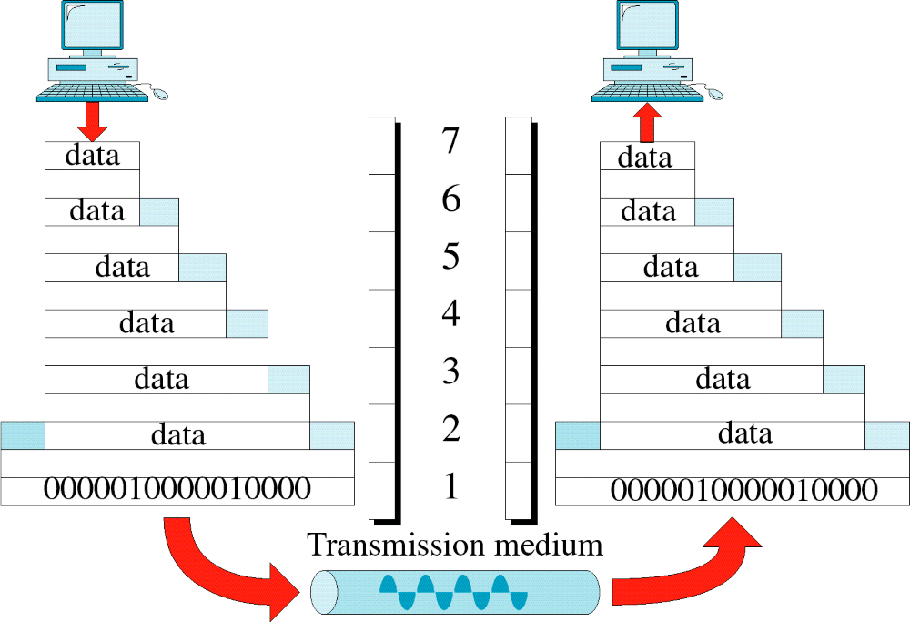
ISO Example
Notes:
In this example, we see a data packet from the application move down the layers in the source side and, at each protocol junction, a header is added. Thus the data acted on by the lower layers includes, as data, the headers from the upper layers. In this example the last (Data Link) layer adds a trailer before the resultant bit stream is passed to the physical transmission medium. The trailer contains redundant data obtained by logical operations on the payload such that a duplicate operation at the receiver can be used to detect errors.
Since lower layers do not modify data from higher layers, a packet in, for example, the fourth layer of the transmitter will appear at the fourth layer of the receiver with no modification. A simple abstraction is that there is a logical connection between transmitter and receiver at each protocol level of the connection
IFSC3315 - Applied Networking
Spring 2012
CHAPTER 1 - FOUNDATION

Slide 31
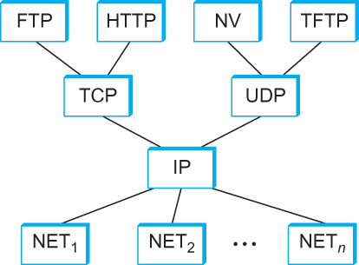
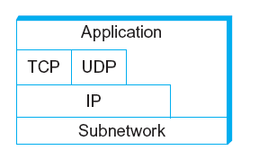
Internet Architecture
Alternative view of the Internet architecture. The “Network” layer shown here is sometimes referred to as the “sub-network” or “link” layer.
Internet Protocol Graph
Notes:
Sometimes called the TCP/IP architecture due to its main protocols: TCP and IP. The internet architecture grew out of the ARPANET defense department research network and preceded the OSI network architecture, which was heavily influenced by the IETF work. By far the majority of networking products in use today are based on the Internet Architecture. Strangely the OSI model is more a tool for understanding network implementation than a basis for product design. We will use the appropriate models for each topic we cover in this course.
Internet Layers:
Network: Hardware and Physical adapter protocols. Ex. FDDI, Ethernet
IP: Single addressing logical internetwork
TCP/UDP: TCP=Reliable byte stream UDP=unreliable datagram delivery
Application Layer: FTP, HTTP, Telnet, SMTP etc
A datagram can be thought of as another word for message. If no harm will be done if the message is lost and if no reply is needed a UDP datagram is suffi-cient. The main advantage of a datagram is that no setup is required. You form the datagram, put in your address and the destination address and fire and forget. With TCP you first set up the channel then start data flowing. When you are done you delete the channel. More overhead but built-in reliability.
To understand the need for higher level protocols we can use Netscape, Mozilla, Explorer, etc on the same server with HTTP as the universal language.
IFSC3315 - Applied Networking
Spring 2012
CHAPTER 1 - FOUNDATION

Slide 32
Internet Architecture
Defined by IETF
Three main features
  Does not imply strict layering. The application is free to bypass the defined transport layers and to directly use IP or other underlying networks
  An hour-glass shape – wide at the top, narrow in the middle and wide at the bottom. IP serves as the focal point for the architecture
  In order for a new protocol to be officially included in the architecture, there needs to be both a protocol specification and at least one (and preferably two) representative implementations of the specification
Notes:
IFSC3315 - Applied Networking
Spring 2012
The acronym IETF stands for Internet Engineering Task Force and it is also and international organization.
The method of propagation of new or changed standards/specifications is known as an RFC which stands for Request for Comment. This is to indicate group participation rather than control by the task force. Some period of time after an RFC is issued and the last requested changes implemented the RFC becomes the defacto standard for designers and implementers.
CHAPTER 1 - FOUNDATION

Slide 33
Application Programming Interface
Interface exported by the network
Since most network protocols are implemented (those in the high protocol stack) in software and nearly all computer systems implement their network protocols as part of the operating system, when we refer to the interface “exported by the network”, we are generally referring to the interface that the OS provides to its networking subsystem
The interface is called the network Application Programming Interface (API)
Notes:
IFSC3315 - Applied Networking
Spring 2012
By having a defined interface each protocol implementation can be reused by many developers to construct complete systems.
CHAPTER 1 - FOUNDATION

Slide 34
Application Programming Interface (Sockets)
Socket Interface was originally provided by the Berkeley distribution of Unix
  - Now supported in virtually all operating systems
Each protocol provides a certain set of services, and the API provides a syntax by which those services can be invoked in this particular OS
Notes:
IFSC3315 - Applied Networking
Spring 2012
The sockets interface started out as a network API in the Berkeley distribution of the UNIX operating system. The sockets interface is now supported by virtually all popular operating systems. This means that applications written to support this API will easily port to multiple operating systems. Since the services supported by the OS will vary, there may still be porting issues but the API will provide the syntax for addressing those services that are common.
CHAPTER 1 - FOUNDATION

Slide 35
Socket
What is a socket?
  The point where a local application process attaches to the network
  An interface between an application and the network
  An application creates the socket
The interface defines operations for
  Creating a socket
  Attaching a socket to the network
  Sending and receiving messages through the socket
  Closing the socket
Notes:
IFSC3315 - Applied Networking
Spring 2012
The term socket is referring to the point at which an application program attaches to the network. Simple operations are creating a socket, attaching the socket to the network, using the socket to transfer information, and closing the socket at the end of the connection.
CHAPTER 1 - FOUNDATION

Slide 36
Socket
Socket Family
  PF_INET denotes the Internet family
  PF_UNIX denotes the Unix pipe facility
  PF_PACKET denotes direct access to the network interface (i.e., it bypasses the TCP/IP protocol stack)
Socket Type
  SOCK_STREAM is used to denote a byte stream
  SOCK_DGRAM is an alternative that denotes a message oriented service, such as that provided by UDP
Notes:
IFSC3315 - Applied Networking
Spring 2012
Each of these terms is accompanied by a structure for passing/retrieving data from the applications. The structures are stored in libraries added to the source program, usually at the beginning.
CHAPTER 1 - FOUNDATION

Slide 37
Creating a Socket
int sockfd = socket(address_family, type, protocol);
The socket number returned is the socket descriptor for the newly created socket
int sockfd = socket (PF_INET, SOCK_STREAM, 0);
int sockfd = socket (PF_INET, SOCK_DGRAM, 0);
The combination of PF_INET and SOCK_STREAM implies TCP
Notes:
IFSC3315 - Applied Networking
Spring 2012
These source statements will, when compiled, implement the described function on whatever target system the compiler is running on. This capability, of generating object code for many types of physical system, is the origin of the term UNIX.
CHAPTER 1 - FOUNDATION

Slide 38
Client-Serve Model with TCP
Server
  Passive open
  Prepares to accept connection, does not actually establish a connection
Server invokes
int bind (int socket, struct sockaddr *address,
int addr_len)
int listen (int socket, int backlog)
int accept (int socket, struct sockaddr *address,
int *addr_len)
Notes:
IFSC3315 - Applied Networking
Spring 2012
The server will open a listener on the network that will respond to requests that match the values set up during the ‘open’. Once the listener is open it will just stay in a wait state until the proper packet is received.
CHAPTER 1 - FOUNDATION

Slide 39
Client-Serve Model with TCP
Bind
  Binds the newly created socket to the specified address i.e. the network address of the local participant (the server)
  Address is a data structure which combines IP and port
Listen
  Defines how many connections can be pending on the specified socket
Notes:
IFSC3315 - Applied Networking
Spring 2012
The characteristics of the socket are used to condition the lower layers of the network to transfer the proper packets to the process.
CHAPTER 1 - FOUNDATION

Slide 40
Client-Serve Model with TCP
Accept
  Carries out the passive open
  Blocking operation
    Does not return until a remote participant has established a connection
    When it does, it returns a new socket that corresponds to the new established connection and the address argument contains the remote participant’s address
Notes:
IFSC3315 - Applied Networking
Spring 2012
This is the process that waits for reception of the packet.
CHAPTER 1 - FOUNDATION

Slide 41
Client-Serve Model with TCP
Client
  Application performs active open
  It says who it wants to communicate with
Client invokes
int connect (int socket, struct sockaddr *address,
int addr_len)
Connect
  Does not return until TCP has successfully established a connection at which application is free to begin sending data
  Address contains remote machine’s address
Notes:
IFSC3315 - Applied Networking
Spring 2012
The client uses the provided parameters to actively connect to the remote socket on the server.
CHAPTER 1 - FOUNDATION

Slide 42
Client-Serve Model with TCP
In practice
  The client usually specifies only remote participant’s address and let’s the system fill in the local information
  Whereas a server usually listens for messages on a well-known port
  A client does not care which port it uses for itself, the OS simply selects an unused one
Notes:
IFSC3315 - Applied Networking
Spring 2012
This is actually a multiplex operation since each host/server connection can be separated by the network and port address coupling. Since at least one of the terms will be different in each connection the packet streams can be separated.
If, for example, a telnet is initiated to a host the request will be on port 23, for which the server will be listening. The server will complete the session by using another port to send back to the client. If multiple applications on one host are using telnet the different receive ports will allow separation of the streams. If a different host is using the same telnet server the network addresses will be different so the streams can still be separated.
CHAPTER 1 - FOUNDATION

Slide 43
Client-Serve Model with TCP
Once a connection is established, the application process invokes two operation
int send (int socket, char *msg, int msg_len,
int flags)
int recv (int socket, char *buff, int buff_len,
int flags)
Notes:
IFSC3315 - Applied Networking
Spring 2012
Once the connection is made the client uses it to send the data packet and the receiver removes the data packet from the socket.
CHAPTER 1 - FOUNDATION

Slide 44
Example Application: Client
1 #include <stdio.h>
2 #include <sys/types.h>
3 #include <sys/socket.h>
4 #include <netinet/in.h>
5 #include <netdb.h>
6
7 #define SERVER_PORT 5432
8 #define MAX_LINE 256
9
10 Iint main(int argc, char * argv[])
11 {
12 FILE *fp;
13 struct hostent *hp;
14 struct sockaddr_in sin;
15 char *host;
16 char buf[MAX_LINE];
17 int s;
18 int len;
19 if (argc==2) {
20 host = argv[1];
21 }
22 else {
23 fprintf(stderr, "usage: simplex-talk host\n");
24 exit(1);
25 }
Notes:
IFSC3315 - Applied Networking
Spring 2012
This example is on Page 41 of your text.
Lines 1-5 list the libraries used to implement the instructions that will be used. Lines 1-2 are the standard input/output routines (print, get input, etc)
Lines 3-5 are header files related to sockets API
Lines 7-8 are static declarations: Ex: port 5432 was chosen since it is unused in most configurations.
Lines 14-18 Start the procedure and initialize storage and memory allocation.
The argc and argv variables are for passing parameters from the
calling program, in this case the keyboard, into the procedure.
Lines 19-25 Check if a hostname was entered when the program is started.
argc is the argument count and *argv is a pointer to an array
containing the data to be passed into the procedure. argv[0]
is the name used to call the program. argv[1] is the first parameter
passed.
CHAPTER 1 - FOUNDATION

Slide 45
Example Application: Client-Cont.
26 /* translate host name into peer’s IP address */
27 hp = gethostbyname(host);
28 if (!hp) {
29 fprintf(stderr, "simplex-talk: unknown host: %s\n", host);
30 exit(1);
31 }
32 /* build address data structure */
33 bzero((char *)&sin, sizeof(sin));
34 sin.sin_family = AF_INET;
35 bcopy(hp->h_addr, (char *)&sin.sin_addr, hp->h_length);
36 sin.sin_port = htons(SERVER_PORT);
37 /* active open */
38 if ((s = socket(PF_INET, SOCK_STREAM, 0)) < 0) {
39 perror("simplex-talk: socket");
40 exit(1);
41 }
42 if (connect(s, (struct sockaddr *)&sin, sizeof(sin)) < 0) {
43 perror("simplex-talk: connect");
44 close(s);
45 exit(1);
46 }
47 /* main loop: get and send lines of text */
48 while (fgets(buf, sizeof(buf), stdin)) {
49 buf[MAX_LINE-1] = ’\0’;
50 len = strlen(buf) + 1;
51 send(s, buf, len, 0);
52 }
53 }
Notes:
IFSC3315 - Applied Networking
Spring 2012
Lines 27-31 Use a library subroutine(gethostbyname) to translate the host alpha-
numeric name into a 32 bit IP address. Each of these statements
looks at a return value to generate an error message is one is
detected.
Lines 33-36 Load the data structure that will be passed through the API to the
network subsystem. AF_INET sets the protocol to IP and
SERVER_PORT passes the previously set port to the API
Lines 38-41 Attempt to create the socket interface. Error if unsuccessful
Lines 42-46 Make connection to remote host. Error if unsuccessful.
Lines 48-52 Enter loop to accept lines of data from keyboard (fgets) and send
each line to the remote host (send). The fgets routine will copy
characters from the keyboard until the RET key is pressed.
CHAPTER 1 - FOUNDATION

Slide 46
Example Application: Server
1 #include <stdio.h>
2 #include <sys/types.h>
3 #include <sys/socket.h>
4 #include <netinet/in.h>
5 #include <netdb.h>
6 #define SERVER_PORT 5432
7 #define MAX_PENDING 5
8 #define MAX_LINE 256
9
10 int main()
11 {
12 struct sockaddr_in sin;
13 char buf[MAX_LINE];
14 int len;
15 int s, new_s;
16 /* build address data structure */
17 bzero((char *)&sin, sizeof(sin));
18 sin.sin_family = AF_INET;
19 sin.sin_addr.s_addr = INADDR_ANY;
20 sin.sin_port = htons(SERVER_PORT);
21
22 /* setup passive open */
23 if ((s = socket(PF_INET, SOCK_STREAM, 0)) < 0) {
24 perror("simplex-talk: socket");
25 exit(1);
26 }
Notes:
IFSC3315 - Applied Networking
Spring 2012
Lines 1-2: Header files included in client program also
Lines 3-5: Specific header files related to sockets API
Lines 6-8: Static declarations. Ex: port 5432 chosen arbitrarily since it is
outside the range of default named port numbers.
Lines 12-15 Start procedure and set up data and memory allocation
Lines 17-20 Load parameters into structure that will be passed to the API
AF_INET sets protocol to IP. htons sets socket port number
Lines 23-25 Attempt to create socket interface. Error if unsuccessful
CHAPTER 1 - FOUNDATION

Slide 47
Example Application: Server
27 if ((bind(s, (struct sockaddr *)&sin, sizeof(sin))) < 0) {
28 perror("simplex-talk: bind");
29 exit(1);
30 }
31 listen(s, MAX_PENDING);
32 /* wait for connection, then receive and print text */
33 while(1) {
34 if ((new_s = accept(s, (struct sockaddr *)&sin, &len)) < 0) {
35 perror("simplex-talk: accept");
36 exit(1);
37 }
38 while (len = recv(new_s, buf, sizeof(buf), 0))
39 fputs(buf, stdout);
40 close(new_s);
41 }
42 }
Notes:
IFSC3315 - Applied Networking
Spring 2012
Lines 27-30 Bind the application to the socket. Error if unsuccessful
Line 31 Enter wait state for connection from remote clients
Lines 33-41 Wait for packet to arrive. When it does move it from the buffer
to the screen.
The addition of network connectivity to a program is comparable to the addition of a link to an external database server. An API for a database server allows data to be sent to and received from a server by a client using extensions to the programming language. Similar extensions to the programming language facilitate the sending and receiving of data by clients and servers.
Connect to Solaris and demonstrate client and server programs.
CHAPTER 1 - FOUNDATION

Slide 48
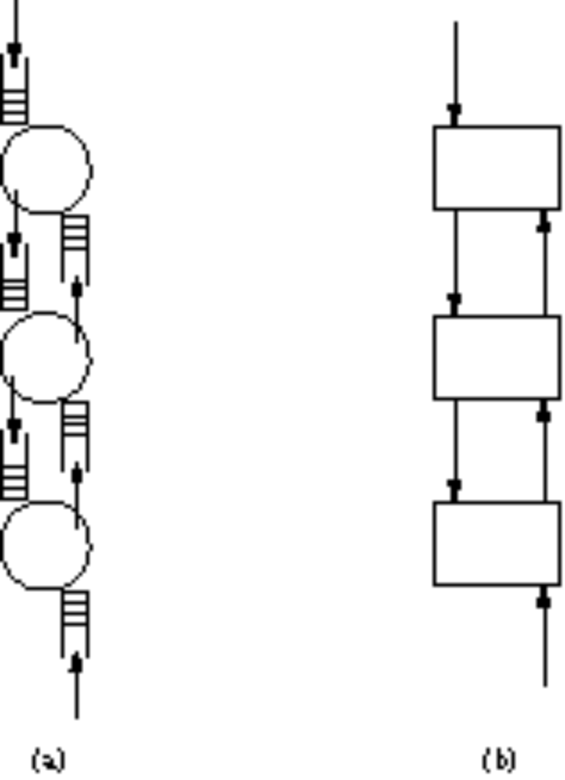
Protocol Implementation Issues
Process Models
Process-per-protocol
Process-per-message
Notes:
The term process may also be referred to as thread. Each process runs largely independently of other processes and the OS is responsible for serving the var-ious processes with services, memory, and CPU cycles. If we a assume a single CPU, only one process will actually be in control of the CPU (execution mode) at any one instant. The OS controls, by various means, the order of processing and using what is known as context switching. The context switch is accomplished by storing the CPU state at the time of the switch on a buffer (stack) structure and restoring the status of the next process in line for execution. One model for analyzing the network subsystem is the process-per-protocol model. The socket interface is process-per-protocol. As a message moves up or down the layers of the stack, it is passed from one protocol to another. Since each protocol step is a different process, a context switch occurs each time a message steps up and down the stack. Since there is a delay associated with each context switch this affects the capacity of the network subsystem. In the process-per-message model the protocols are invoked as procedure calls as the message traverses the layers. Since procedure calls typically have less overhead than context switches some efficiency may be gained. The use of socket type interfaces for the API (the interface between the application and the highest network protocol layer) and process-per-message for protocol-to-protocol communication maximizes the convenience of such and API while minimizing the number of time consuming context changes needed to flow the message out the bottom of the protocol stack.
IFSC3315 - Applied Networking
Spring 2012
CHAPTER 1 - FOUNDATION

Slide 49
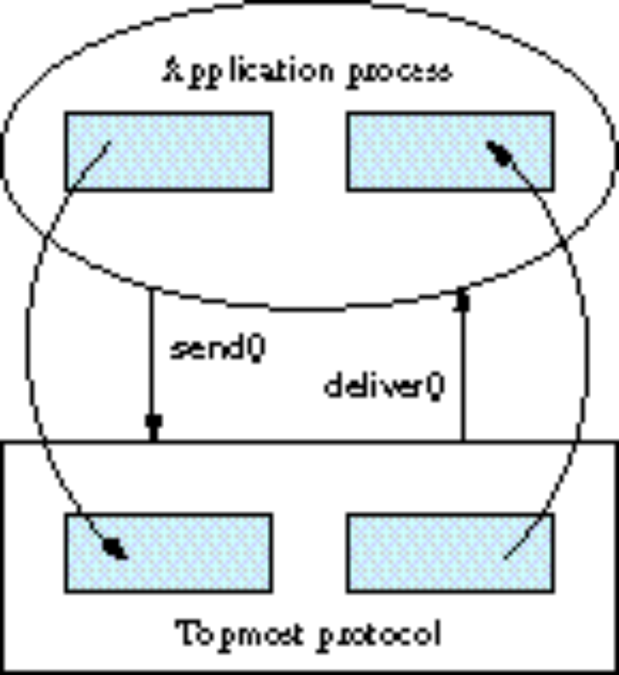
Message Buffers
Notes:
Since the application program provides the buffer that contains the outgoing message when calling send, the topmost protocol must copy the data from this buffer into a network buffer. Increases in processor speed have left memory speed behind, so this memory-to-memory transfer robs network subsystem capacity. By organizing the buffer locations based on the total protocol picture, the different layers can perform their header and trailer operations on the locations above and below the data in the buffer so that actual transfer from buffer to buffer is minimized. The operations shown in the text example use ‘logical copying’ which manipulates memory pointers rather than actual data transfer.
Other OS features are usually offered to streamline the implementation of the network subsystem. For example, a commonly used network function is to recover from common errors by ‘timing out’ if an expected event, such as a response from the remote end, doesn’t occur before the end of a specified interval. An event timer will be started at the beginning of the interval, such as after a packet transmission. If the reception of the response precedes the expiration of the timer, the timing process will be killed without causing the underlying error recovery routine to be executed
IFSC3315 - Applied Networking
Spring 2012
CHAPTER 1 - FOUNDATION

Slide 50
Performance Measures
Bandwidth-Common Usage: the physical width of the available frequency band.
  Example: Voice channel = 300-3300Hz = 3000 Hz
  Example: Ethernet = 10Mbps or 100ηs/bit
Throughput-Common Usage: the measured performance of a system.
  Example: an FTP connection over Ethernet 2Mbps due to round trip delays and packetizing effects.
Notes:
IFSC3315 - Applied Networking
Spring 2012
In this example a 10Mbps ‘pipe’ connecting two hosts for file transfer purposes might see only 2Mbps of data transfer. If, for example, the data were packetized using small packets, each of which must be acknowledged before continuing, the round trip delays could add up to less total throughput. If there are errors the cure would be retransmission of the bad packets. Since throughput is a measured quantity, all factors, such as error rate, congestion, etc. must be included if it is to be calculated without measurement. For example, the ‘overhead’ induced by the packet size selection has a direct effect on throughput.
CHAPTER 1 - FOUNDATION

Slide 51
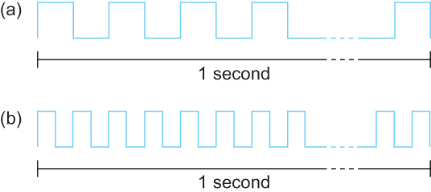
Bandwidth
Bits transmitted at a particular bandwidth can be regarded as having some width:
(a) bits transmitted at 1Mbps (each bit 1 μs wide);
(b) bits transmitted at 2Mbps (each bit 0.5 μs wide).
Notes:
Depending on the medium this can be translated to a physical distance. If the transmission medium is vacuum then each1 µs ‘bit’ is equivalent to 3 x 10⁸ m/sec x 10⁻⁶ secs = 300 meters.
IFSC3315 - Applied Networking
Spring 2012
CHAPTER 1 - FOUNDATION

Slide 52
Performance
Latency = Propagation + transmit + queue
Propagation = distance/relative speed of light
Transmit = size/bandwidth
One bit transmission => propagation is important
Large bytes transmission => bandwidth is important
Notes:
IFSC3315 - Applied Networking
Spring 2012
Latency is a calculated variable but it can also be a subjective judgement of an observer . If a user requests a web page latency can refer to the user’s perception of the time it takes to load and display the web page.
The propagation time is dependant on the medium being used. All real medium transmit electromagnetic signals at some fraction of the speed of light in a vacuum. For example the speed in most twisted pair or fiber media is about 2/3 of the speed in a vacuum.
The concept we are trying to convey is that some systems, due to their structure, will be more sensitive to the propagation time and others to the transmit bandwidth. Some variables can be controlled by the designer while others, such as the speed of light and the physical distance between network facilities, cannot.
CHAPTER 1 - FOUNDATION

Slide 53
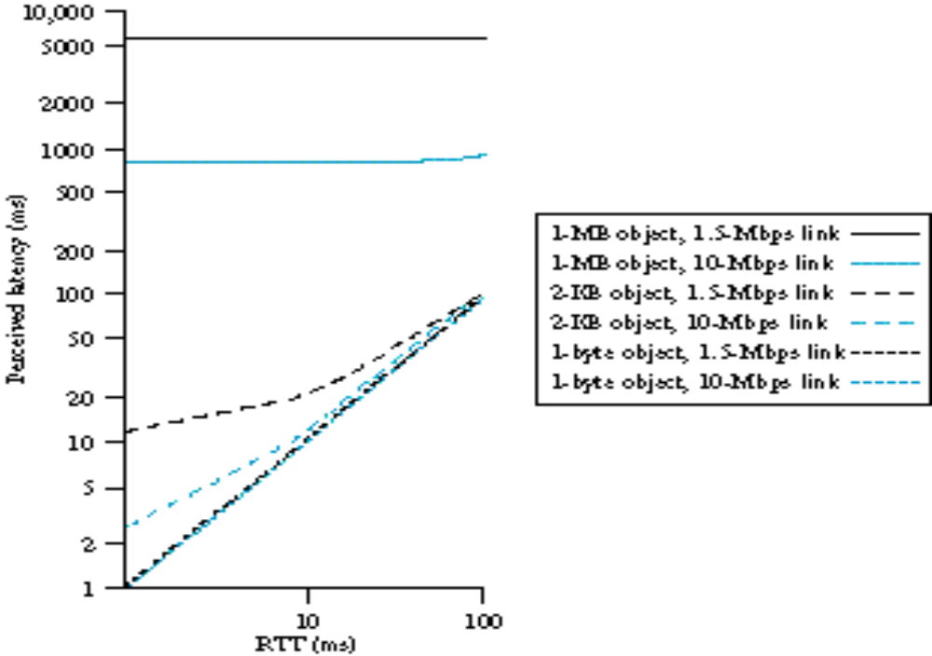
Notes:
Here is an example of how network parameters interact. The four parameters shown in this figure are: Bandwidth ( either 1.5 or 10 Mbps ) packet size: 1 byte, 2 Kbyes, 1 Mbyte., Round Trip Time (RTT) and Perceived Latency. The perceived latency expresses the response time to a request that a user would perceive in each of the scenarios.
With small packets (related to the network speed) the perceived delay closely follows the RTT. For medium packets the perceived delay is initially longer than the RTT but asymptotically approaches the RTT with increasing trip delay. For packets with size significant with respect to bandwidth, the perceived delay is almost constant and related to the transmit time of the packet.
The point of the graph is that a bad (long) response time can be the result of many factors, not all of which are under control of the designer or provider. For example, the RTT for a transcontinental hop is still 100 ms due to the speed of light regardless or bandwidth
IFSC3315 - Applied Networking
Spring 2012
CHAPTER 1 - FOUNDATION

Slide 54

Bits and Bytes
A common error is to confuse the b in Mb with the B in MB. The difference is that b usually stands for binary bit and B usually stands for Byte(8 bits)
Unfortunately, we routinely use both terms in net-working design specifications. A 10 Mbps network, such as Ethernet, will have a clock rate at the transmitter of 10MHz. Typical file transfer rates are given in KBps where we mean kilobytes per second.
Notes:
An additional confusion is that the K and M designations are decimal when used with bits and usually a type of binary when referring to Bytes. A KB typically means 1024 bytes, not 1000 bytes. This can produces a small (2.4%) error if neglected. The required precision of your calculation should determine whether you take the time to apply the correction factors.
IFSC3315 - Applied Networking
Spring 2012
CHAPTER 1 - FOUNDATION

Slide 55
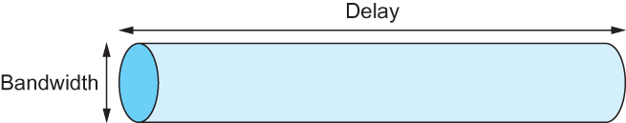
Delay X Bandwidth
We think the channel between a pair of processes as a hollow pipe
Latency (delay) length of the pipe and bandwidth the width of the pipe
Delay of 50 ms and bandwidth of 45 Mbps
50 x 10⁻³ seconds x 45 x 10⁶ bits/second
2.25 x 10⁶ bits ≈ 280 KB data.
Network as a pipe
Notes:
IFSC3315 - Applied Networking
Spring 2012
Assume a bit stream at 45Mbps starts at 1. By the time the first bit in the stream has arrived at B 50 ms of the stream has entered at an and is ‘in the pipe’
,05 sec x 4.5 x 10⁷ = 2.25 x 10⁶ bits / 8 bits/bytes / 1024 bytes/KB = 274.66KB
CHAPTER 1 - FOUNDATION

Slide 56
Delay X Bandwidth
Relative importance of bandwidth and latency depends on application
  For large file transfer, bandwidth is critical
  For small messages (HTTP, NFS, etc.), latency is critical
  Variance in latency (jitter) can also affect some applications (e.g., audio/video conferencing)
Notes:
IFSC3315 - Applied Networking
Spring 2012
To summarize: If the data is small related to the latency then the latency will be the dominant factor in perceived latency. If the data is large related to the latency than the bandwidth will be the dominant factor in the perceived latency.
CHAPTER 1 - FOUNDATION

Slide 57
Delay X Bandwidth
  How many bits the sender must transmit before the first bit arrives at the receiver if the sender keeps the pipe full
  Takes another one-way latency to receive a response from the receiver
  If the sender does not fill the pipe—send a whole delay × bandwidth product’s worth of data before it stops to wait for a signal—the sender will not fully utilize the network
Notes:
IFSC3315 - Applied Networking
Spring 2012
CHAPTER 1 - FOUNDATION

Slide 58
Delay X Bandwidth
Infinite bandwidth
  RTT dominates
  Throughput = TransferSize / TransferTime
  TransferTime = RTT + 1/Bandwidth x TransferSize
Its all relative
  1-MB file to 1-Gbps link looks like a 1-KB packet to 1-Mbps link
Notes:
IFSC3315 - Applied Networking
Spring 2012
Refer back to the graph on page 48 of the text.
CHAPTER 1 - FOUNDATION

Slide 59
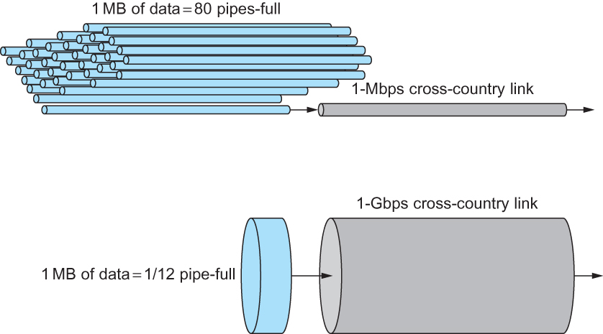
Relationship between bandwidth and latency
A 1-MB file would fill the 1-Mbps link 80 times,
but only fill the 1-Gbps link 1/12 of one time
Notes:
In both cases above the delay is the same ( about 100ms ) In the first case at 1Mbps the line is tied up for 80 RTT intervals from handling other messages. In the second example only .084 of the pipe is occupied by the packet, minimizing the delay, due to queuing, exported to other processes trying to use the channel.
Another way of looking at this is that the 1Gb system is latency relative where the 1 Mb system is bandwidth limited. In a bandwidth limited system the throughput will be improved by raising the bandwidth. In a latency (RTT) limited system raising the bandwidth will not have a controlling effect on throughput.
IFSC3315 - Applied Networking
Spring 2012
CHAPTER 1 - FOUNDATION

Slide 60
Summary
We have identified what we expect from a computer network
We have defined a layered architecture for computer network that will serve as a blueprint for our design
We have discussed the socket interface which will be used by applications for invoking the services of the network subsystem
We have discussed two performance metrics using which we can analyze the performance of computer networks
Notes:
IFSC3315 - Applied Networking
Spring 2012
CHAPTER 1 - FOUNDATION

