Slide 1
Slide Set 15: IP Multicast

Slide 2
In this set
What is multicasting ?
Issues related to IP Multicast
Section 4.4

Slide 3
What is multicast ?
Sending a packet to a plurality of receivers.
Example: A lecture may be sent to a subset of students on campus (e.g. only those students who are taking a course.
Multicasting at MAC layer -- easy -- send a packet to the multicast address
  simply broadcast the packet.
Challenges are at IP layer -- IP multicast.

Slide 4
The multicast address
Simple way -- send unicast packets to all multicast receivers.
  However approach not scalable.
We want the source to be able to send the packet to a single multicast address
Sending the packet to this address should result in the delivery of the packet to each of a group of selected hosts.

Slide 5
Scalability considerations
One way is for the host to have all of the addresses of group members.
  However, it simply cannot.
How does it know who should be included ?
A multicast group is formed -- the receivers “subscribe” to the multicast group.
They can choose to join or leave this group at will.
No synchronization or negotiation is needed with the other members of the group.

Slide 6
The Multicast Group
Thus, each group has a multicast address.
In IPv4, this is assigned from the Class D address space.
In IPv6, a portion of the address space is reserved for multicast.

Slide 7
IGMP
The Internet Group Management Protocol.
Used by hosts to notify routers on their network of their intent to receive multicast packets.
How do the nodes know which multicast group they want to join ?
  Out of band methods -- group addresses are advertised on the Internet at times.

Slide 8
Link State Multicast
Basic Idea: Create the shortest path multicast tree from any source to any group.
  Use of Dijkstra’s algorithm.
Note that each member announces on its particular physical link or LAN, the multicast groups to which it belongs.
This information is then used by routers to determine which groups have which members on which links.

Slide 9
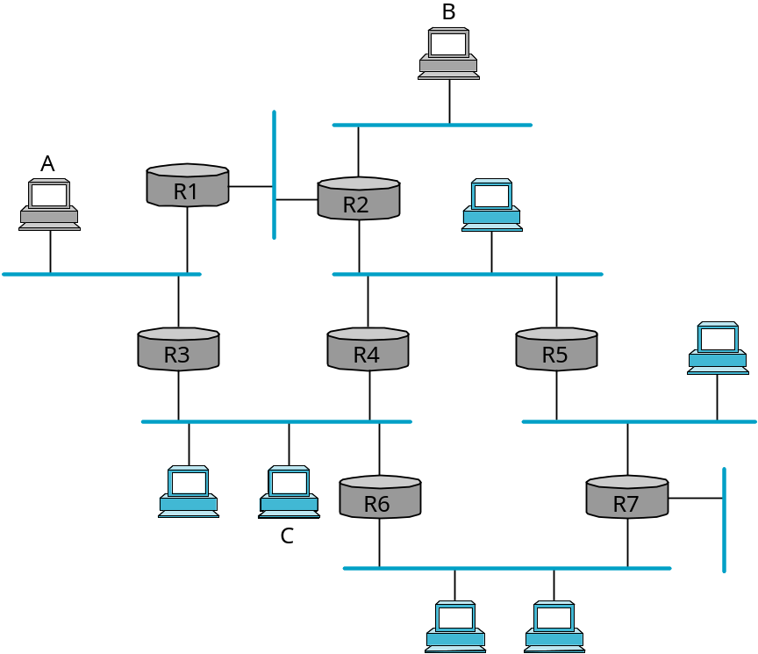
An Example
Blue hosts belong to a group (say G).
The routers would compute the shortest path multicast trees for the source nodes A, B and C.
Use these trees to forward packets.
As an example, Router R3 would forward a packet from host A to group G to R6.

Slide 10
Note that...
Every node has to keep a separate shortest path multicast tree from every source to every group.
Since this is expensive, it computes and caches only those that are active.

Slide 11
Distance-Vector Multicast
With this, routers do not know the entire topology.
So constructing multicast trees is a bit trickier.
Recall that each router maintains <Destination, Cost, NextHop> and exchanges <Destination, Cost> info with its directly connected neighbors.
What do we need ?
  A Broadcast mechanism that allows for a packet to be sent to all the networks on the Internet
  A pruning mechanism that removes those networks that do not belong to the multicast group.

Slide 12
Reverse Path Broadcast (RPB)
Each node knows that the current shortest path to a destination goes through NextHop.
Thus, whenever a node receives a multicast packet from a source S, the router forwards the packet on outgoing links except on the one on which the packet arrived only if ...
... only if the packet arrived “from” the next hop associated with S in its routing table.
Note -- it is the “reverse shortest” path to S that it looks at.
  Packet has to arrive on the reverse shortest path from S.

Slide 13
Shortcomings of RPB
Truly floods the network -- no way of avoiding those networks that have no group members.
On any LAN, all routers connected to the LAN forward the packet.
  An artifact of the policy of forwarding packets on all links except on the link on which the packet arrives as long as the packet arrived on the reverse shortest path.

Slide 14
Overcoming the shortcomings of RPB
Let us address the second shortcoming first.
Choose a “designated parent router” for each network
  this is the only router that is allowed to forward packets on the LAN.
The router with the shortest path to the source is chosen as the parent.
  Ties are broken based on the address.

Slide 15
RPM --Reverse Path Multicast
The first limitation is addressed by pruning.
The previous method (with the parent router) creates the reverse shortest-path broadcast.
Now we want to remove those networks that have no hosts belonging to group G.
We achieve this via two phases
  Pruning out the leaf networks
  Pruning out other networks

Slide 16
Pruning out Leaf Networks
If the parent router is the only router on the network, then the network is a leaf network.
If the network does not have members (members periodically announce their existence), then, the network is pruned (i.e., router does not forward multicast packets on this network).

Slide 17
Second stage of Pruning
This “no members of G here” information needs to be propagated up the tree.
Information augmented to the regular distance vector info that is sent.
Information then “accumulated” and propagated so that a router knows if it has to propagate the multicast information further.
In practice, since this is expensive, the information is exchanged only for groups wherein a source is active.
  RPB is created, but pruning happens only after source starts sending.

Slide 18
Scalability Issues again!
Note that if there are only a small amount of routers that are interested this is not a good way of doing things.
We create the entire broadcast tree and then require “a large number of routers” to prune themselves out.
This lead to the design of PIM or Protocol Independent Multicast.

Slide 19
PIM Basics
Does not depend on underlying routing protocol.
The previous problem (with sparse membership) resulted in two functional modes -- the sparse mode and the dense mode.
Since in the dense mode, the functionality of PIM is similar to the distance vector scheme, we will focus on the sparse mode of operation.

Slide 20
PIM Sparse Mode
Routers explicitly join and leave the group -- use of “Join” and “Leave” messages.
Where are these messages to be sent ?
PIM assigns a representative node called the “rendezvous point” (or RP) to each multicast group.
  In general, a number of routers are configured to be RPs. PIM has a set of procedures by which the routers in the domain can agree to use a specific node as the RP for a group.
  Procedures rather complex (failures need to be addressed etc.)-- we will assume that RP’s IP address is known to all the routers in a domain.

Slide 21
Forwarding Trees
PIM-SM (for sparse mode) allows two kinds of trees to be built
  built using “Join” messages.
Shared Tree: Used by all senders
Source-Specific Tree: Used by only a specific sending host.
Under normal course of operations a shared tree is built first. The source specific tree is constructed if there is enough traffic to warrant this.

Slide 22
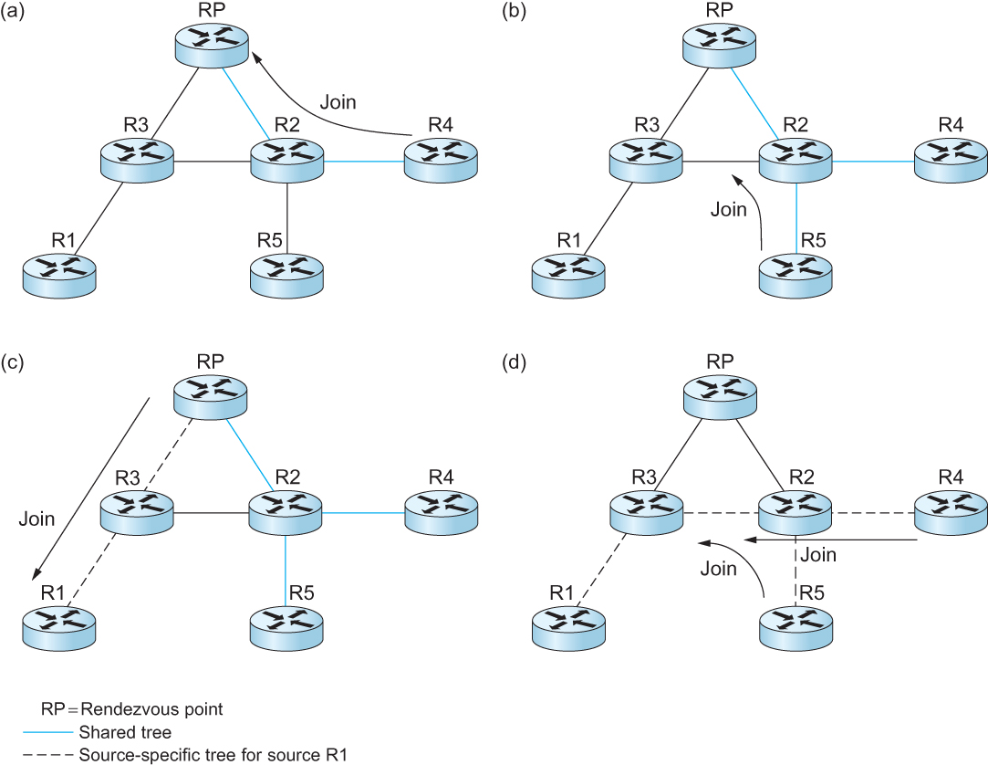
Protocol Independent Multicast (PIM)
Shared Tree
Source specific tree

Slide 23
The Join message
Router unicasts (using IP) a Join message towards the RP.
The initial Join message is “wildcarded” i.e., it applies to all senders.
When a router receives the Join message, it creates a forwarding entry for the shared tree (*, G) which implies, all senders for the group.
It marks the interface on which the Join arrived to be the one on which packets are to be forwarded.
It then also forwards the message on the right interface towards the RP.
This is the only interface on which incoming packets for G are accepted.
The RP receives the Join and this completes the construction of the tree branches.
RP
Join
R3
R2
R4
R1
R5

Slide 24
Additional Joins
Similar procedure is used for additional joins.
However, note that the Join message only needs to go to R2.
R2 “does not” have to forward the Join to RP.
The end result is a tree rooted at RP.
RP
R3
R2
R4
Join
R1
R5

Slide 25
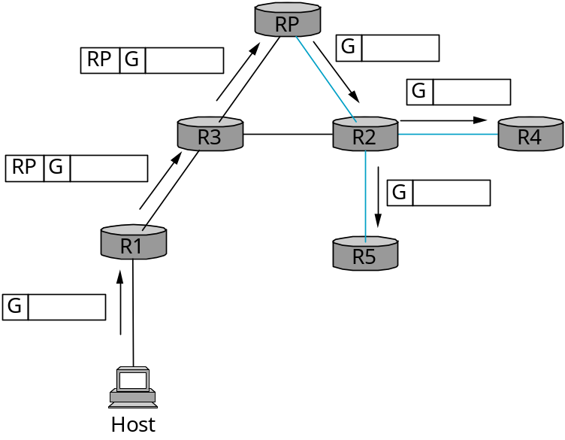
Sending messages
A host that wishes to send multicast messages now, sends the message to its “designated router” (DR).
DR will “tunnel” the packet to “RP”.
  Encapsulates packet in a new IP wrapper; sends to RP.
RP gets packet, removes wrapper and sends it on the shared multicast tree (it is the root of the tree).
In the above example, R1 sends to R4 and R5 via the shared tree.

Slide 26
Why source-specific trees ?
The path from sender to receiver via RP could be large as compared to the shortest path between them.
Problematic if lot of data (inefficient, could lead to higher congestion).
In this case, it is desirable to create a different “source-specific” tree on which data can be forwarded.

Slide 27
Creating Source Specific Trees
The router downstream (say R4) observes a high volume of data from a sender.
It sends a source-specific “Join” towards the source.
The routers en route, create a source specific state (S,G) for the tree.
The result is a tree rooted at the source (rather than RP).
RP
R3
R2
R4
Join
Join
R1
R5
Note that RP is not a part of the tree.
Also note that the shared tree still exists -- in case there are other sources.

Slide 28
Protocol Independence
Note the protocol independence property of PIM.
Irrespective of whatever unicast routing protocol is used, trees can be created.
Not independent of IP -- independent of routing.

Slide 29
Where are we ?
We are done with Section 4.2 (please read).

Slide 30
Inter-domain Multicast
PIM-SM has some significant short comings when it comes to inter-domain multicast.
MSDP is used to connect different domains.(TCP)
MSDP messages are broadcasts through the mesh of peers RPs.
What information does MSDP broadcast through mesh RPs?
  Register message
  Source Active message
Other PPT

Slide 31
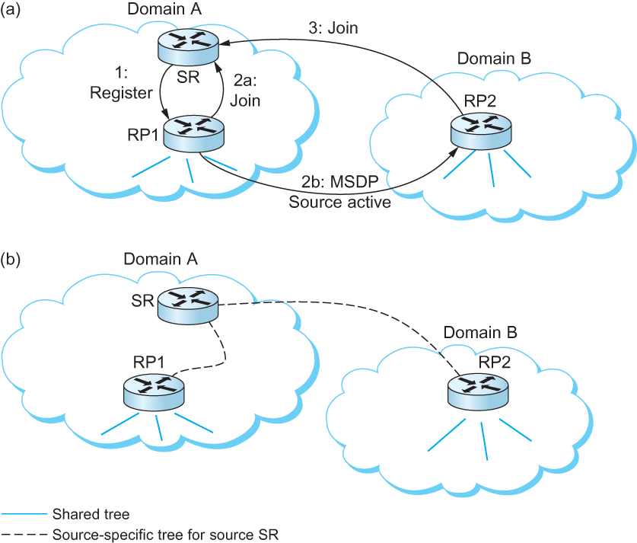
Inter-domain Multicast
Multicast Source Discovery Protocol (MSDP)
Fig a: SR send a Register to RP1
Fig b: As results RP1 and RP2 are in Source specific tree for SR.

Slide 32
Bidirectional Trees (BIDIR-PIM)
BIDIR-PIM is a recent variant of PIMSM that is well suited to many-to-many multicasting within a domain.
PIM-SM’s unidirectional tree, but BIDIR-PIM’s trees are bidirectional.
A surprising aspect of BIDIR-PIM is that there need not actually be an RP
BIDIR-PIM cannot thus far be used across domains.

Slide 33
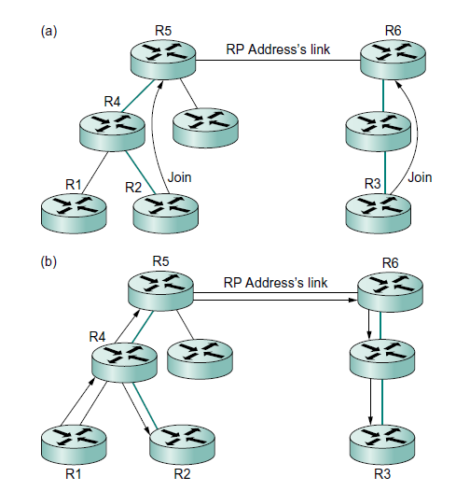
BIDIR-PM Operation
Fig a: R1 and R3 send join towards to RP Address
Fig b: Flow Multicast traffic from R1

Slide 34
Advantages over PIM-SM for many-to-many multicast within a domain:
No source registration Process
The routes are more direct because they go only as far up the tree as necessary, not all the way to the RP.
Bidirectional trees use much less state than the source-specific trees
The RP cannot be a bottleneck, and indeed no actual RP is needed.

Slide 35
Now Section 4.4
ROUTING AMONG MOBILE DEVICES

Slide 36
Challenges for Mobile Networking
It is easy enough today to turn up in a wireless hotspot, connect to the Internet using 802.11 or some other wireless networking protocol, and obtain pretty good Internet service.
Which was the key enabling technology?

Slide 37
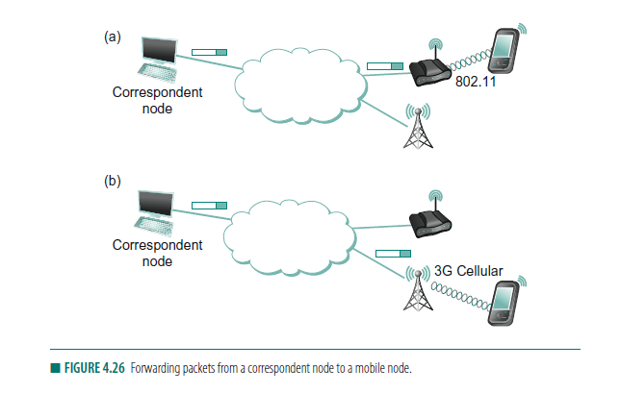
Address where you used to be, not where you are now

Slide 38
Routing for Mobile Hosts(Mobile IP)
Mobile IP is the primary mechanism in today’s Internet architecture to tackle the problem of routing packets to mobile hosts.
The mobile host is assumed to have a permanent IP address, called its home address

Slide 39
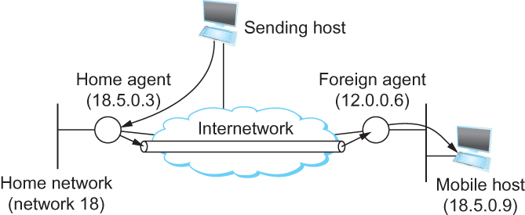
Routing for Mobile Hosts
Mobile IP
  home agent
    Router located on the home network of the mobile hosts
  home address
    The permanent IP address of the mobile host.
    Has a network number equal to that of the home network and thus of the home agent
  foreign agent
    Router located on a network to which the mobile node attaches itself when it is away from its home network

Slide 40
Routing for Mobile Hosts
Problem of delivering a packet to the mobile node
  How does the home agent intercept a packet that is destined for the mobile node?
    Proxy ARP
  How does the home agent then deliver the packet to the foreign agent?
    IP tunnel
    Care-of-address
  How does the foreign agent deliver the packet to the mobile node?

Slide 41
Routing for Mobile Hosts
Route optimization in Mobile IP
  The route from the sending node to mobile node can be significantly sub-optimal
  One extreme example
    The mobile node and the sending node are on the same network, but the home network for the mobile node is on the far side of the Internet
      Triangle Routing Problem

Slide 42
Triangular Routing Problem
Triangular routing is a method for transmitting packets of data in communications networks. It uses a form of routing that sends a packet to a proxy system before transmission to the intended destination

Slide 43
Routing for Mobile Hosts
  Solution
    Let the sending node know the care-of-address of the mobile node. The sending node can create its own tunnel to the foreign agent
    Home agent sends binding update message
    The sending node creates an entry in the binding cache
    The binding cache may become out-of-date
      The mobile node moved to a different network
      Foreign agent sends a binding warning message

