Slide 1
Eniac”s Strategic Discounting:
Balancing Growth with Brand Integrity
Data-Driven Insights to Settle the Revenue vs. Volume Debate
Prepared By: Suthanthiradevi Seenivasan

Slide 2
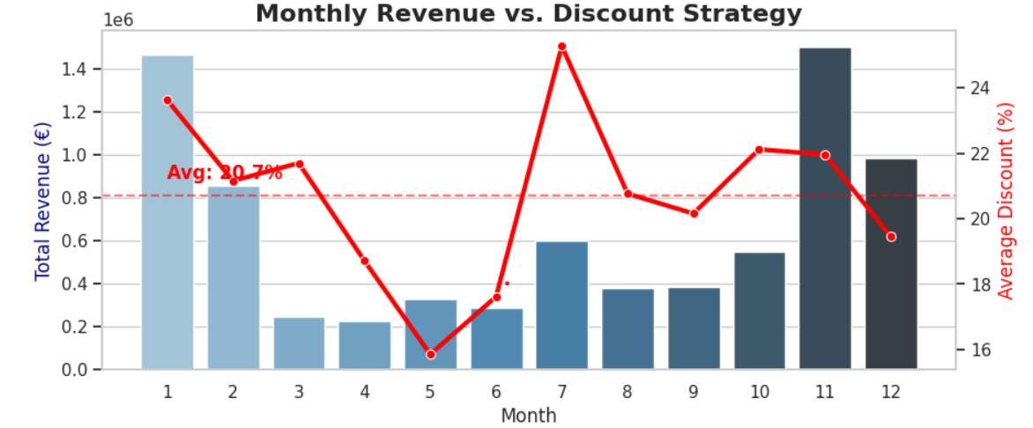
The Strategic Tension: Revenue Peaks vs. Discount Dependency
Marketing Team
Perspective: Growth
Acquisition
Retention
Market Share
Investor Board
Perspective:Profitability
Unit Value
Brand Integrity
Total Revenue
Inefficient Peak
Efficient Peak

Slide 3
Data Integrity: From Chaos to Insight
1.Data Merge 2.Quality Checks 3.Enrichment
Orders
Orderlines
Products
Brands
0 Ghost SKUs
Only ‘Completed’ States
Duplicate Removal
“Uncorrupted price”
Strategic
Business
Categories
Result: A reliable “Source of Truth” for Decision Making

Slide 4
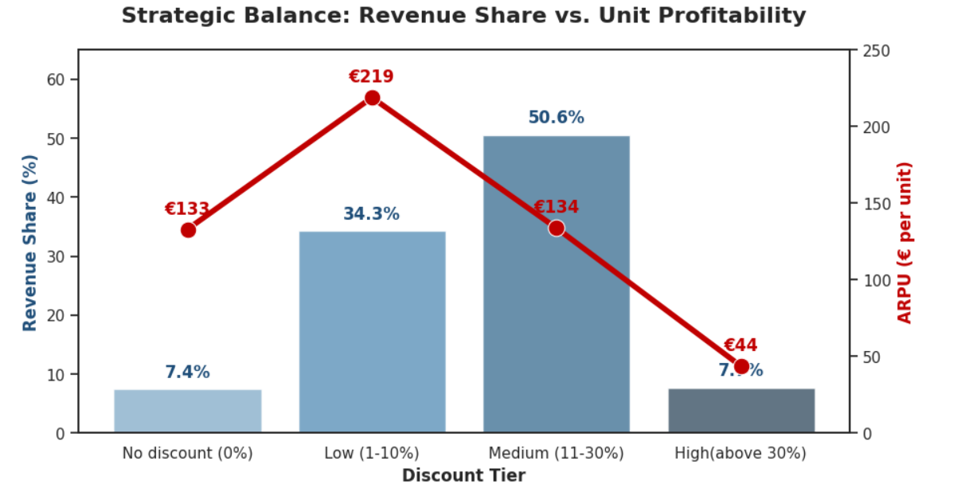
The Discount Paradox: Volume vs. Profitability
Strategic Insight:
Discounts between 11-30% drive of revenue,but exceeding 30% degrades unit value by 80% .

Slide 5
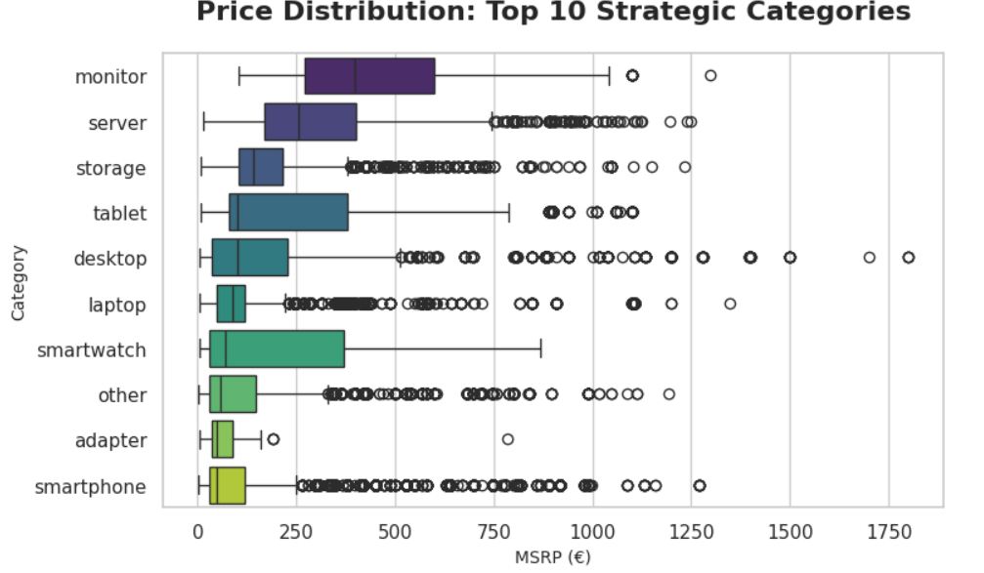
Price Distribution Across Product Categories
Most products cluster at affordable prices… but every category has premium outliers.
Servers and desktops drive the highest extremes.
Everyday devices stay in lower, tighter ranges.
Overall: a broad base with a long tail of high-end products.

Slide 6
Recommendations
1. Strategic Recommendations (The "What")
Implement Discount Caps: Discounts at below 20%
Premium products are less price-sensitive
Implement other promotional offers during the seasonal sales (eg. free delivery, offered an accessory when purchasing over certain amount,...)
2. Data Collection Roadmap (The "How")
Integrate price units in order to minimize data loss during data cleanings
Fixed Category IDs: Replace manual text-cleaning with a standardized database table.
Tracking the production costs would provide a better overview of an actual product profit.

