Slide 1
“Evaluation of Magist for ENIAC Partnership”
Is Magist a suitable partner for Eniac?
Are orders delivered On-Time?
Objective:
Product Analysis
Seller Analysis
Delivery Status Analysis
Customer Review Analysis

Slide 2
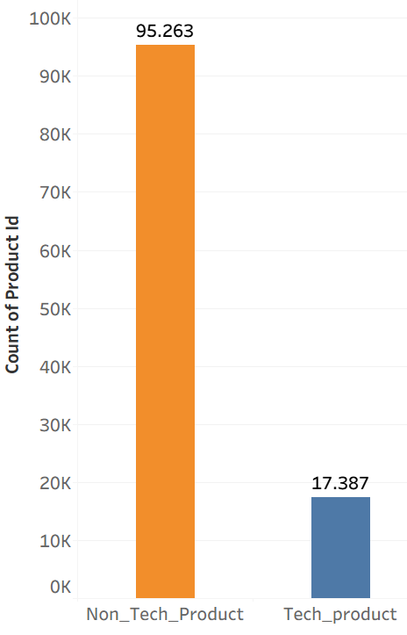
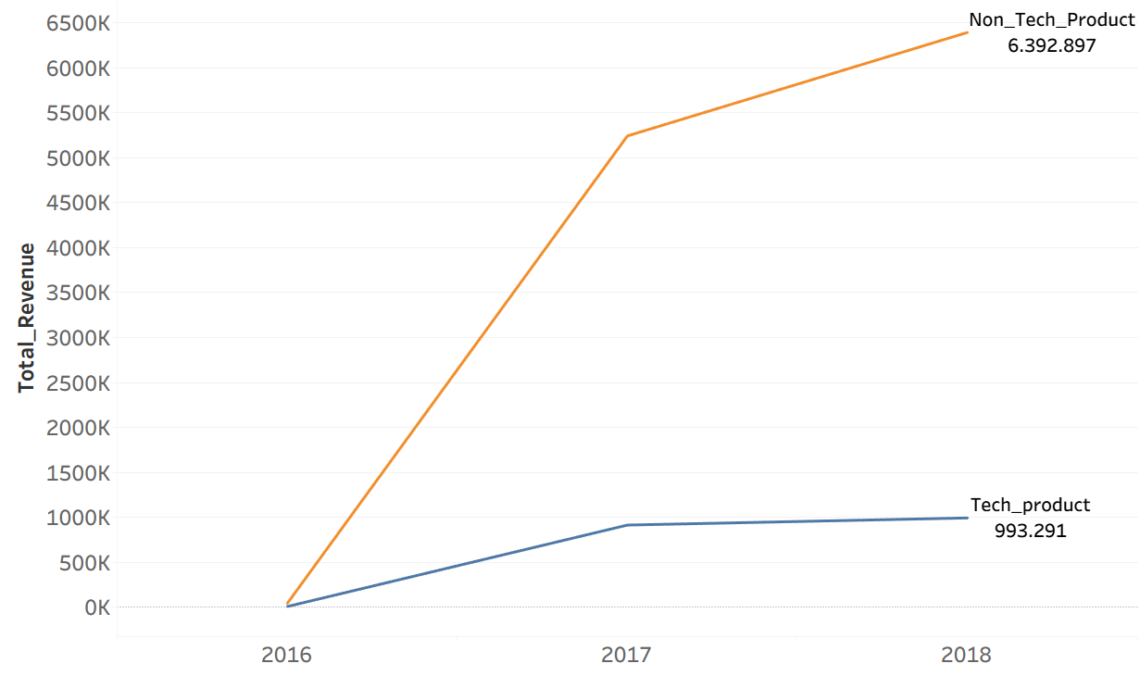
Product Analysis
Product Sold
Revenue

Slide 3


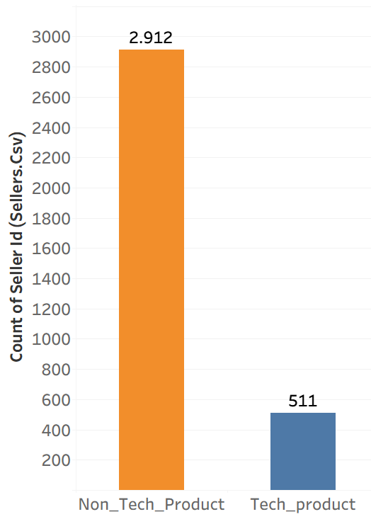
Seller Analysis
Limited product variety
Higher dependency on few sellers –
supply risk.
Hard to grow business without strong seller base.

Slide 4
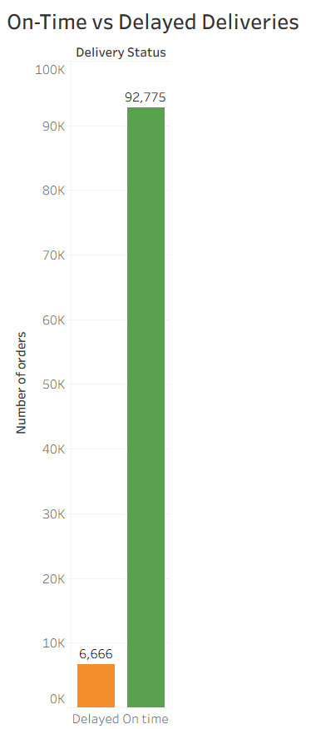
Delivery Status Analysis
Majority of orders are delivered On_Time .
The delay rate is relatively low.
This indicates that Magist has reliable logistics and delivery performance.

Slide 5
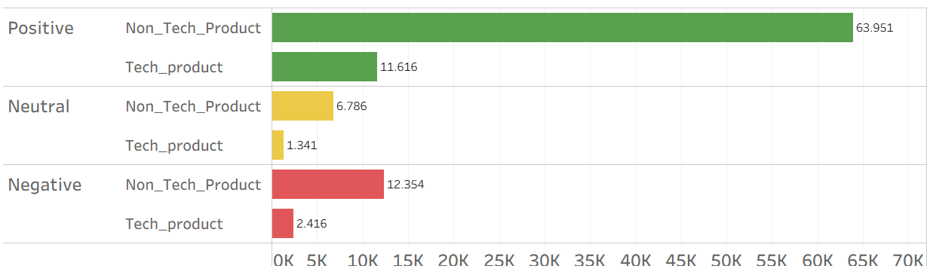
Customer Review Analysis
Non_tech products get more reviews compared to tech products.
Tech products have fewer customer responses or feedback.
Fewer purchases compared to non_tech products.

Slide 6
Conclusion
Eventhough delivery performance on Magist is reliable, tech products contribute only a small portion of Total revenue.
Limited market presence.
Indicates that Magist is not currently an Ideal platform for Eniac’s High-end Tech_products.
Therefore, we do not recommend a full_scale partnership.

Slide 7
Thank you

