Slide 1
SaaS Sales, Discount and Profitability
Manju Suthar | Business Analyst portfolio project
Fictional company, public sample data

Slide 2
Which products and segments make money, and where do discounts destroy profit?
Data: 9,994 order lines, 2020 to 2023, public sample for a fictional company
Tools: Excel, SQL, Python, Power BI
Output: 4-page dashboard, BRD and analysis report

Slide 3
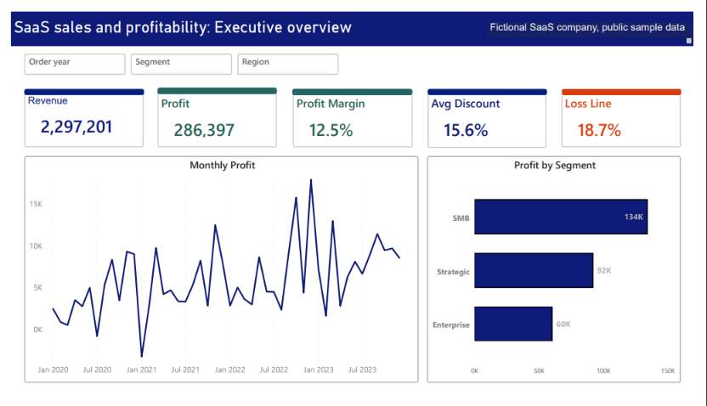





Revenue is 2.3M, but only 12.5% reaches profit
Revenue 2,297,201 and profit 286,397
Average discount 15.6%
18.7% of order lines lose money

Slide 4
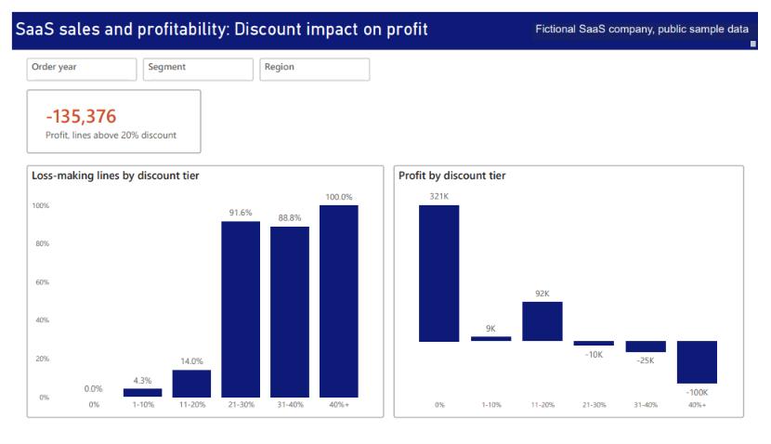
Discounts above 20% lost 135,376
Loss-making lines: 14.0% at 11-20% discount, 91.6% at 21-30%, 100% at 40%+
The 0% discount tier earned 321K
Spearman ρ = -0.54, Kruskal-Wallis p < 0.001

Slide 5
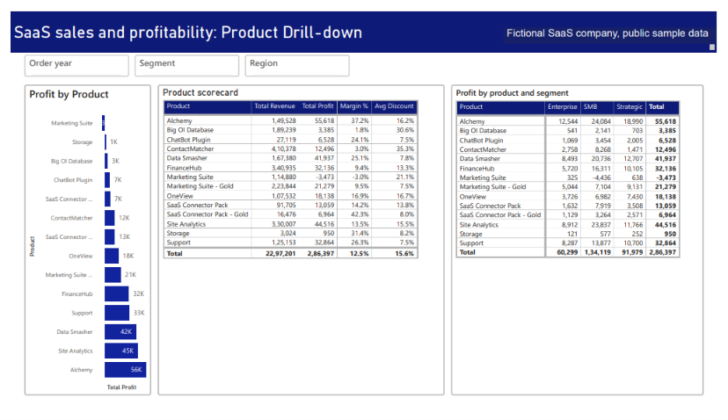
One product loses money; two have thin margins
Marketing Suite: -3,473 (SMB: -4,436)
ContactMatcher: 3.0% margin at 35.3% average discount
Big OI Database: 1.8% margin at 30.6%
Alchemy earns most: 55,618 (37.2% margin)

Slide 6
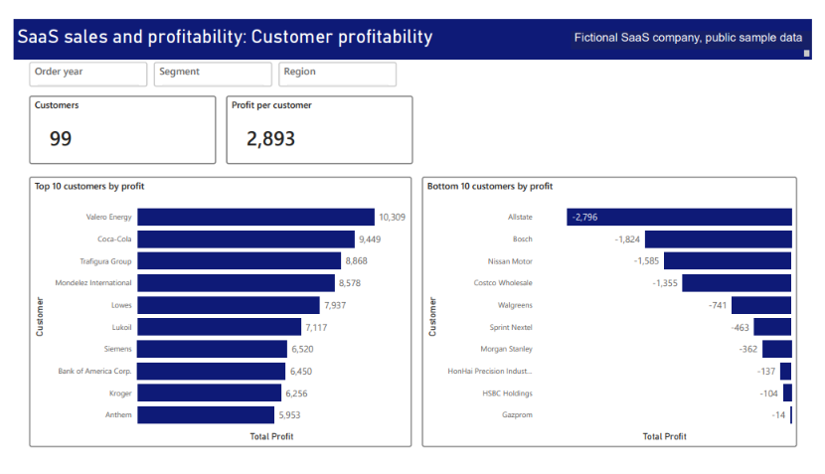
Profit is concentrated, and the bottom 10 customers all lose money
SMB is 47% of profit
Top 10 customers earn 77,437 (27%)
Bottom 10 customers lost 9,381 in total
99 customers, 2,893 profit per customer

Slide 7
Recommendations
Require approval for any discount above 20%
Scenario: a 20% cap gives profit of about 421,773 to 505,588, against 286,397 today (a scenario, not a forecast)
Review Marketing Suite pricing and the discounting on ContactMatcher and Big OI Database
Review terms for the 10 loss-making customers

Slide 8
Method and limits
Methods: correlation, Kruskal-Wallis test, linear regression (R² = 0.048), decision tree (splits at 25%)
Sample data for a fictional company
Association, not proof of cause
The scenario assumes customers react as they did in the past
Data: Amazon AWS SaaS Sales Dataset (Kaggle, nnthanh101), fictitious company.

