Slide 1
Expercise_Chart_Tableau
File created on: 9/14/20 6:39:20 AM CDT

Slide 2
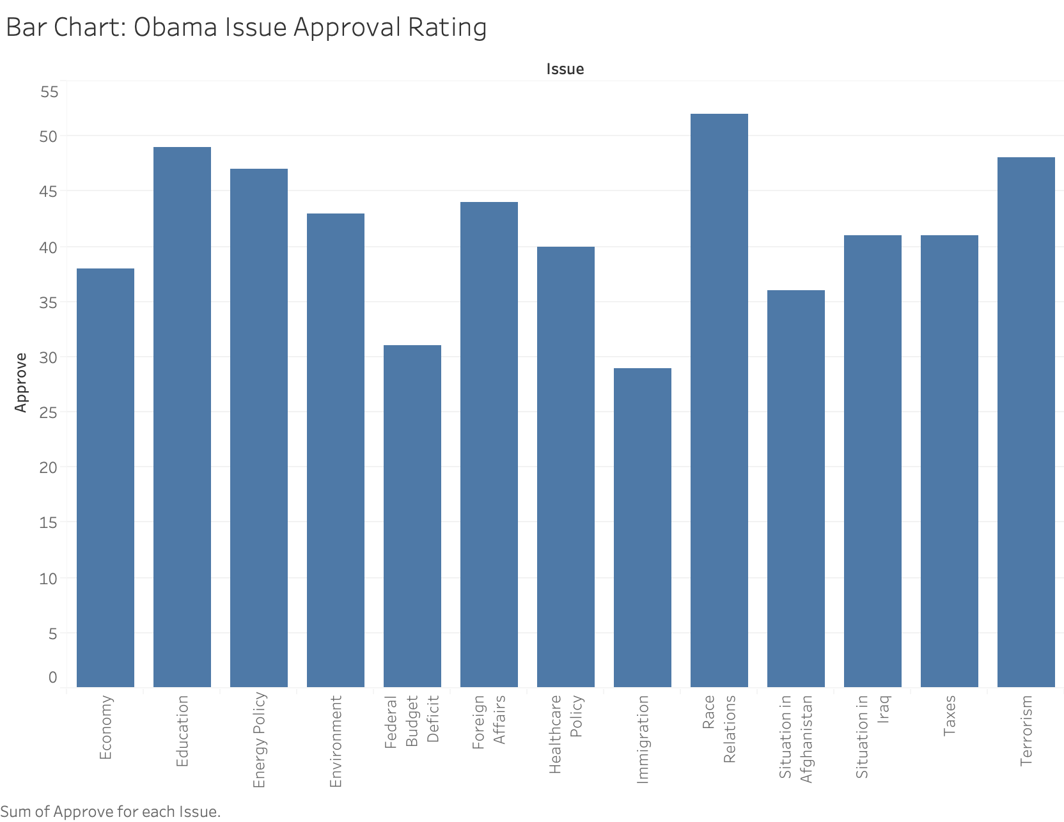

Slide 3
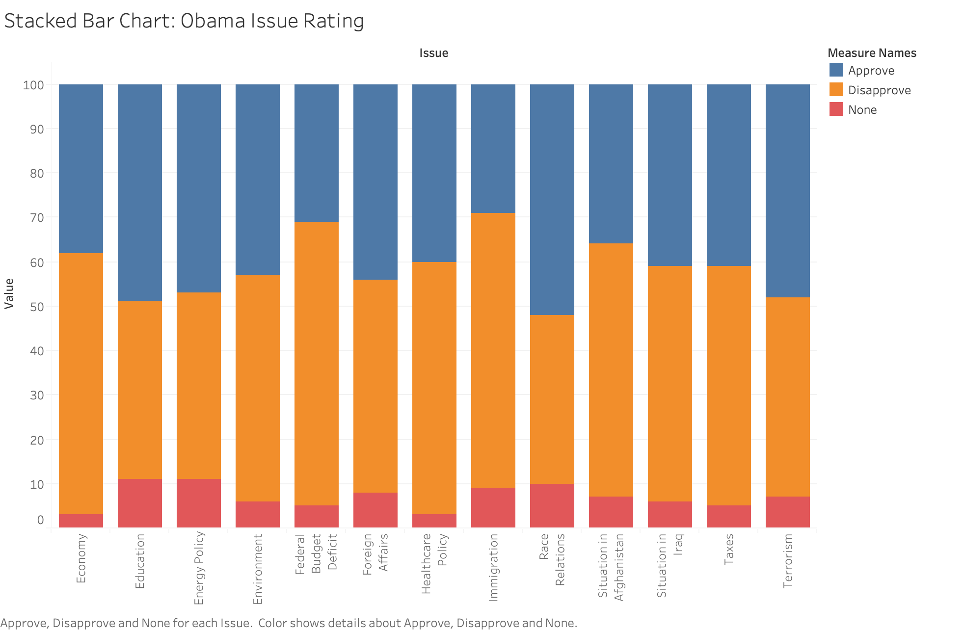

Slide 4
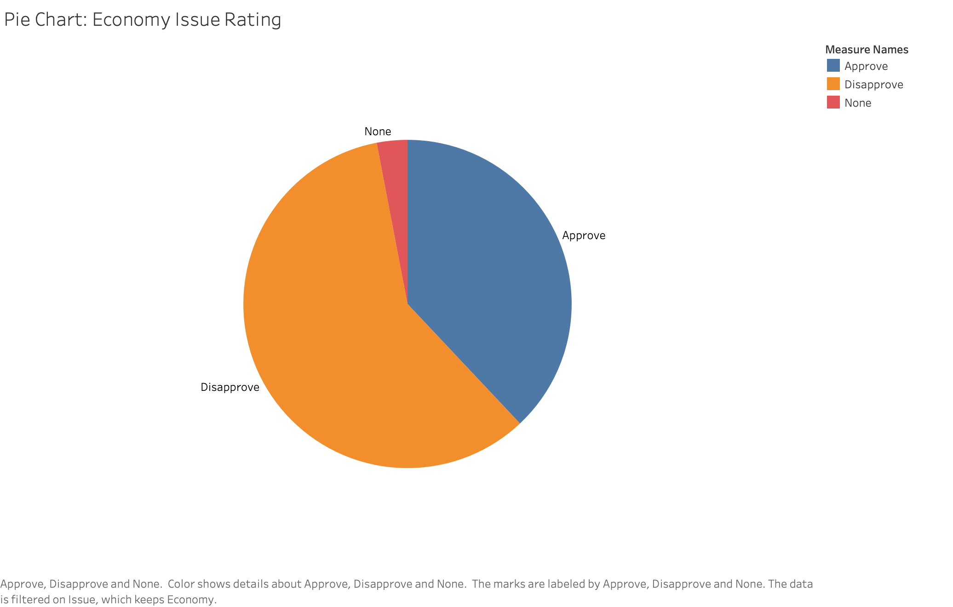

Slide 5
