Slide 1

Project Title - Seasonal Agriculture Performance Analysis
Student Name : SUTIRTHA GIRI
College Name : NETAJI SUBHASH ENGINEERING COLLEGE
AICTE STU ID : STU6a6050cd2e1271784697037

Slide 2

PROBLEM STATEMENT
Agricultural activities are influenced by seasonal variations in environmental conditions, farming practices, resource availability and market conditions. As a result, agricultural performance may differ from one season to another.
However, raw agricultural data does not clearly explain how agricultural performance changes across seasons or what patterns can be observed in different seasonal conditions.
The problem is to analyze the given agricultural dataset and investigate seasonal differences in agricultural performance by identifying meaningful patterns, trends, relationships and variations within the available data.
Key Questions Addressed:
How do crop yield and net profit vary across different cropping seasons?
What are the environmental determinants (rainfall, humidity, temperature) of seasonal performance?
Which irrigation techniques maximize water efficiency and economic returns?
Are profitability differences across seasons statistically significant?

Slide 3
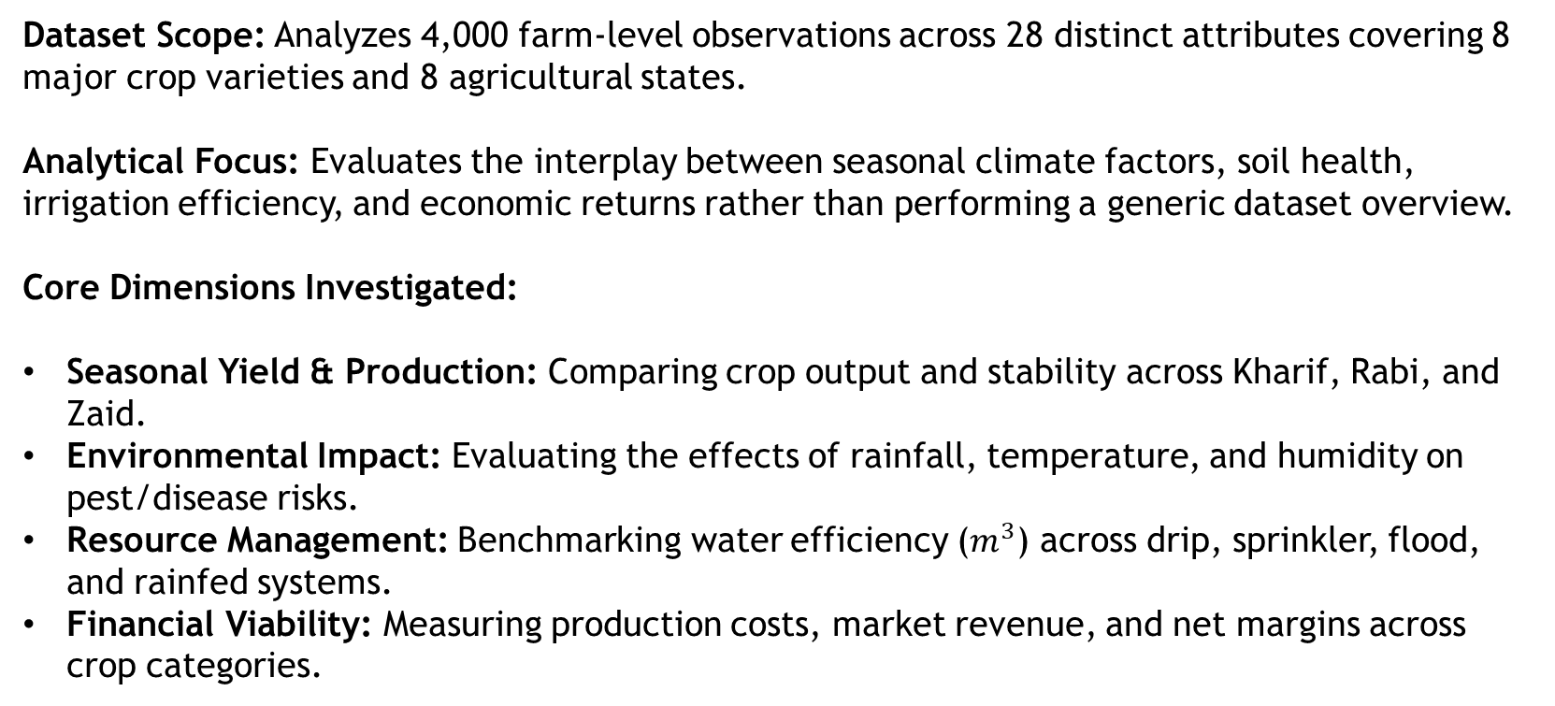
Project Description
Dataset Scope: Analyzes 4,000 farm-level observations across 28 distinct attributes covering 8 major crop varieties and 8 agricultural states.
Analytical Focus: Evaluates the interplay between seasonal climate factors, soil health, irrigation efficiency, and economic returns rather than performing a generic dataset overview.
Core Dimensions Investigated:
Seasonal Yield & Production: Comparing crop output and stability across Kharif, Rabi, and Zaid.
Environmental Impact: Evaluating the effects of rainfall, temperature, and humidity on pest/disease risks.
Resource Management: Benchmarking water efficiency ($m^{3}$) across drip, sprinkler, flood, and rainfed systems.
Financial Viability: Measuring production costs, market revenue, and net margins across crop categories.

Slide 4

WHO ARE THE END USERS?
Farmers & Cultivators: For selecting the most profitable and high-yielding crops suited to specific seasons.
Agricultural Planners & Policy Makers: For designing regional water distribution plans and seasonal subsidies.
Agribusinesses & Supply Chain Managers: For predicting seasonal commodity supply and market pricing trends.
Agronomists & Researchers: For studying the impact of climate variations and irrigation efficiency on crop yield.

Slide 5

Technology Used
  Technologies used in this project are:
  Language: Python
  Data Manipulation: Pandas, NumPy
  Data Visualization: Matplotlib, Seaborn
  Statistical Analysis: SciPy (scipy.stats)
  Environment: Google Colab

Slide 6
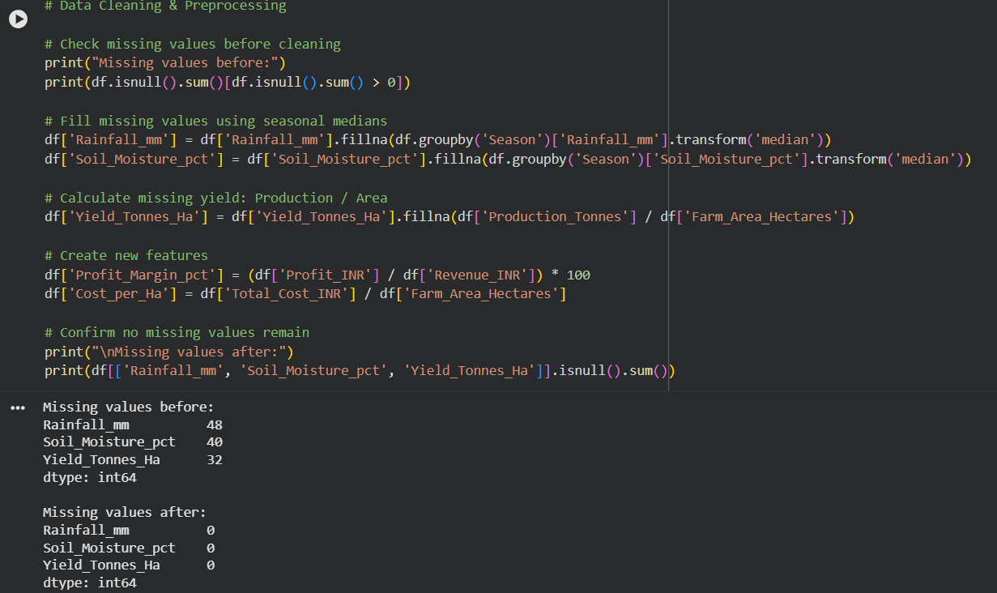
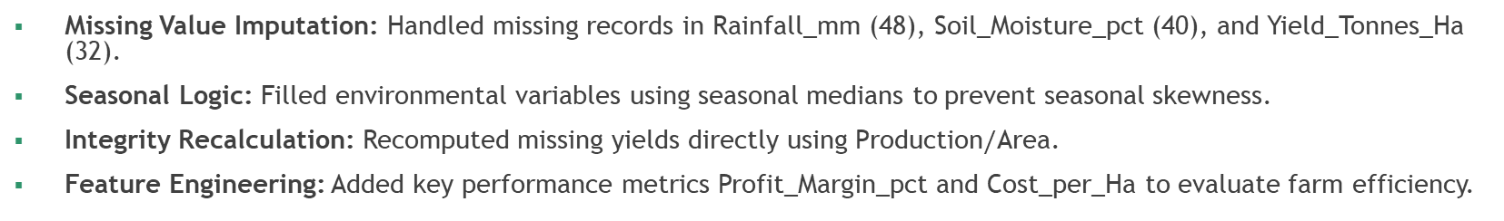
RESULTS -Data Cleaning & Preprocessing
Missing Value Imputation: Handled missing records in Rainfall_mm (48), Soil_Moisture_pct (40), and Yield_Tonnes_Ha (32).
Seasonal Logic: Filled environmental variables using seasonal medians to prevent seasonal skewness.
Integrity Recalculation: Recomputed missing yields directly using $\text{Production}/\text{Area}$.
Feature Engineering: Added key performance metrics Profit_Margin_pct and Cost_per_Ha to evaluate farm efficiency.

Slide 7
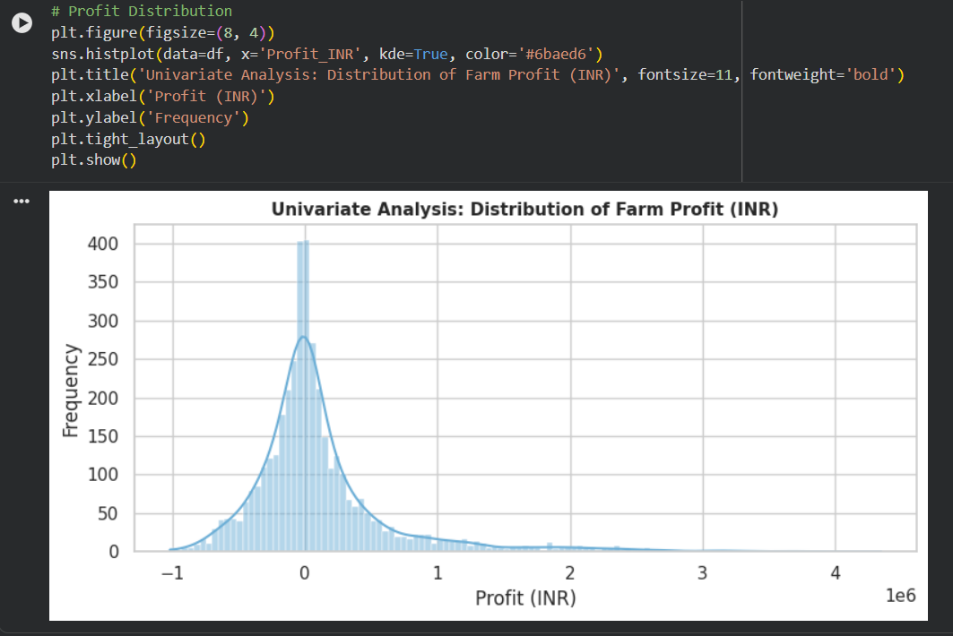
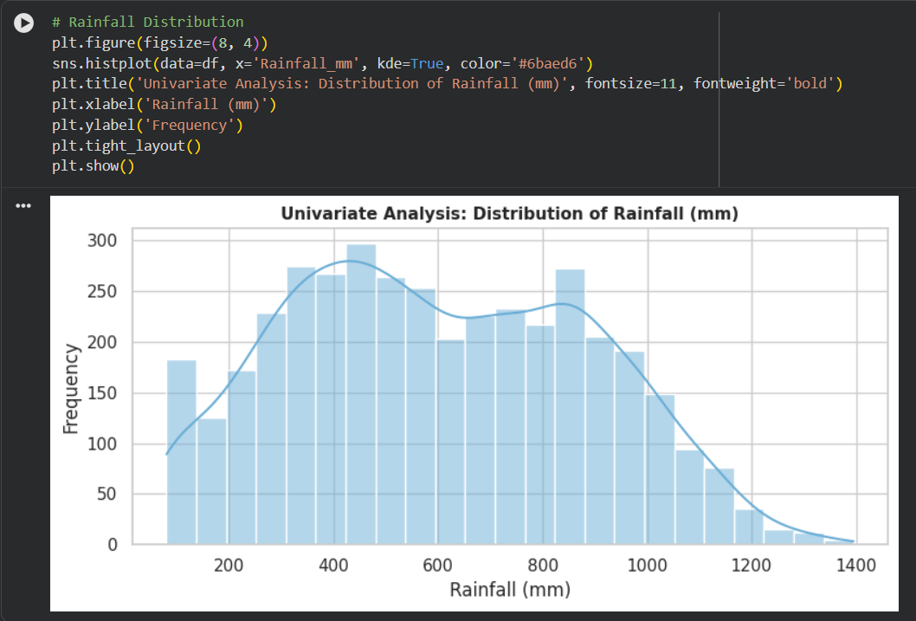
RESULTS - Univariate Distribution Analysis
Farm Profit Spread: Highly right-skewed distribution centered near break-even; high positive returns are driven by cash crops like Sugarcane and Chilli
Loss Identification: Highlights clusters of negative farm profits, identifying vulnerable farming groups operating at a net loss.
Rainfall Spread: Multi-modal distribution spanning 100 mm to 1,400 mm, capturing distinct arid, semi-arid, and high-monsoon cultivation zones.
Baseline Baseline: Verifies variable spreads and data hygiene prior to cross-seasonal bivariate comparisons.

Slide 8
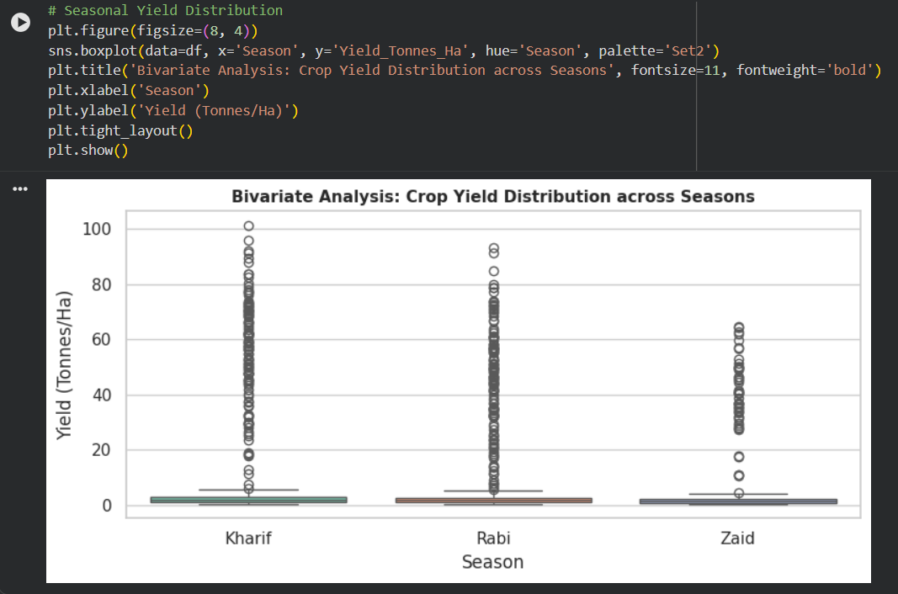
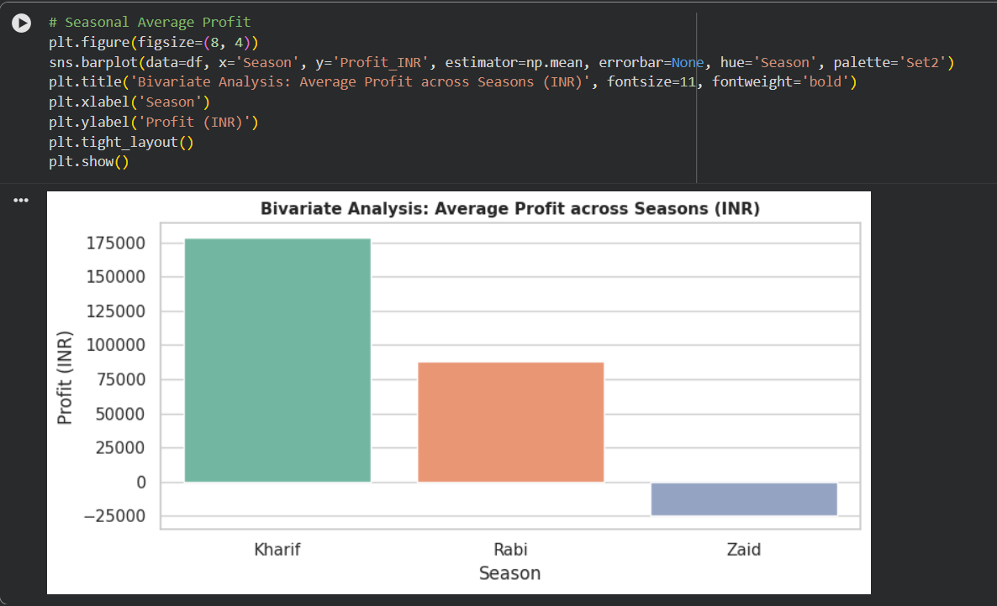
RESULTS-Bivariate Analysis: Seasonal Yield & Profit
Kharif Season: Delivers the highest average profit at ₹1,78,915, driven by monsoon conditions.
Rabi Season: Demonstrates consistent yield output with a stable average profit of ₹87,689.
Zaid Season: Records an average loss of -₹24,805 due to high irrigation and resource requirements during summer heat.

Slide 9
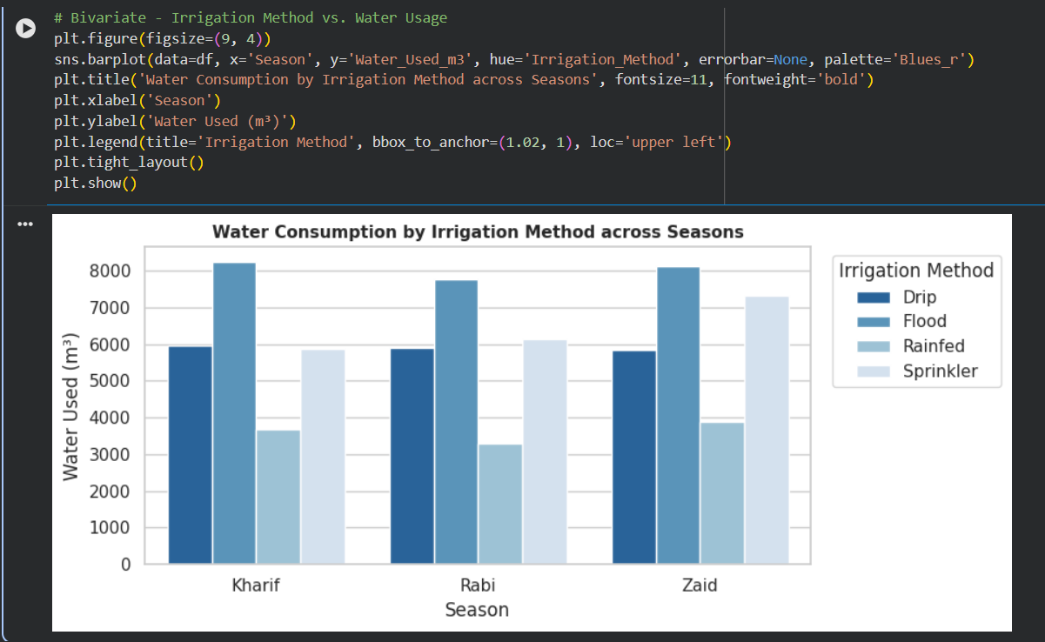
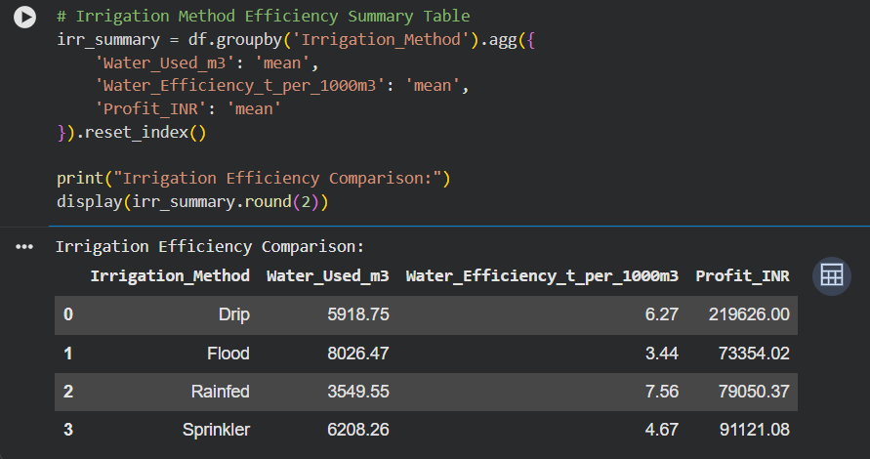
RESULTS - Bivariate Analysis: Irrigation & Water Efficiency
Drip Irrigation: Yields the highest average profit (₹2,19,626) with strong water efficiency (6.27 t/1,000 m³).
Flood Irrigation: Consumes the highest water volume (~8,026 m³) but produces lower profit (₹73,354).
Modern micro-irrigation reduces water usage by ~25% while stabilizing yields during water-scarce seasons.

Slide 10
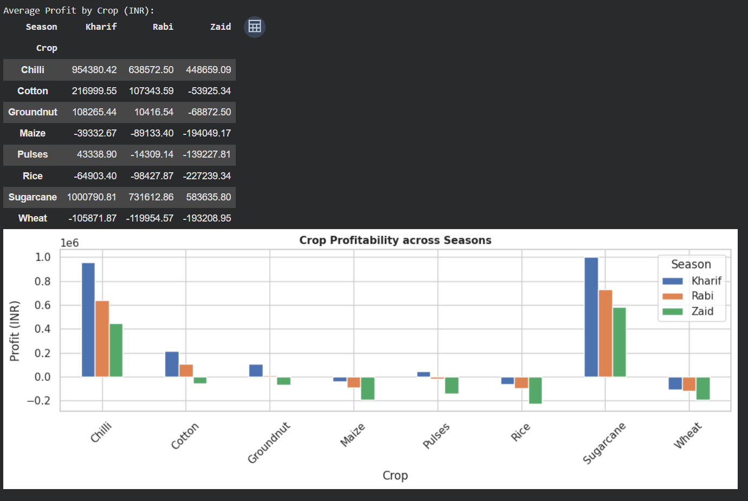
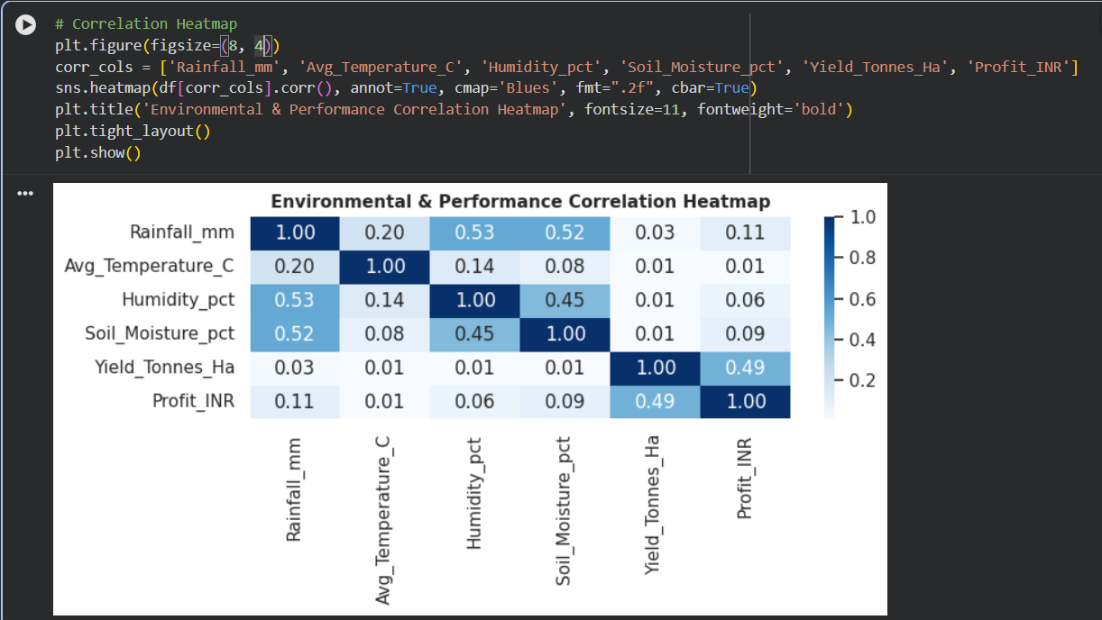
RESULTS - Crop Profitability & Climate Correlation
Commercial crops like Sugarcane and Chilli generated the highest profits.
Staple Grains (Wheat and Rice) operate on narrower margins under heavy input costs.
Elevated rainfall and humidity strongly correlate with disease and pest risk, peaking at 54.5% during Kharif.

Slide 11
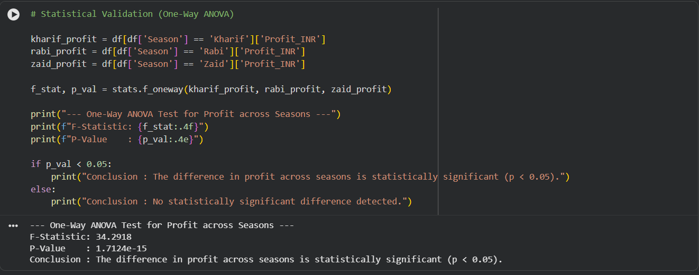
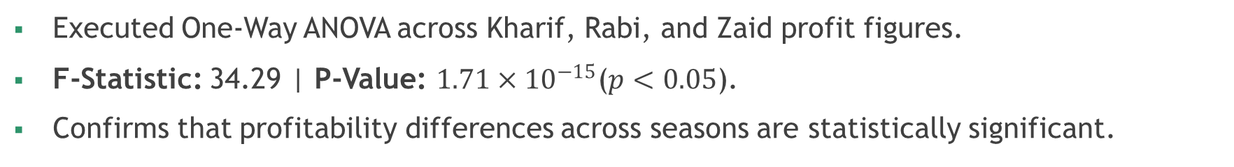
RESULTS - Statistical Hypothesis Testing
Executed One-Way ANOVA across Kharif, Rabi, and Zaid profit figures.
F-Statistic: 34.29 | P-Value: $1.71×{10}^{−15}$($p<0.05$).
Confirms that profitability differences across seasons are statistically significant.

Slide 12
Future scope
Build a predictive model by implementing Machine Learning (e.g., Random Forest, XGBoost) for yield and profit before the sowing season.
Forecast seasonal crop performance using historical data.
Integrate real-time weather APIs and soil sensor data for live irrigation recommendations.
Add time-series weather and market-price data for more accurate agricultural forecasting.
Develop an interactive Power BI dashboard for real-time farm monitoring useful for farmers and agricultural planners.
Extend the analysis with region-level recommendations and optimization of water, fertilizer and irrigation resources.

Slide 13
GitHub Link
https://github.com/sutirtha44g/VOIS-Major-Project-Agriculture-Analysis

Slide 14

VOIS Course completion certificate -
Course name- Data Visualization

Slide 15
Thank you
GitHub Repository
.
.

