Slide 1

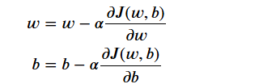

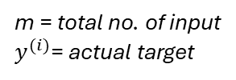
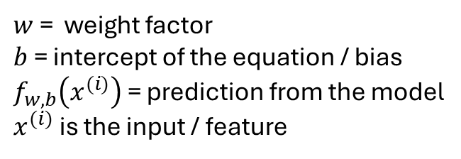

Machine Learning model Description
We used the Linear regression ML model (simplest ML model) to fit the data here.
Linear regression is a type of supervised machine learning algorithm that computes the linear relationship
between the dependent variable and one or more independent features by fitting a linear equation to observed
data.
In our linear regression model we have used 85% of data for training and 15% data for testing. (this is a standard
practice for ML model validation)
Mathematical foundation of Linear regression model:
Fit the parameter w, b using gradient to minimize the error
(cost function) between the predictions and the actual data
(exp points)
Linear regression model
$$f_{w,b}\left(x^{(i)}\right)=wx^{(i)}+b$$
m = total no. of input
$y^{(i)}$= actual target
$w$ = weight factor
$b$ = intercept of the equation / bias
$f_{w,b}\left(x^{(i)}\right)$ = prediction from the model
$x^{(i)}$ is the input / feature
Cost function
Run iterations to optimize the w and b such that cost function
is minimized. The algorithm that used in linear regression
for this optimization is called gradient descent.
$α$ = step parameter

