Slide 1
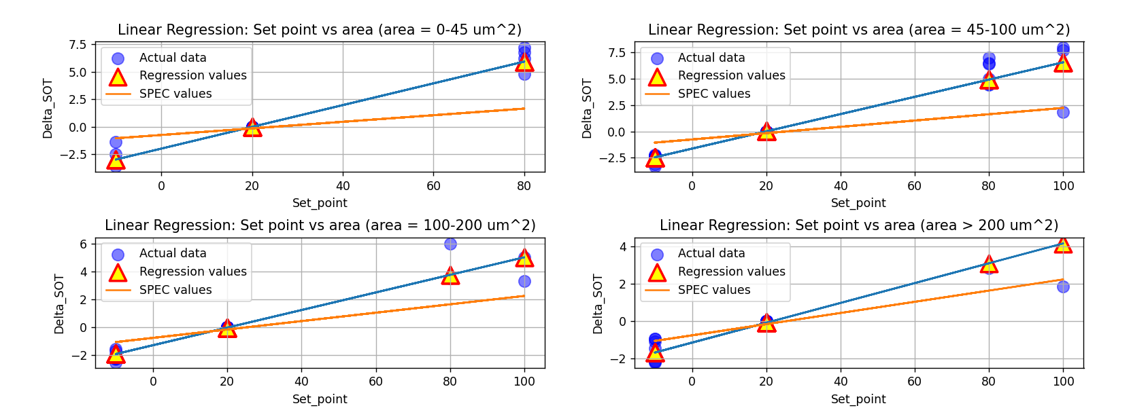
Plot 1 : For all the values of X and Y (test and train both == Full Dataset)

Slide 2
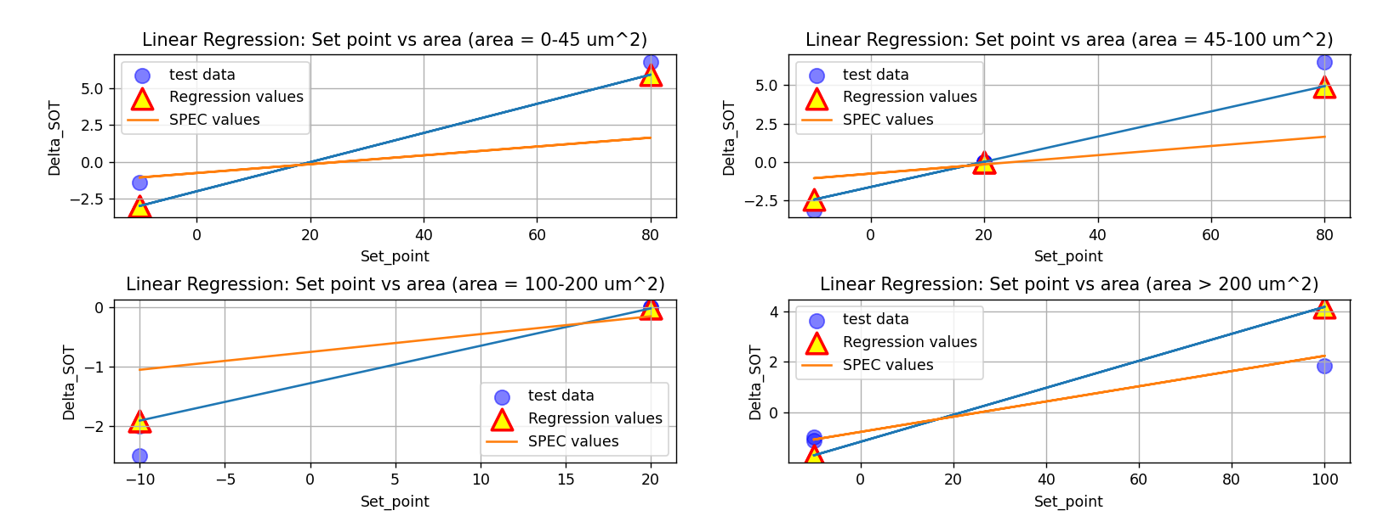
Plot 2 : For only testing values

Slide 3
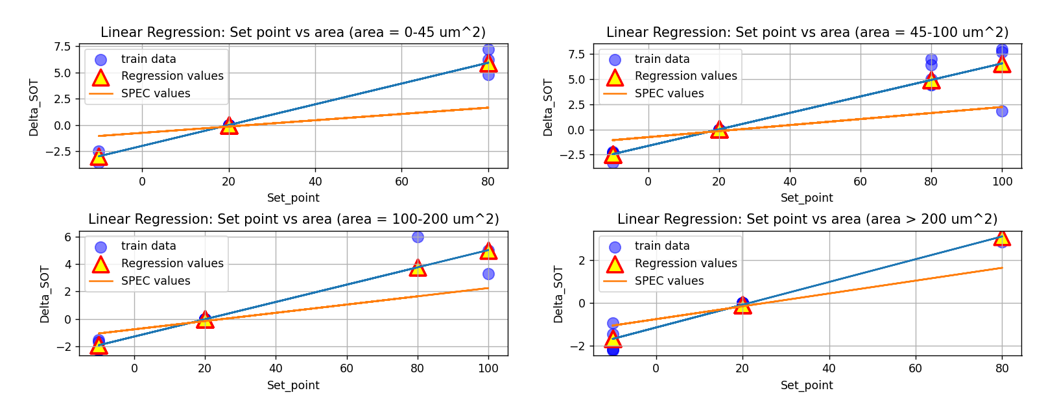
Plot 3 : For only training values

Slide 4
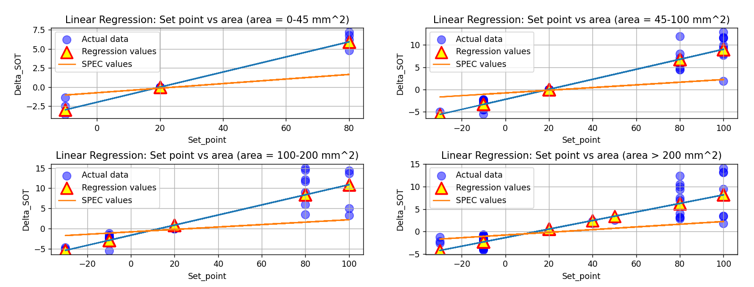
Plot 1 : For all the values of X and Y (test and train both == Full Dataset)

Slide 5
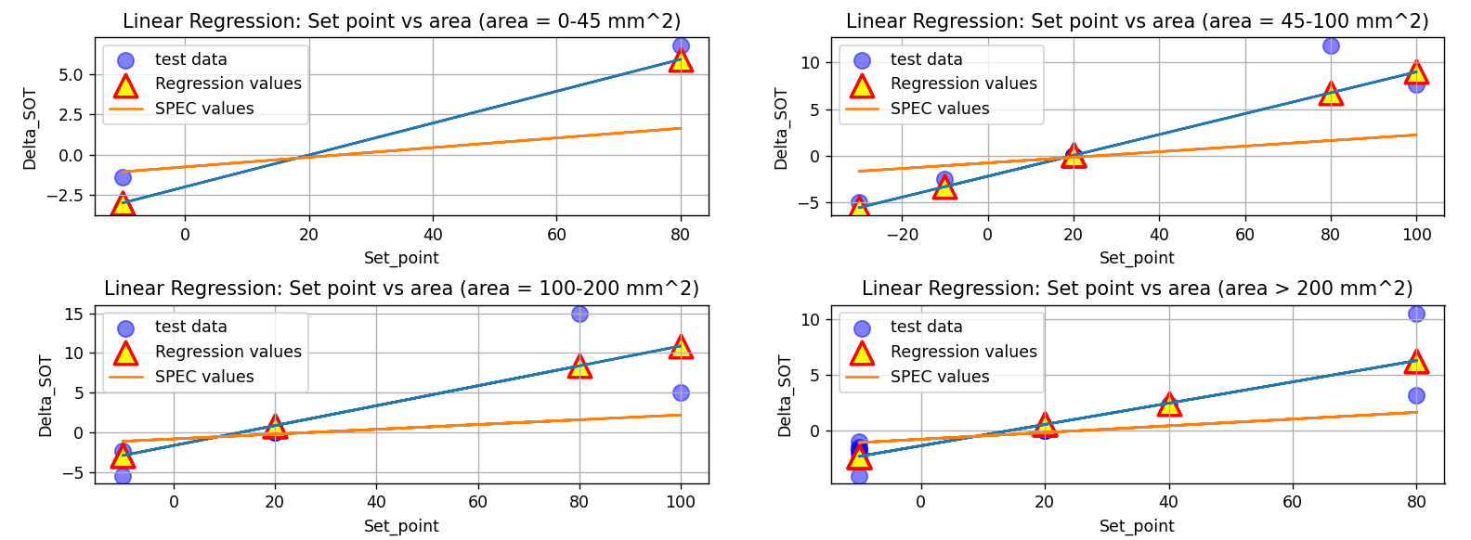
Plot 2 : For only testing values

Slide 6
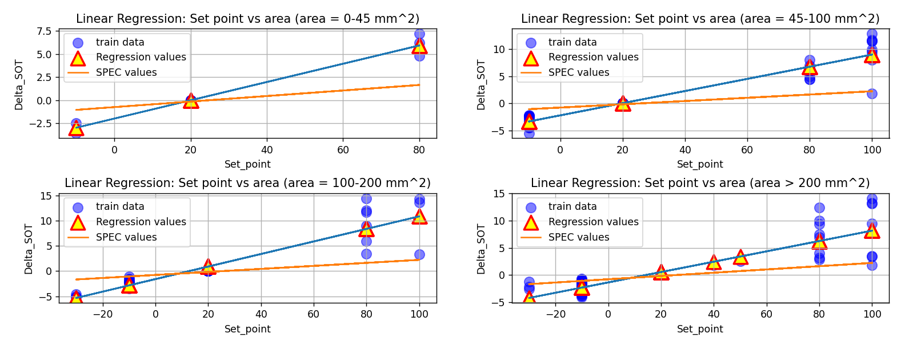
Plot 3 : For only training values

